Slide 1
VOTING IN CONGRESS:
It’s More Than Just “Yea” or “Nay”
Part 2: Try Your Hand!
Notes:
To hear special effects, make sure your sound is up.

Slide 2
Learning Targets
Students will be able to understand the process of voting on a bill.
Students will be able to compare and contrast the factors in deciding weather to maintain or raise the minimum wage.
Students will be able to analyze the reasons on why congress does or doesn’t consider certain bills to be relevant or outdated.

Slide 3



BILL “A”
mail delivery on Saturdays!
Stop
We’d better look at the four factors…
Yikes! That seems like a big decision!

Slide 4
FACTOR #1
Does Congress have the power to stop Saturday mail delivery?
Does Congress have the power to establish post offices?
Yes
No

Slide 5
FACTOR #1
Does Congress have the power to stop Saturday mail delivery?
Is deciding what days mail will be delivered part of establishing a post office?
Probably
Probably not

Slide 6
FACTOR #1
Does Congress have the power to stop Saturday mail delivery?
Therefore:
Congress has the power to stop Saturday mail delivery
Congress does not have the power to stop Saturday delivery
(Quickly explain why on your paper.)

Slide 7
FACTOR #2
In your opinion, should Saturday mail delivery end?
WAIT!
There are a few things you should know before you make up your mind.

Slide 8







The U.S. Postal Service pays for itself with the money it brings in from its services.

Slide 9
HOWEVER… The Postal Service is losing a LOT of money because people are sending fewer letters.

Slide 10


Instead of using the mail, people are texting and sending email…
… and paying their bills online.

Slide 11




In 2009, the Postal Service lost
$ 3,800,000,000
(That’s $3.8 billion.)
(With a “b.”)
Stopping delivery on Saturdays would save the Postal Service
$ 3,000,000,000
(That’s $3 billion.)

Slide 12
FACTOR #2
In your opinion, should Saturday mail delivery end?
Is it worth it? Should you consider other factors besides how much money it costs?
Decide what you think and mark your answer on your paper. Don’t forget to explain your choice.

Slide 13

FACTOR #3
Would your political party support ending Saturday delivery?
Look at the checklist of values on your handout.
Which value most matches the purpose of this bill?

Slide 14
FACTOR #3
Would your political party support ending Saturday delivery?
Cost saving!
That means the Republican Party would be most likely to support this bill.

Slide 15

FACTOR #4
Would your voters support ending Saturday mail delivery?
WAIT!
There are a few things you should know before you make up your mind.

Slide 16

In 1957, Congress passed a law to stop Saturday mail. It lasted one Saturday!
We are MAD!
Where’s our mail?
Voters were so angry that Congress passed a bill to bring Saturday delivery back!

Slide 17
FACTOR #4
Would your voters support ending Saturday mail delivery?
Did they have email in 1957?
Yes
No
(Do you think that would make a difference to voters today?)

Slide 18













FACTOR #4
Would your voters support ending Saturday mail delivery?
For this activity, let’s pretend the state or district you represent has more older voters than younger voters.

Slide 19
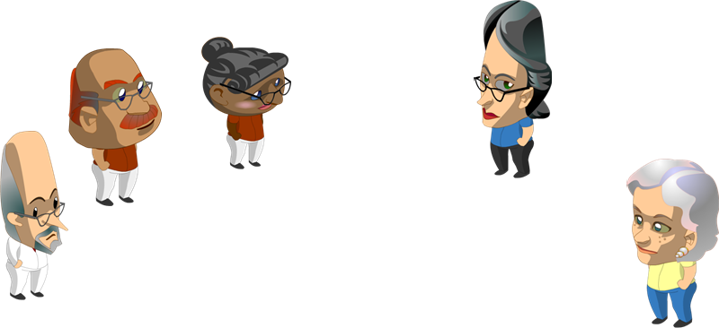
FACTOR #4
Would your voters support ending Saturday mail delivery?
Older voters are more likely to still use the Postal Service. Younger voters are more likely to use email.

Slide 20
FACTOR #4
Would your voters support ending Saturday mail delivery?
So… Do you think your voters will support this bill?
Mark your papers.

Slide 21
TIME TO VOTE!
You’ve looked at all four factors.
Now you must weigh them all and decide whether to vote “yea” or “nay.”
Mark your papers.

Slide 22
TIME TO VOTE!
If you marked “yea,” raise your hand.
If you marked “nay,” raise your hand.

Slide 23
TIME TO VOTE!
Did the bill pass?

Slide 24
BILL “B”
Increase the minimum wage from
$8.75
to
$9.00
per hour.
We’d better look at the four factors…
25 cents! That’s a lot!

Slide 25
FACTOR #1
Does Congress have the power to raise the minimum wage?
What is the minimum wage?
Grr.
It’s when a wabbit gets a tiny bit angwy.
B. It’s the lowest hourly rate an employer is allowed to pay an employee.

Slide 26
FACTOR #1
Does Congress have the power to raise the minimum wage?
Look at the list of powers Congress has. Does it say Congress can set peoples’ wages?
Yes
No

Slide 27
FACTOR #1
Does Congress have the power to raise the minimum wage?
What power lets Congress do something that’s not on the list if it relates to something that is on the list?
Make any laws “necessary and proper” for laws on the list!

Slide 28
FACTOR #1
Does Congress have the power to raise the minimum wage?
Look at the list again. Is there a power that might relate to the money people earn at their jobs?

Slide 29
FACTOR #1
Does Congress have the power to raise the minimum wage?
Here’s a hint: It’s one of these three powers:
Establish post offices
Pass laws about business that happens across state lines
Declare war

Slide 30
FACTOR #1
Does Congress have the power to raise the minimum wage?
Businesses are the ones that pay people a wage, so this power is related to a bill about the minimum wage.
Notes:
Explain to students that there is a national minimum wage, but that many states also have a state minimum wage. Because federal laws are superior to state laws, states cannot set a minimum wage that is lower than the federal minimum wage.

Slide 31
FACTOR #1
Does Congress have the power to raise the minimum wage?
Mark your papers!

Slide 32
FACTOR #2
In your opinion, should Congress raise the minimum wage to $9.00 per hour?
Mark your papers!

Slide 33
FACTOR #3
Would your political party support raising the minimum wage?
Look at the checklist of values on your handout.
Which value most matches the purpose of this bill?

Slide 34
FACTOR #3
Would your political party support raising the minimum wage?
Generosity!
That means the Democratic Party would be most likely to support this bill.

Slide 35
FACTOR #4
Would your voters support raising the minimum wage?
WAIT!
There is some important information that will help you decide...

Slide 36
FACTOR #4
Would your voters support raising the minimum wage?
Some states have their own minimum wage that is higher than the national minimum wage.
Some do not.

Slide 37
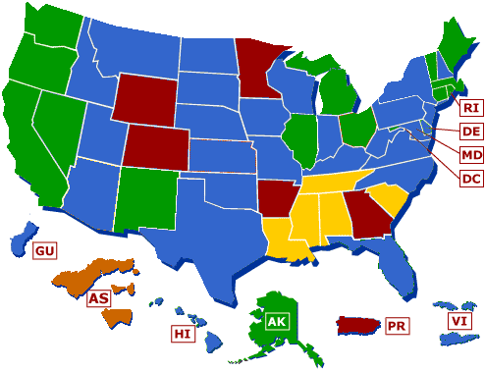
Check out the minimum wage laws in your state:
The state’s minimum wage law is…
higher
lower
equal to
… the national minimum wage.
No state minimum wage.
Write down the information for your state.
January 1, 2010
Source: http://www.dol.gov/whd/minwage/america.htm
Notes:
Have students jot down the information for their state. They’ll need to refer to it a few slides later.
If students ask, “AS” is American Samoa, which has its own minimum wage laws.

Slide 38
FACTOR #4
Would your voters support raising the minimum wage?
Mark your papers!

Slide 39
TIME TO VOTE!
You’ve looked at all four factors.
Now you must weigh them all and decide whether to vote “yea” or “nay.”
Mark your papers.

Slide 40
TIME TO VOTE!
If you marked “yea,” raise your hand.
If you marked “nay,” raise your hand.

Slide 41
TIME TO VOTE!
Did the bill pass?

Slide 42
BILL “C”
The government will give titles of nobility to some citizens.
Dunno! Better look at the four factors…
Hey! Who made her Queen?

Slide 43
FACTOR #1
Does Congress have the power to grant titles of nobility?
Is “granting titles of nobility” on the list of Congress’s powers?
Yes
No
Absolutely not!!

Slide 44
FACTOR #1
Does Congress have the power to grant titles of nobility?
The Constitution specifically says that “no title of nobility shall be granted by the United States.”

Slide 45
FACTOR #1
Does Congress have the power to grant titles of nobility?
Mark your papers!

Slide 46
FACTOR #2
In your opinion, should Congress grant titles of nobility?
Mark your papers!

Slide 47
FACTOR #3
Would your political party support granting titles of nobility?
Look at the checklist of values on your handout.
Do any of the values match the purpose of this bill?

Slide 48
FACTOR #3
Would your political party support granting titles of nobility?
No!
X
X
X
X
X
X
Neither party would support this bill. It’s just plain
un-American!

Slide 49
FACTOR #4
Would your voters support granting titles of nobility?
Since not everyone would get a special title, do you think most voters would support this?
Mark your papers!

Slide 50
TIME TO VOTE!
You’ve looked at all four factors.
Now you must weigh them all and decide—
WAIT!

Slide 51
TIME TO VOTE!
There is one factor that matters more than all the rest. Which one is it?
Congress’s power
Your personal opinion
Political party support
What your voters think

Slide 52
TIME TO VOTE!
Would a bill clearly against Congress’s power even make it to a vote?
Probably
Probably not

Slide 53
TIME TO VOTE!
If this bill did come to a vote, would YOU vote yea or nay?
Mark your papers.

