Slide 1

VOTING IN CONGRESS:
It’s More Than Just “Yea” or “Nay”
(It’s more than thumbs up or down, too. Sorry.)
Notes:
To hear special effects, make sure your sound is up.

Slide 2
Learning Targets
Students will be able to understand how Congress passes laws.
Students will be able to know the factors that members of Congress consider when voting.
Students will be able to understand how political party affiliation influences how members of Congress vote.

Slide 3
Members of Congress think about
FOUR FACTORS
when deciding whether to vote for a law.

Slide 4




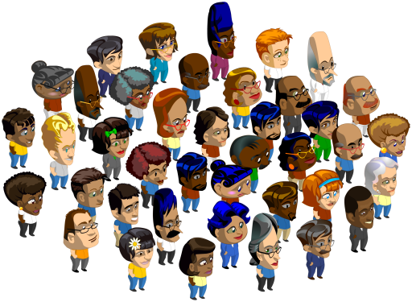
FACTOR #1
FACTOR #2
Does the Constitution give Congress the power to pass the law?
What is my personal opinion?
FACTOR #3
FACTOR #4
What are the views of my political party?
What do my voters think?

Slide 5

FACTOR #1
The POWERS of CONGRESS
Congress is limited by what the Constitution says.
The Constitution only gives Congress certain powers.
Like What?

Slide 6
FACTOR #1
The POWERS of CONGRESS
Here is what the Constitution says Congress can do:
Collect taxes to raise money to pay debts, to defend the country, and to provide for the general welfare of the United States.

Slide 7
FACTOR #1
The POWERS of CONGRESS
Here is what the Constitution says Congress can do:
Control commerce (business) that happens across state lines, with foreign countries, and with Indian tribes.

Slide 8
FACTOR #1
The POWERS of CONGRESS
Here is what the Constitution says Congress can do:
Make laws about immigration.
Make laws about bankruptcy.
Establish post offices.

Slide 9
FACTOR #1
The POWERS of CONGRESS
Here is what the Constitution says Congress can do:
Declare war.
Raise and support armies.

Slide 10
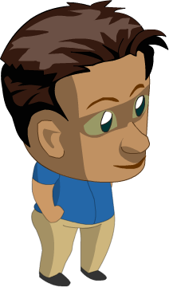
FACTOR #1
The POWERS of CONGRESS
Oh, and here’s one more:
Make all laws that are “necessary and proper” for executing any of these powers.
Hold on! What does that mean?

Slide 11
FACTOR #1
The POWERS of CONGRESS
That means Congress can sometimes do things that are not on the list . . .
. . . if it relates to something that is on the list!

Slide 12
MINI QUIZ
Can Congress pass any law it wants to?
YES! Congress has the power to do anything.
NO! Congress can only do what the Constitution says it can do.

Slide 13
MINI QUIZ
Congress has the power to create armies.
True
False

Slide 14
MINI QUIZ
Congress cannot control business that happens in more than one state.
True
False

Slide 15
MINI QUIZ
Congress may collect taxes for certain reasons.
True
False

Slide 16
MINI QUIZ
Congress may not make any laws about immigration.
True
False

Slide 17
MINI QUIZ
Congress may make any law as long as it is “necessary and proper.”
True
False

Slide 18
MINI QUIZ
When may Congress do something that is not listed in the Constitution?
Always
Never
When it relates to something that is listed
Only on Thursdays

Slide 19

FACTOR #2
PERSONAL OPINION
Members of Congress are human beings, just like you!
Love it!
Sometimes they agree with a bill…
No way!
…and sometimes they are totally against a bill.

Slide 20

FACTOR #3
POLITICAL PARTY VIEWS
People in a political party share similar values.
They work for laws that reflect those values.

Slide 21
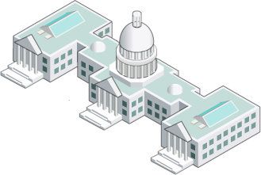
FACTOR #3
POLITICAL PARTY VIEWS
For a member of Congress, being in a political party is like being on a team.
Members of the team support each other and try to create bills that reflect their values.

Slide 22

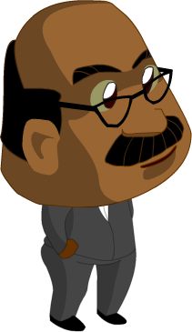



FACTOR #3
POLITICAL PARTY VIEWS
Usually members of Congress agree with their political party about bills.
But sometimes they don’t.

Slide 23
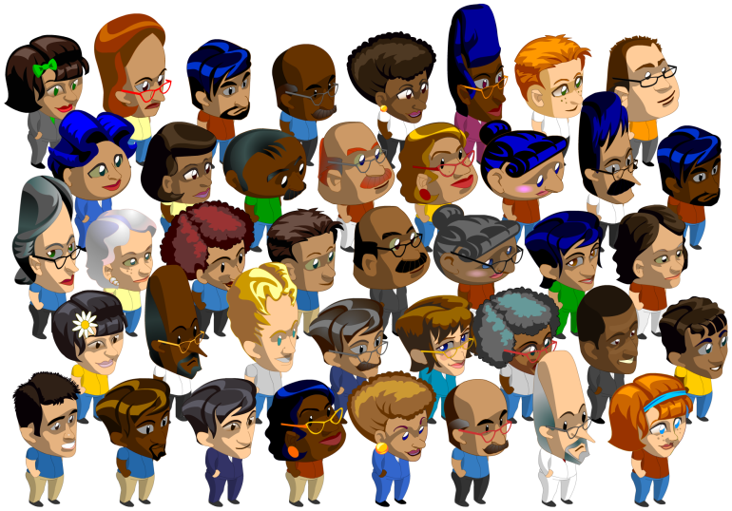

FACTOR #4
VOTERS
There would be too many people in Congress if everyone went . . .
So voters choose a few people to represent them.

Slide 24
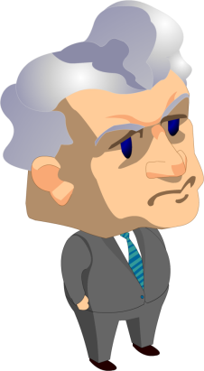
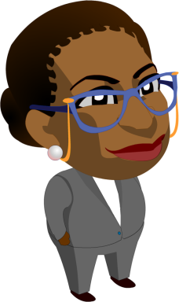
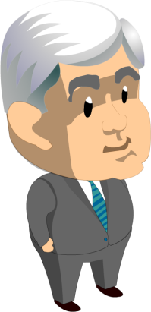
FACTOR #4
VOTERS
People in Congress are responsible for representing the voters back home.
So they’d better think about those voters, because…

Slide 25


FACTOR #4
VOTERS
Voters send people to Congress . . .
. . . and voters can kick people out!

Slide 26
MINI QUIZ
Members of Congress vote based only on their personal opinions.
TRUE! Personal opinion is the only factor.
FALSE! They consider other factors too.

Slide 27
MINI QUIZ
Members of Congress always agree with their political party about bills.
True
False

Slide 28
MINI QUIZ
When considering a bill, members of Congress should think about...
Only themselves
Voters back home
People on the moon

Slide 29
MINI QUIZ
If members of Congress do a bad job, voters can kick them out.
True
False

Slide 30
MINI QUIZ
In Congress, being in a political party is like being on a...
Team
Game show
Surf board

Slide 31
MINI QUIZ
People in the same political party share similar…
Eye color
Opinions about movies
Values

Slide 32
MINI QUIZ
When considering a bill, members of Congress usually think about…
Their own opinions
The Constitution
Political party views
What voters think
All of the above

