Slide 1
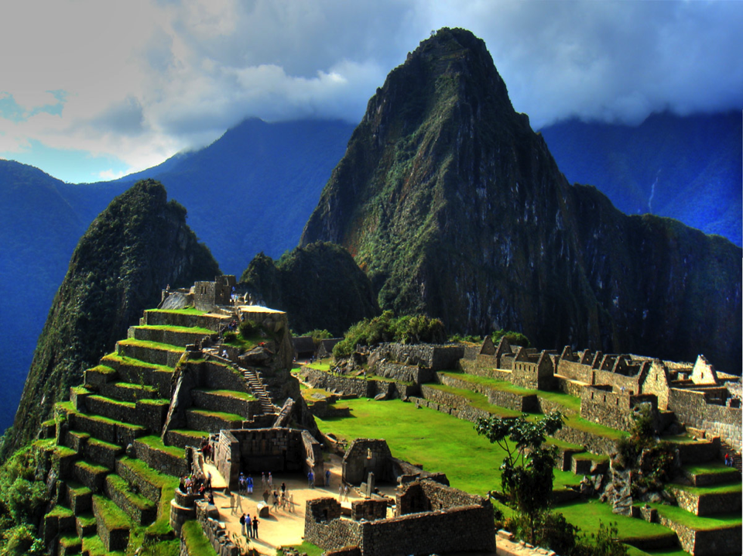
Early History of the Western Hemisphere

Slide 2
W2.1 Describe the characteristics of early Western Hemisphere civilizations and pastoral societies
Early agrarian civilizations and pastoral societies emerged. Many fundamental institutions, discoveries, inventions, and techniques appeared
Pastoral societies developed cultures that reflected the geography and resources that enabled them to inhabit the more challenging physical environments such as the tundra and semi-arid regions of North and South America.

Slide 3
Era 3 – Classical Traditions and Major Empires, Western Hemisphere
Mayan, Aztec, and Incan societies had their beginnings in Era 3 but became more prominent as civilizations in Era 4 – but you need to teach them in MS
Analyze civilizations and empires that emerged during this era, noting their political, economic, and social systems, and their changing interactions with the environment.
Analyze innovations and social, political, and economic changes that occurred through the emergence of agrarian societies of Mesoamerica and Andean South America and the subsequent urbanization and trading economies that occurred in the region

Slide 4
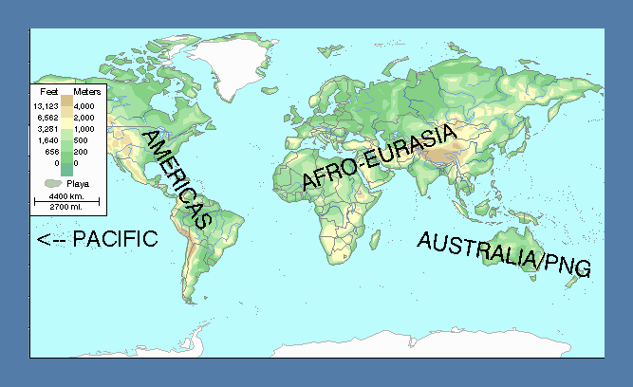
Geography context: ‘World Zones’ from c. 1,000 BCE
History took a different trajectory in each zone
= Main agricultural regions

Slide 5
Questions about the place of the Americas in World History
How do the histories of the different world zones differ?
  How is the history of the American world zone
    Similar to and
    Different from
  The histories of the Australasian and Pacific zones?
  The history of the Afro-Eurasian zone?
What can these differences and similarities tell us about human history in general?

Slide 6
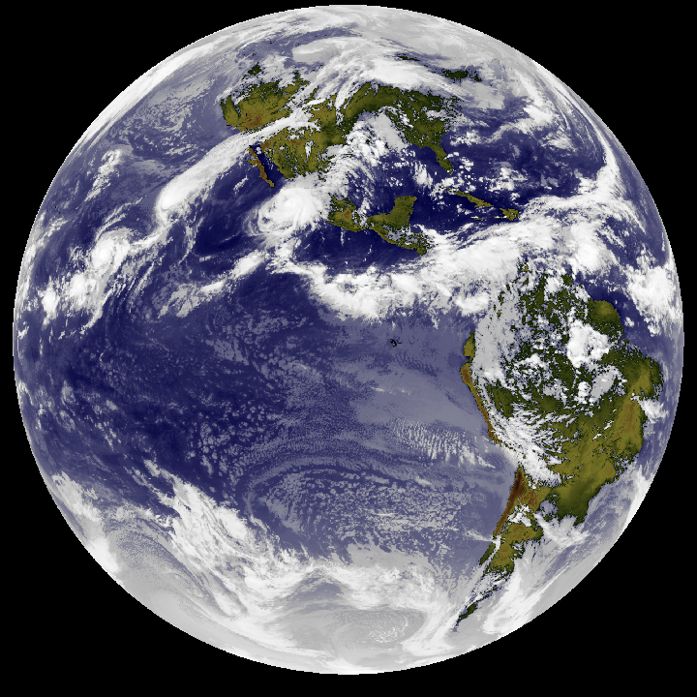
Comparing the Americas, Australasia & the Pacific
Summary:
  The American world zone was
    Larger
    More populous
    Evolved larger communities
    Evolved more productive technologies than the Australasian and Pacific world zones
How do the Americas compare with the Afro-Eurasian world zone?

Slide 7
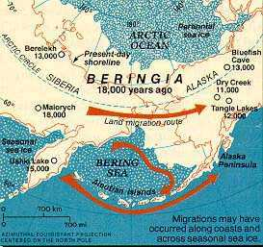

Comparing the American and Afro-Eurasian world zones
4 Major Differences:
The Americas are settled later
The geographies are different
Agriculture appears later in the Americas
Agrarian Civilizations appear later
www.rootsweb.com/~akahgp/ Social/beringia.htm

Slide 8
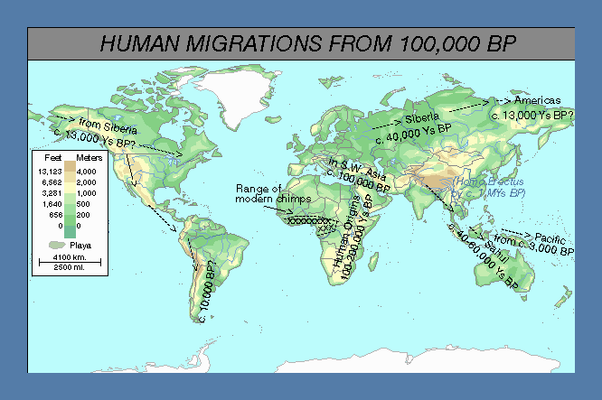
The 1st Difference:
Later Settlement
15,000 Ys ago
Many new technologies required
40,000 Ys ago
New hunting techniques; adaptations to cold
60,000 Ys ago
Sea-going technologies
Chimp
range
Range of
Early humans
Notes:
Note the difference between chimps and humans in the size of their ranges

Slide 9
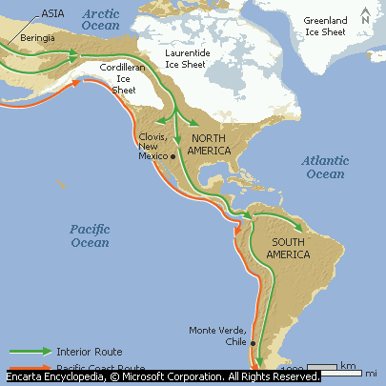
Early Migrations to the Americas
Humans may have arrived earlier, but they certainly reached the Americas by 15,000 years ago, traveling either by sea, along the W. Coast, or inland between the great ice sheets

Slide 10
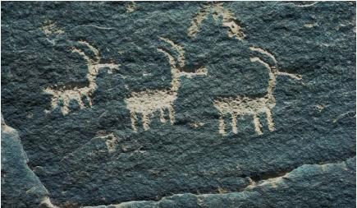
So, American History Started Later
Humans arrived with technologies adapted for the north and north east of Eurasia
The Americas were a new land
  The first Americans had to learn new techniques
  They had to become familiar with new animals and plants
  American animals and plants had to adapt to the presence of humans

Slide 11
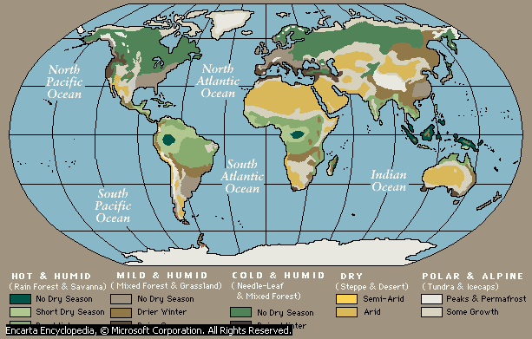
The 2nd Difference: Geographical Orientation
E-W axis
N-S axis

Slide 12
Traveling south through the Americas meant adapting to many different environments
The Biologist, Jared Diamond, has pointed out that:
Migrating east through Afro-Eurasia was fairly easy
  Climates and environments did not change too much
  So it was easier to adapt familiar technologies
Migrating south through the Americas was tougher
  Climates and environments changed as you moved towards and away from the equator
  Still, humans migrated all the way in c. 2,000 years (a sign of the increasing adaptability of humans by 13,000 years ago)
  But exchanging technological ideas was tougher

Slide 13
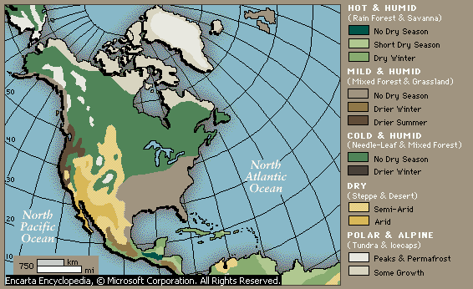
N. America: Climates
Traveling E-W you encounter less climatic variety
E-W Travel
N-S Travel
Traveling N-S you pass through many different climate zones

Slide 14
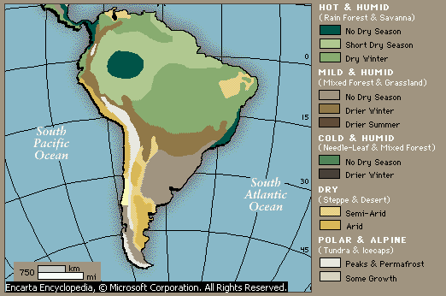
S. Americas: Climates
E-W Travel
N-S Travel

Slide 15
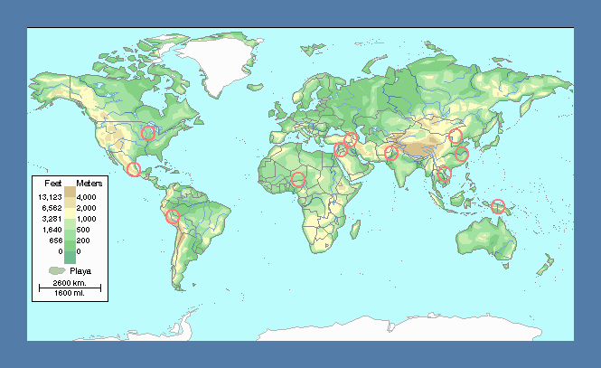
The 3rd Difference:
Agriculture appears later
Mississippi valley
S.W. Asia
N. China
Egypt
S. China
Pakistan
Mesoamerica
S.E. Asia
W. Africa
Andes
Papua New Guinea
Phase 3: after 4,000 BCE
Phase 2: 7,000-4,000 BCE
Phase 1: 9,000-7,000 BCE

Slide 16

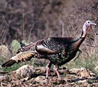

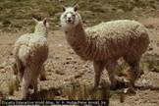
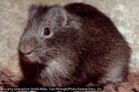
Major American Domesticates?
How many could you have named?
  Tomatoes
  Potatoes
  Chili
  Beans
  Squash
  Quinoa
  Alpaca/llamas
  Guinea pigs
The Potato, a native of Peru
Turkey, domesticated by the Aztecs
Quinine comes from the bark of the Cinchona tree
Alpaca
Wild Cavy

Slide 17
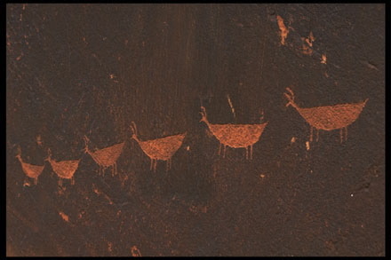
Why does agriculture appear later in the Americas?
Possible answers:
Species were different:-
  Many American plants were harder to domesticate
  Many potential animal domesticates were driven to extinction
Humans arrived later:-
  So they took longer to learn how to use American plants and animals
  Problems of overpopulation emerged later

Slide 18
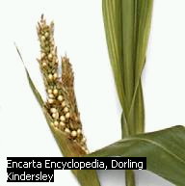
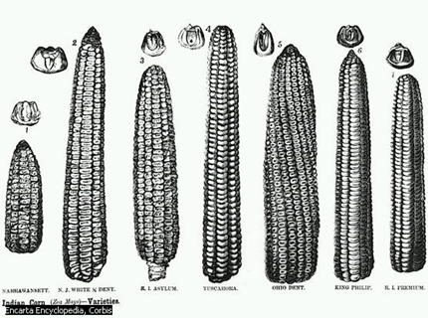
Maize was less ‘pre-adapted’ for domestication than wheat
Modern varieties of maize are larger and much more nutritious; but they took a long time to get that way
Teosinte, the ancestor of maize, is small, weedy and not too nutritious, but it can survive in the wild

Slide 19
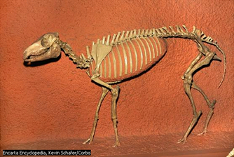
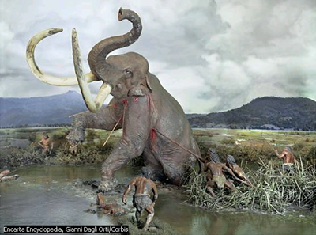
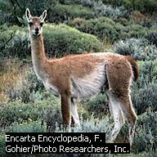
Extinct N. American megafauna
included potential domesticates
Horses evolved in the Americas, but were hunted to extinction there.
Species of elephants, including mastodon and mammoth, were hunted to extinction.
Many species of camelids evolved in the Americas, such as this guanaco. Some survived.

Slide 20
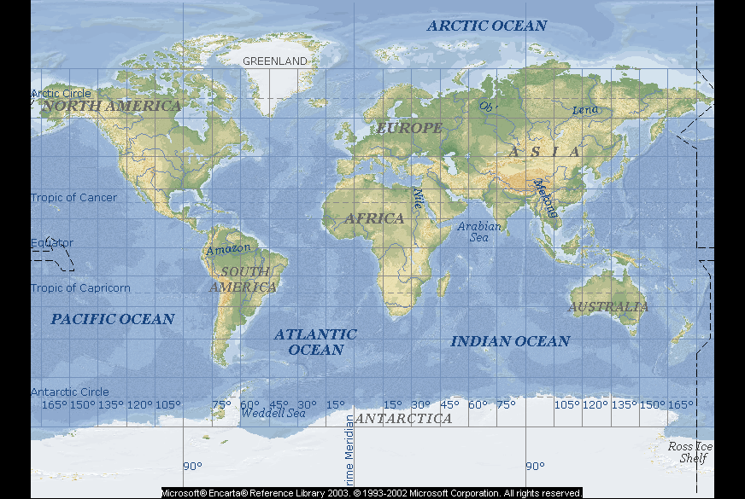
4th Difference: Agrarian Civilizations arrived later in the Americas
= Zones of Agrarian Civilization

Slide 21
Agrarian Civilizations in the Americas: Chronology
c. 1500 BCE:
  towns, powerful ‘chiefdoms’ amongst Olmec, Mesoamerica
500 BCE:
  cities and small states, Mesoamerica (e.g. Monte Alban)
500 CE:
  large states (e.g. Teotihuacan, Mayan regions)
1500 CE:
  large empires (Aztecs, Incas)

Slide 22
Afro-Eurasian & American agrarian civilizations shared much, even though there was no contact between them
They were based on agriculture
There was an elaborate division of labor, with specialist artisans, traders and warriors
They built monumental architecture devoted to the gods
They engaged in warfare
They had powerful and wealthy leaders
They had large cities
They had taxation and writing

Slide 23
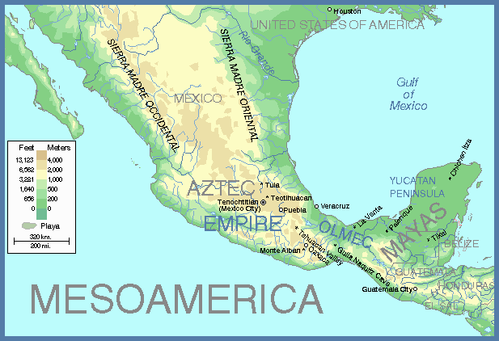
Teotihuacan
Chichen
Itza
MAYAS
AZTEC EMPIRE
Tikal
Tenochtitlan
Monte Alban
OLMEC

Slide 24
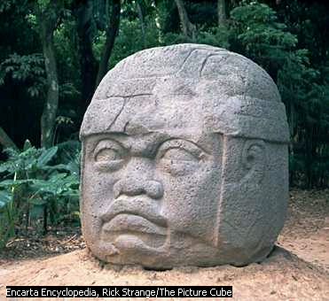
Olmec monumental art, c. 1600 BCE, La Venta, Tabasco St., Mexico

Slide 25
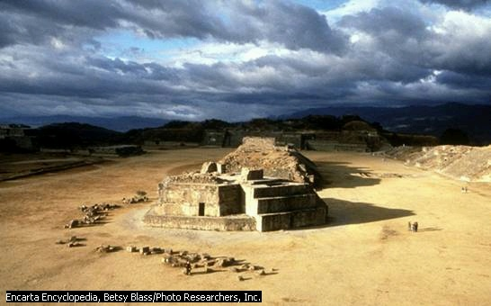
Ruins of Monte Alban, Oaxaca valley (c. 500 BCE-500 CE)

Slide 26
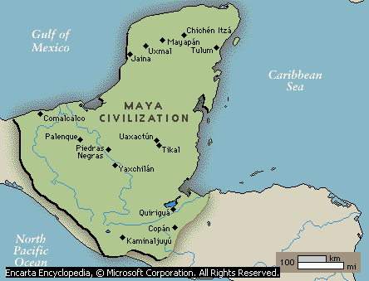
Regions of Mayan Civilization
Chichen Itza
Tikal

Slide 27
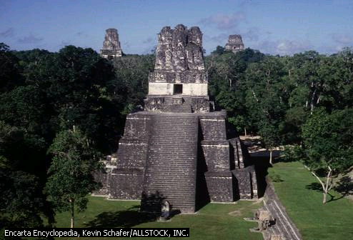
Tikal, Guatemala, c. 200 CE
Like all monumental architecture, these pyramids almost certainly had deep religious significance

Slide 28
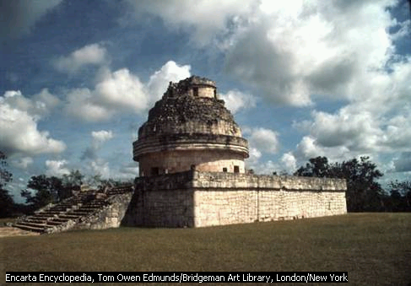
Chichen Itza in Mayan Yucatan, built c. 1050 CE

Slide 29
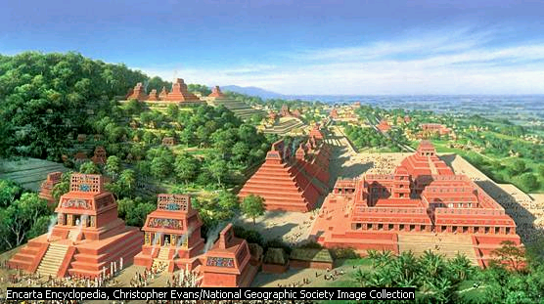
A reconstruction of Mayan monumental architecture

Slide 30
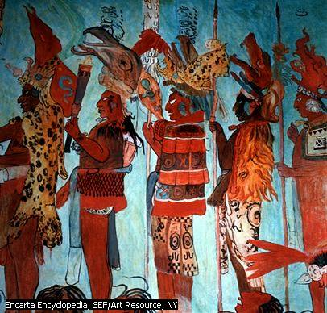
Warfare was as important as in all agrarian civilizations
Bonampak frescoes, c. 792 CE
Mayan warriors guard prisoners of war

Slide 31
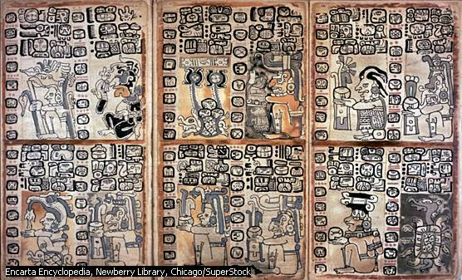
Mayan writing, from the Madrid codex, c. 1500

Slide 32
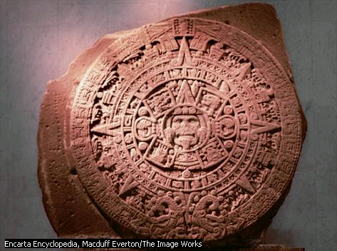
Mayan and Aztec calendars were amongst the most accurate in the world
Aztec
Calendar
Stone

Slide 33
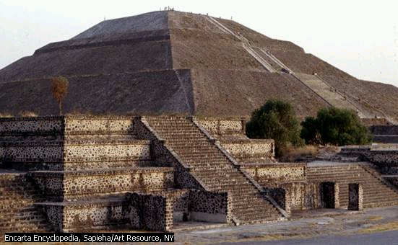
Teotihuacan (Temple of the Sun) flourished c. 200-600 CE
At its height, 200,000 people may have lived in Teotihuacan.
It traded over a large area of Mesoamerica

Slide 34
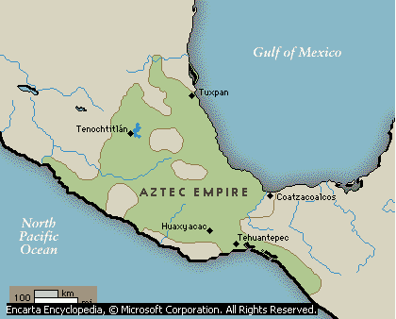
The Aztec Empire
Tenochtitlan/
Mexico city

Slide 35
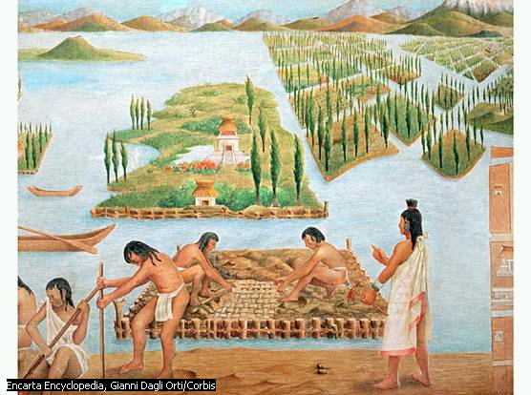
Aztec Chinampas agriculture: a 16th C. painting

Slide 36
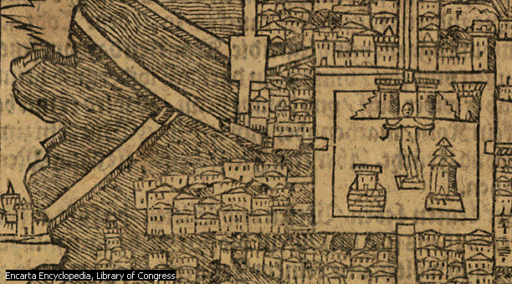
Cities: 16th century map of Mexico city/ Tenochtitlan
2 Million people lived here in 1500
Causeways across the lake

Slide 37
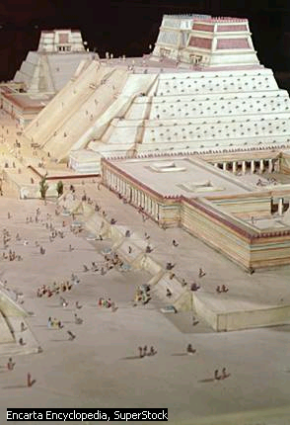
Reconstruction of the pyramids of Tenochtitlan
‘When we saw all those cities and villages built in the water, and other great towns on dry land, and that straight and level causeway leading to [Tenochtitlan], we were astounded. These great towns and … buildings rising from the water, all made of stone, seemed like an enchanted vision from the tale of Amadis. Indeed, some of our soldiers asked whether it was not all a dream. It was all so wonderful that I do not know how to describe this first glimpse of things never heard of, seen or dreamed of before.’
From the memoirs of Bernal Diaz, a soldier with Cortes

Slide 38
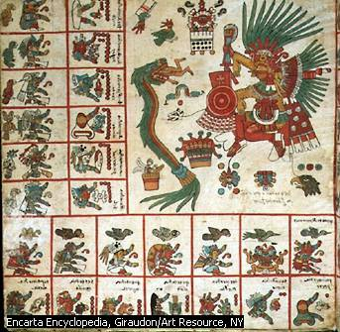
Aztec
Writing
An Aztec ‘codex’, showing the gods, Tezcalipoca (right) and Qetzalcoatl (in the form of a green serpent)

Slide 39
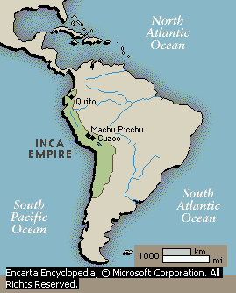
The Inca Empire by 1500

Slide 40
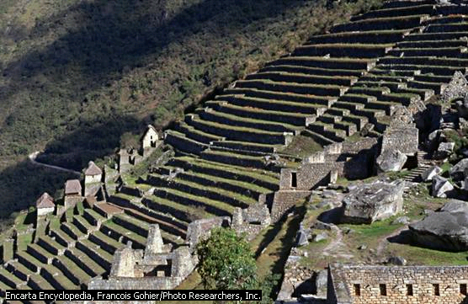
In the Andes, agriculture required elaborate systems of terracing

Slide 41
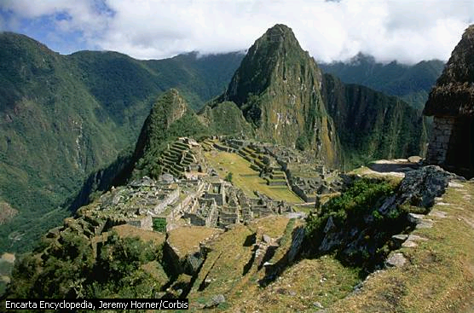
Machu Picchu (80 kms NW of Cuzco, 8,000 ft. high) was probably an Inca country estate

Slide 42
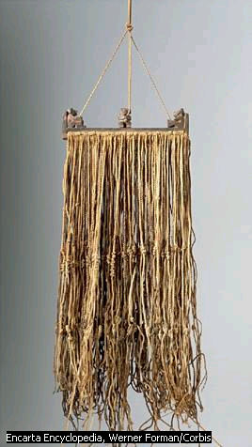
Writing or Accounting?
The Inca did not have a system of writing, but used knotted ropes, or ‘quipu’ to record important state information.

Slide 43
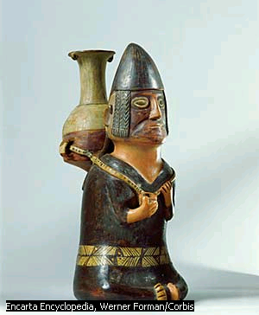
With few domestic animals, most trade was carried by porters along a vast system of state roads
Inca ceramic, 15th century

Slide 44
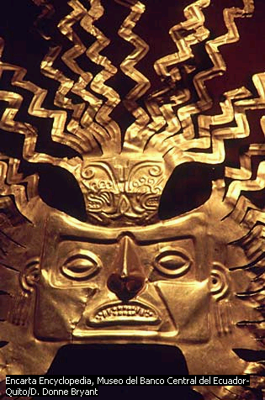
As in all agrarian civilizations, Inca rulers acquired fabulous wealth
Inca Sun Mask made of gold

Slide 45
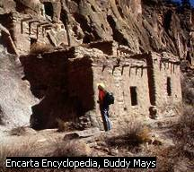
Anasazi dwellings,
New Mexico
In other regions, there appeared
smaller power systems
The Anasazi of
S.W. USA

Slide 46
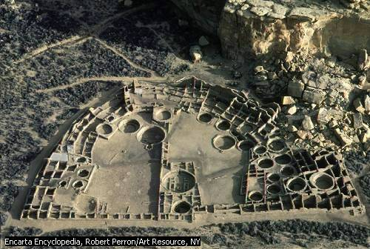
Chaco Canyon, New Mexico: an Anasazi ritual center

Slide 47
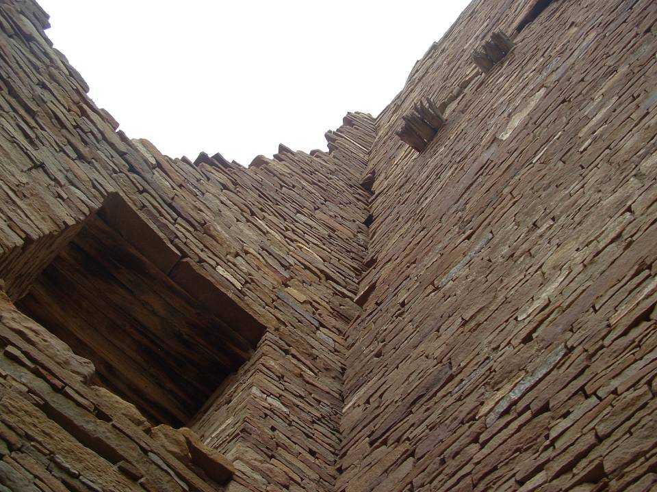

Slide 48
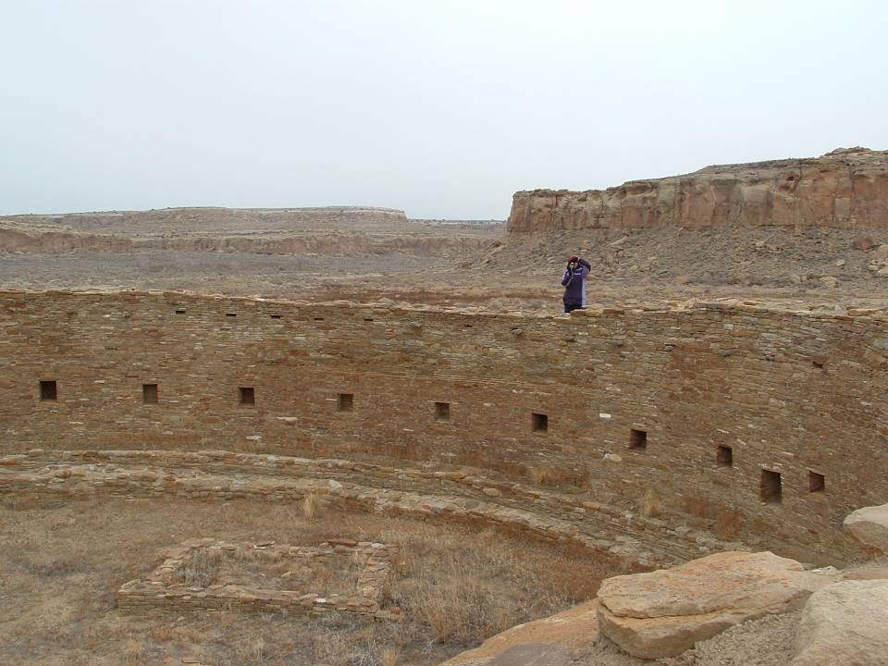
The great kiva of Casa Rinconada

Slide 49
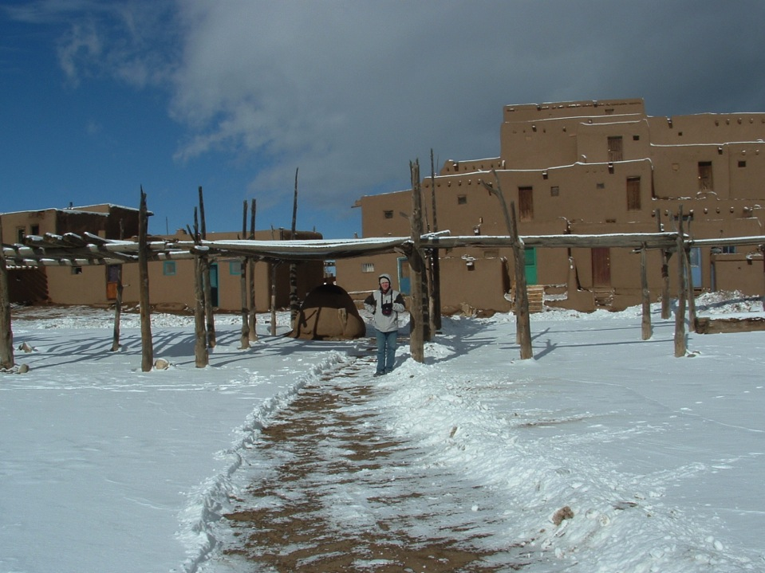
Taos Pueblo is also extraordinary! The oldest, continuously-occupied building in North America
Puebloan peoples have lived here for over 1000 years

Slide 50
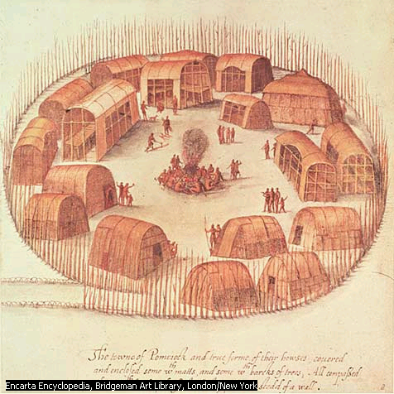
Iroquois ‘Longhouses’ with fortifications
The Mississippi Valley

Slide 51
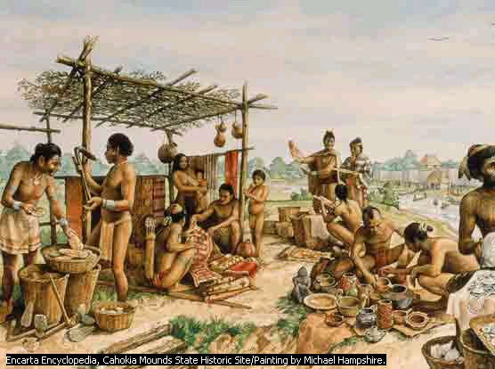
Cahokia (nr. St. Louis): an artist’s reconstruction
In 1200 CE,
30-40,000 people lived near Cahokia

Slide 52

The death of a Cahokian chief
Eyewitness account
The French 16th century explorer, Le Page du Pratz,
‘found himself in a rigidly stratified society, divided into nobles and commoners and headed by a chieftain known as the Great Sun, who lived in a village of nine houses and a temple built on the summit of an earthen mound. Pratz witnessed the funeral of the Great Sun. His wives, relatives, and servants were drugged, then clubbed to accompany him in death.’

Slide 53

Cahokia Indian Mounds, Illinois

Slide 54

Main Similarities and Differences between the American and Afro-Eurasian Zones
How similar was the history of these two regions?
What were the major differences?
Can we explain these major differences?

Slide 55
Similarities: American & Afro-Eurasian World Zones
Though there were no significant contacts between the two world-zones …
  Agriculture appeared in both zones
  Early power structures appeared in both zones
  Agrarian Civilizations appeared in both zones
    Agrarian Civilizations shared many features
      Monumental architecture
      Powerful leaders
      Armies
      Writing systems
  Networks of exchange appeared in both zones
How can we explain these similarities even though there was no significant contact before 1492?

Slide 56

Differences in 1500:
How large were populations?
In 1500, c. 40-60 million people lived in the Americas, mostly in Mesoamerica and Peru
In 1500, over 400 million people lived in Afro-Eurasia
  c. 84 million lived in China
  c. 95 million in the Indian sub-continent
  c. 67 million in Europe
  c. 78 million in Africa south of the Sahara

Slide 57


Differences in 1500:
How powerful were states?
The size of states is one way of measuring their power:
The Inca and Aztec Empires each controlled c. 2.2 ‘megameters’ in 1500. In contrast:
  The Persian empire, in 500 BCE, controlled 5.5 megameters
  The Roman empire controlled 4.0 megameters
  The early Islamic empires controlled 10.0 megameters
  The Mongol empire controlled 25.00 megameters

Slide 58
Differences in 1500:
How large were exchange networks?
American Networks of Exchange were extensive
Mesoamerican networks reached along the Mississippi river
  e.g. the adoption of maize growing from c. 1,000 CE
Limited contacts between the Andean and Mesoamerican regions
  Perhaps using large, ocean-going canoes
But American networks were
smaller, and
much less varied than those of Afro-Eurasia
  Did the equator act as a barrier to communications (as it did in Africa?)

Slide 59

Exchange Networks: Americas c. 1500 CE
Hub Zones
Looser links

Slide 60

For Comparison: Eurasian Exchange Networks c. 1500 CE
= Zones of Agrarian Civilization
Notes:
China 1) part of largest connected land-mass on earth
2) Coastal, 3) temperate, 4) at extreme edge

Slide 61

Why these differences mattered?
Compared to the other world zones, the Afro-European zone was
  Larger,
  More interlinked,
  More technologically dynamic
This is why, when the world zones collided after 1492, the societies of the Afro-Eurasian zone soon dominated the other zones!

