Slide 1
The Rise of Islam
The religion of Islam, whose followers are called Muslims, emerged in the Arabian Peninsula. This region is mostly desert, yet it was home to many Arab tribes in the A.D. 500s.

Slide 2
Muhammad Becomes a Prophet
Muhammad was born in the oasis town of Mecca around A.D. 570.
Mecca was a bustling market town at the crossroads of several caravan routes. It was also a thriving pilgrimage center.
Many Arabs came to pray at the Kaaba, an ancient temple that housed statues of pagan gods and goddesses.

Slide 3
Muhammad Becomes God’s Messenger.
Muhammad was troubled by the moral ills of Meccan society, especially greed.
He often went to a cave in the hills near Mecca to meditate, he heard a voice of the angel Gabriel calling him the messenger of God.
Muhammad devoted his life to spreading Islam.
He urged Arabs to give up their worship of pagan gods and submit to the one true god, Allah.

Slide 4
The Hijra: A Turning Point
Muhammad and his followers left Mecca for Yathrib, a journey known as the hijra, later Yathrib was renamed Medina.
Muslim convers welcomed Muhammad and agreed to follow his teachings. They became a community of Muslims, or umma.
After fighting battles with the Meccans, Muhammad triumphantly returned to Mecca, and destroyed the idols in the Kaaba.

Slide 5
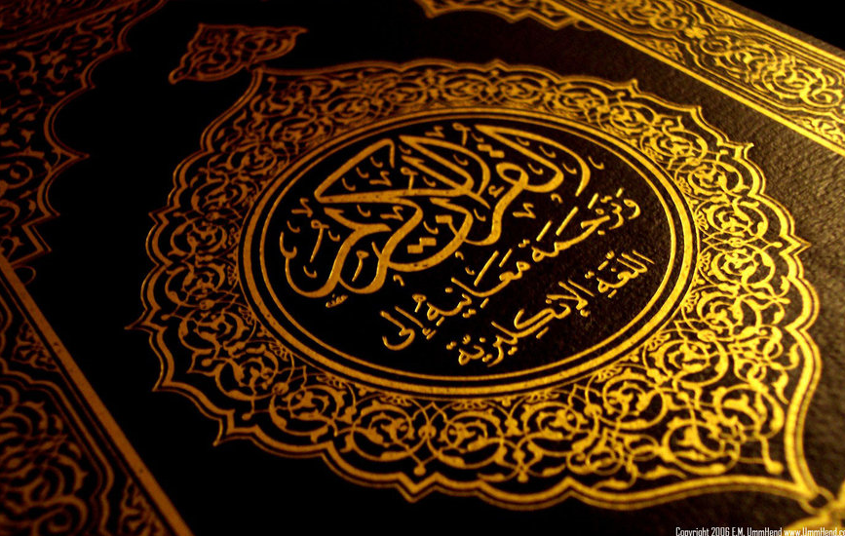
Teachings of Islam
Islam is monotheistic.
The Quran is the sacred text of Islam, it teaches that God is an all-powerful and compassionate God.

Slide 6
Muslims Study the Quran
To Muslims, the Quran contains the sacred word of God as revealed to Muhammad.
Muslims believe the Quran is the direct, unchangeable word of God.

Slide 7
Muslims Follow Duties
All Muslims perform five basic duties, know as the Five Pillars of Islam. First, to make a declaration of faith. Second, is to pray five times daily. Third, to give charity to the poor. Fourth, to fast from sunrise to sunset during the holy month of Ramadan. Fifth, to make a pilgrimage to Mecca.

Slide 8
Sharia-Islamic System of Law
Over time, Muslim Scholars developed the Sharia, a body of law that includes interpretation of the Quran.

Slide 9
Impact of Islam on Women
Before Islam, the position of women in Arab society varied. In some communities, women were active in religion, trade, or politics.
Women had mostly limited rights, they couldn’t inherit property, and had to obey a male guardian.
Islam extended rights and protection to women by affirming the spiritual equality of all Muslims.
Although spiritually equal under Islam, men and women had different rights and roles.

Slide 10
Presentation by
Valentino Aliaj
Josh Owens
Cameron

