Slide 1
Mongols Take Over China
(Chapter 12 sec 2) By: Jannet Habbi, Halah Yaldo, Mirna Ismael & Verjeen Shawkat.

Slide 2
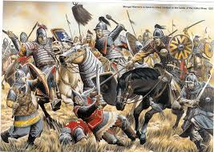
Mongols invade china
• Mongol armies conquered the Asian steppe lands with some ease, but as they turned on China, they came across the problem of attacking walled cities. • The Mongols and Chinese launched missiles against each other from metal tubes filled with gunpowder.

Slide 3
China under Mongol rule
• The Mongols needed nearly 70 more years to conquer the south. • The Mongol invasion of China spanned six decades in the 13th century and involved the defeat of the Jin dynasty, Western Xia, the Dali Kingdom and the Southern Song, which finally fell in 1279.

Slide 4
KUBLAI KHAN
•The grandson of Genghis Khan, the founder of the Mongol Empire, Kublai Khan was the fifth Great Khan of the Mongol Empire. •He tried to prevent the Mongols from being absorbed into Chinese civilization as other conquerors of China had been. •Kublai adopted a Chinese name for his dynasty, the Yuan and turned Khanbaliq into a Chinese walled city.

Slide 5
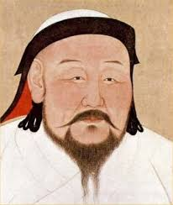

Slide 6
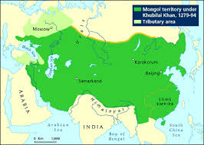

Slide 7
The End

