Slide 1
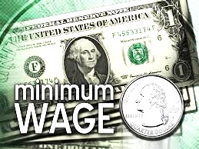
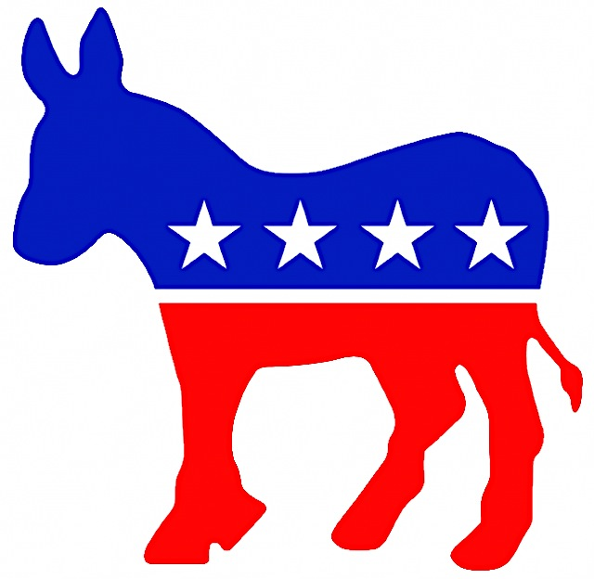
Democrats Raising Minimum Wage
By: Loretta C, Stefan P, Emily L, Matthew

Slide 2
WHY RAISE THE MINIMUM WAGE
With a higher wage, workers stay on the job longer, thus increasing labor efficiency and decreasing the cost of recruitment and retraining.
Raising the minimum wage would pump billions of dollars of consumer spending into the American economy.
The current minimum wage is not enough to keep many Americans above the poverty line.

Slide 3
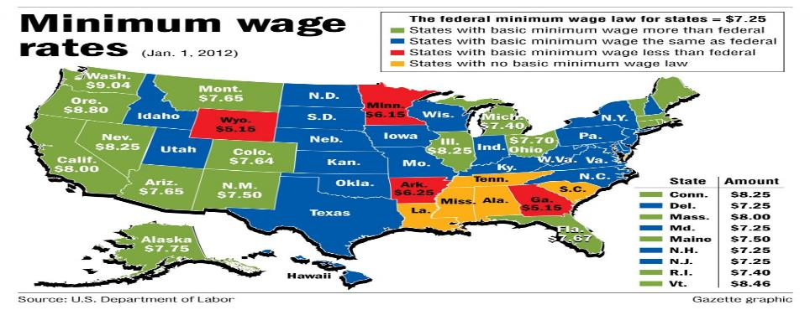
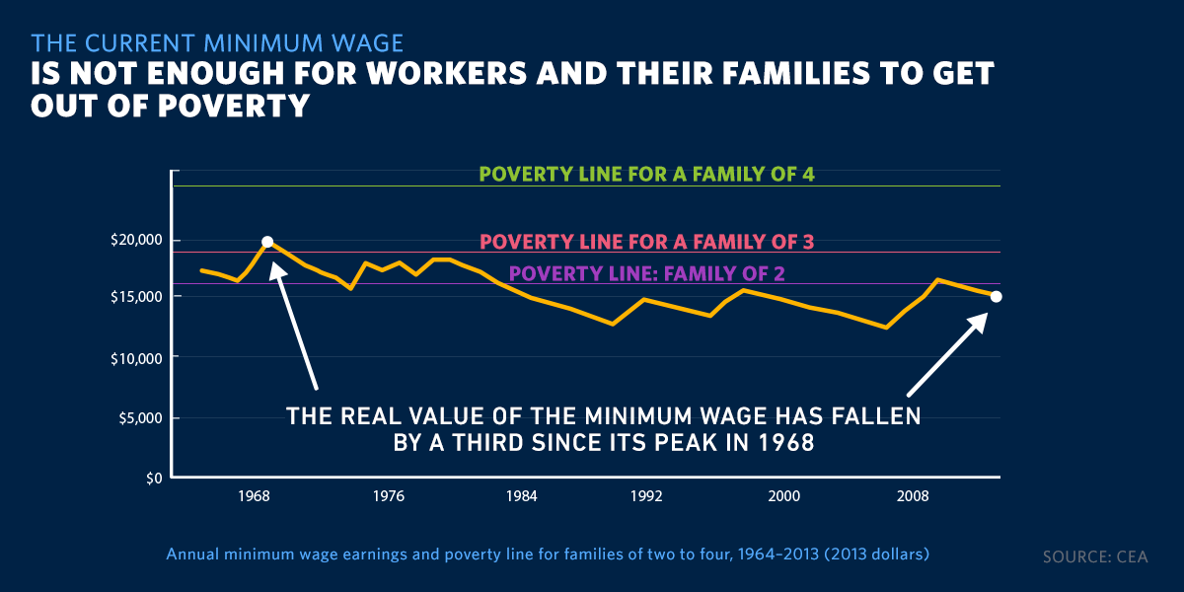

Slide 4
The major objection trumpeted by the corporations and their apologists is that raising the minimum wage would lead to a loss of jobs. But sophisticated studies by economists have reported little or no effect on employment of raising the minimum wage.
Another objection is that low-wage workers are mostly teenagers, who don't have to support a family. But people over the age of 20 constitute more than 88 percent of the 30 million American workers who would receive a raise if the federal minimum wage were increased to $10.10 an hour. These are adults -- many of them married and, also, parents.

Slide 5
Works Cited
Wittner, Lawrence. "The Minimum Wage Should Be Raised." The Huffington Post. TheHuffingtonPost.com, 10 Nov. 2013. Web. 11 Dec. 2014.
"The Health Equity and Policy Blog." : Raising the Minimum Wage. N.p., n.d. Web. 11 Dec. 2014.

