Slide 1
Chapter 8 American History
Essential Question:
In what ways did President Franklin Roosevelt’s “New Deal” provide relief, recovery, and reform during the Great Depression?

Slide 2
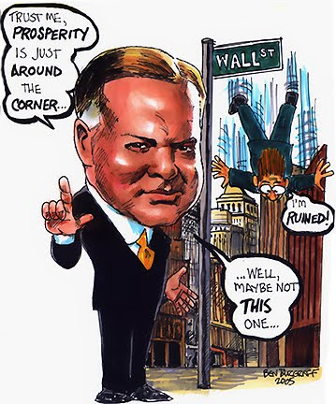
From 1929 to 1932, President Hoover was criticized for not doing more to end the depression
Tens of thousands of businesses failed and unemployment rose to 25%
The American banking system collapsed
Hoover initially relied on rugged individualism but offered relief checks and job programs, but it was seen as too little, too late

Slide 3
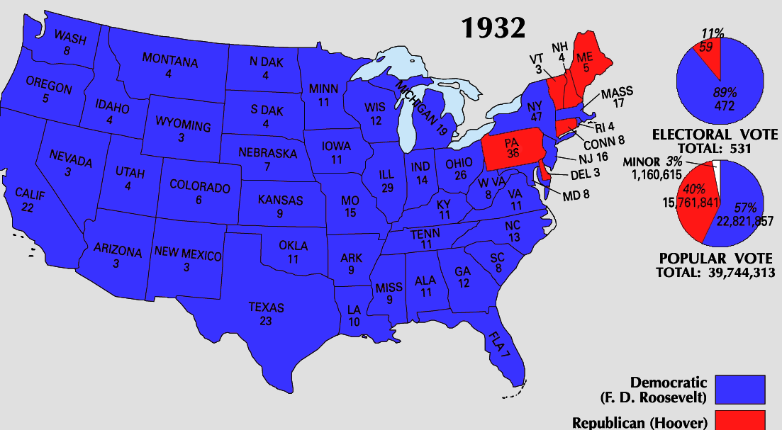
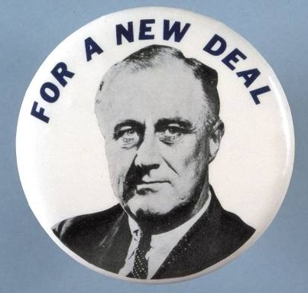
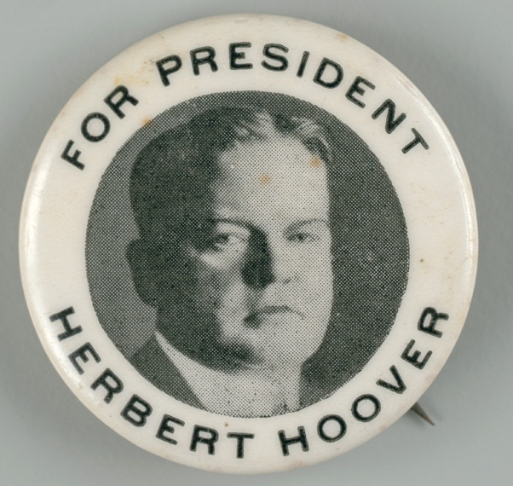
By the election of 1932, Hoover ran for re-election but Americans wanted hope and strong leadership
Democratic candidate Franklin Roosevelt defeated Hoover and won the presidency

Slide 4
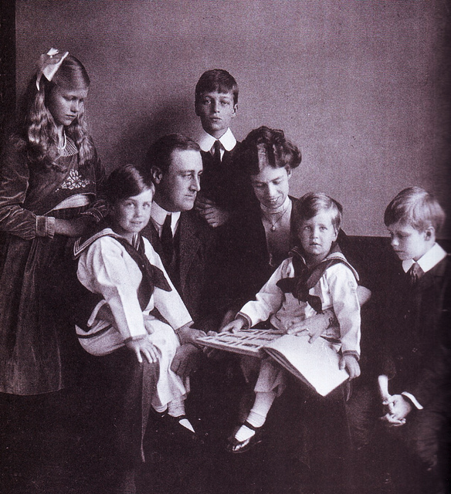
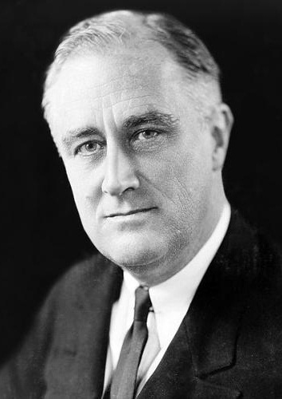
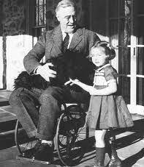
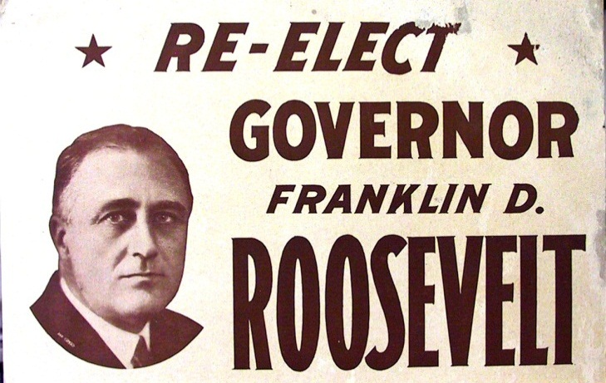
FDR Biography

Slide 5
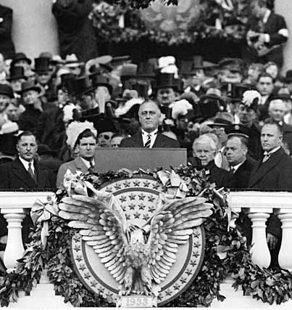
When Roosevelt was inaugurated as president, unemployment was at an all-time high
In his inaugural address, FDR inspired hope, declaring “the only thing we have to fear is fear itself”
“Let me assert my firm belief that the only thing we have to fear is fear itself; nameless, unreasoning, unjustified terror which paralyzes needed efforts to convert retreat into advance.”

Slide 6
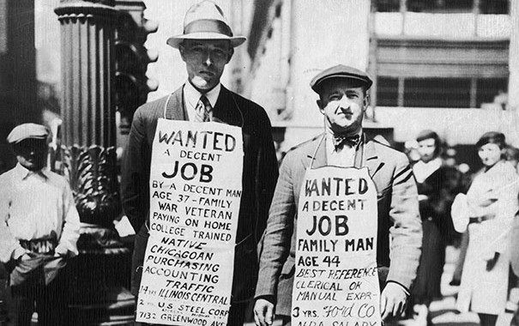
When FDR became president be promised decisive gov’t action to fight the depression
FDR believed the gov’t should use deficit spending (spending that causes debt) to stimulate the economy

Slide 7
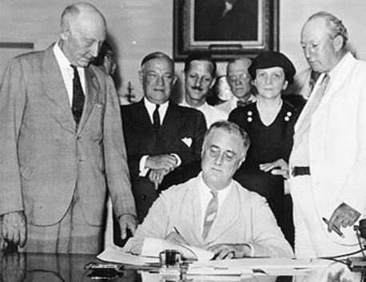
In his first 100 days in office, FDR and Congress passed a broad platform of legislation to attack the depression called the “New Deal”

Slide 8
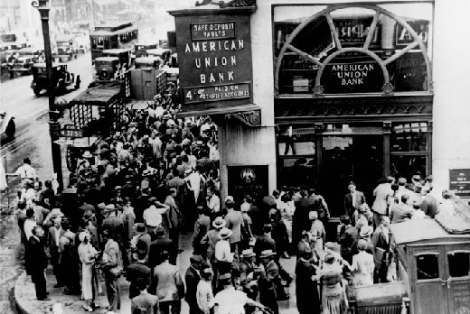
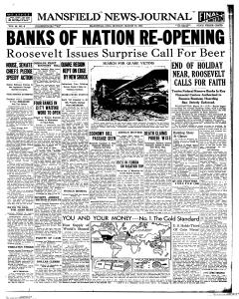
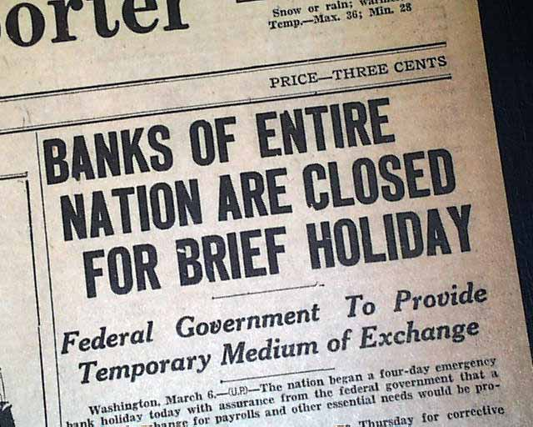
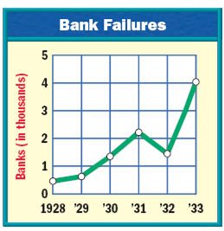
FDR’s first action was to address the bank crisis
By 1933, 25,000 banks had failed and the USA was in a complete financial collapse
FDR declared a four-day “bank holiday”: all banks were closed and inspected by federal regulators to determine which banks were healthy…
…Only healthy banks could reopen after the bank holiday

Slide 9
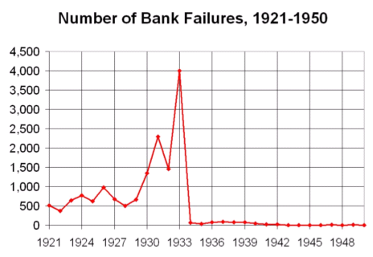
After the bank holiday, few U.S. banks failed and Americans slowly began to regain confidence in banks

Slide 10
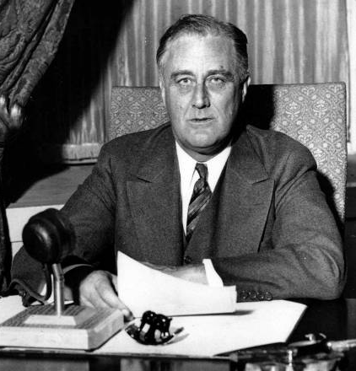
FDR used the power of the radio to communicate to the American people the steps the government was taking to address the problems of the depression
FDR’s “fireside chats” used simple, clear language to explain New Deal programs
These weekly radio addresses gave people confidence that the government was actively fighting the Great Depression

Slide 11
The New Deal focused on the three “Rs”
New Deal Programs
Relief Relief checks and job programs to lower unemployment
Recovery Programs to stimulate agriculture, industry, and the economy to end the depression
Reform Programs to correct problems in the economy and prevent future depressions

Slide 12
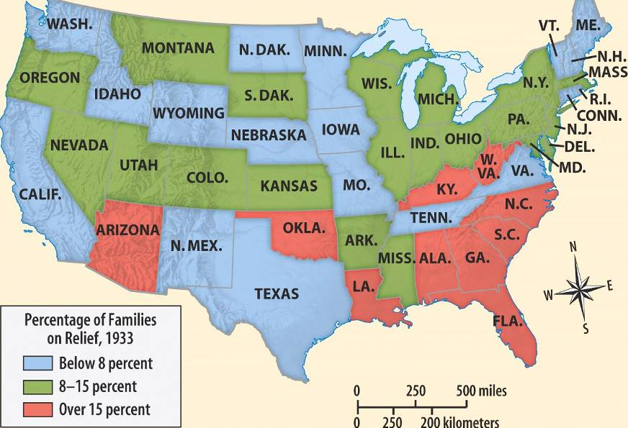
The greatest success of the New Deal was its ability to offer relief to unemployed citizens with unemployment checks and job programs
During the New Deal, the gov’t provided relief checks to 15% of Americans

Slide 13
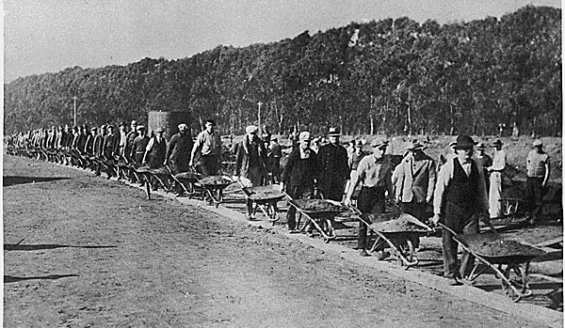
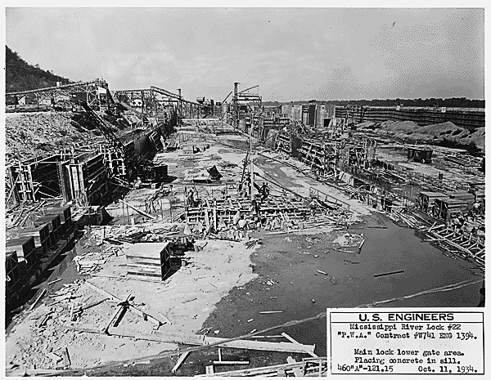
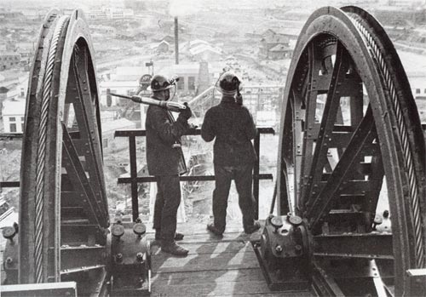
The government helped relieve unemployment by creating jobs
The Public Works Admin (PWA) hired 2 million to build airports, dams, schools, hospitals, parks
Notes:
The PWA funded the construction of more than 34,000 projects, including airports, electricity-generating dams, and aircraft carriers; and seventy percent of the new schools and one third of the hospitals built during that time

Slide 14
The New Deal created long-term reforms to address weaknesses in the American economy and address the causes of the Great Depression
Securities and Exchange Commission (SEC) was created to regulate the stock market and prevent another crash

Slide 15
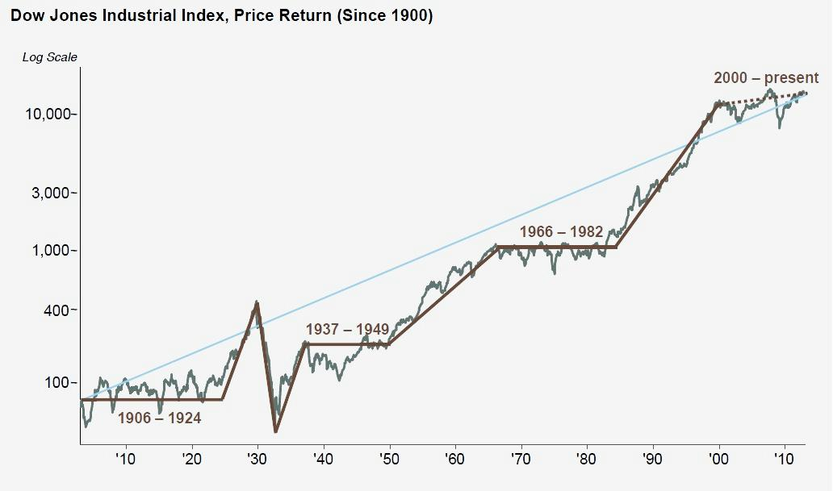
The New Deal created long-term reforms to address weaknesses in the American economy and address the causes of the Great Depression

Slide 16
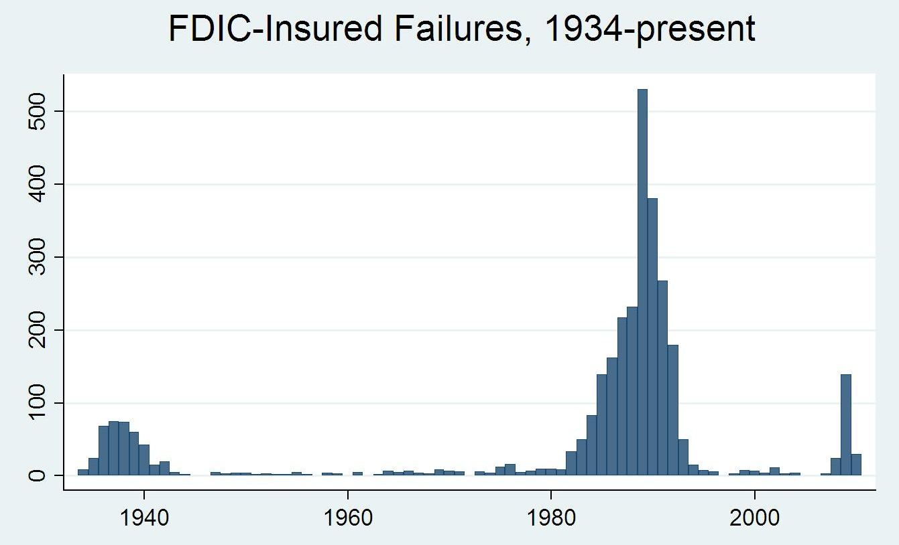
The New Deal created long-term reforms to address weaknesses in the American economy and address the causes of the Great Depression
The Federal Deposit Insurance Corporation (FDIC) was created to guarantee customer bank accounts and restore public confidence in banks
The government insures up to $250,000 in each bank account

Slide 17
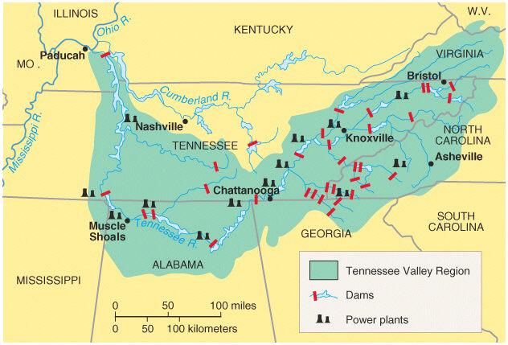
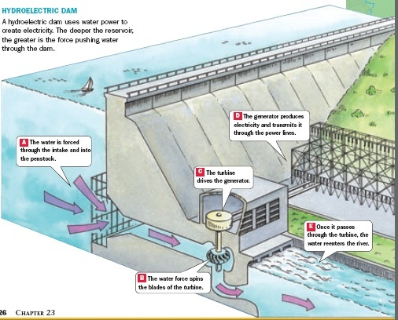
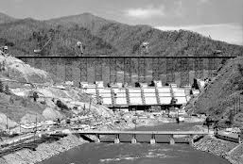
The New Deal created long-term reforms to address weaknesses in the American economy and address the causes of the Great Depression
The Tennessee Valley Authority (TVA) was created to bring electricity to the South and create jobs
The TVA built hydroelectric power plants in seven Southern states providing issued cheap power

Slide 18
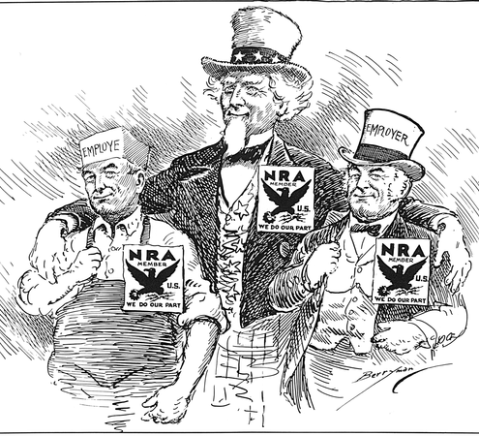
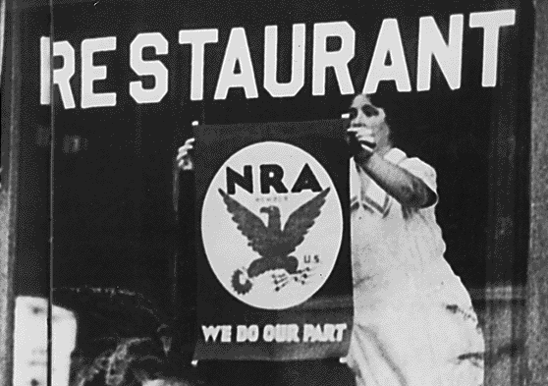
New Deal programs tried to recover the economy by stimulating industry and farming
The National Recovery Administration (NRA) was created to stimulate industry
The NRA tried to set fair wages and hours for workers and minimum prices for products
The NRA failed to create fair competition, stimulate industry, or end the depression

Slide 19
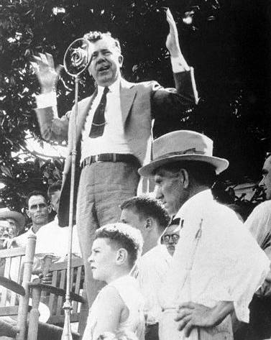
“The Kingfish” Huey Long
“How many men ever went to a barbecue and would let one man take off the table what's intended for 9/10th of the people to eat?
The only way you'll ever be able to feed the balance of the people is to make that man come back and bring back some of that grub that he ain't got no business with!...
…But when they've got everything on God's loving earth that they can eat and they can wear and they can live in, and all that their children can live in and wear and eat, and all of their children's children can use,…
…Now, how are you going to feed the balance of the people?
What's Morgan and Baruch and Rockefeller and Mellon going to do with all that grub?
They can't eat it, they can't wear the clothes, they can't live in the houses…
…then we've got to call Mr. Morgan, Mr. Mellon, and Mr. Rockefeller back and say: “Come back here, put that stuff back on this table here that you took away from here that you don't need. Leave something else for the American people to consume.”
Huey Long threatened to run as a 3rd party candidate but was assassinated in 1935
Notes:
Kingfish

Slide 20
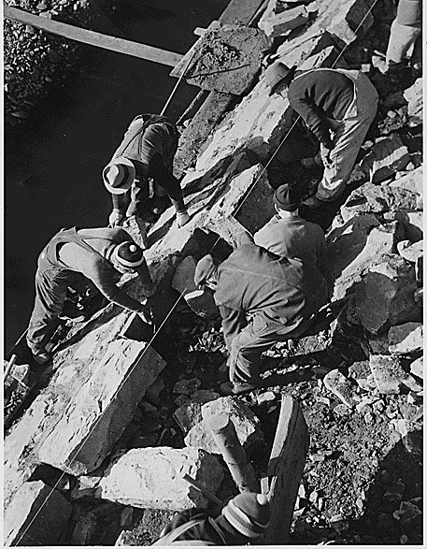
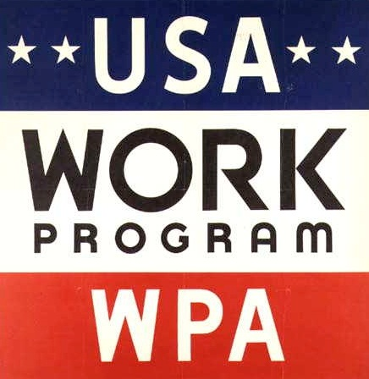
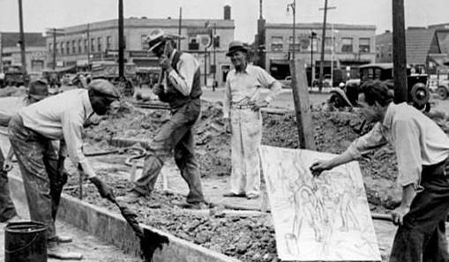
The most ambitious works program of the New Deal was the Works Progress Administration (WPA)
By 1935, most New Deal work programs were non-skilled building jobs
The WPA was created to provide as many as 10 million jobs for men, women, and youths in building projects…

Slide 21
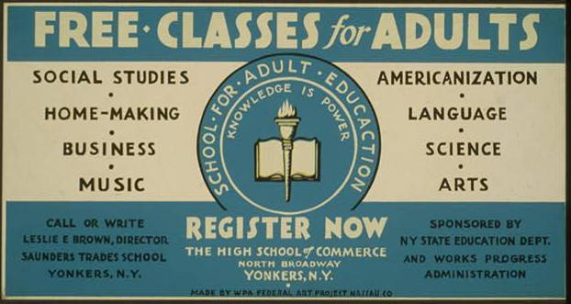
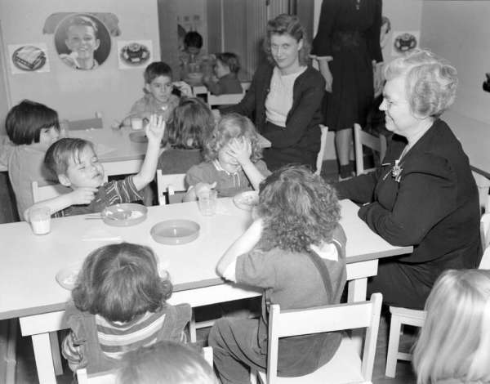
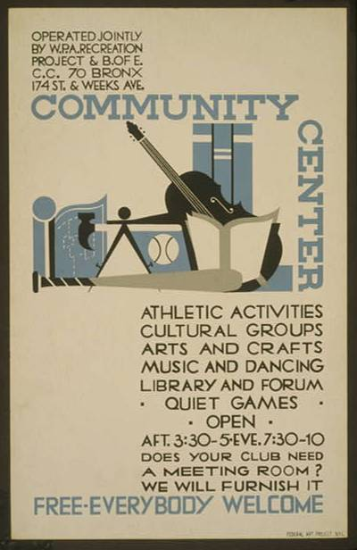
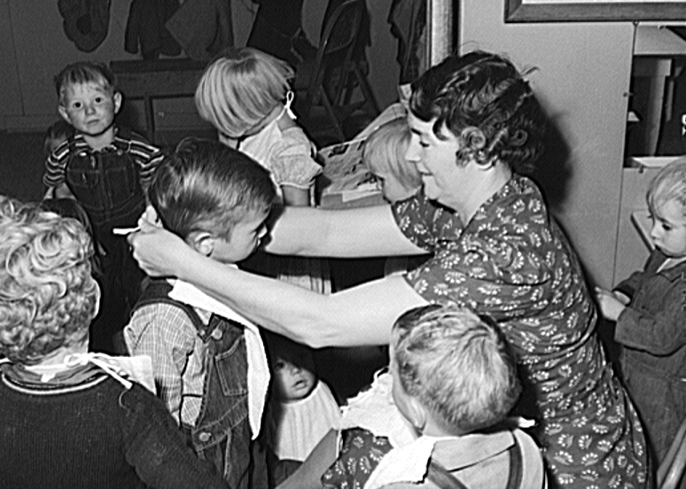
…as well as a variety of professions including artists, writers, teachers,...

Slide 22
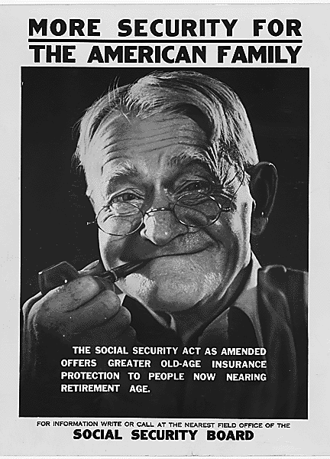
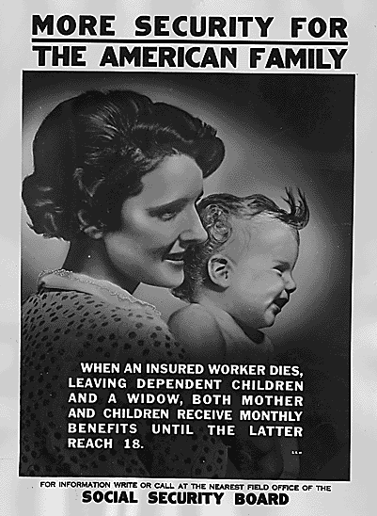
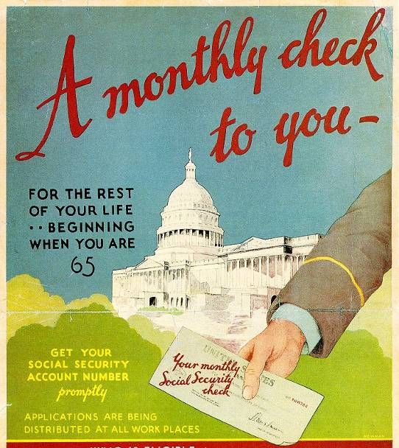
To combat poverty among the elderly and disabled, Congress created the Social Security Act
Social Security provided old-age pensions for Americans at age 65
Social Security was also America’s first welfare program because it provided payments for blind, handicapped, and needy children

Slide 23
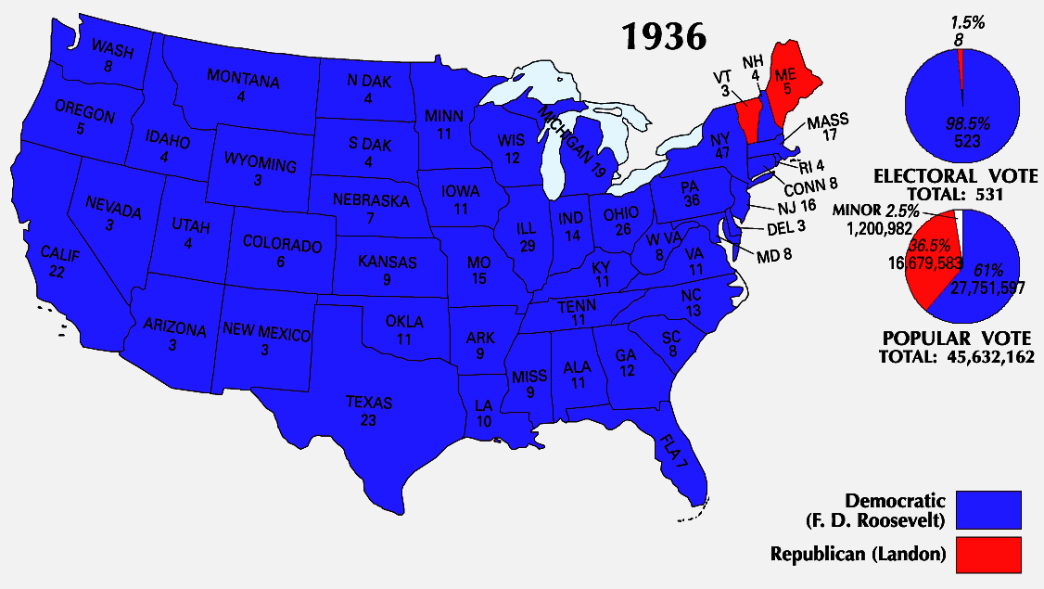
In 1936, FDR was overwhelmingly elected to a second term…
…But his second term would prove more difficult than his first

Slide 24
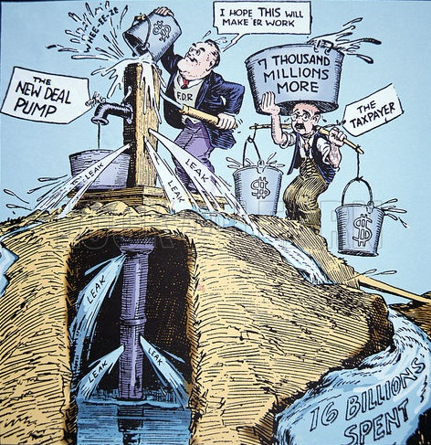
By 1937, President Roosevelt faced criticisms that the New Deal was too expensive, did not eliminate unemployment, or end the depression
FDR backed off government funded job programs and unemployment quickly rose
The New Deal was not stimulating the economy to end the Great Depression
The “First” New Deal
The “Second” New Deal

Slide 25
After 1938, Congress focused on trying to control spending and did not pass any more New Deal laws
Class Discussion: How effective was the New Deal at relief, recovery, and reform?
New Deal Programs
Relief Job programs to lower unemployment
Recovery Programs to stimulate the economy and end the depression
Reform Programs to correct problems in the economy and prevent future depressions
Success or failure?
Evidence?
Success or failure?
Evidence?
Success or failure?
Evidence?

Slide 26
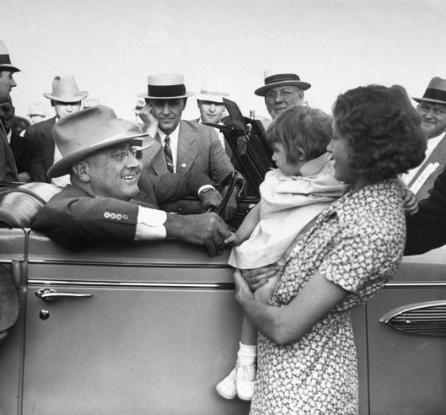
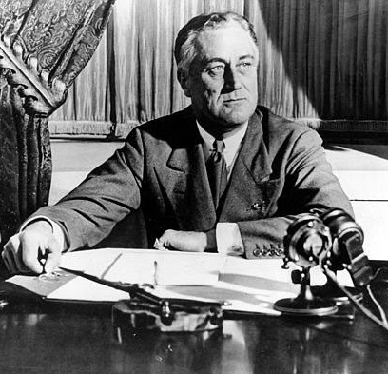
FDR’s charisma and active involvement in the economy in changed the role of the presidency and expectations of gov’t
FDR’s leadership unified African Americans, unions, immigrants, and poor voters under the Democratic Party

Slide 27
