Slide 1
Objective/Learning Target: To examine the rise of Southern anger over Reconstruction.
Do Now:
Analyze the cartoon “Tis But a Change in Banners”.
What is the artist trying to say about presidential candidate Horatio Seymour and the Democratic Party?

Slide 2
1868
1864
“Tis But a Change of Banners”

Slide 3
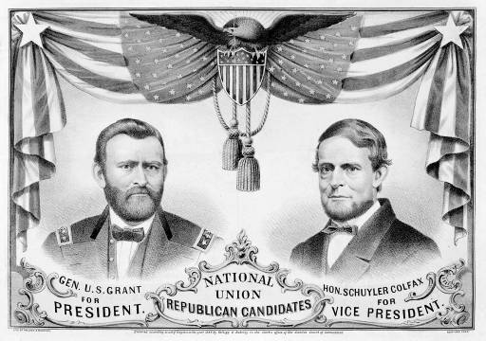
The 1868 Republican Ticket

Slide 4
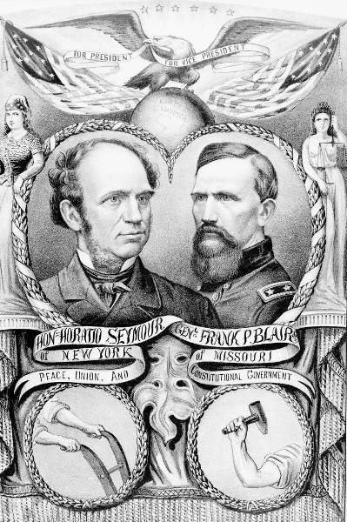
The 1868 Democratic Ticket

Slide 5
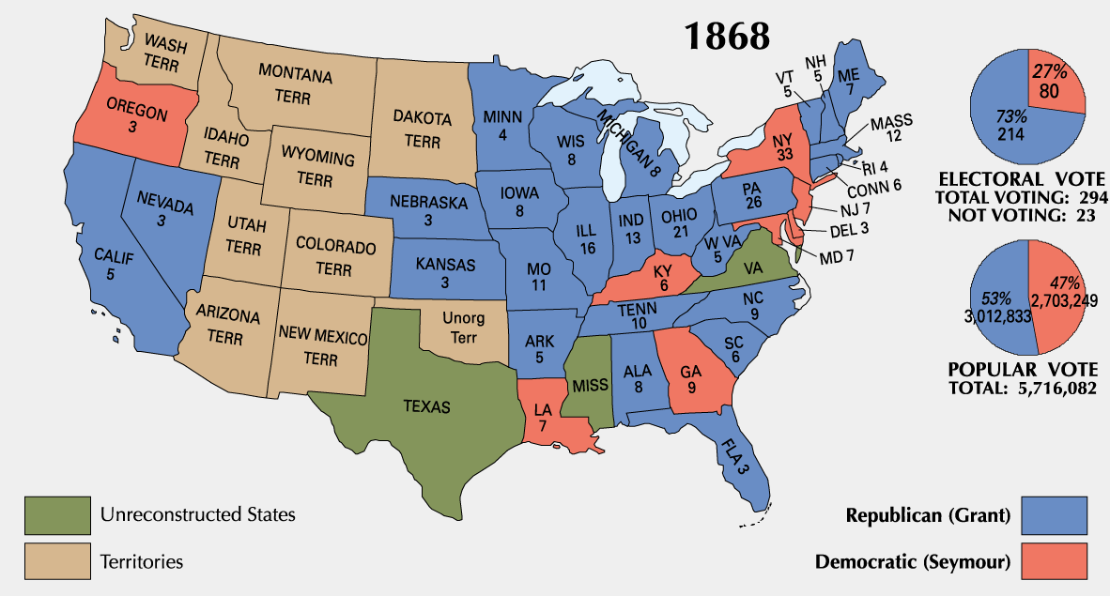
1868 Presidential Election

Slide 6
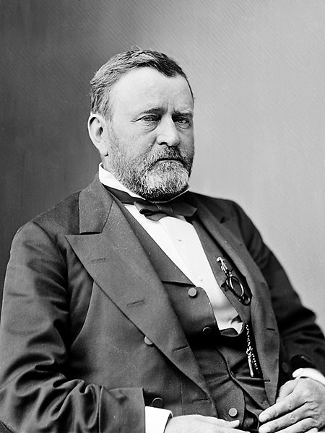
Ulysses S. Grant
1868 - Ulysses S. Grant, a Republican, wins the Presidential election, defeating Democrat Horatio Seymour.

Slide 7
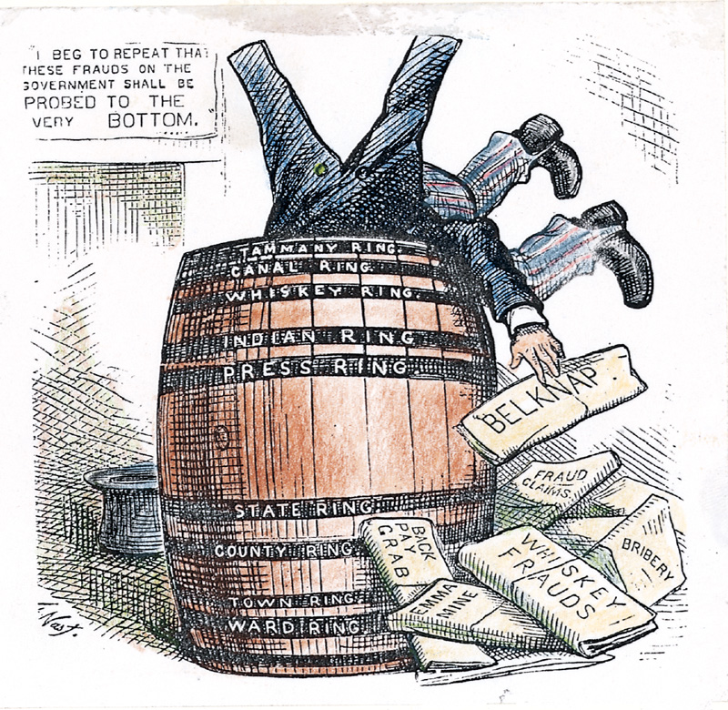
Grant Administration Scandals
Grant presided over an era of unprecedented growth and corruption.
Credit Mobilier Scandal.
Whiskey Ring.
The “Indian Ring.”

Slide 8
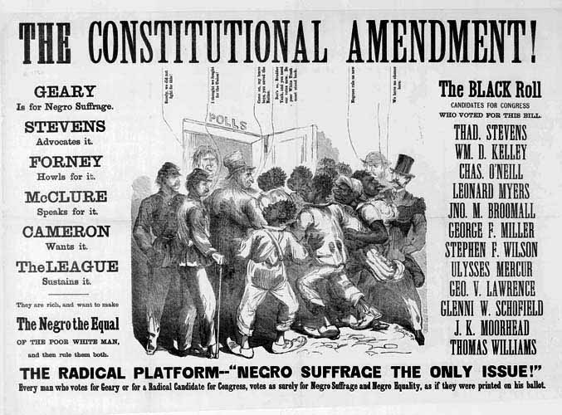

Slide 9
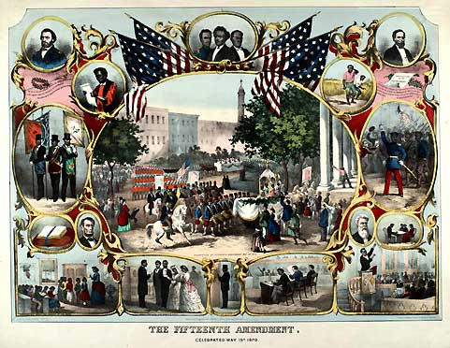
1870 -The Fifteenth Amendment is ratified, making it illegal to deny African-Americans the right to vote.

Slide 10
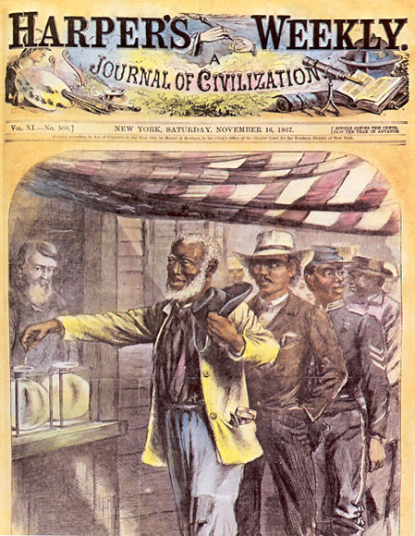

Slide 11
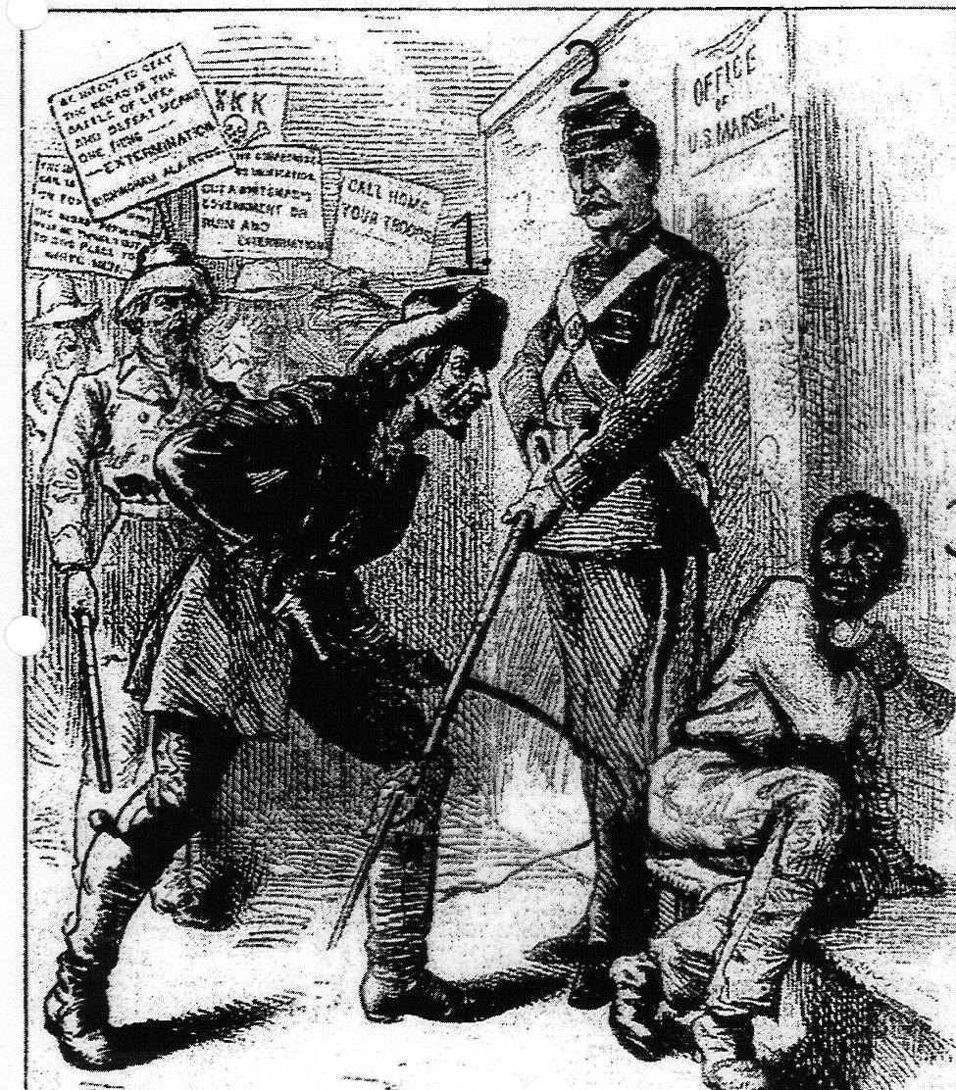
· Southerners could now vote again, and federal troops were removed from the South.

Slide 12
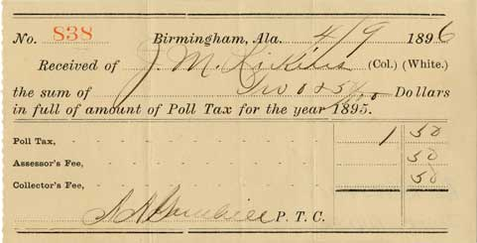
Separate But Not Equal
Voting Restrictions:
· Poll taxes and literacy tests were used to prevent freedmen from voting.

Slide 13
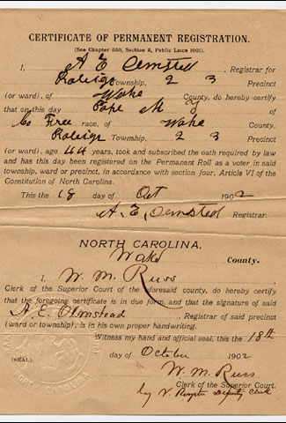
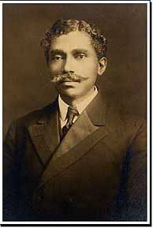
Grandfather Clause
In order to help poor, illiterate whites to vote, a grandfather clause was passed.
It stated that if a voter’s father or grandfather was eligible to vote on January 1, 1867, they did not have to take a literacy test.
This allowed whites to vote, but not freedmen.
Dr. Manassa Thomas Pope was able to receive a voter registration card because his parents had been freed prior to 1867. He was one of only seven black voters in Raleigh and one of 31 in all of Wake County, NC.

Slide 14
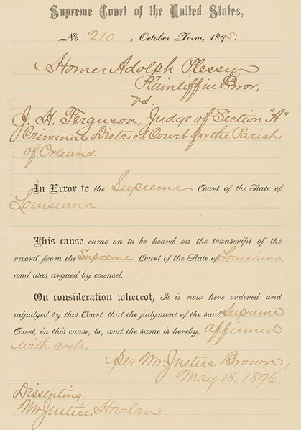
Plessy v. Ferguson - The Supreme Court ruled that segregation was legal as long as facilities were “separate but equal”.
This cause came on to be heard on the transcript of the record from the Supreme Court of the State of Louisiana, and was argued by counsel.
On consideration whereof, It is now here ordered and adjudged by this Court that the judgement of the said Supreme Court, in this cause, be and the same is hereby, affirmed with costs.

Slide 15
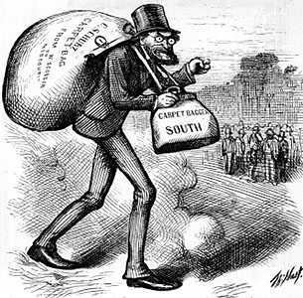
Carpetbaggers - Northerners that moved to the South during Reconstruction looking for wealth, land, or to help the freedmen.
A cartoon from the 1870s makes fun of a Northern politician. It shows him as a carpetbagger, or a Northerner who moved to the South with only what he could carry in a small bag. (At the time, traveling bags were commonly made of carpet.)

Slide 16
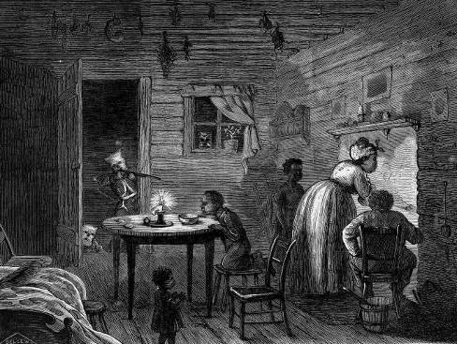
The Failure of Federal Enforcement
Enforcement Acts of 1870 & 1871 [also known as the KKK Act].
“The Lost Cause.”
The rise of the “Bourbons.”
Redeemers (prewar Democrats and Union Whigs).

Slide 17
The Civil Rights Act of 1875
Crime for any individual to deny full & equal use of public conveyances and public places.
Prohibited discrimination in jury selection.
Shortcoming → lacked a strong enforcement mechanism.
No new civil rights act was attempted for 90 years

Slide 18
Objective/Learning Target: To discuss sharecropping and the end of Reconstruction.
Do Now: I. What were some suggestions by made by Radical Republicans to help freedmen?
Give each freedman 40 acres of land and a mule
Break up plantations and redistribute the land to freedmen
II. In the end, what did freedmen receive?
“nothing but freedom”
III. What problem did large planters face?
they could no longer rely on slave labor to work on their plantations

Slide 19
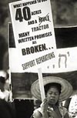
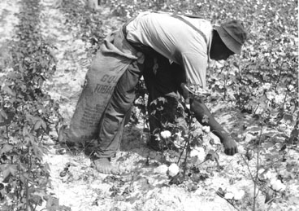
A Cycle of Poverty
· Some Radical Republicans wanted to give each freedman “40 acres and a mule”. However, all the freedmen were given was their freedom.
Sharecropper - farmer who works part of the land and gives the landowner part of the harvest
Southern sharecropper picking cotton.

Slide 20
How did sharecropping work?
· Freedmen would farm land belonging to white owners, oftentimes their old masters.
Plantation
Land worked by sharecroppers.
· Freedmen would pay rent for the land they farmed by giving the landowner a percentage of their crops.
· In addition, freedmen would purchase seed, tools, and other supplies from the landowner.
* As a result, freedmen were in constant debt to the landowners and were never able to earn a profit. If they tried to move, they could be arrested. Therefore, freedmen became tied down to the land, in a state similar to slavery.

Slide 21
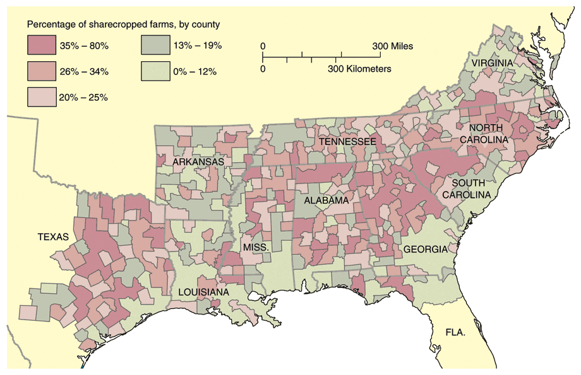
Sharecropping

Slide 22
Tenancy & the Crop Lien System
Furnishing Merchant | Tenant Farmer | Landowner
Loan tools and seed up to 60% interest to tenant farmer to plant spring crop. Farmer also secures food, clothing, and other necessities on credit from merchant until the harvest. Merchant holds “lien” {mortgage} on part of tenant’s future crops as repayment of debt. | Plants crop, harvests in autumn. Turns over up to ½ of crop to land owner as payment of rent. Tenant gives remainder of crop to merchant in payment of debt. | Rents land to tenant in exchange for ¼ to ½ of tenant farmer’s future crop.

Slide 23
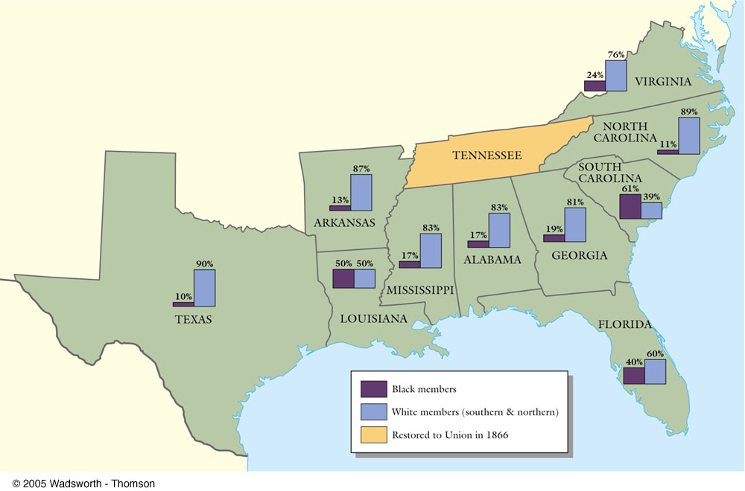
Black & White Political Participation

Slide 24
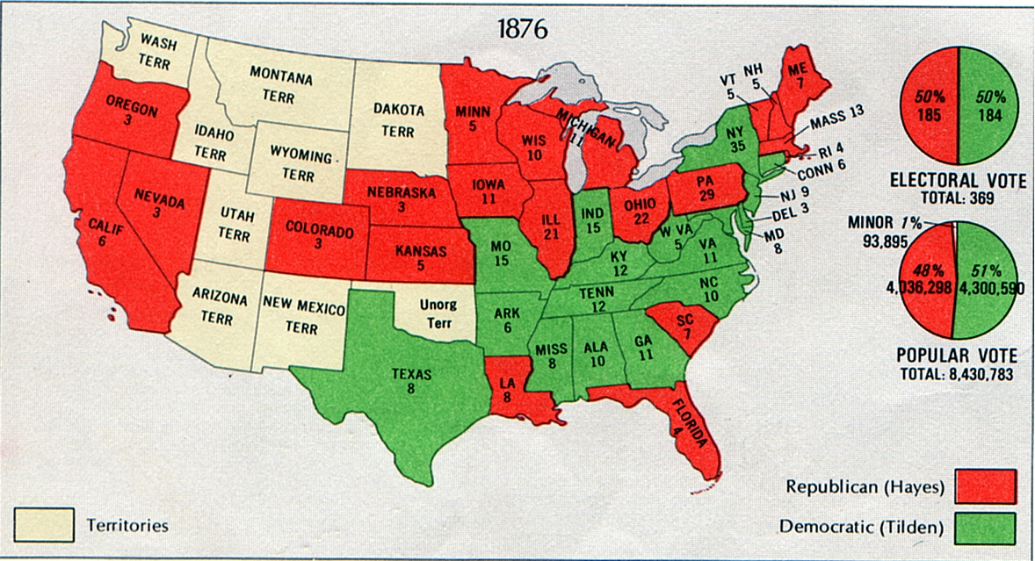
Election of 1876
· Neither candidate, Republican Rutherford B. Hayes or Democrat Samuel Tilden, had enough electoral votes to win the election.

Slide 25
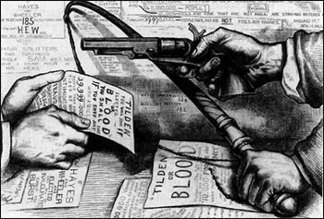
· A special commission of Congress awarded the election to Hayes, who promptly ended Reconstruction.

Slide 26
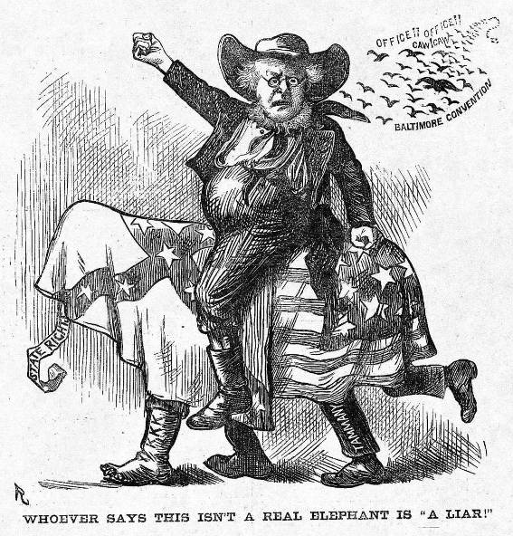
The Election of 1872
Rumors of corruption during Grant’s first term discredit Republicans.
Horace Greeley runs as a Democrat/Liberal Republican candidate.
Greeley attacked as a fool and a crank.
Greeley died on November 29, 1872

Slide 27
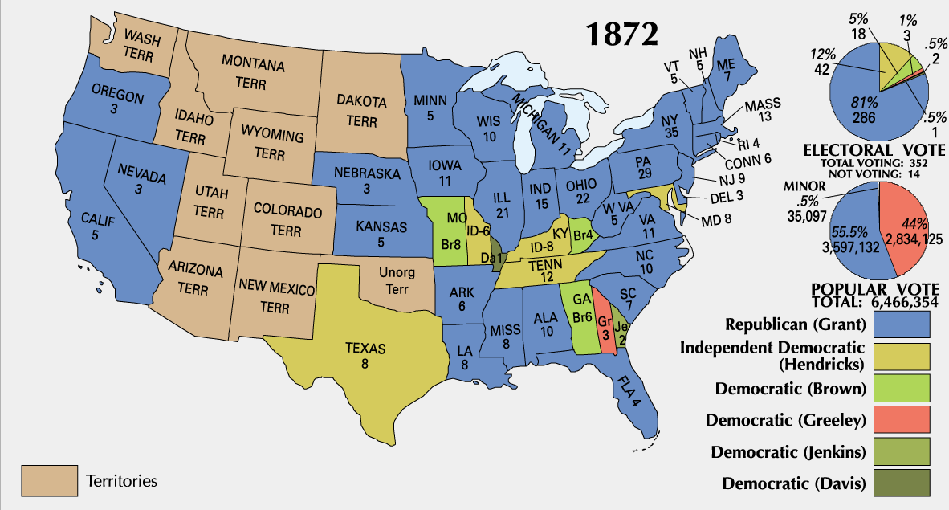
1872 Presidential Election

Slide 28
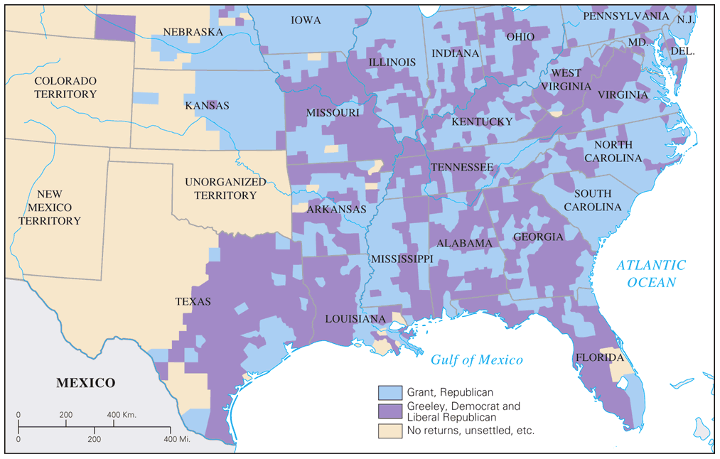
Popular Vote for President: 1872

Slide 29
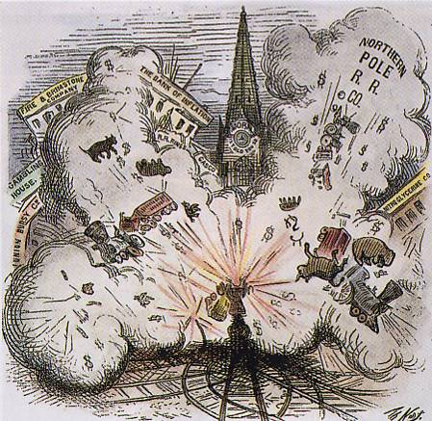
The Panic of 1873
It raises “the money question.”
debtors seek inflationary monetary policy by continuing circulation of greenbacks.
creditors, intellectuals support hard money.
1875 → Specie Redemption Act.
1876 → Greenback Party formed & makes gains in congressional races → The “Crime of ’73’!

Slide 30
Legal Challenges
The Slaughterhouse Cases (1873)
U. S. v. Cruickshank (1876)
These cases limited the ability of the Federal Government to intervene and protect the rights of Freedmen.

Slide 31
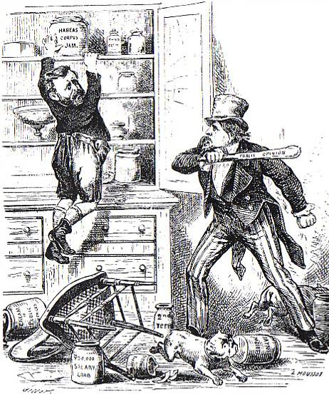
Northern Support Wanes
“Grantism” & corruption.
Panic of 1873 [6-year depression].
Concern over westward expansion and Indian wars.
Key monetary issues:
should the government retire $432m worth of “greenbacks” issued during the Civil War.
should war bonds be paid back in specie or greenbacks.

Slide 32
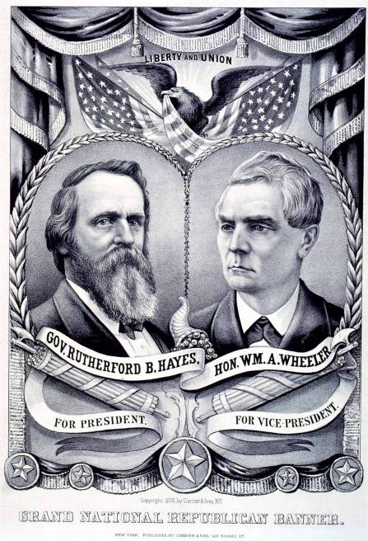
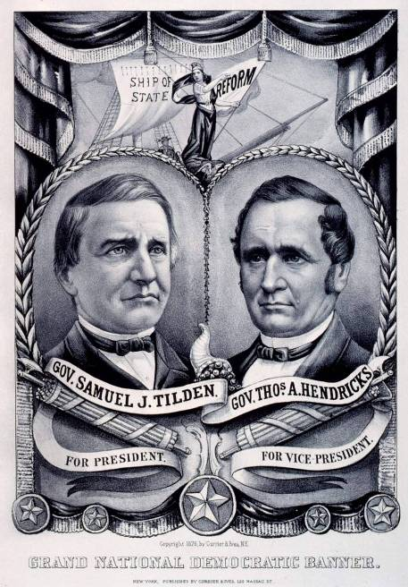
1876 Presidential Tickets

Slide 33
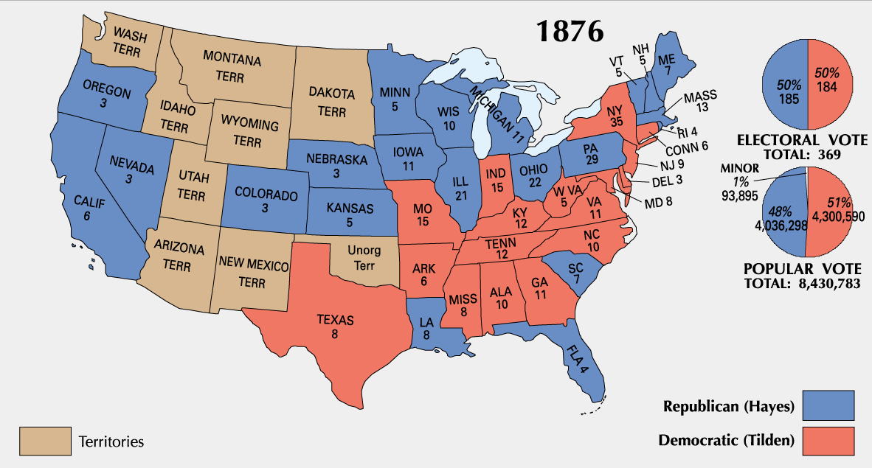
1876 Presidential Election

Slide 34
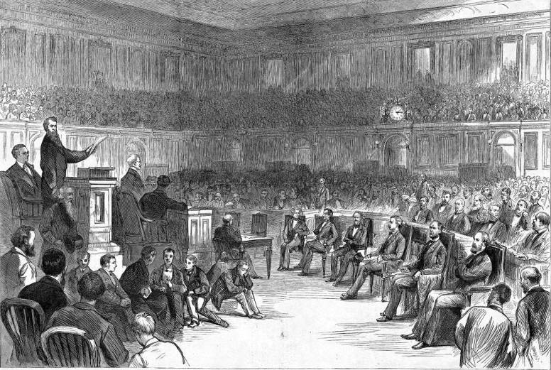
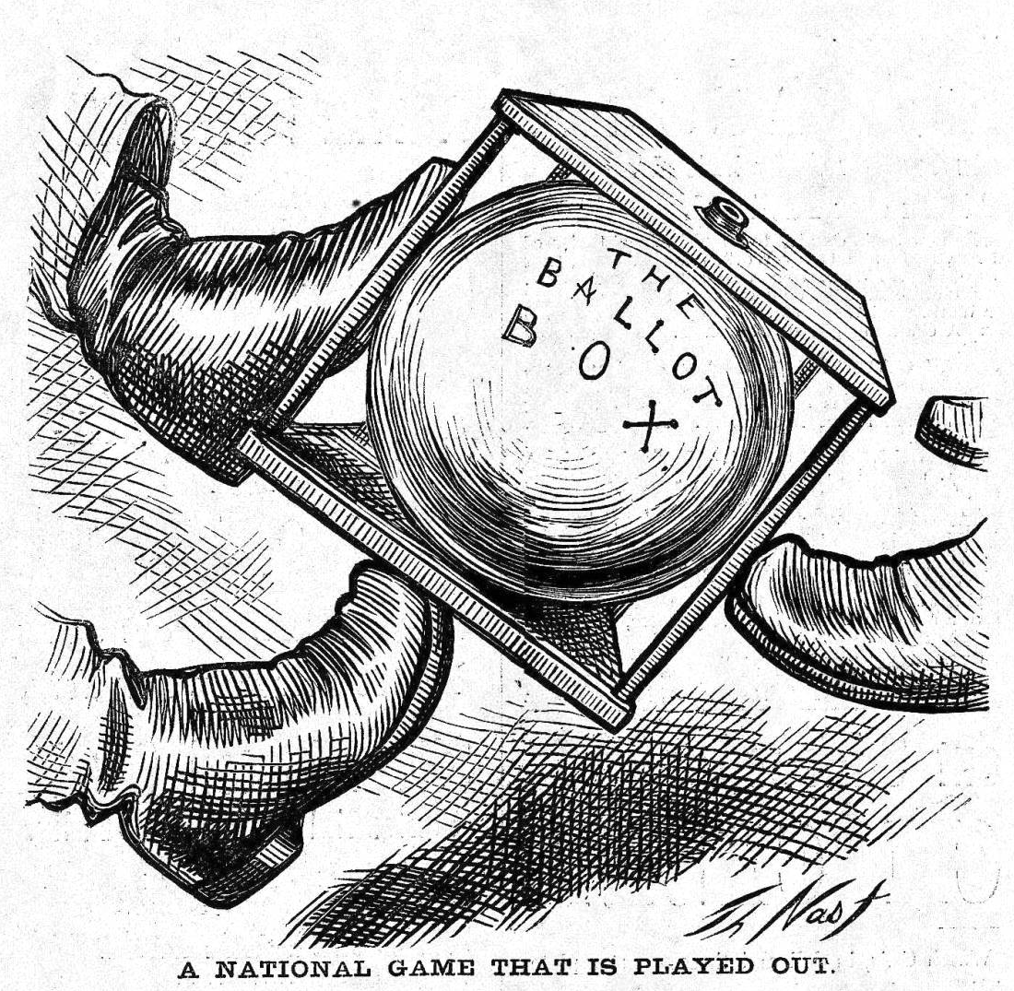
The Political Crisis of 1877
“Corrupt Bargain” Part II?

Slide 35
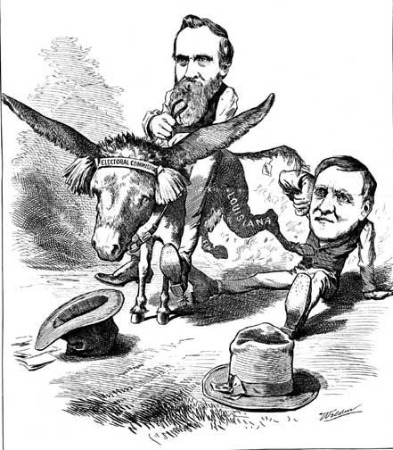
Hayes Prevails

Slide 36
A Political Crisis: The “Compromise” of 1877

