Slide 1
Learning Targets/Objectives
Explain how early political parties emerged.
Compare the political views of the Republicans and the Federalists.
Discuss the result of the election of 1796.

Slide 2
Terms and People
faction – an organized political group
James Madison – supported Thomas Jefferson’s Republican views
Thomas Jefferson – Republican candidate for President in 1796 and the nation’s second Vice President
Alexander Hamilton – Washington’s Secretary of the Treasury; supported Federalist ideas

Slide 3
Terms and People (continued)
John Adams – Federalist candidate for President in 1796 and the nation’s second President

Slide 4
Set Questions: (use pages 290-293 if needed)
What two political parties emerged during Washington’s Presidency?
Federalists and Republicans
What was the main issue dividing these two factions?
Size and power of the Federal Government
What party gets most of its support from farmers?
The Republicans

Slide 5
How did two political parties emerge?
Early political groups were called factions. They were widely thought to be selfish groups.
Washington and others feared that factions would be destructive to the new government.

Slide 6
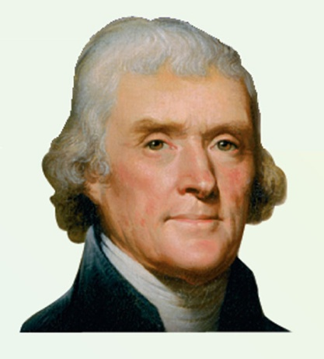
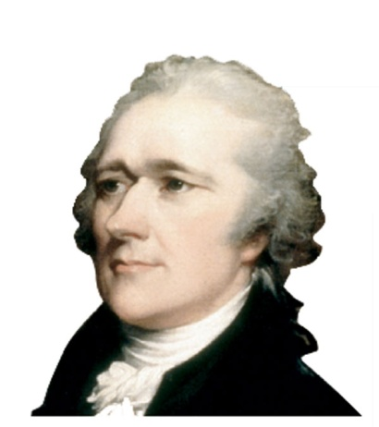
By the 1790s, Thomas Jefferson and Alexander Hamilton were quarreling and growing apart.
Thomas Jefferson, Secretary of State
Alexander Hamilton, Secretary of the Treasury

Slide 7
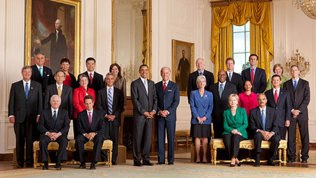
What are all the President’s advisors called?
The Cabinet

Slide 8
Jefferson’s and Hamilton’s differences led to the development of the first political parties.
Republicans supported Thomas Jefferson and his ally, James Madison.
Federalists supported Alexander Hamilton and his ideas.

Slide 9
The Republicans wanted to keep most power at the state or local level.
Federal government
States
They feared that a strong central government would act like a monarchy.

Slide 10
The Federalists said that the United States needed a strong federal government.
Federal government
They believed the federal government would hold the country together and deal with its problems.
States

Slide 11
The two parties also had geographic differences.
Federalists were strong among Northern merchants.
Republicans were supported largely by Southern farmers.

Slide 12
Federalists and Republicans disagreed about many issues.
Republicans | Federalists
Were led by Thomas Jefferson | Were led by Alexander Hamilton
Believed people should have political power | Believed wealthy and educated should lead
Favored strong state government | Favored strong central government
Emphasized agriculture | Emphasized manufacturing, shipping, and trade
Favored strict interpretation of Constitution | Favored loose interpretation of Constitution
Were pro-French | Were pro-British
Opposed national bank | Favored national bank
Opposed protective tariff | Favored protective tariff

Slide 13
In 1796, Washington said he would not seek a third term. There would be an election.
Both political parties nominated a candidate.
Republican Candidate
Thomas Jefferson
Federalist Candidate
John Adams

Slide 14
In 1796, the President and Vice President were not elected together, as they are today.
The candidate with the most votes became President.
The second-place candidate became Vice President.

Slide 15
Adams finished first and Jefferson finished second. The nation gained a Federalist President and a Republican Vice President.
#1
#2
John Adams
Thomas Jefferson
This led to serious tensions during the next four years.

Slide 16
Section Review
QuickTake Quiz
Know It, Show It Quiz
Notes:
16

