Slide 1
CHAPTER 8 SECTIONS 1 & 2 THE HIGH AND LATE MIDDLE AGES (1050-1450)
PRESTENTED BY
Erika Banet
Lauren Ross
Zoe Lavalle
Nicole Liboy

Slide 2
MONARCHS, NOBLES, AND THE CHURCH
Monarchs had limited power in Europe society.
Nobles and the Church had as much power as Monarchs.
Nobles and the Church had their own courts, collected their own taxes, and fielded their own armies.
1000 to 1300s Monarchs used different ways to centralized power, while expanding the royal domain.

Slide 3
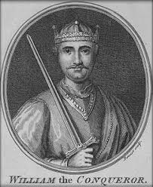
WILLIAM OF NORMANDY CONQUERS ENGLAND
400s to 500s the Germanic tribe Angelo-Saxtons conquered most of Britain, which became known as England.
In 1066 King Edward of England died without an heir, so a council of Nobles chose Edward’s brother-in-law Harold to rule, but unknowingly King Edward promised William, Duke of Normandy the throne. To declare the King they both battled.
William was victorious, and was officially king of England in 1066 on Christmas day.
William completed census that was taken in 1086, which led to the Domesday Book that listed every castle, field etc.
Williams successors created the royal treasury to collect taxes, fees, fines, and other dues.

Slide 4
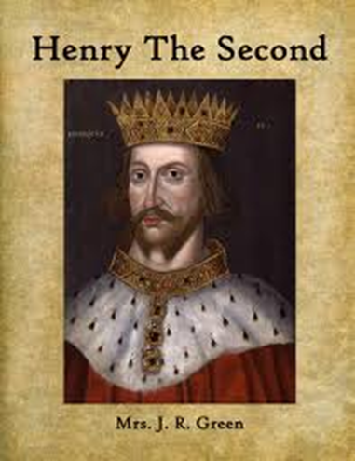
DEVELOPING A UNFIED LEGAL SYSTEM
In 1154, King Henry ii took the throne, he sent out traveling justice to enforce royal laws.
The common law was used throughout England, which was the legal system based on customs and court rulings.
King Henry ii developed early jury system, that we now use in our society today.

Slide 5
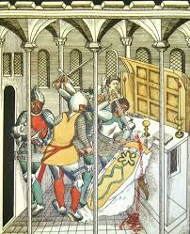
CONFLICT WITH THE CHURCH
In 1170, four knights of King Henry ii murdered Thomas Becket- the archbishop of Canterbury, was killed in his cathedral. He strongly opposed King Henry ii expanding the royal power which led to tension with the church over the issue of legal authority.
After the death of Thomas becket, the archbishop of Canterbury, he was honored as a martyr- a person who is killed because of their religious or other beliefs, and he was declared a saint by the church.

Slide 6
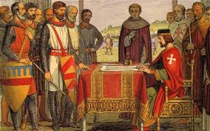
KING JOHN MAKES POWERFUL ENEMIES
King John, son of Henry ii lost the war with Philip ii and had to give up lands in Anjou and Normandy.
John rejected the pope’s nominee for the new archbishop of Canterbury, so the pope excommunicated him in 1209.
Many of his own nobles grew very upset over King Johns abuse of his power and taxes, so in 1215 a group of barons cornered King John and forced him to sign the Magna Carta.
The Magna Carta stated that the nobles had certain rights and as time passed rights were extended to all the English citizens. Also, the Magna Carta made it clear that the Monarchs must obey the laws.

Slide 7
DEVELOPMENT OF PARLIAMENT
During the 1200s a council developed into a parliament that helped join England.
The parliament developed into a two house body, the house of lords with nobles and high clergy, and the house of commons with knights and middle class citizens. This created limited power of monarchs.

Slide 8
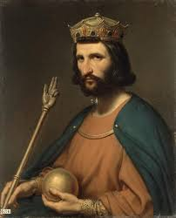
CAPETAIN KINGS
In 987, nobles elected Hugh Capet to take the French throne because they thought he was weak and wouldn’t pose a threat to them.
But unknowingly, he slowly began to increase royal power. He declared that the throne will be hereditary, and the Capetain throne lasted about 300 years.
Hugh Capet built an effective bureaucracy.

Slide 9
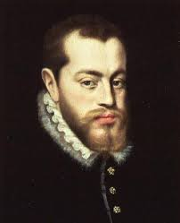
PHILIP AUGUSTUS EXTENDS FRENCH POWER
In 1179, Philip ii became King of France and most powerful ruler in Europe by 1223.
Philip allowed middle class officials who owed him loyalty to fill government positions.
He also gained tons of land through trickery, diplomacy and war.
King Philip ii set knights to help the pope end a heretical group called the Albigensians in the south.

Slide 10
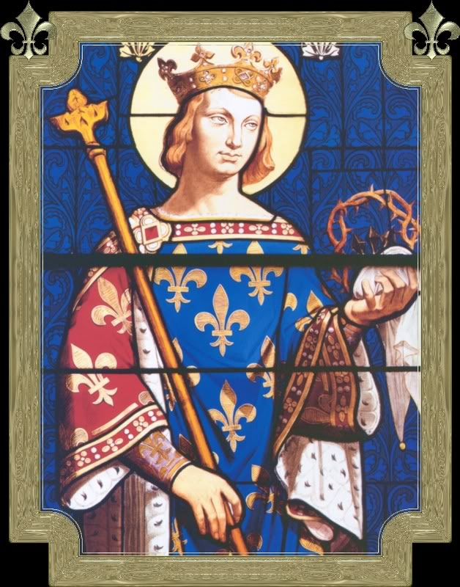
LOUS IX, KING AND SAINT
Louis ix, King of France in 1226, tormented those who held beliefs, contrary to church teachings, he also victimized Jews and led French knights in two crusades.
By his death in 1270, France was emerging as an efficient centralized monarchy.

Slide 11
CLASHING WITH THE POPE
Philip iv, Louis’s grandson tried to raise cash by collecting new taxes from the clergy, but pope Boniface viii did not agree with his tactic, so he forbid him to do so without papal consent.
King Philip iv threatened to arrest the clergy if they did not pay.
King Philip sent troops to seize the pope, but he escaped and died soon afterwards.
In 1305, a Frenchman was announced pope, and he moved the papal court to Avignon- located just outside of France.

Slide 12
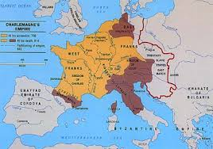
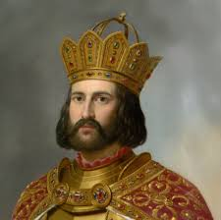
THE HOLY ROMAN EMPIRE
Charlemagne brings most of present day France and Germany as one.
Secular and the church officials clash.
After Charlemagne died, Otto i becomes emperor.
Appointed bishops to elite government jobs.
Real ruler of land were emperors vassals, hundreds of nobles and church officials.

Slide 13
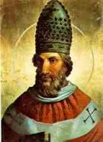
THE FUED BETWEEN POPE AND EMPEROR
Conflict between King Henry iv and pope Gregory vii erupted.
Gregory wanted to make the church independent from secular rulers, so he banned the practice of lay investiture.
Lay investiture was when the emperor or lay person (member of the clergy) presented bishops with the ring and staff that symbolized their office, but only the pope had the right to appoint and install bishops in the office.

Slide 14
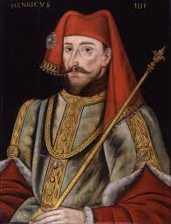
HENRY IV
Henry iv were the bishops overlord, he also felt titled to give them symbols of office.
In 1076, Gregory excommunicated King Henry iv.
He tried to save his throne in January 1077, he presented himself to the pope as a repentant sinner, the pope had no choice to forgive him.
Henry, after being freed from excommunication, leads an army to Rome and forces pope to exile.

Slide 15
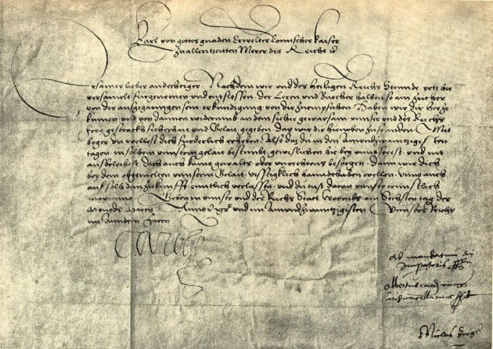
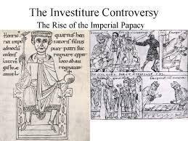
A COMPROMISE: CONCORDAT OF WORMS
The argument of the investiture lasted for about 50 years.
Finally in 1122, Concordat of Worms declared that the church had the power to elect spiritual authority

Slide 16
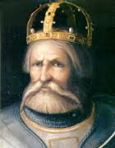
THE STRUGGLE FOR ITALY
German emperors had conflict with popes and wealthy cities of Italy.
Fredrick i fought for wealthy cities in Italy. Germany doesn’t become a nation-state for another 600 years.
Local uprisings against French rule in Sicily led to 200 years of chaos, as the French and Spanish rivals battled for power. The once powerful region was left in ruins.

Slide 17
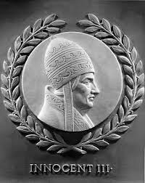
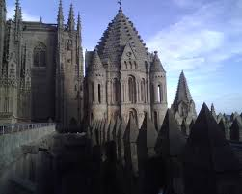
CHURCH POWER REACHES ITS HEIGHT
Gregory's successors expanded papal power.
Pope Innocent iii takes power in 1198.
Pope Innocent iii launches crusades against the Albigensians in southern France, tens of thousands of people were slaughtered in the crusade.
Pope Innocent iii extended the papal states, reformed church courts, and changed election style of church officials.
Even though popes continued to claim supremacy, the papacy entered a decline.

Slide 18
THE END

