Slide 1
Chapter 5 Section 1 If you were a founding father after the revolution, what principles/ideas would you want to put into a new government. (Think of things the British did that the colonists wouldn't want to happen again)

Slide 2
Essential Question: Why did the Article of Confederation Fail?
Learning Target/Objectives: Students will be able to...(1) Compare government today with government under the Articles of Confederation (2) Identify key issues and weaknesses of the Articles of Confederation.

Slide 3
Make a chart in your notes that looks like this….
Provisions:
Weaknesses/Failures | Strengths/Successes

Slide 4
Articles of Confederation – New Government
Weak central government
Once a year, each state would send delegation from Capital to meet (Confederation Congress)
Powers: Declare war, raise armies, sign treaties
Couldn’t: Tax or regulate trade

Slide 5
Major Provisions (Parts) What are some potential problems…
No power to tax:
No power to enforce treaties:
Every state (no matter the size) has one vote:
No power to regulate commerce/trade:
Amending requires unanimous vote

Slide 6
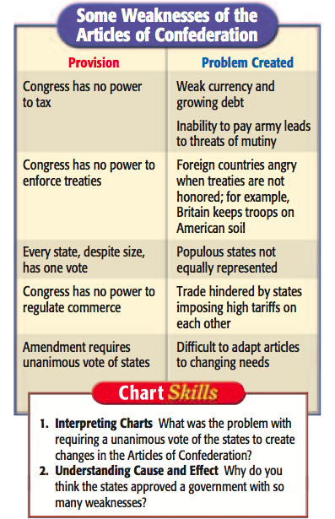
Weaknesses
Which weakness do you think was the biggest?

Slide 7
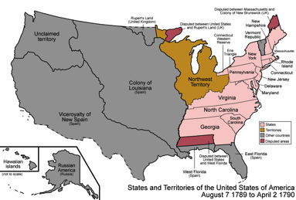
Successes - Northwest Ordinance
What do we do with all this new land?

Slide 9
Northwest Ordinance
Rules about how to settle:
Congress would choose a governor, a secretary, and three judges for that territory
When 5,000 free males settled in the territory, they elected a legislature
When the population reached 60,000 they could apply to become a state “on an equal footing with the original states”
Said that they had rights in the territory (Freedom of Religion, property rights, and trial by jury)
No Slavery was allowed

Slide 10
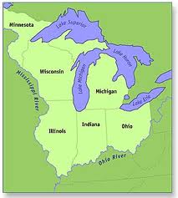
What states were created?
Ohio
Illinois
Wisconsin
Michigan
Indiana

Slide 11
Success in Trade
After War Britain imposed sharp restriction on American trade
American goods going to Caribbean had to be on British Ships
American ships could bring stuff to Britain, but only have stuff on ship from 1 state
Congress negotiated treaties with Holland, Prussia, and Sweden
1790 – Trade greater than pre-revolution

Slide 12
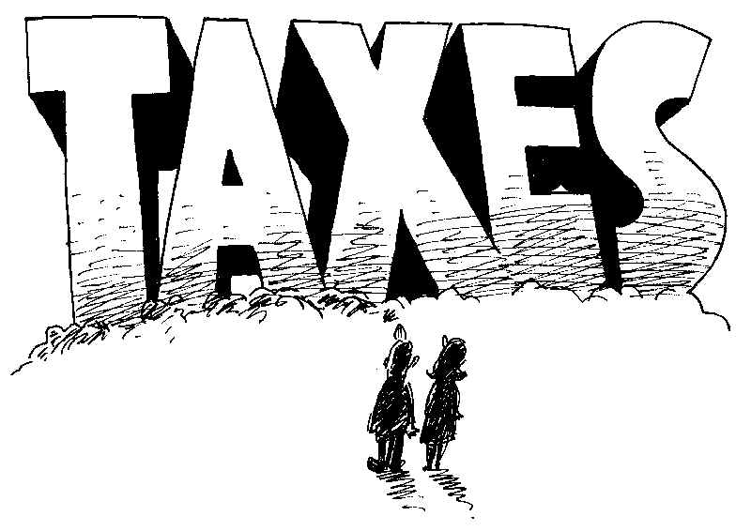
Problems with Trade….
States had different duties on imports.
States began taxing each other for the goods the sold to other states

Slide 13
Problems with Diplomacy
Treaty of Paris
British lenders could get money back
Loyalists could get property back
Congress couldn’t fix any of these (Can’t tax or regulate trade)

Slide 14
Recession – Economic slowdown
Farmers hurt most – have to keep borrowing
States issued bonds to wealthy during the war to pay for it
Farmers wanted paper money to be printed

Slide 15
Shays Rebellion
Massachusetts raised taxes instead of printing $$$
Farmers hurt most – people lost farms
They rebelled

Slide 16
Exit Ticket
What did Shay’s Rebellion show the colonists?

