Slide 1
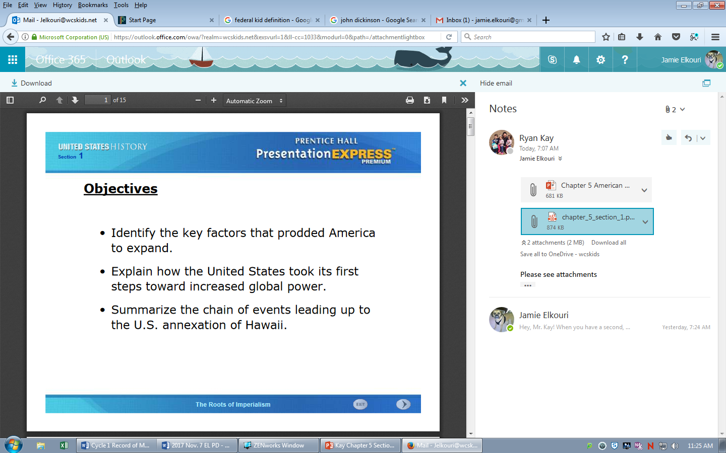
Learning Targets/Objectives:
Identify the reasons behind why the U.S. expanded (got more land).
Explain how the U.S. took its first steps toward more power in the world.
Summarize how the U.S. annexed (took over) Hawaii.

Slide 2
Terms &
People

Slide 3
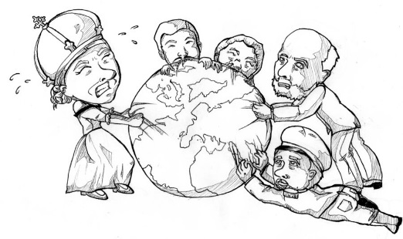
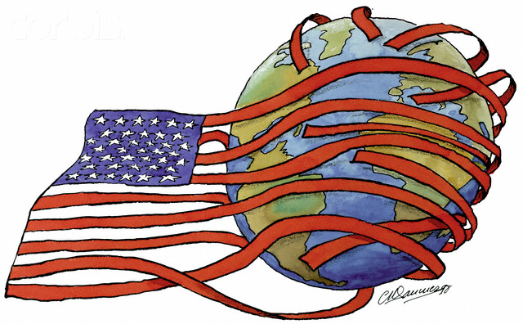
imperialism
when stronger countries grow by taking control of weaker countries

Slide 4
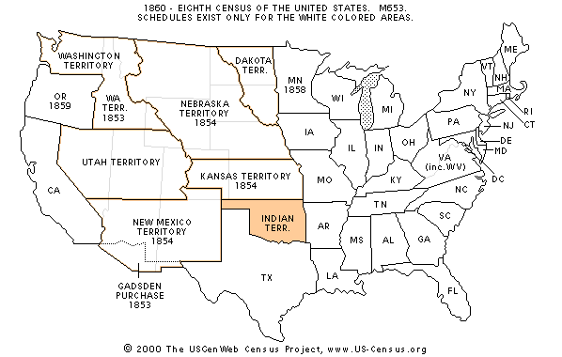
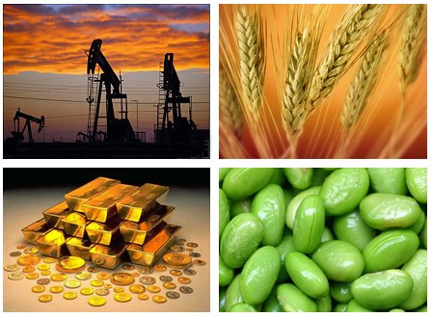
extractiveeconomy
a country has this kind of economy when a more powerful country is in control and takes its raw materials

Slide 5
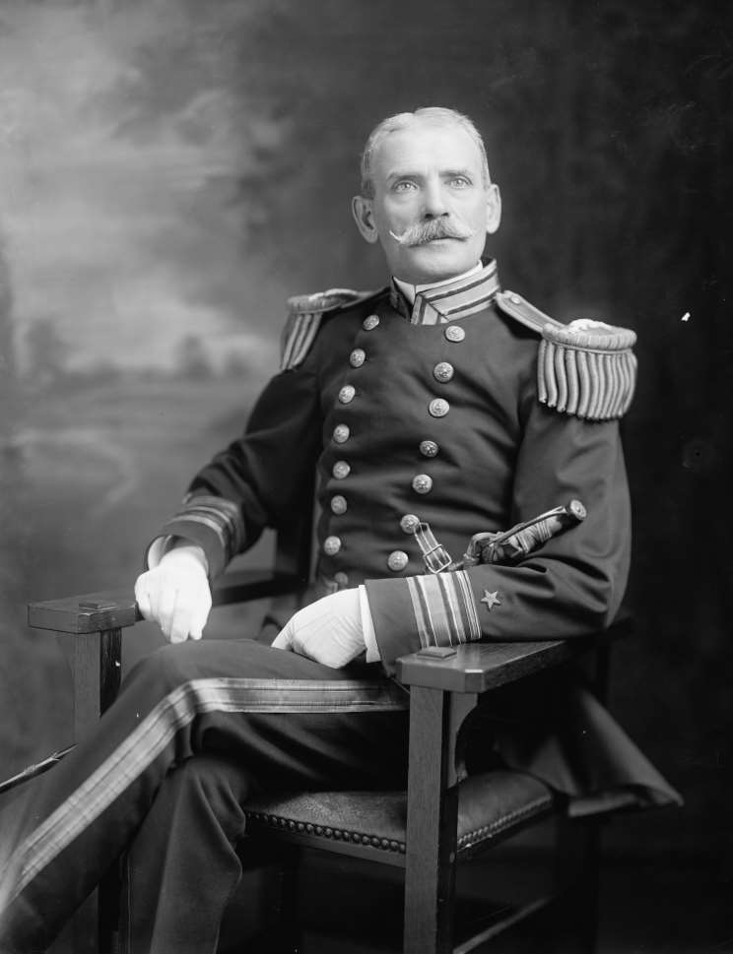
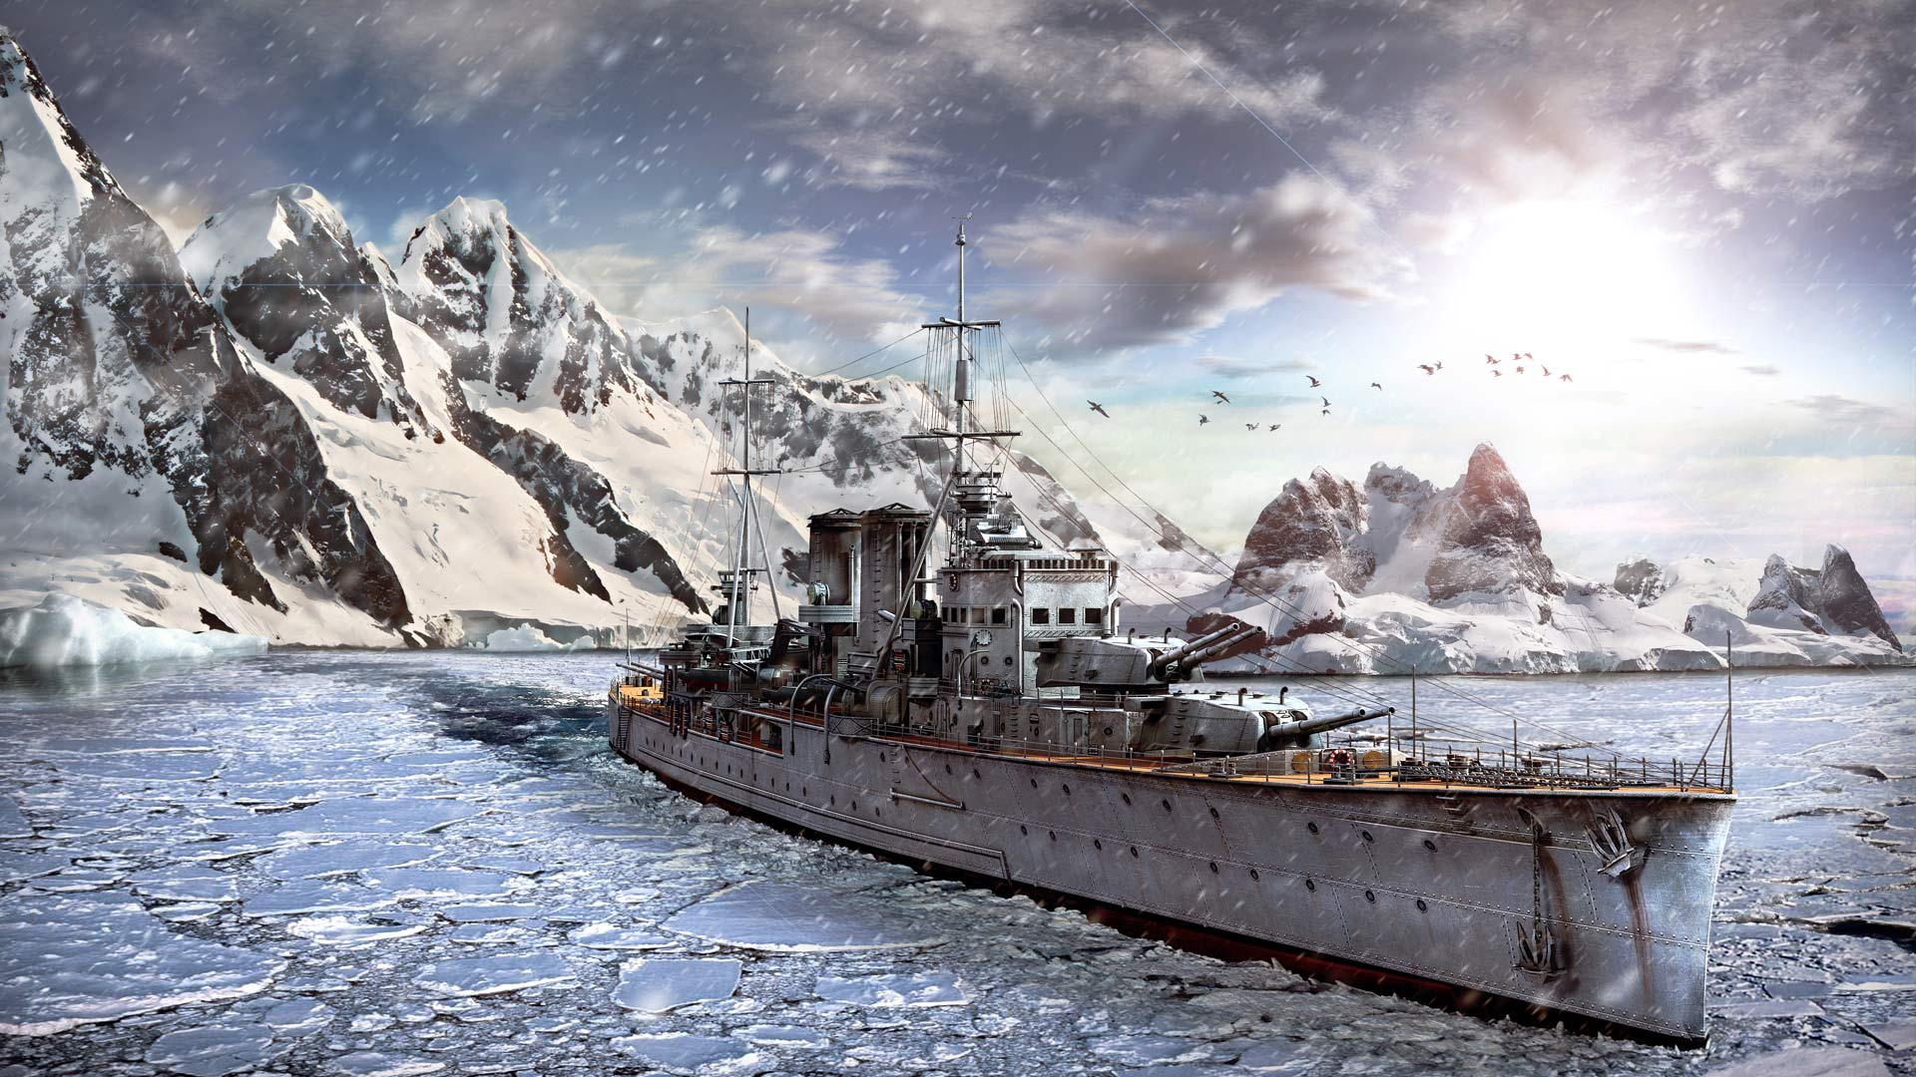
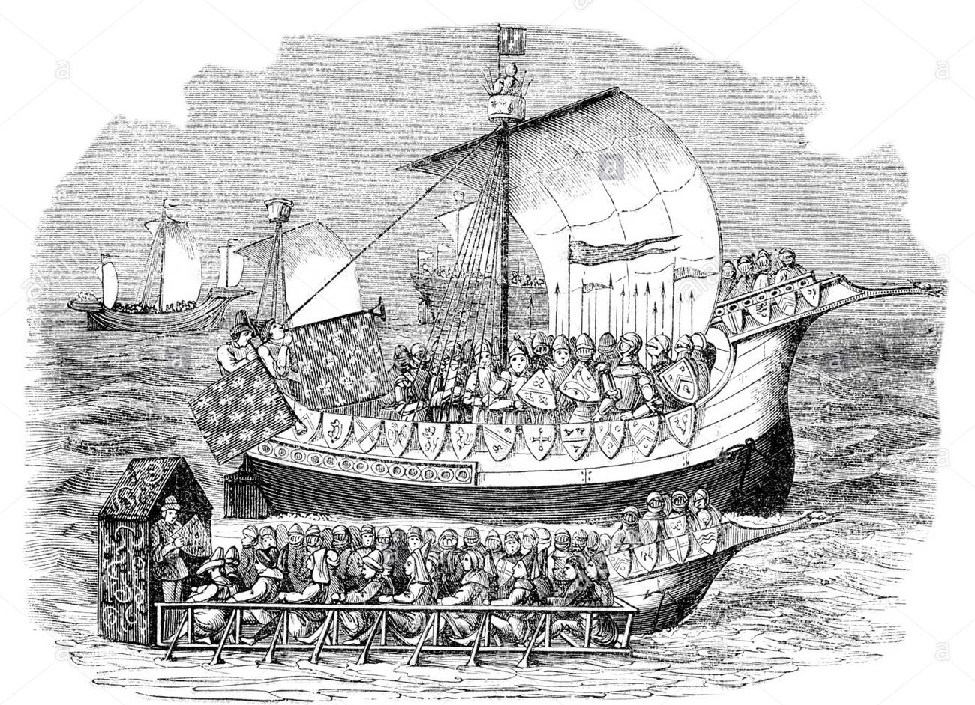
Alfred T. Mahan
believed that a great nation must have a great navy and pushed the U.S. to make its navy stronger

Slide 6
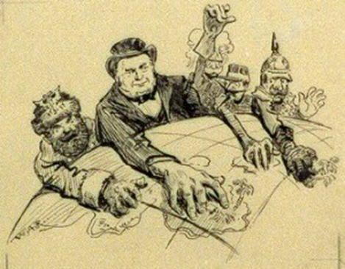

Social Darwinism
the belief that Darwin’s theory of “survival of the fittest” (only the strong will survive) was also true for countries—justifying (giving a reason for) imperialism

Slide 7
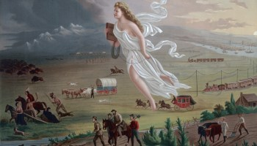
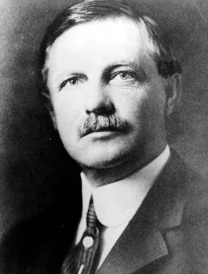
Frederick J. Turner
A historian who believed that every time America got more land (in the West), it became more powerful. Other people used his ideas as reasons why the U.S. should get more land overseas.

Slide 8
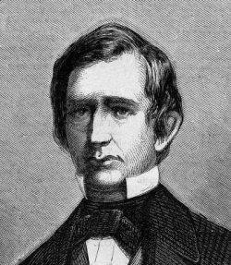
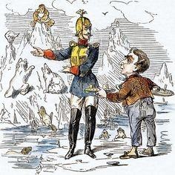
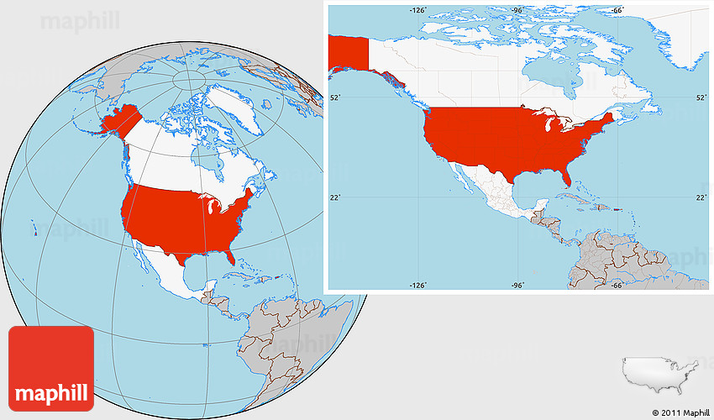
William Seward
Secretary of State in 1867 who bought Alaska from Russia

Slide 9
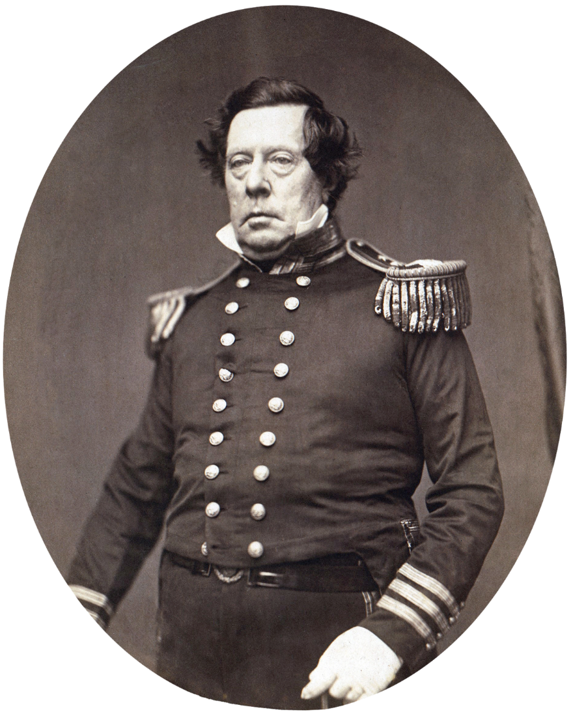
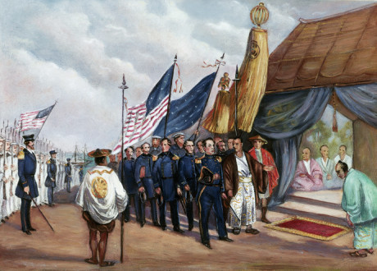
Matthew Perry
a U.S. naval commander who sailed a fleet (group of ships) into Tokyo Bay and opened trade with Japan in 1853

Slide 10

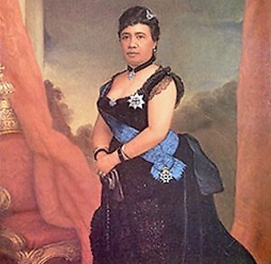
Queen Liliuokalani
Hawaiian monarch (queen) dethroned in 1893 by rebel American planters

Slide 11

How and why did the United States
take a more active role in world affairs?
For most of its early history, the United States played a small role in world affairs. But in the late 1800s, some began calling for the U.S. to join the ranks of the world’s major powers.
Eventually, the United States abandoned isolationism and began to acquire influence and territories outside its continental borders.

Slide 12
Powerful European nations extended their political, economic, and military influence by adding colonies in Africa and Asia.
Meanwhile, the United States and Japan considered the benefits and implemented similar imperialist policies.
The mid-1800s through the early 1900s was an “Age of Imperialism.”

Slide 13
Colonial extractive economies were based on removing raw materials. The imperialist nations built strong armies and navies to protect their interests.
There were strong economic incentives for the U.S. to also adopt a policy of imperialism to obtain raw materials like rubber, iron, and oil.
American entrepreneurs also sought new overseas markets for their manufactured and agricultural products.
Notes:
13

Slide 14
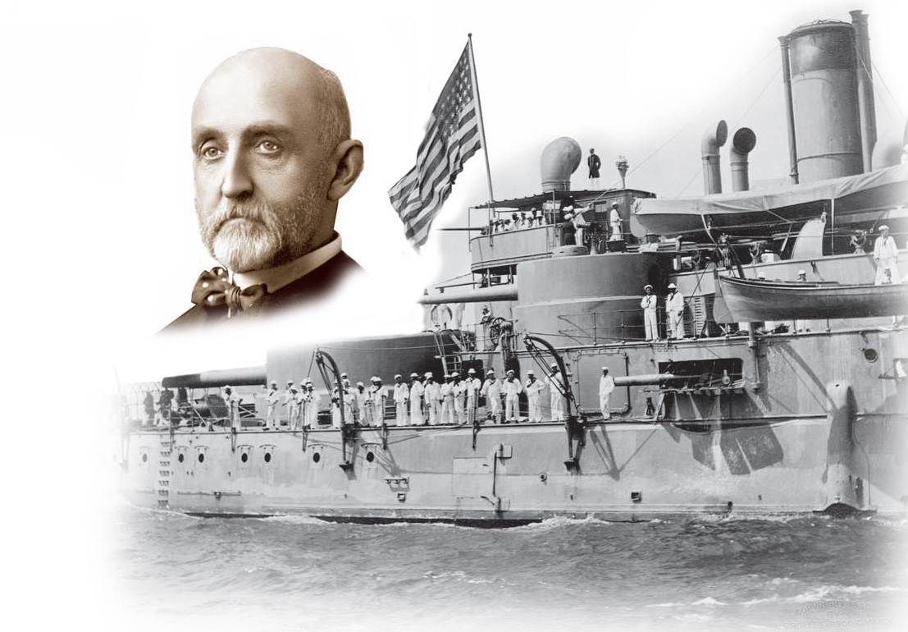
In The Influence of Sea Power Upon History, historian Alfred T. Mahan argued that all great nations owed their greatness to naval power.
He urged construction of a fleet of steel ships, acquisition of overseas bases, and construction of a canal across Central America.
The U.S. eventually followed all of his recommendations.
Notes:
14

Slide 15
Imperialists justified their actions based on beliefs about their own racial, national, and cultural superiority.
Social Darwinism applied Darwin’s theories of natural selection to societies. In a competitive world, only the fittest nations survive.
Americans extended their belief in Manifest Destiny overseas, justifying imperialism as God’s will.
Notes:
15

Slide 16
Historian Frederick J. Turner argued that the frontier served as a “safety valve,” siphoning off potential discontent in the U.S.
Turner’s followers urged overseas expansion as America’s next frontier to avert future discontent in the U.S.
Notes:
16

Slide 17
In 1867, Secretary of State William Seward purchased Alaska from Russia for $7.2 million.
  Critics mocked “Seward’s Icebox” and “Seward’s Folly” as a far off and useless frozen tundra.
  But, valuable resources including gold, timber, and oil were found.
  Alaska also doubled America’s territory.

Slide 18
  In the 1790s Americans planters established sugar cane plantations in Hawaii.
    In 1887, these planters gained control of the government from King Kalakaua.
    In 1891, Queen Liliuokalani, attempted to regain control of her island.
    In 1893, with the help of U.S. Marines, the Queen was dethroned. President McKinley backed annexation when he took office.
In 1898 Congress voted to annex Hawaii.

Slide 19
The United States expanded
overseas after 1850.
Commodore Matthew Perry’s fleet entered Tokyo Bay persuading Japan to trade with the U.S.
1853
1865
1867
1898
1898
Secretary of State William Seward purchased Alaska from Russia.
The U.S. obtained Midway Islands in the Pacific.
Congress approved the annexation of Hawaii.
The Spanish American War gave the U.S. control of the Philippines, Puerto Rico and Guam.

Slide 20
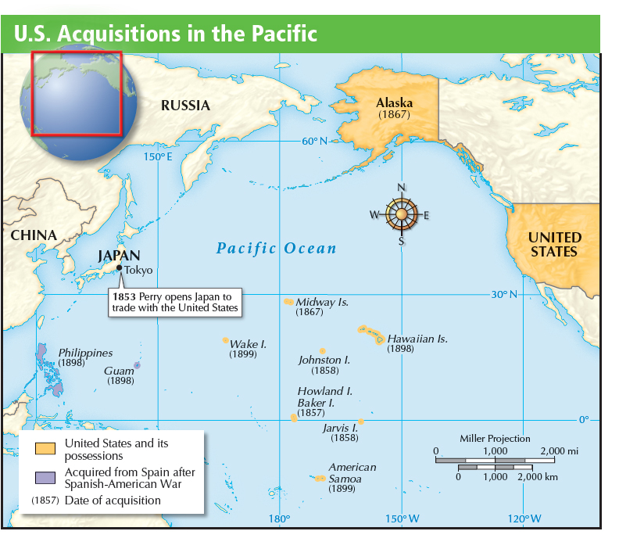

Slide 21



Section Review
QuickTake Quiz
Know It, Show It Quiz
Notes:
21

