Slide 1
Chapter 4 Section 4
Independence

Slide 2
Independence
War in the South
War in the North, wasn’t going as planned for British
Switched to the South where they had more loyalty
As they moved across the south the British planned to free the slaves
Brutal Fighting
Pitted more and more Americans against each other
Crops and property were destroyed and prisoners weren’t taken by the British
Georgia first to fall
Charleston, SC fell easily, the British only had 250 casualties out of 14,000 men

Slide 3
Independence
Failed Attack
Most of the attacks by the Patriots failed due to lack of trained men, and lack of supplies including food.
Guerrilla Warfare
Tactic that the Patriots switched to
Gave them advantage since they couldn’t just line up against the Redcoats
Most famous fighter was Francis Marion

Slide 4
Independence
Battle of Yorktown
Early 1781 morale is down, battle is not going well, Benedict Arnold betrays the Patriots
Nathanael Green takes over in the South and begins to have some success against General Cornwallis
Cornwallis moves his troops to Yorktown, VA
Washington, Lafayette block Cornwallis escape with help from Comete De Rochambeau (French)
French Navy takes control of Chesapeake Bay
Cornwallis was under siege
Oct. 19, 1781- Cornwallis surrenders to Washington
Last major battle of the Revolutionary War.

Slide 5
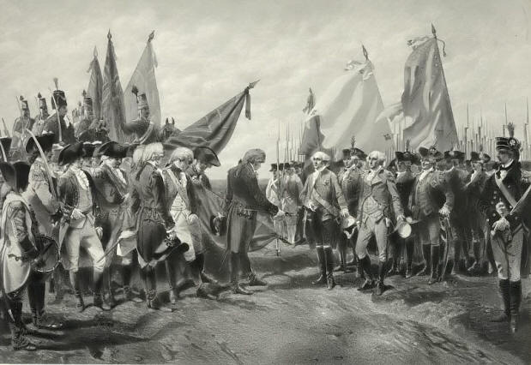
Independence

Slide 6
Independence
Treaty of Paris
Took a couple of years to come to a peace agreement
Treaty of Paris 1783
Recognized U.S. as a separate country
Could settle west of the original 13 colonies

