Slide 1
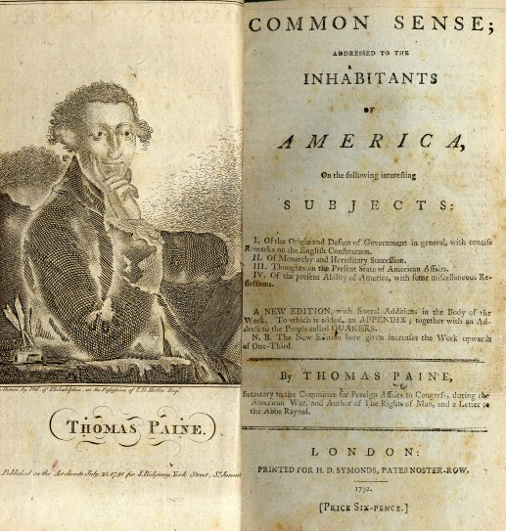
Chapter 4 Section 2: Ideas Help Start a Revolution

Slide 2
1. What does the Continental Congress do to bring about peace?
They sent the Olive Branch Petition to King George III.
The Olive Branch Petition urged a “return to “the former harmony” between Britain and the colonies. – King George flatly rejected the petition

Slide 3
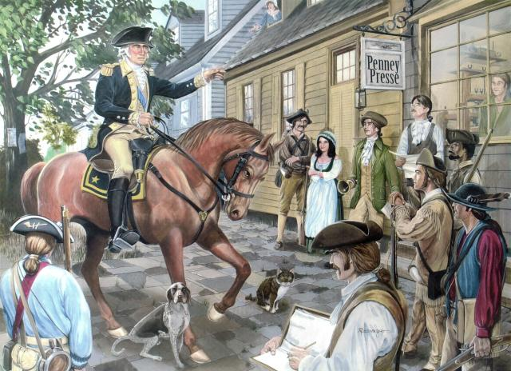
2. What does the Continental Congress do to prepare for war?
Created the Continental Army and appointed George Washington its commander
Authorized the printing of money to pay the soldiers
Organized a committee to deal with foreign nations

Slide 4
3. What are the main points of Common Sense?
King George is a tyrant
The time has come for American independence
Independence will allow Americans to create a better society

Slide 5
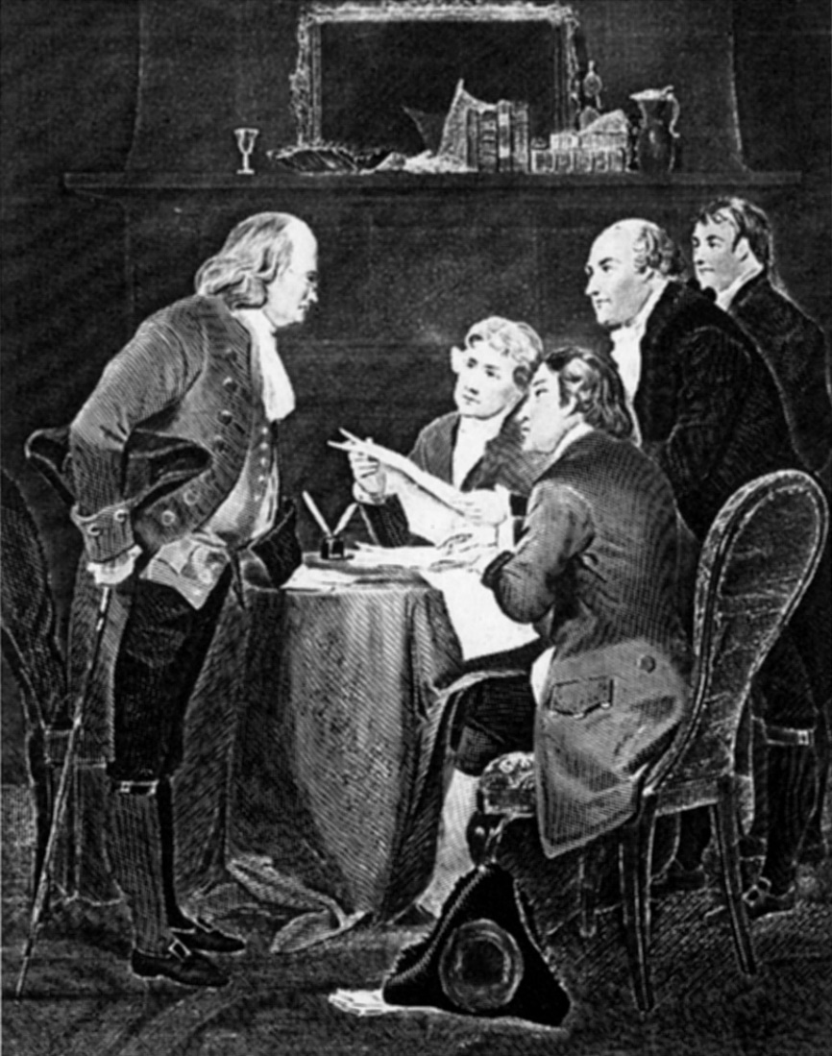
4. What is the purpose of a formal declaration of war?
To explain the reasons for the colonists’ actions

Slide 6
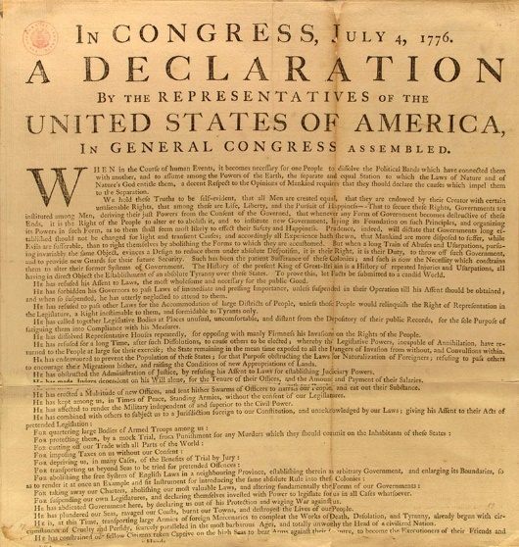
5. What are the main ideas of the Declaration of Independence?
People have the inalienable rights to “life, liberty, and the pursuit of happiness”
Governments derive their powers from a social contract with their people
The people have the right to “alter” or “abolish” any government that threatens their natural, inalienable rights
All men are created equal

Slide 7
Thomas Jefferson
Main Author of the Declaration of Independence
A member of the 2nd Continental Congress from Virginia

Slide 8
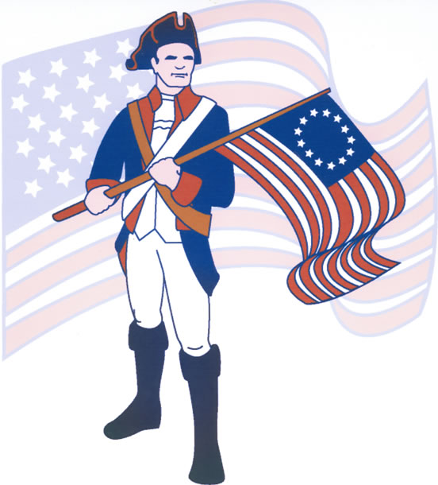
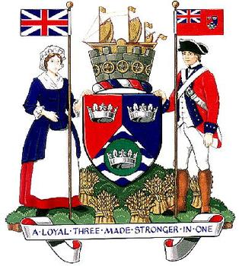
Patriot: Colonist who wanted independence from Britain
Loyalist: Colonist who was loyal to Britain and wanted to remain a British citizen

