Slide 1
The Revolution Begins
The Big Idea
The tensions between the colonies and Great Britain led to armed conflict in 1775.
Main Ideas
The First Continental Congress demanded certain rights from Great Britain.
Armed conflict between British soldiers and colonists broke out with the “shot heard ’round the world.”
The Second Continental Congress created the Continental Army to fight the British.
In two early battles, the army lost control of Boston but then regained it.

Slide 2
Main Idea 1: The First Continental Congress demanded certain rights from Great Britain.
First Continental Congress: a meeting in Philadelphia of delegates from all colonies except Georgia.
Delegates halted trade with Britain and alerted the colonial militia to prepare for war.
Drafted Declaration of Rights that included the right to “life, liberty, and property.”
Colonists who chose to fight for independence from Britain became known as Patriots.

Slide 3
Main Idea 2: Armed conflict between British soldiers and colonists broke out with the “shot heard ’round the world.”
The Ride of Paul Revere
Massachusetts governor, Thomas Gage, sent British troops to seize weapons at Concord.
Paul Revere and two others rode to warn colonists.
Local militia, minutemen, readied for battle.
Battles at Lexington and Concord
April 19, 1775– British troops arrived in Lexington and colonists fire the “shot heard ‘round the world.”
British Redcoats continue on to Concord but are forced to retreat back to Boston. Their red uniforms made an easy target for Patriot marksmen.

Slide 4
Main Idea 3: The Second Continental Congress created the Continental Army to fight the British.
Second Continental Congress
Delegates from 12 colonies met in Philadelphia in May 1775.
Some called for peace, others for war.
Compromised—created army but also sent Olive Branch Petition to King George
Continental Army
Congress created the Continental Army.
Named a Virginian, George Washington, to command army and prepare for the war

Slide 5
Main Idea 4: In two early battles, the army lost control of Boston but then regained it.
Battle of Bunker Hill
Patriots attacked British at Fort Ticonderoga on May 10, 1775, to seize large supply of weapons.
Colonial forces fortified Breed’s Hill to prevent British escape from Boston.
Army of 2,400 Redcoats fought 1,600 Americans at the Battle of Bunker Hill.
Americans forced to retreat, but only after causing more than 1,000 British casualties.
Dorchester Heights
General Washington arrived in Boston and took command.
Cannons were brought in from Fort Ticonderoga.
On March 4, 1776, Washington moved his army to Dorchester Heights and placed the cannons on Nook’s Hill.
American troops fired down upon the British.
The British were forced to retreat from Boston.

Slide 6
Declaring Independence
The Big Idea
The colonies formally declared their independence from Great Britain.
Main Ideas
Thomas Paine’s Common Sense led many colonists to support independence.
Colonists had to choose sides when independence was declared.
The Declaration of Independence did not address the rights of all colonists.

Slide 7
Main Idea 1: Thomas Paine’s Common Sense led many colonists to support independence.
Common Sense: 47-page pamphlet written by Thomas Paine, published in January 1776.
Urged separation from Great Britain.
Argued that citizens, not monarchs, should make laws.
Argued for economic freedom and the right to military self-defense.
Cried out against tyranny, the abuse of government power.
Reached a wide audience, selling some 500,000 copies.

Slide 8
Main Idea 2: Colonists had to choose sides when independence was declared.
Many colonial leaders agreed with Thomas Paine’s ideas.
Second Continental Congress created a committee in June 1776 to write a document declaring independence.
Thomas Jefferson was main author.
Declaration of Independence formally announced break with Great Britain.
Approved on July 7, 1776.

Slide 9
Choosing Sides
Patriots
Patriots chose to fight for independence.
About 40 to 45 percent of Americans were Patriots
Loyalists
Loyalists, sometimes called Tories, remained loyal to Britain.
About 20 to 30 percent of Americans were Loyalists.
Neutral
About 25 percent of Americans remained neutral.

Slide 10
Main Idea 3: The Declaration of Independence did not address the rights of all colonists.
Declaration ignored many colonists.
Did not address the rights of women.
Did not recognize the rights of enslaved African Americans.
Did not address the rights of Native Americans to life, liberty, or property.

Slide 11
The Struggle for Liberty
The Big Idea
Patriot forces faced many obstacles
in the war against Britain.
Main Ideas
Many Americans supported the war effort.
The Patriots both won and lost battles during the years 1775-1777.
France and Spain helped the Patriots fight the British.
The winter at Valley Forge tested the strength of Patriot troops.
The war continued at sea and in the West.

Slide 12
Main Idea 1: Many Americans supported the war effort.
More than 230,000 soldiers served in the Continental Army.
145,000 enlisted in local militias.
Soldiers
First banned from serving, but when the British promised freedom to any slave who fought on their side, the Continental began to allow free African Americans to serve.
African-Americans
Ran farms and businesses
Helped by raising money for supplies or by making clothing
Served as messengers, nurses, and spies
Some dressed as men and fought.
Women

Slide 13
Main Idea 2: The Patriots both won and lost battles during the years 1775-1777.
Canada
November 1775
Some patriots thought British-controlled Canada should be the “14th colony”
American forces attacked Quebec.
Attack failed, and hopes of taking Canada faded.
New York
June 1776
Washington’s 23,000 militiamen opposed by 32,000 better-equipped British soldiers.
Series of battles
Washington’s forces pushed into New Jersey.
New Jersey
Battle of Trenton won by Americans on December 26, 1776.
Washington crossed the Delaware on Christmas night.
Attacked the mercenaries as they slept.
Defeated the British at the Battle of Princeton January 2, 1777.

Slide 14
Battle of Saratoga
British upset by two quick defeats in New Jersey.
British General John Burgoyne planned to seize Hudson River Valley to cut off New England.
British army crushed by Patriot forces under General Horatio Gates on October 17, 1777.
Battle of Saratoga in New York was the turning point of the Revolutionary War.

Slide 15
Main Idea 3: France and Spain helped the Patriots fight the British.
French and Spanish had lost large expanses of land in North America to the British.
Both countries happy to see trouble for Britain in the American colonies.
After the Battle of Saratoga, France, Spain and Holland joined the fight on the side of the Patriots.

Slide 16
Help from Europe
Independent Soldiers
Marquis de Lafayette, supplied money and military skills.
Baron Freidrich von Steuben came from Prussia to help train the Continental Army.
France
Officially joined forces in May 1778
Signed treaty of support
Increased level of supplies and agreed to provide soldiers and ships.
Spain
Joined war in 1779
Bernardo de Gálvez, governor of Spanish Louisiana, seized British posts.

Slide 17
Main Idea 4: The winter at Valley Forge tested the strength of Patriot troops.
Continental Army was low on supplies.
Washington and 12,000 men wintered at Valley Forge, Pennsylvania, during 1777–78.
Suffered through the brutal winter and shortages of food, clothing, and shelter.
Continental Army survived, but 2,000 died of disease and malnutrition.

Slide 18
Main Idea 5: The war continued at sea and in the West.
Tiny Continental Navy could not fight large battles.
Sunk hundreds of individual British ships.
John Paul Jones was commander of victorious Bonhomme Richard. This former British outlaw became an American naval hero.
War at Sea
George Rogers Clark captured British trading village of Kaskaskia, Illinois, in 1778.
Clark’s forces won Battle of Vincennes in 1779.
War in the
West

Slide 19
Independence!
The Big Idea
The war spread to the southern colonies,
where the British were finally defeated.
Main Ideas
Patriot forces faced many problems in the war in the South.
The American Patriots finally defeated the British at the Battle of Yorktown.
The British and the Americans officially ended the war by signing the Treaty of Paris of 1783.

Slide 20
Main Idea 1: Patriot forces faced many problems in the war in the South.
War was not going well for British in North, so they set their sights on South.
Hoped to find support from a large Loyalist population in Georgia, the Carolinas, and Virginia
Planned to free slaves and give them arms

Slide 21
Brutal Fighting
Patriots fought the Loyalists in direct combat in South.
Georgia fell to British in 1778; Charleston, South Carolina, in 1780.
Americans attacked British in August 1780, but failed to drive them out of South Carolina and suffered many casualties.
Francis Marion was more successful using guerrilla warfare against British.
Surprise attacks to disrupt communication and supply lines.

Slide 22
Main Idea 2: The American Patriots finally defeated the British at the Battle of Yorktown.
General Charles Cornwallis moved British forces to Yorktown, Virginia, in 1781.
Washington’s Continental Army and French troops under Comte de Rochambeau surrounded the British.
Cornwallis surrendered on October 19, 1781, after weeks of fighting. Patriots took 8,000 prisoners–the largest British army in America.
The Battle of Yorktown was the last major battle of the American Revolution.

Slide 23
Main Idea 3: The British and the Americans officially ended the war by signing the Treaty of Paris of 1783.
After Yorktown, there were only a few small battles. The British lacked money to pay for a new army, so they entered into peace talks with the Patriots.
Treaty of Paris of 1783
It took two years to come to a peace agreement.
Britain recognized American independence.
Set America’s borders
British accepted America’s right to settle west of the original 13 colonies.
After Yorktown, there were only a few small battles. The British lacked money to pay for a new army, so they entered into peace talks with the Patriots.

Slide 24
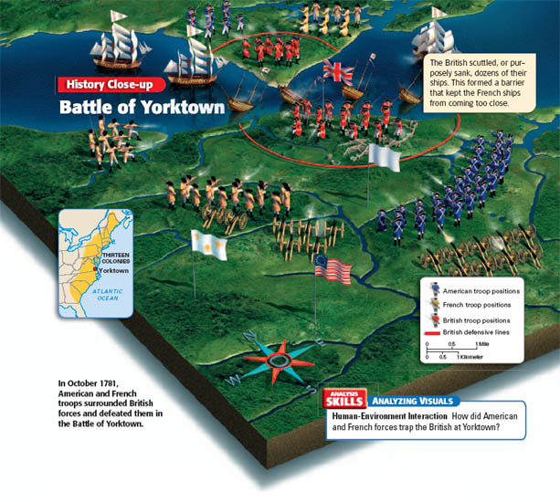

Slide 25
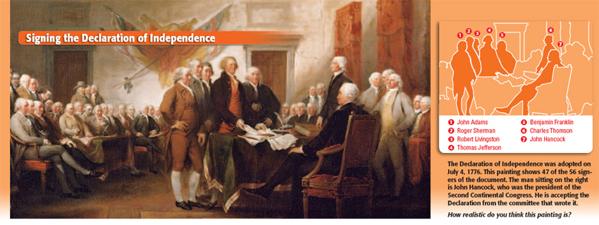

Slide 26
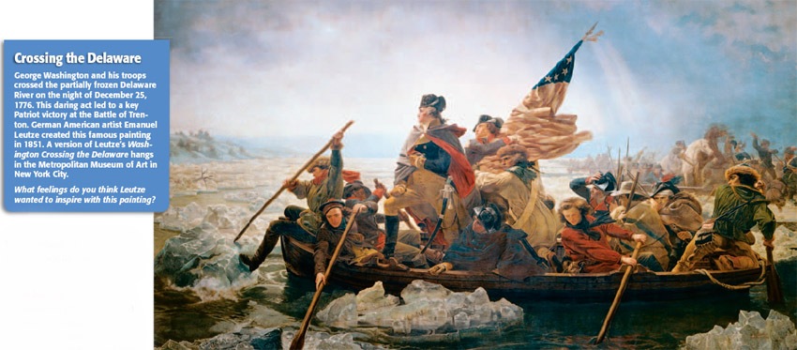

Slide 28
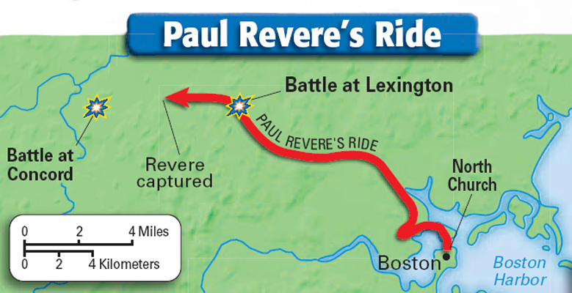

Slide 29
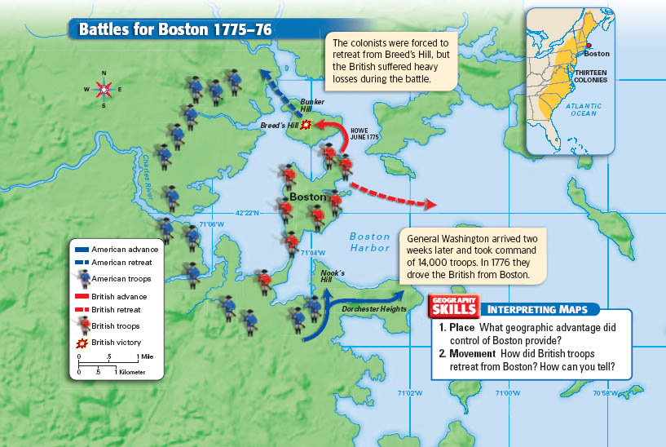

Slide 30
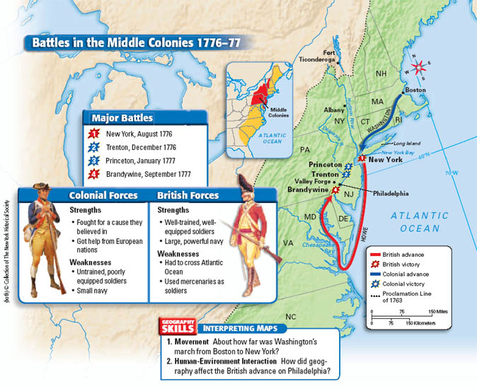

Slide 31
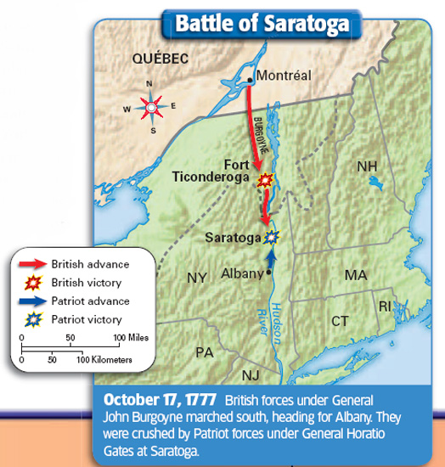

Slide 32
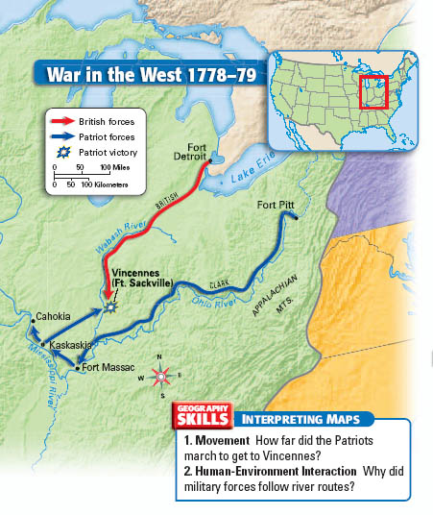

Slide 33
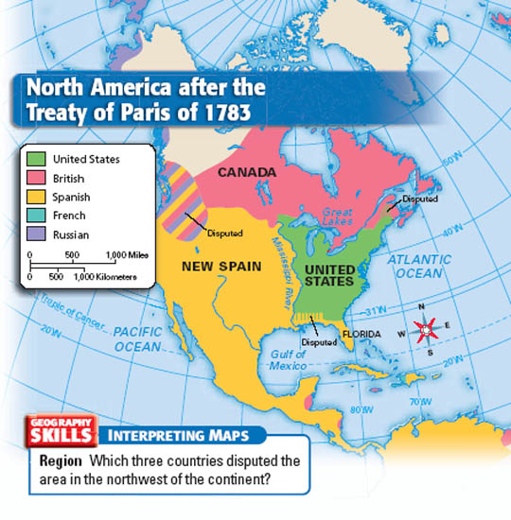

Slide 34
Click window above to start playing.

