Slide 1
Chapter 2 Section 3: Spain Builds an Empire
The Big Picture: Following Columbus’ voyages, European nations competed to establish colonies in the Americas. Their efforts, however, had disastrous consequences for the Native Americans.

Slide 2
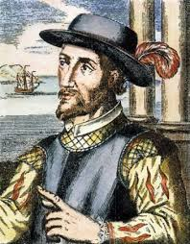
Spanish Conquistadors
1494: Catholic Spain and Portugal appeal to the Pope to resolve competing claims to the New World
the Treaty of Tordesillas: drew a line on the map and gave all land to the west of the line to Spain and all land east to Portugal
Ponce de Leon & Florida
Spanish explorers called conquistadors began exploring the Caribbean, South, and Central America after Columbus
Their goals were “God, gold, glory”
Ponce de Leon, had sailed with Columbus, was governor of Puerto Rico, and searched for the fabled fountain of youth
He became the first Spanish explorer in mainland North America when he claimed Florida for Spain

Slide 3
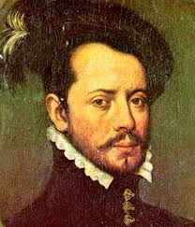
Cortez and the Aztec
Cortez claimed and explored Mexico in an attempt to find gold
When attempting to conquer the Aztec, he was aided by the enemies of the Aztec and an ancient legend that made them believe the Spanish were messengers from the Gods
The Aztec fell to the Spanish in 1521

Slide 4
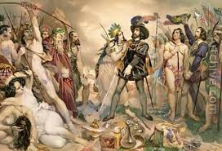
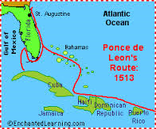
Golden Cities and other Explorers
The successful domination of the Aztec and persistent rumors of cities of gold encouraged other explorers to push into modern-day Mexico, Texas, and Florida
Explorers like de Soto, Cabrillo and de Coronado explored as far north as Tennessee and as far west as California, but did not find the gold they wanted
Eventually the Spanish focused on mining in Mexico
In 1565 the Spanish establish a colony at St. Augustine, Florida
It is the oldest city in the U.S. today

Slide 5
Spain Builds an Empire
Spanish crown appointed viceroyalty to run new colonies that were being established
Also key to the structure were missionaries who served to convert natives to Catholicism and to teach the faithful

