Slide 1
Chapter 15
The Nation Breaking Apart
1846-1861

Slide 2
Economic and Social Differences
South – Controlled by a small number of wealthy planters. The Economy is based on agriculture. Cotton exports drive the economy.
Most southerners did not own slaves and were poor. There was very little industry in the south.

Slide 3
Economic and Social Differences
North – Cities with manufacturing industries drive the northern economy.
The east and north had vast amounts of roads, canals,& railroads. Not so in the south.
Immigration from Europe led to growth in cities and overall population

Slide 4
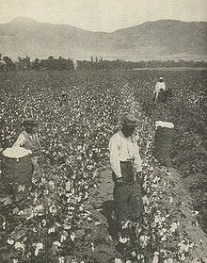
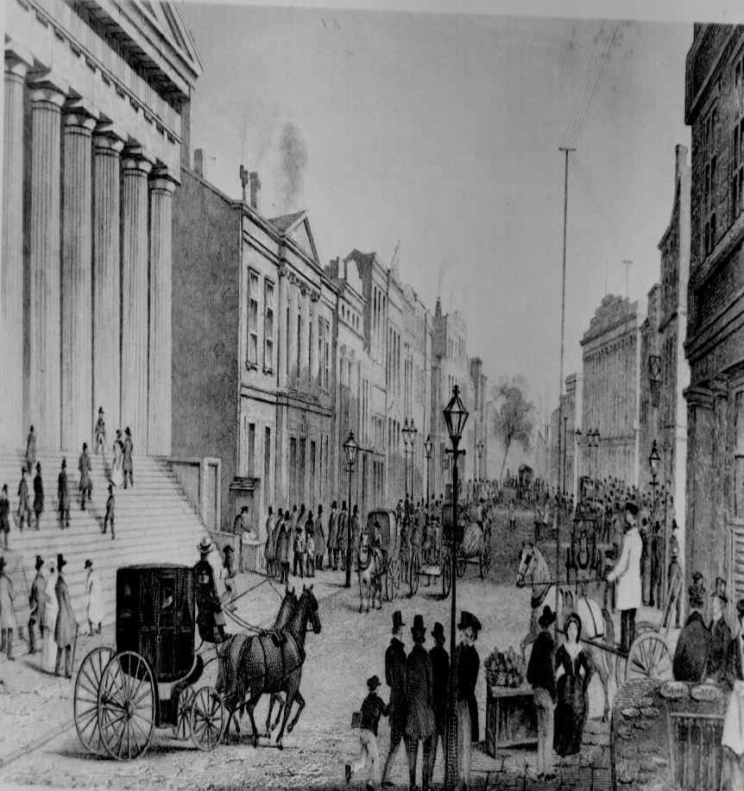
Economy of the South and North
Agricultural South
Industrial North

Slide 5
The Compromise of 1850
Conflict over whether the lands of the Mexican Cession would be slave or free led to the need for another compromise.
The key points of Henry Clay’s plan:
1. To keep the north happy California would be admitted as a free state, and the slave trade would end in Washington D.C.
2. The keep the south happy congress would allow the rest of the won territory to decide for themselves whether to be slave or free. A fugitive slave law would be passed requiring the return of all escaped slaves.

Slide 6
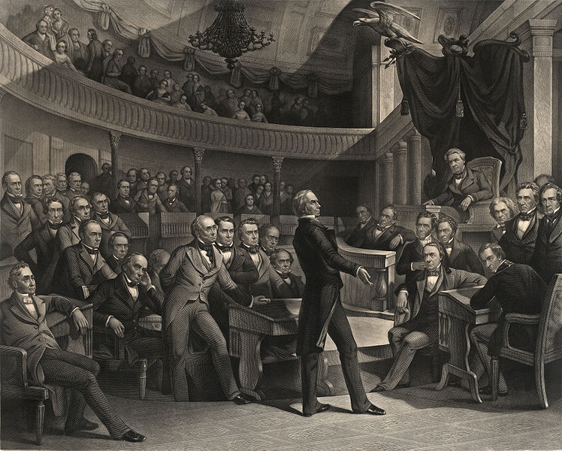
Henry Clay

Slide 7
Fugitive Slave Act of 1850
An 1850 law that help recapture escaped slaves.
Northerners were required by law to aid in the recapture, which was something many opposed on moral grounds.

Slide 8
“Uncle Tom’s Cabin”
A novel by Harriet Beecher Stowe
The book is the fictional tale of Tom and his life under three owners.
It was very popular in the north (abolitionists) and considered false and negative in the south.

Slide 9
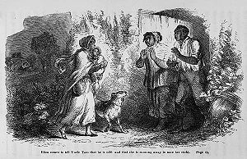
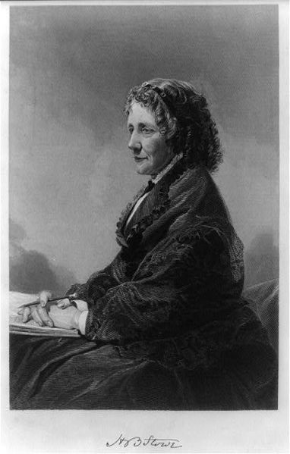
Uncle Tom’s Cabin Illustrates the evils of slavery
Harriet Beecher Stowe

Slide 10
Kansas – Nebraska Act
Divided the Nebraska Territory into two territories Nebraska and Kansas
Allowed the people of the territories to decide whether to be slave or free (popular sovereignty).
This would repeal the Missouri Compromise.
The act was approved.
Pro-free and Pro-slave groups entered the area to influence the decision. The area was called “BLEEDING KANSAS” because of the violence.
Fighting even occurred in the U.S. senate.

Slide 11
The Republican Party 1854
Because of the Kansas and Nebraska act the WHIG PARTY split into two.
Northern WHIGS who opposed slavery, formed the REPUBLICAN Party.
Because of the problems in Kansas many people in the north supported the new party.
The 1856 election showed that the Republicans had power although they did not win, they were growing in support. The election also showed a split in the nation over slavery.

Slide 12
Dred Scott Case
Scott sued for his freedom because he had lived in area where slavery was illegal.
Then he returned to a slave area/state (Missouri)
After his owners death, he sued saying because he had lived in a free area he should be free.
The Supreme Court decided the following:
1. Scott was not a citizen and could not sue in U.S. courts
2. When he was in free areas he was still the property of his owner
3. The Chief Justice Roger B. Taney argued that the Congress could not ban slavery in a territory. Because it violated the property rights of slave holders.

Slide 13
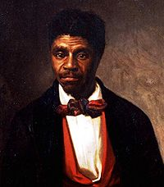
Dred Scott

Slide 14
Lincoln and Douglas Debated
A series of debates between Abraham Lincoln and Stephen Douglas
The debates are models for political debate
“ A house divided against itself cannot stand.” -Abraham Lincoln

Slide 15
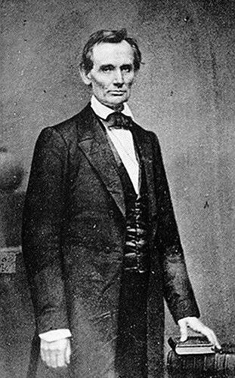
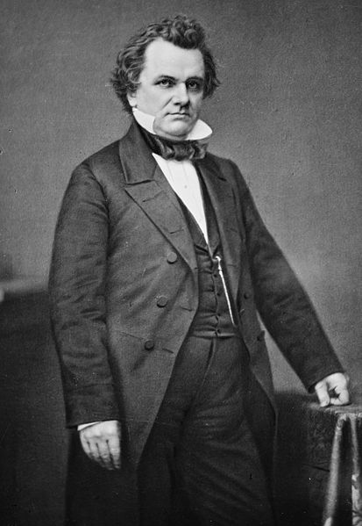
Lincoln and Douglas Debated

Slide 16
John Brown’s Raid
John Brown leads a raid on Harper’s Ferry
He goes to Virginia to capture Army weapons to arm slaves.
He is stopped, captured and later hung. He was a hero for those opposed to slavery and a villain to southerners who supported slavery.

Slide 17
The election of 1860
Lincoln runs as the Republican candidate
Douglas runs as the Northern Democrat candidate
Breckenridge runs as the Southern Democrat candidate
Bell ran as a third party candidate
Lincoln was not on the ballot in the south, and if he won southern states they would likely secede.
Lincoln won & Secession Began

Slide 18
The Confederate States of America
In 1860 states began to leave the union
1860 December South Carolina left
1861 Mississippi, Florida, Alabama, Georgia, Louisiana, and Texas all left
Formed the Confederate States of America
With Jefferson Davis as President
Efforts to compromise failed

Slide 19
Compare North and South
Northern population 22 million
(South had 9 million 3.5mil. were slaves)
North had 71% of all railroads
(South had 29% of all railroads)
North had 85% of manufacturing plants
(South had 15% of manufacturing plants)
North had 92% of industrial workers
(South had 8% of industrial workers)

