Slide 1
CANADA POWERPOINT DIRECTIONS
THE 6TH GRADE SOCIAL STUDIES

Slide 2
What do you know about Canada?
Location
Landforms and Bodies of Water
Climate
Natural Resources
Languages Spoken
Ethnic Groups
Clothes they wear

Slide 3
Canada
Geography
Learning Target and Objectives: The student will locate select features of Canada: Atlantic Ocean, Pacific Ocean, Hudson Bay, St. Lawrence River, the Great Lakes, the Canadian Shield, and the Rocky Mountains

Slide 4
Canada is located in the Northern and Western Hemispheres of the globe

Slide 5
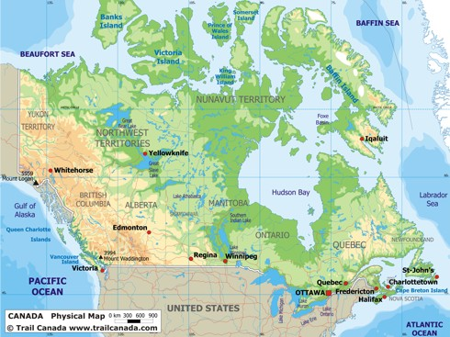
Canada is surrounded on three sides by 3 of the Earth’s major oceans:
Canada is bordered in the South by the United States: They share a 3,000 mile long border. It is the longest unguarded border in the world
NORTH: Arctic Ocean
CANADA
EAST: Atlantic Ocean
WEST: Pacific Ocean
UNITED STATES

Slide 6
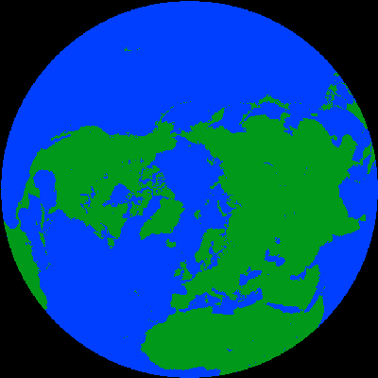
Having coastlines along each of these 3 major oceans, along with a southern border with the United States, makes trade / travel with the rest of the world easy for Canadians
Pacific
Canada
Asia
Arctic
Russia
Europe
Atlantic

Slide 7
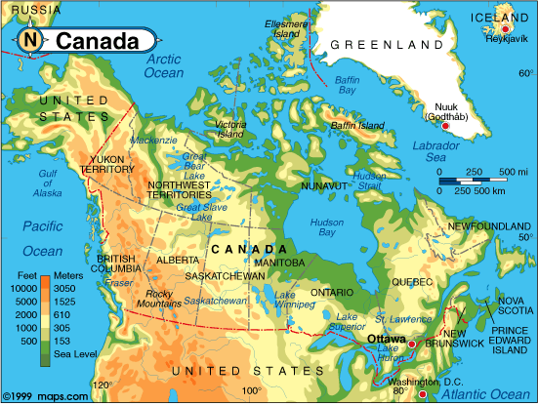
Canada’s Waterways
Hudson Bay
The Great Lakes:
St. Lawrence River
HOMES
Superior
Huron
Ontario
Michigan
Erie

Slide 8
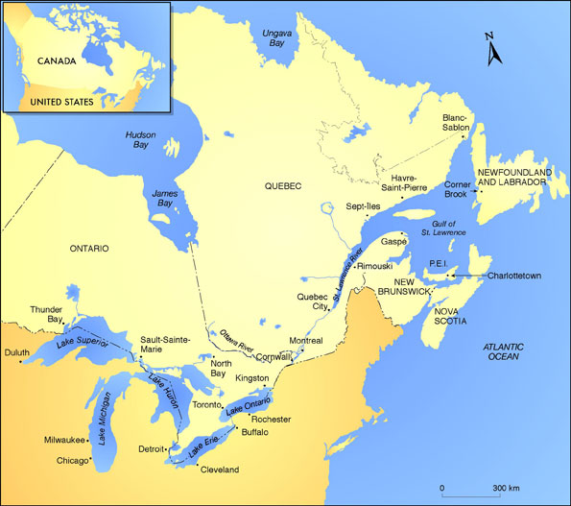
St. Lawrence River
The St. Lawrence River is located in Eastern Canada; stretching from Lake Ontario to the Atlantic Ocean. Why would this water be important?

Slide 9
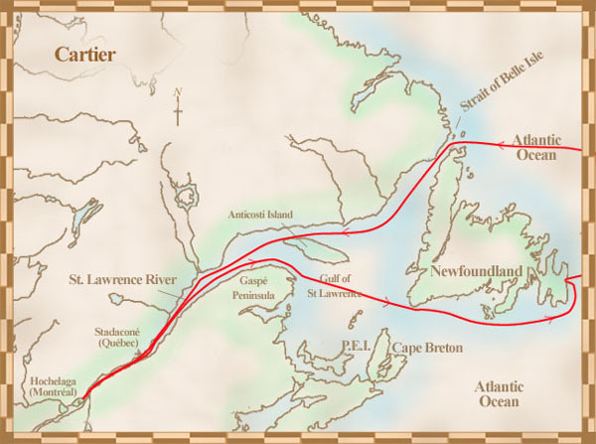
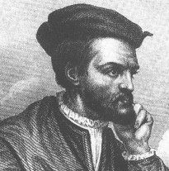
The St. Lawrence River played an important role in Canada’s history: Allowed European explorers to easily travel farther into North America
The French explorer Jacques Cartier explored much of the St. Lawrence river system. In 1541 he led an expedition back to Canada, along with a few hundred colonists, to create New France.

Slide 10
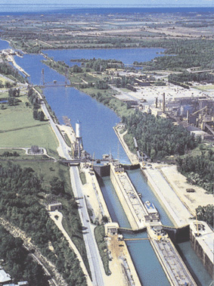
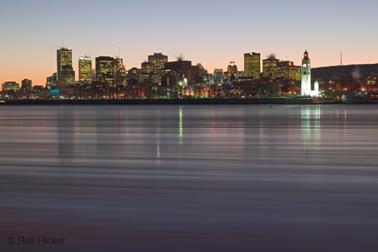
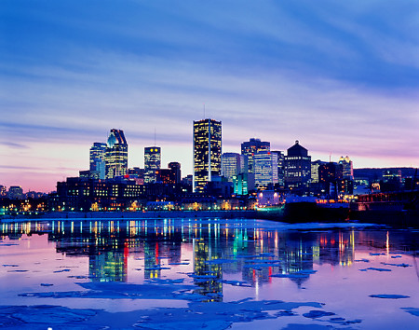
Today, the St. Lawrence still plays an important role in Canada: Source of fresh water, fish, & is still a valuable trade/travel route

Slide 11
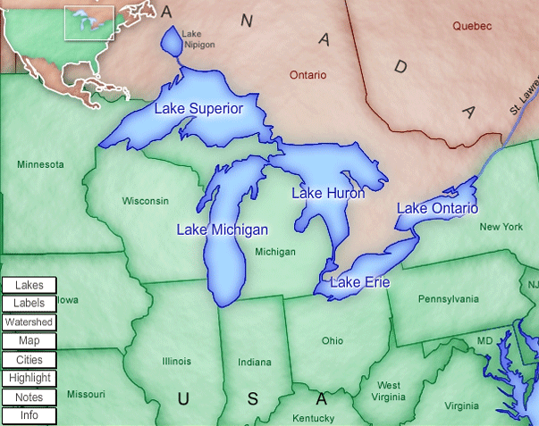
The Great Lakes
The Great Lakes are located in southern Canada, four of which form part of the border between Canada and the U.S.
Only Lake Michigan is unshared, lying in and completely controlled by the U.S.

Slide 12
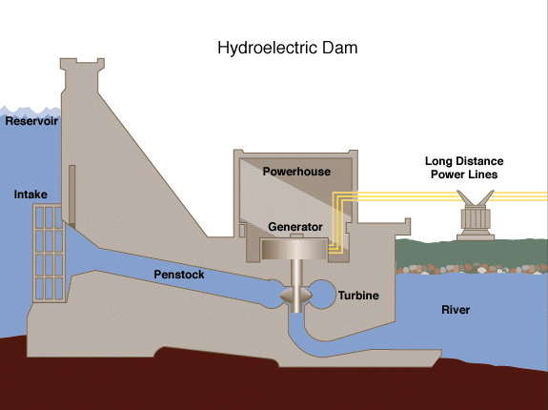
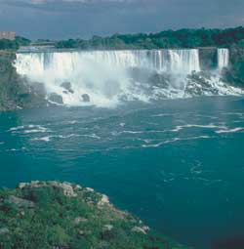
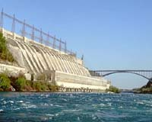
The four Great Lakes that do form part of the U.S./Canada border (Superior, Huron, Ontario, & Erie), also provide fresh water, fish and hydroelectricity for the people of Canada.

Slide 13
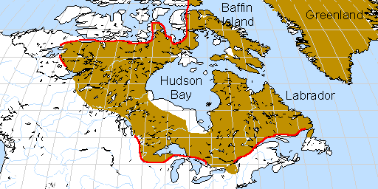
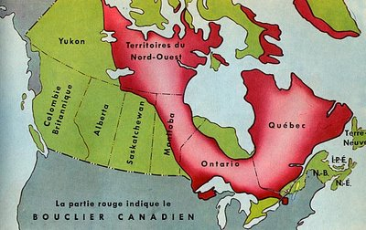
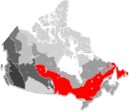
Canadian Shield
The Canadian Shield covers a large portion of Eastern & Southern Canada, wrapping around the Hudson Bay

Slide 14
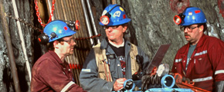
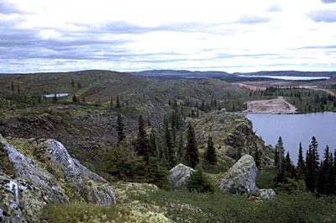
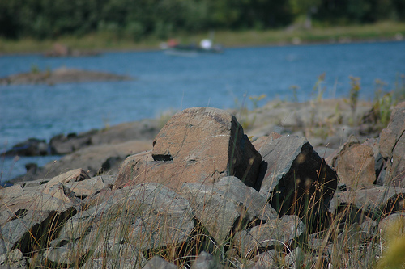
The Canadian Shield:
Rough, rolling landscape with thin, rocky soil
Many lakes and rivers provide water & fish
MOST important resource (in abundance) throughout the Canadian shield are minerals (from iron ore, to nickel, to silver & gold) You know that means?

Slide 15
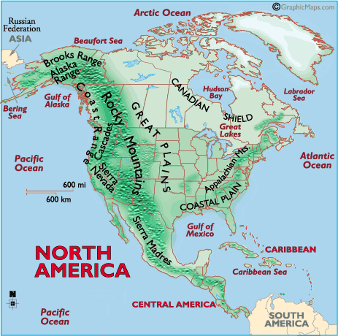
The Rocky Mountains
Located in the Western portion of Canada, the Rocky Mountains stretch over 3,000 miles (from British Columbia in Canada to New Mexico in the U.S.

Slide 16
Learning Targets
The student will explain the impact of location, climate, distribution of natural resources, and population distribution on Canada.
(A) Impact on where people live
(B) Impact on trade

Slide 17
Canada is the largest country (in area), in the Western Hemisphere
But, only about 33 million people live in Canada.
Canada’s population is much smaller than both Mexico’s and the United States’
Mexico’s population is 3 times Canada’s population
The United States population is 9 times Canada’s population

Slide 18
The reason that Canada’s population is so
much smaller, (while Canada is very large in
size), is that much of Canada’s land lies in a
part of the Northern hemisphere where the
climate is harsh and living conditions are
difficult

Slide 19
Climate of Canada
Most of the southeastern part of Canada has a humid continental climate.
It has warm to hot summers & cold winters
There can be up to 60 inches of precipitation per year

Slide 20
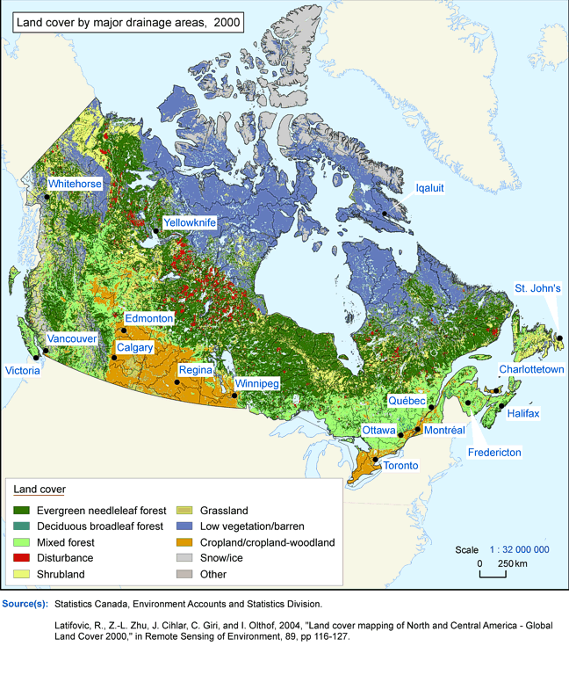
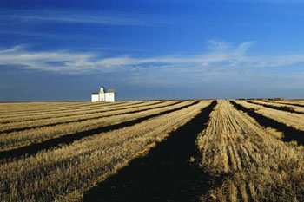
The climate in the southern and central parts of Canada allow for a long growing season
Canada’s central plains are an important source of canola, wheat, and other grains

Slide 21
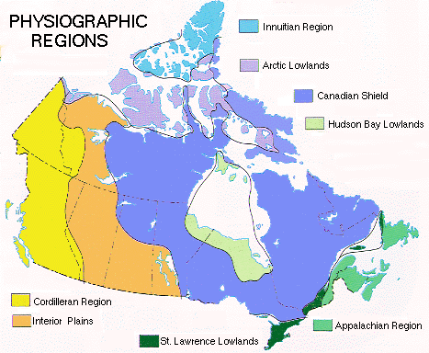
The area in Canada along the Pacific coast has a temperate climate
The ocean cools the region in the summer and keeps it warmer in the winter
It can receive up to 100 inches of rain in a year (mostly in the winter)

Slide 22
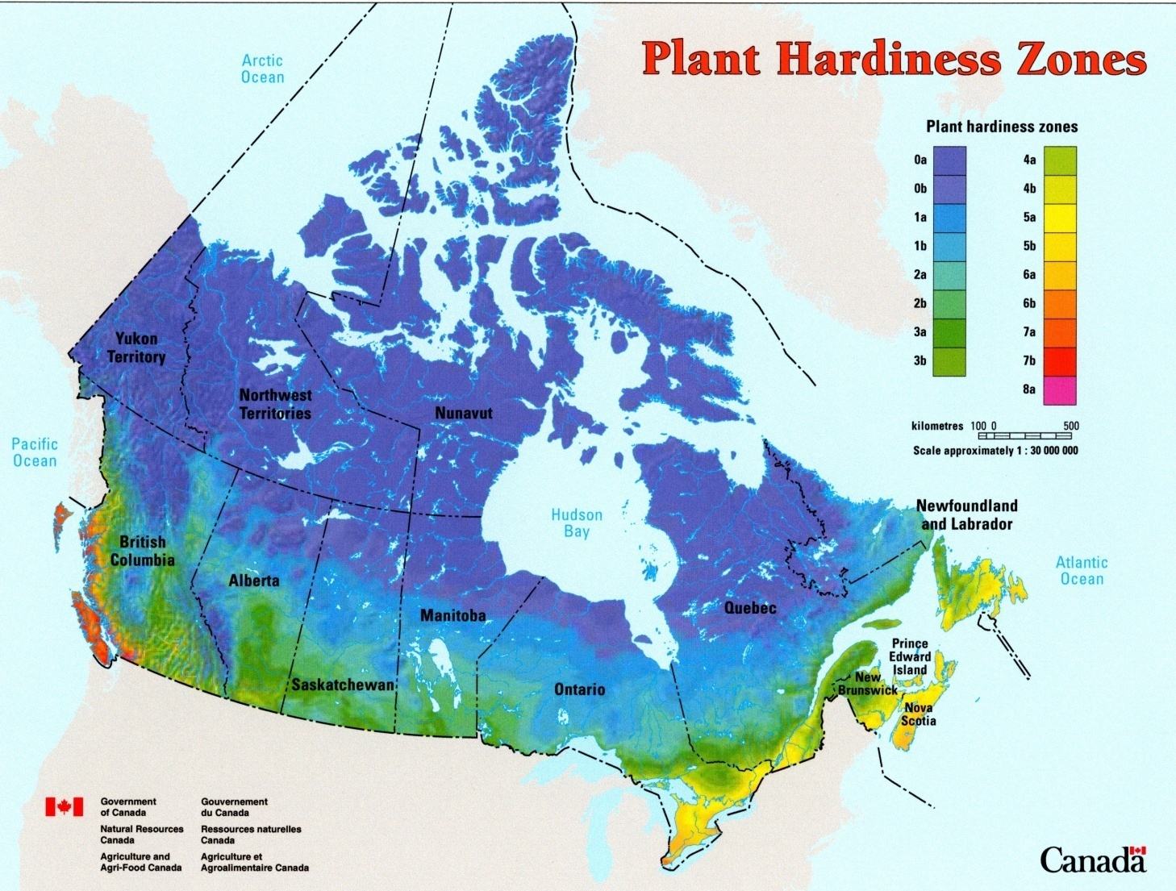
Northern Canada has a subarctic climate
It is much colder in this region of the country
Here they have long, cold winters and short, cool summers
It is possible to have temperatures below freezing even during the summer

Slide 24
This is a ‘Permafrost’ Map of Canada: (Permafrost is when the soil in an area stays permanently frozen).

Slide 25
90% of Canadians live in the Southern region of Canada (within 100 miles of the Canada / U.S. border)
Most of these people live toward the east and central parts of the country
Most Canadians live in towns or cities, only about 20% live in rural areas

Slide 27
Canada’s Political Boundaries/Divisions
Because so many people in Canada live such a small portion of the country I (within 100 miles of the Canada / United States border)
And Because so few people in Canada live in such a large portion of the country: (in the northern regions)
Canada has chosen to divide its land into two different types of political divisions (we divide our country’s land into states here in the U.S.)
Provinces
Territories

Slide 28
Canada has 10 provinces (These are similar in their structure and purpose to our own States. British Columbia, Alberta, Saskatchewan, Manitoba, Ontario, Quebec, Newfoundland and Labrador, Prince Edward Island, Nova Scotia, & New Brunswick)
Canada has 3 territories (These are all located in the northern regions of Canada where there are far fewer people and thus less reason to formalize these areas into provinces)

Slide 29
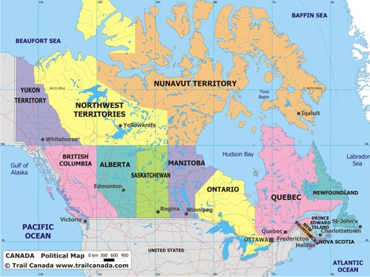

Slide 30
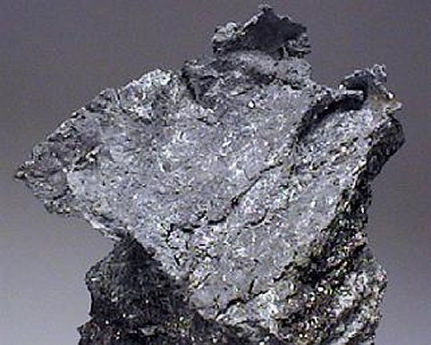
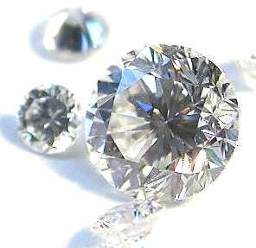
Natural Resources of Canada
Canada is rich in natural resources
Some of their most important of these resources (found primarily in the Canadian Shield), are iron ore, nickel, zinc, copper, gold, lead, diamonds, and silver

Slide 31
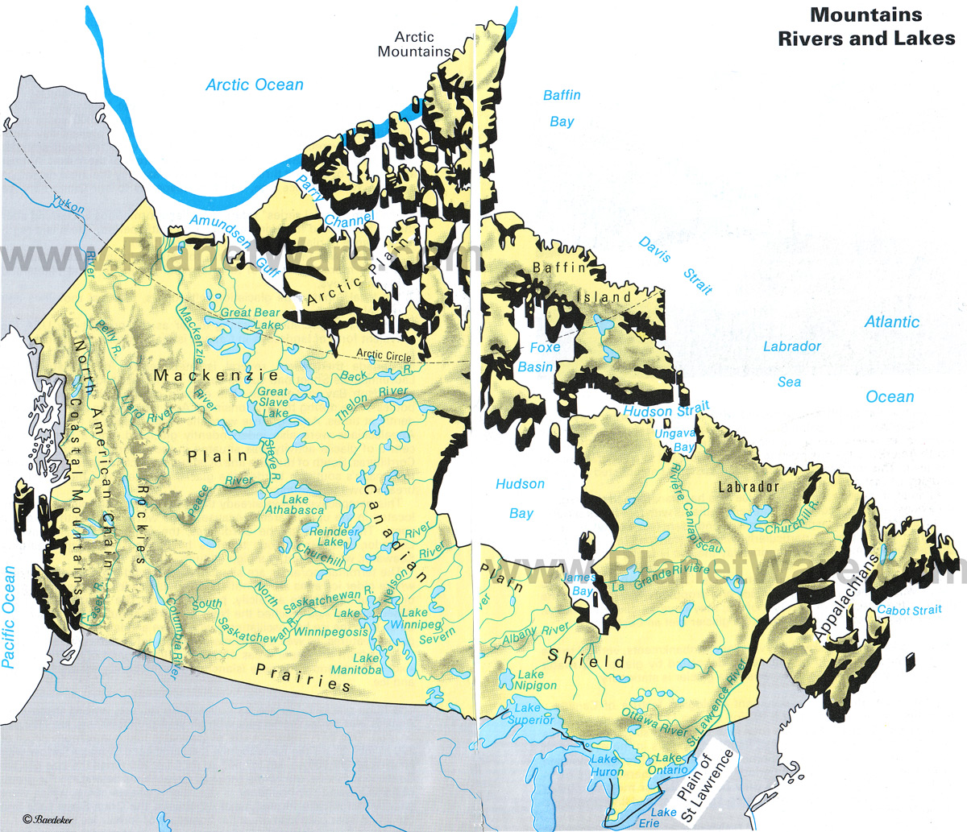
Canada’s large number of lakes and rivers are an excellent source of fish, fresh water, and hydroelectricity

Slide 32
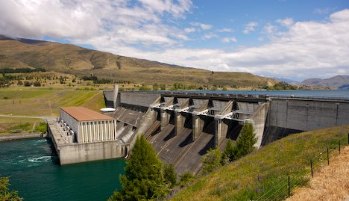
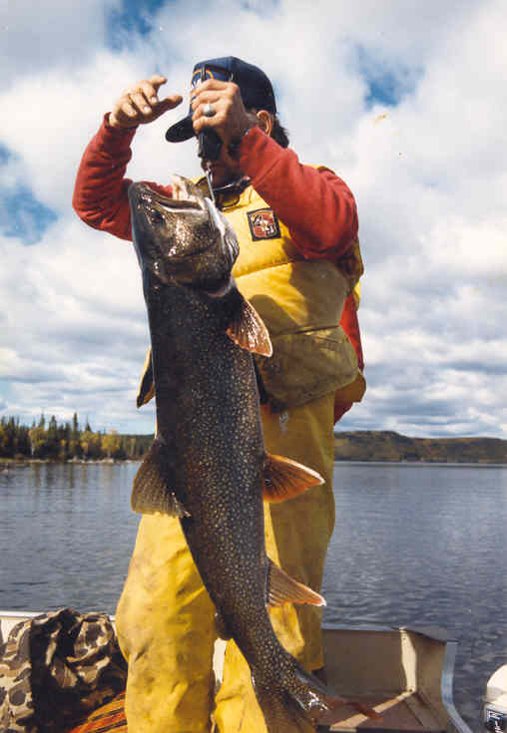
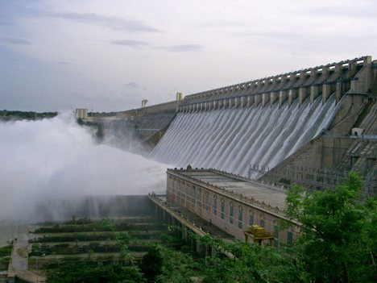

Slide 33
Good soil in Canada allows farmers to grow crops for the people of Canada with enough left over to trade with other countries
About 5% of Canada’s land is arable (farmable)
While this may seem like only a small amount of land, 5% of Canada is actually quite large (remember that Canada is the largest country in the Western Hemisphere)

Slide 34
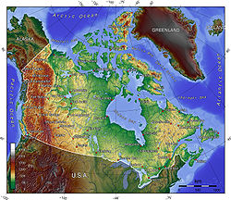
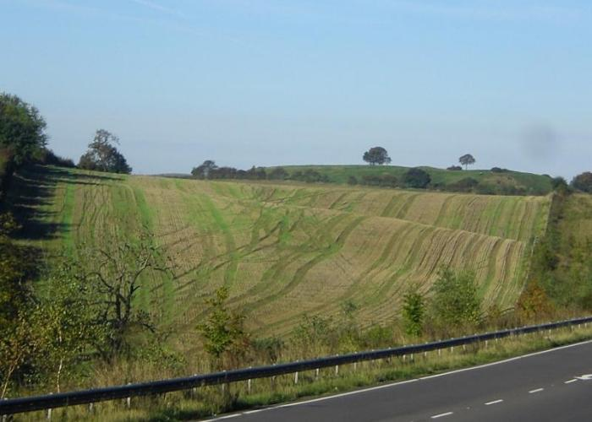
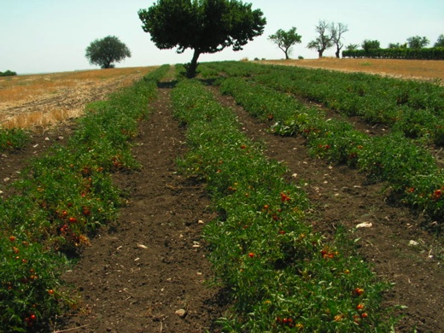

Slide 35
Forests in Canada are a major natural resource with an abundance of timber, which is harvested in Canada to be used by its own people as well as traded with other countries around the world.
The forests are also home to abundant wildlife

Slide 36
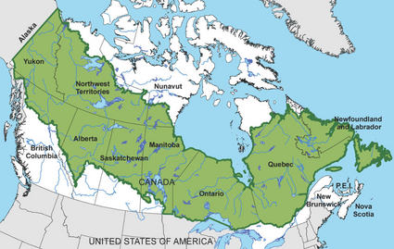
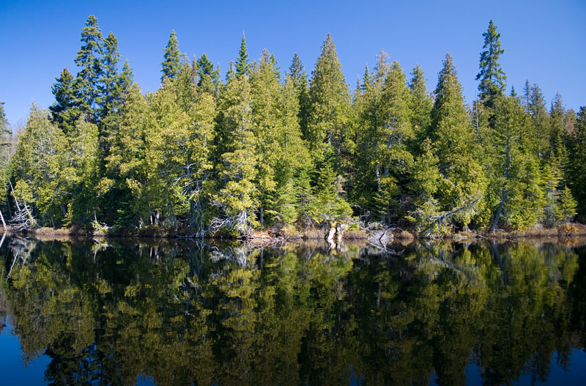
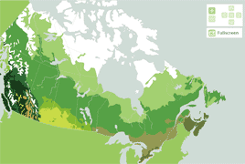

Slide 37
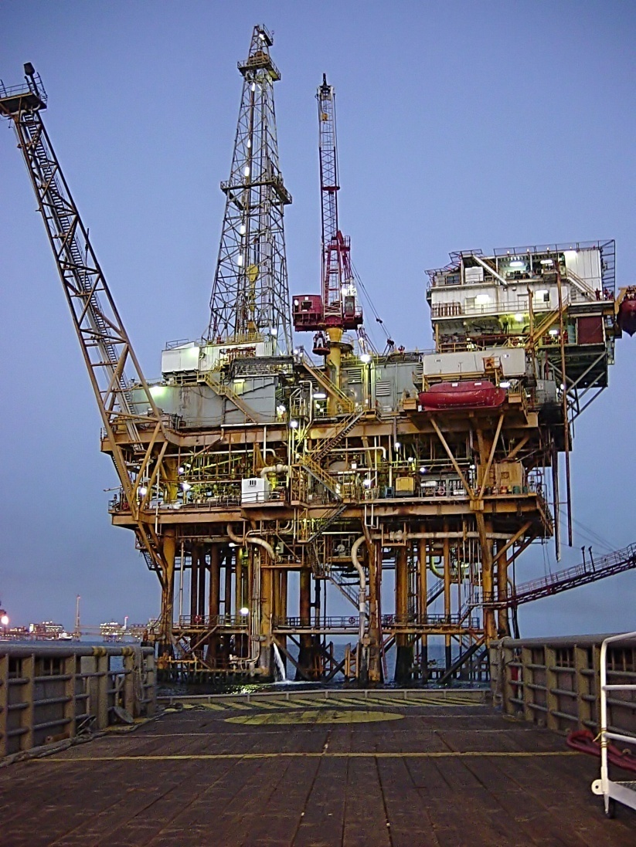
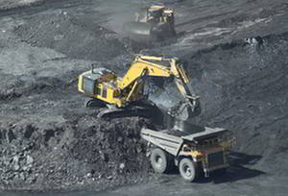
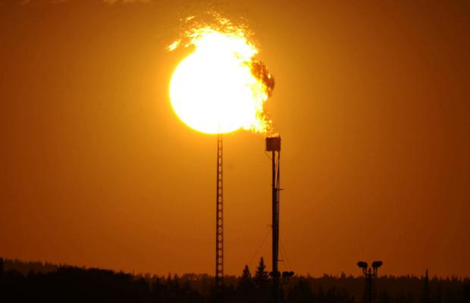
Canada also has a large supply of natural energy resources, such as coal, oil, and natural gas
They have enough to supply their own needs and sell the rest to other countries

Slide 38
Review of Canada’s Natural Resources:
Minerals found in the Canadian Shield (iron ore, nickel, zinc, copper, gold, lead, diamonds, & silver)
Fish, fresh water, hydroelectricity from lakes & rivers
Many crops due to good soil
Timber & wildlife from the forests of Canada
Coal, oil, & natural gas

Slide 39
Because many of the natural resources of Canada are located in remote areas of the country, small communities are found spread across the country where mining, logging, and farming are important
Goods from these areas are shipped by rail or highway to larger cities for trade with other parts of Canada and the world
An excellent system of highways, railroads, and air transportation have been built throughout Canada and adapt to the colder climate

Slide 40
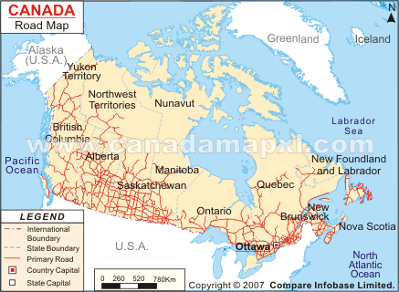

Slide 41
Summary & Review
These are the questions located at the end of your notes… You must write the questions and your answers on YOUR OWN sheet of paper.
1. What 3 oceans and 1 country make up Canada’s 4 borders?
North – Arctic Ocean
East – Atlantic Ocean
South – The United States
West – The Pacific Ocean

Slide 42
Summary & Review
2. How does Canada’s location impact its ability to trade / travel with the rest of the world?
Canada’s location, surrounded by three oceans with its Southern border formed by the United States, makes travel / trade with the rest of the world easy for Canadians

Slide 43
Summary & Review
3. Why is Canada’s population so small, even though it is a very large country?
Because a large part if Canada’s land lies so far north in the northern hemisphere that the climate is harsh and living conditions difficult. Most of Canada is uninhabitable due to its harsh, cold climate

Slide 44
Summary & Review
4. Where do most Canadians live?
90% of all Canadians live in southern Canada (within 100 miles of Canada’s border with the United States)

Slide 45
Summary & Review
5. Why do most Canadians live in this region?
Because the farther north you travel in Canada, the colder the temperatures become, the harsher the climate is, and the more difficult it is to survive

Slide 46
Summary & Review
6. How does the Pacific Ocean impact Canada’s Pacific coast region?
The ocean creates a temperate climate in the region, it cools the area in the summer and helps keep it warmer in the winter

Slide 47
Summary & Review
7. Describe the climate of Northern Canada?
Northern Canada is much colder than the rest of the country. They have cold winters and cool summers. The climate is harsh, making living conditions difficult

Slide 48
Summary & Review
8. List Canada’s major natural resources:
Lakes & Rivers: fresh water, fish, hydroelectricity and routes for trade and travel
Good Soil: crops like canola, wheat & other grains
Forests: timber
Canadian Shield: minerals, like uranium, gold, and silver
Natural Energy: coal, oil, & natural gas

