Slide 1
Republican Party (GOP)
By: Ishtyaq, Alex, Dane

Slide 2
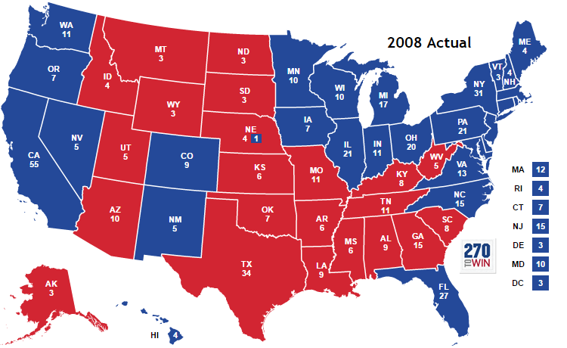
Recent History #1
In 2004, Bush was reelected by a close margin winning both popular vote and electoral vote.
Republicans had control of both of the houses in Congress until 2006 where Republicans faced opposition due to the Iraq war.
Both the house and senate regained by the Democrats, In 2006.
In 2008, Senator John McCain was the Republican presidential nominee and faced Barack Obama for presidency.
Obama won in a landslide winning 365 electoral votes compared to John McCain's 173 electoral votes.
Popular vote was much closer as Obama had 52.93% of votes and McCain had 45.65% of votes.

Slide 3
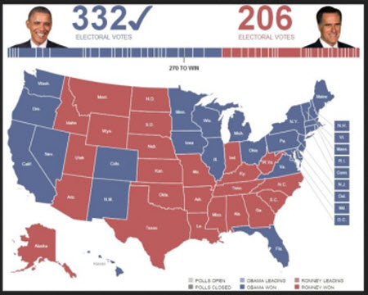
Recent History #2
Mitt Romney was the presidential candidate for the Republican party for the 2012 election, where Obama ran for reelection.
Obama won the electoral votes, it was much closer compared to McCain’s electoral votes where Mitt Romney had 206 electoral votes and Obama had 332 electoral votes.
The popular vote was even closer with Obama having 50.1% of the votes and Romney with 48.1% of the votes.
Since 2008, the Republicans have controlled both House and Senate for 8 years straight.
The upcoming election for the Republican party has Donald Trump as the running mate against Hillary Clinton the Democrat presidential nominee.

Slide 4
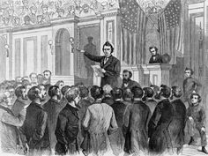
Political Ideals #1
Republican ideals have changed from being a predominantly left-wing political party to a shifted right-wing conservative party.
The purpose of the party at the beginning was to abolish slavery in existing areas; Radical Republicans were the main force for blacks to have equal political rights and believed that the south should be punished for the civil war.
Most of the party members believed in limited government but still used its power to introduce various departments.
The party’s progressive views been in place up until the 1960’s, where the party started to lean towards conservative views due to the south’s influence.
Religious faith had no role in the Republican party until the 1990’s where the party was becoming even more conservative.
Republicans tend to favor personal responsibility, in that people should be able choose for themselves and what not to do as long as they are not breaking current existing laws.

Slide 5
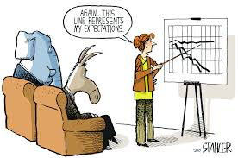
Political Ideals #2
Republicans believe that tax reductions should be for everyone even big corporations and high income wages. Republicans believe in a child tax credit where each child will reduce your federal income tax.
Republicans oppose the current Social Security system and believe that workers need to be given a greater control of their own retirement investments.
Republicans also believe in low government spending or minimal involvement claiming that governments role should as minimal as possible.

Slide 6
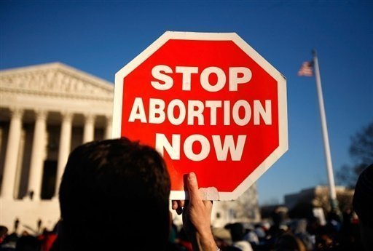
Stance on Social Issues #1
Republican views on abortion have a belief that an unborn child has an individual right to life and should not be infringed upon by others. Republicans believe that the fourteenth constitution that guarantees all rights to Americans apply to unborn children as well. Republicans oppose public revenue going towards abortions or any sort of health care plan that cover abortions.
Republicans believe that Americans are allowed to carry, own, and use guns. Republicans believe that governement regulation of guns are unconstitutional and is stated in the second amendment, “the right to bear arms”.
The Republican party stand in historical text that marriage is between one man and one woman. The opposition towards gay marriage is believed due to the institution of marriage the founding fathers had created. An effort of recognition for gay rights has been a higher discussion in the Republican party.

Slide 7
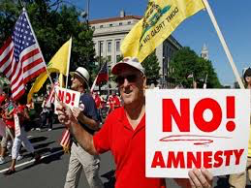
Stance on Social Issues #2
Republicans believe in immigration laws and reforms that address national security. Republicans mostly agree that a system needs to be in place for illegal citizens to not have the same benefits as legal citizens. Republicans hold the belief that amnesty to illegal immigrants will lead to more illegal immigration.
Republicans support the use of oil and natural gas resources, Republicans believe in using clean renewable energy in a private sector. Republicans also support the use of clean coal energy but the support for coal has been diminishing the last couple of years.
Republicans have criticized Obama mainly due to that it forces American people to have health care. Republicans believe that the law reduces competition and minimizes healthcare quality and choice.

Slide 8
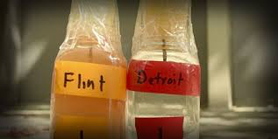
Relationship with Michigan #1
When Trump, Cruz, Kasich, and Rubio were arguing over the Republican nominee, Donald Trump won Michigan.
In Michigan, Donald Trump had 36.25% of the vote and 25 delegates as he was fighting for the Republican nominee.
The cause of the Flint water crisis was due to the absence of support from Republican governor Rick Snyder.

Slide 9
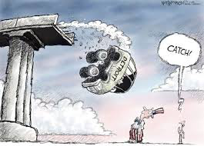
Relationship with Michigan #2
Republicans disapprove of trying to save the auto industry and believed in the Mitt Romney way to let Detroit go bankrupt.
Many political figures such as Ted Cruz believe that the government should not be handing out bailouts and Donald Trump believes with or without the auto bailout the city would be the same.

Slide 10
Citations
www.britannica.com/topic/Republicanparty/
www.270towin.com/2008_Election/
www.republicanviews.org
www.usatoday.com
www.Mlive.com

