Slide 1
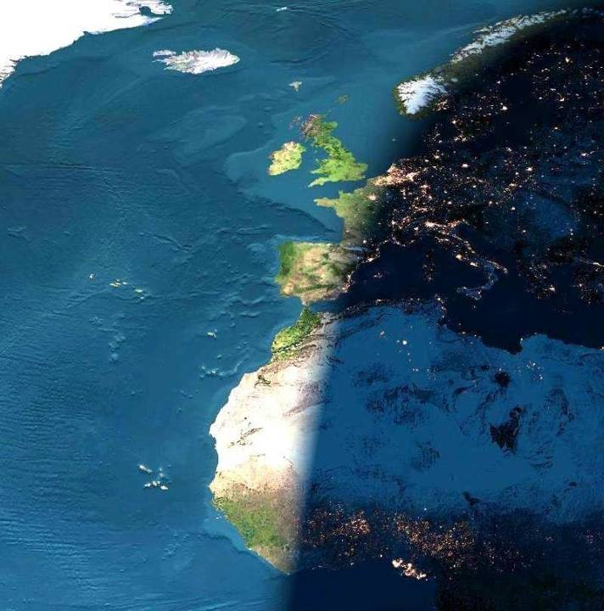
World History Eras 1 and 2: Urbanization,
Agriculture, and Ancient Civilization

Slide 2
Is there a Problem with World History?
Too much stuff!
  How can I cram it all in?
The wrong way of thinking about world history!
  World History is not just more of the same old history
  World History focuses on different themes and topics
  Because different things can be seen at different scales
Notes:
2

Slide 3
What Do We See at Large Scales?
World history as a Whole
Now:
What are the most important developments we see when we look at the whole of Eras 1 and 2?
Notes:
3

Slide 4
Era 1 – The Beginnings of Human Society (to 4000 BCE)
1.1 Peopling of the Earth (Paleolithic Era c. 200,000 – 10,000 BP)
95% of human history; small communities; ice age; global migrations; megafaunal extinctions; slow population growth; slow technological change
1.2 Agricultural Revolution (Early Agrarian Era c. 10,000 – 6000 BP, or 4000 BCE)
Major transition from hunter-gathering to sedentary agriculture; impact on the environment; impact of transition on human lifeways

Slide 5
Era 1.1 Peopling of the Earth
(Paleolithic Era)
Literally, the ‘Old Stone Age’
  i.e. technologies dominated by stone tools
Paleolithic Era of human history: C. 200,000- c. 10,000 years ago
Often neglected in World History, but
It is when we were formed as a species
  It is when we became what we are
It is the foundation of World History, so we have much to learn by studying it closely
  Everything else in history starts here
It includes c. 95% of human history!

Slide 6

The Paleolithic Era:
95% of Human History
End of Ice Age; beginnings of agriculture
Modern Humans in northern Eurasia
Modern Humans in Australia/Sahul
Earliest possible evidence
of modern humans in Africa
Modern Humans in S.W. Asia
Modern Humans in Americas
Earliest cities and states
Last Ice Age begins
Industrial Revolution
200
175
150
125
100
75
50
25
0
THOUSANDS OF YEARS BEFORE PRESENT DAY
TIME-CHECK: Timeline 6: 200,000 years

Slide 7
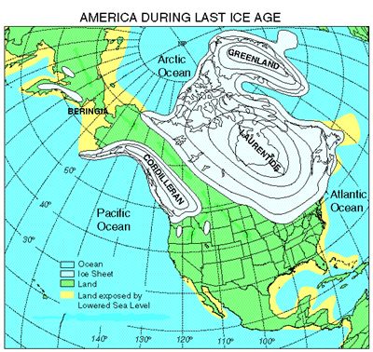
Main events of the Paleolithic Era
Climate Changes: the Ice Ages
Global migrations:
  Spread of humans around the world as they develop
  New technologies for new environments
: climate.uvic.ca/.../ afanning-glaciation.html

Slide 8
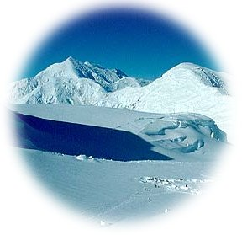
Climate Changes
In the last million years, there have been
  Regular ‘Ice Ages’
  Each lasting c. 100,000 years
  With warmer ‘interglacials’ lasting 10,000 years between
The last ice age began c. 100,000 years ago
  The last ‘interglacial’ began c. 10,000 years ago
  We’re overdue for a new ice age!
  But despite the last ice age, humans migrated all over the world ….

Slide 9
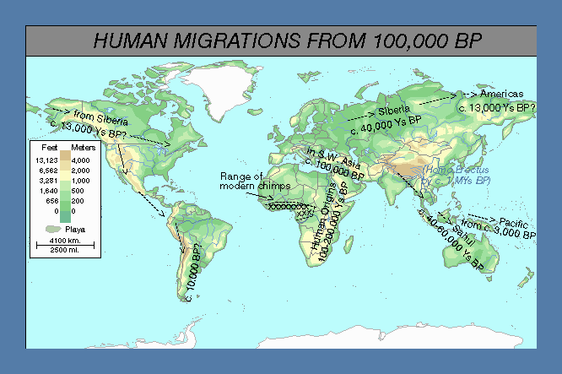
New technologies adapted for specific environments allowed human global migrations from c. 100,000 BP
15,000 Ys ago
Many new technologies required
40,000 Ys ago
New hunting techniques; adaptations to cold
60,000 Ys ago
Sea-going technologies
Chimp
range
Range of
Early humans
Notes:
Note the difference between chimps and humans in the size of their ranges

Slide 10
New technologies needed for new environments
Some of the major changes:
Desert technologies—arid regions
Forest technologies—forest regions
Sea-going technologies—sea crossing
Cold-region technologies (fire, improved hunting techniques, tailoring)—zones affected by ice age glaciation

Slide 11
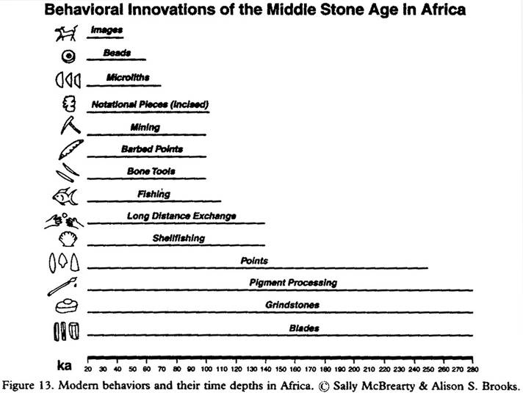
Archaeological evidence of technological innovations
New materials, new techniques
Exchanges of information
Shellfish: new lifeways
Pigments imply symbolic language
Improved stone tools
McBrearty & Brooks, ‘The Revolution that wasn’t’, 2000

Slide 12
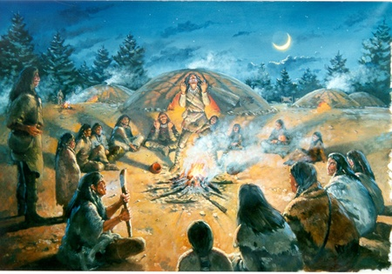
How did people live in the Paleolithic?
We have no written evidence and no names for 95% of human history:
What evidence is available?
  Archaeological Remains:
    Bones
    Tools
    Living sites
  Analogies with modern societies most like Paleolithic societies
  But both forms of evidence can be misleading

Slide 13
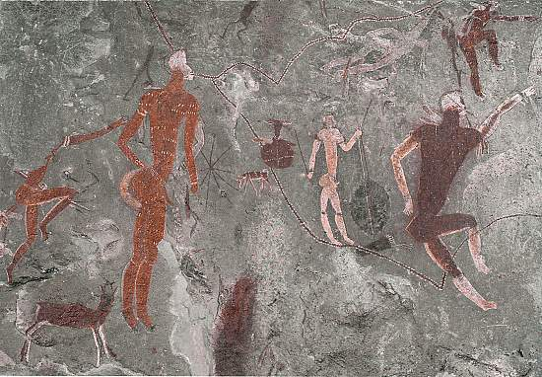
‘Foraging’ as a way of living
Foraging means
  gathering foodstuffs and other needed materials from the environment
Foragers need a large territory to support themselves
So populations were
small
Foragers live in
  Tiny, family-sized
  groups from 10-50
  people in size
  Sometimes splitting
  into smaller groups
  Sometimes meeting
  in larger groups
www.museums.org.za
Rock painting of San Hunter-Gatherers

Slide 14
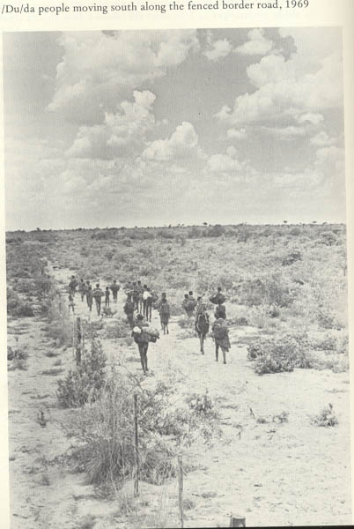
Living in small groups:
Do it yourself!
There was no government to take care of things
Everything had to be done within the family
  Most people met less than 500 people in their lives
  Family was ‘society’
  Justice, education, eating, ceremonies, all took place in small groups
Aboriginal ‘family’ group
migrating in Central Australia
www.artsci.wustl.edu

Slide 15
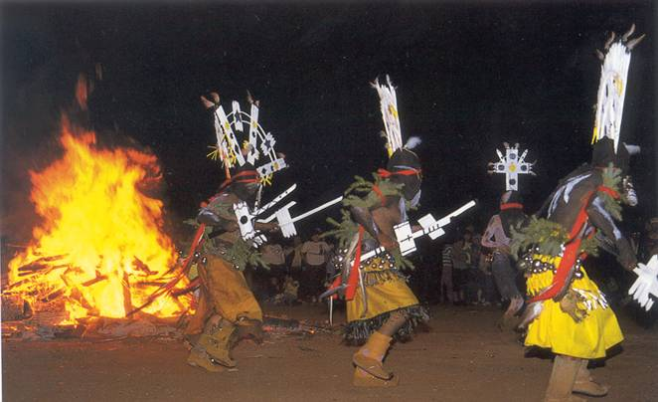
Living in small groups
Gift-giving was a vital way of holding groups together
Ceremonies were equally vital
Contacts with neighboring groups were made at regular meetings and rituals, where
  gifts and information were swapped and
  marriages made
Justice was personal
  No police meant ‘Do-it-yourself’ justice
www.dam.brown.edu
Apache Ritual

Slide 16
Do-it-your-self death penalties: Justice among the ‘San’
‘Twi had killed three other people, when the community, in a rare move of unanimity, ambushed and fatally wounded him in full daylight. As he lay dying, all the men fired at him with poisoned arrows until, in the words of one informant, ‘he looked like a porcupine.’ Then, after he was dead, all the women as well as the men approached his body and stabbed him with spears, symbolically sharing the responsibility for his death.’ (John Coatsworth)
Would you do the same if a murderer was on the loose and there were no police and no courts?

Slide 17
Foraging ‘technologies’
To modern eyes, foraging technologies appear simple
But to live from them, you need immensely detailed knowledge of your environment
And a very wide range of skills
What would I need to survive as a Paleolithic forager?

Slide 18
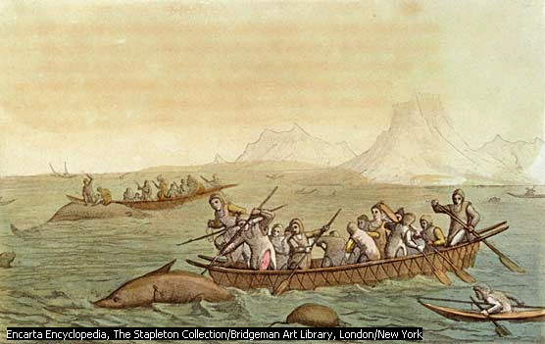
Living in cold climates in the recent past
Inuit hunting whales from ‘kayaks’ & ‘umiaks’: Special clothing, special equipment
Painting from the 1830s

Slide 19

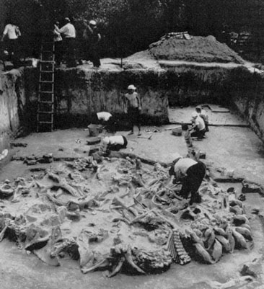
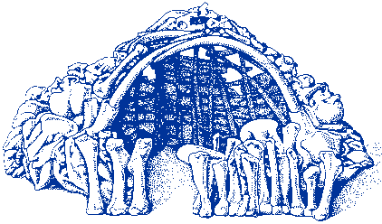
Living in cold climates: Mezhirich, Ukraine 20,000 BP
A mammoth bone house
Bone needle with an ornamental head, probably used to fasten garments, found at the Mezhirich site.

Slide 20
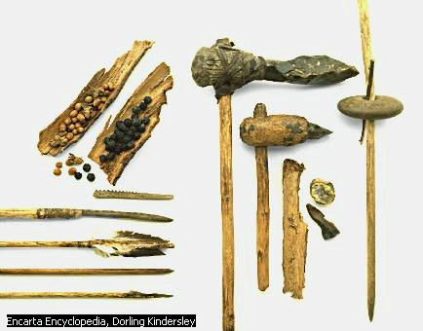
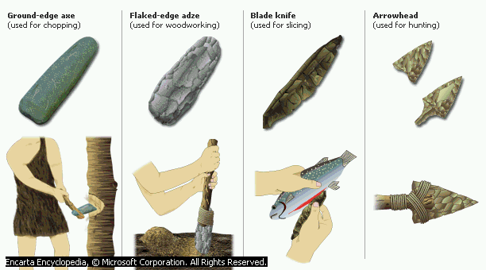
Stone Age tools; and hafted stone axes

Slide 21
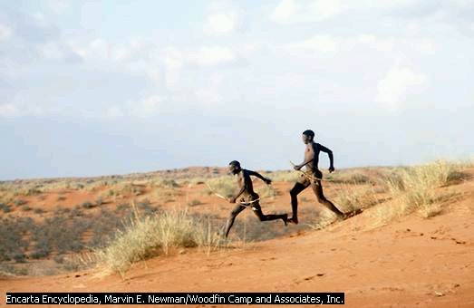
‘San’ hunters of the Kalahari
Ask your kids if they could survive by hunting and gathering?

Slide 22
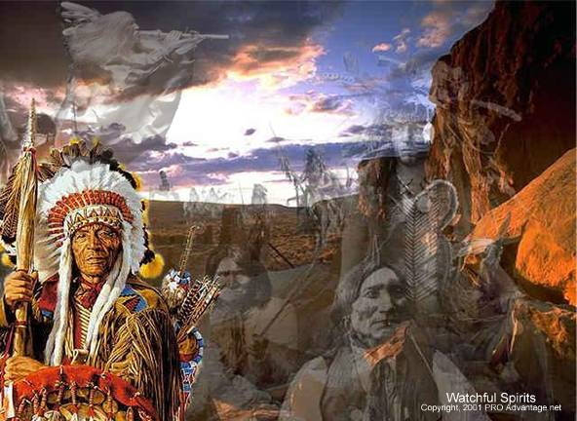
Paleolithic ideas about the world
Foragers lived very close to nature
  And thought of themselves as part of the natural world
  Many believed that their spirits would return in the form of other animals or natural features of the landscape
  They believed in a world full of spirits of many different kinds
Such ideas made up the ‘science’ and ‘religion’ of foraging societies

Slide 23
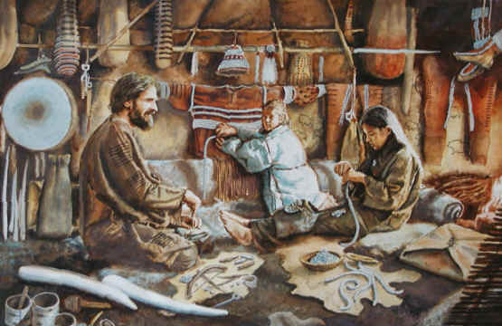
Did Paleolithic foragers live well? Living Standards
The traditional view: their lives were ‘nasty, brutish and short’
Modern views: their lives were
  More egalitarian than ours (no states, no jails)
  Healthy (fewer diseases, good, varied food)
  Less stressful (more leisure, less pressure, strong sense of community)
Was the Paleolithic ‘the original affluent society’? [Marshall Sahlins]

Slide 24
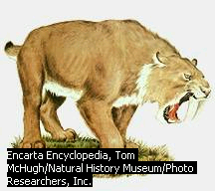
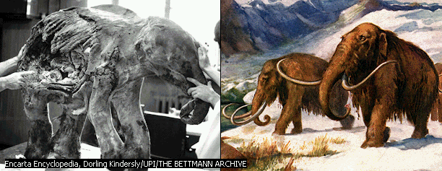
A dangerous species
Our impact on other species?
As humans migrated into more and more environments, they displaced
  other species of hominines (e.g. Neanderthals), and
  other types of animals
Driving them to extinction
Our arrival marks a fundamental turning point in the history of life on earth!

Slide 25
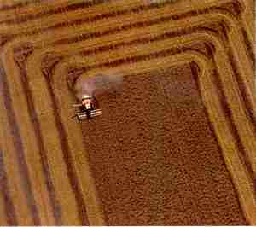
Part 2: Era 1.2 The Agricultural Revolution:
Why is it so important?
resurgence.gn.apc.org/ issues/pretty205.htm
From 12-10,000 years ago, new technologies start to appear in some regions
These gave humans access to more energy and resources
With more food and energy humans began to:
  Multiply more rapidly
  Live in larger and denser communities
Leading to A NEW LEVEL OF COMPLEXITY

Slide 26
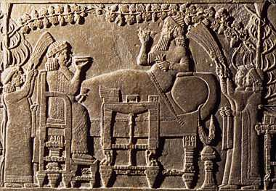
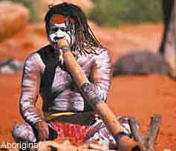
This meant pace of change began to vary from region to region
Where dense populations appeared, change was generally faster
Where populations remained small and scattered, change was generally slower
So:
Different parts of the world began to have very different histories
: freewebhosting.hostdepartment.com
: www.landenweb.com/bevolking

Slide 27
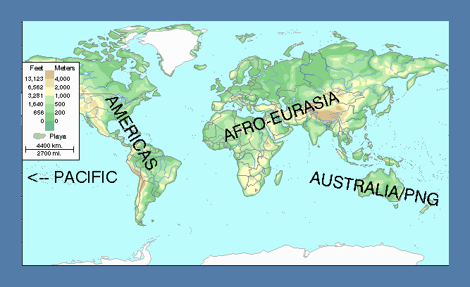
Three main ‘World Zones’ in the last 10,000 years
History took a different trajectory in each zone
= Early agriculture, dense settlement
Notes:
Four ‘world zones’, the petri dishes of world history
Jared Diamond

Slide 28
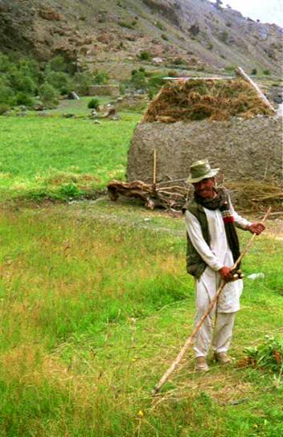
Contrasting
Foragers and Farmers
Foragers ‘harvest’ a wide variety of different animals and plants that are provided by natural selection
www.kidzpicz.com
Farmers
  ‘harvest’ a smaller number of animals and plants but
  increase their output artificially
From
  Relying on nature, to
  Manipulating nature
danny.oz.au/travel

Slide 29
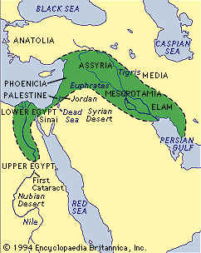
When and Where?
A Slow Revolution
The ‘revolution’ began, first, in a few separate areas
Then gradually it spread
The entire process continues up to the present day

Slide 30
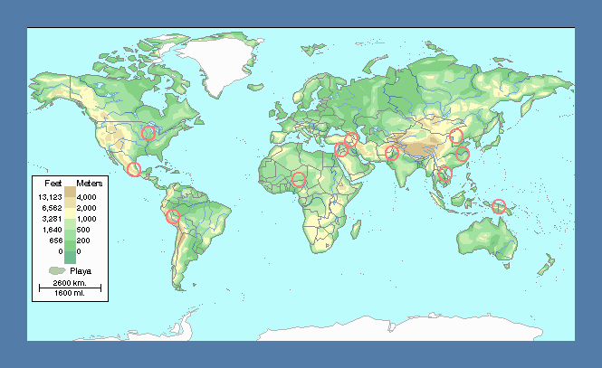
Early Agricultural Sites
Mississippi valley
S.W. Asia
N. China
Indus
S. China
Mesoamerica
Egypt
& Sudan
S.E. Asia
W. Africa
Andes
Papua New Guinea

Slide 31
Explaining the Origins of Agriculture
The obvious (but wrong) answer:
  Someone invented it
  Everyone else copied it
There’s a problem!
  Agriculture appeared separately in different parts of the world, within a few millennia
  Not everyone wanted to be a farmer, because
    Living as a farmer was often
      Harder and
      Less healthy
    than living as a forager

Slide 32
So why did some take up farming? A possible answer: Step by Step
Step 1: Precondition 1: Humans already had a lot of the necessary knowledge and skills
Step 2: Precondition 2: Some species were already ‘pre-adapted’ as ‘domesticates’
Step 3: Becoming less nomadic:
  Because of Climatic change (Gardens of Eden)
  Over population (Local shortages)
Step 4: The ‘trap of Sedentism’: Sedentism makes further intensification necessary
Step 5: Voilà! Agriculture!

Slide 33
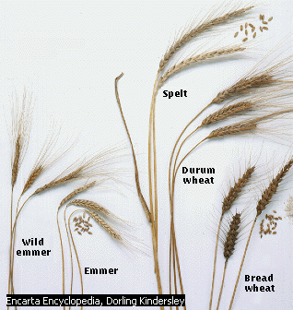
Note critical interaction between geography and history: Some species were ‘pre-adapted’ for domestication!
Some species were more suitable for domestication
  E.g. wheat, which has been changed very little by humans
  In contrast to maize, which had to be ‘trained’ for a long time first
There were many promising species in S.W. Asia
This may be one reason why agriculture began there [according to Jared Diamond]
Varieties of wheat

Slide 34
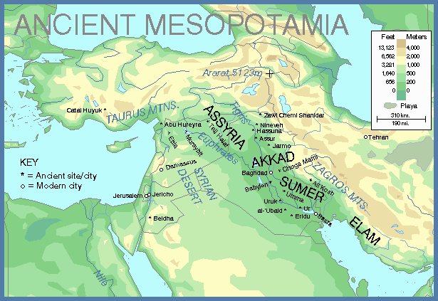
The Fertile Crescent
Catal Huyuk
Jericho

Slide 35
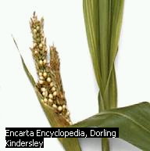
Maize was less ‘pre-adapted’ for domestication than wheat
Teosinte: small, weedy and not too nutritious
Perhaps that’s one reason why agriculture developed later in the Americas

Slide 36
As farming spread, it eventually led to a new era in human history … Era 2
Number of farming communities increased until, by 5,000 years ago, most people on earth were probably farming for a living
This was a world with increasing numbers of farmers and villages
Eventually some of these villages became town, and and handful of these towns evolved into the first cities and states

Slide 37
Era 2: Early Civilizations and Early Pastoral Societies
W2.1.1 Development of human language
W2.1.2 Major river systems and early civs: Tigris and Euphrates, Nile, Indus, Yangtze, Huanghe
W2.1.3 Common features of early civilizations
W2.1.4 Cultural diffusion
W2.1.5 Pastoralism

Slide 38
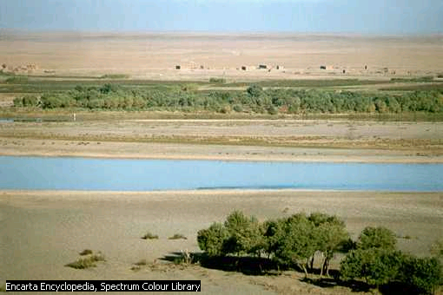
Bringing water to an arid land
The Tigris river
Mesopotamian Examples –
spread of villages
After c. 5000BCE, more and more villages were appearing in the arid lands of Mesopotamia
Here, there was so little rainfall that farmers had to use simple forms of irrigation
But, if they could find enough water, crops grew well

Slide 39
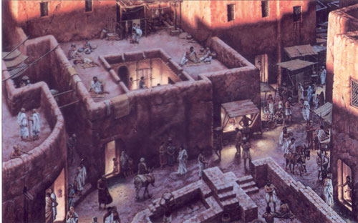
Irrigation, population growth and larger settlements
Irrigation greatly increased productivity
  As irrigation spread and became more sophisticated, populations rose rapidly
Towns appeared,
providing services for
nearby villages, such as
  markets
  grain stores
  temples
Powerful rulers appeared
  We can tell from the appearance of large building projects and monumental architecture
www.garone.net/ tony/mesopotamia.html

Slide 40
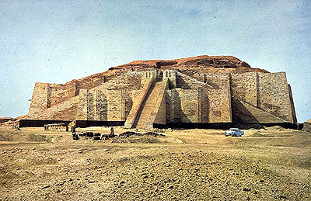
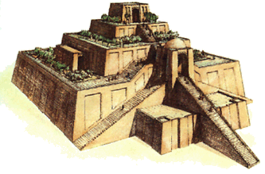
Remains of a Ziggurat at Uruk

Slide 41
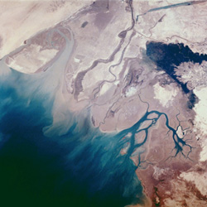
These processes were most striking in the Delta lands of S. Mesopotamia
S. Mesopotamia was a land of swamps
  There was plenty of water
  Crops flourished
  Villages multiplied
  And towns began to appear
Archaeologists can trace the increase in the number and size of settlements

Slide 42
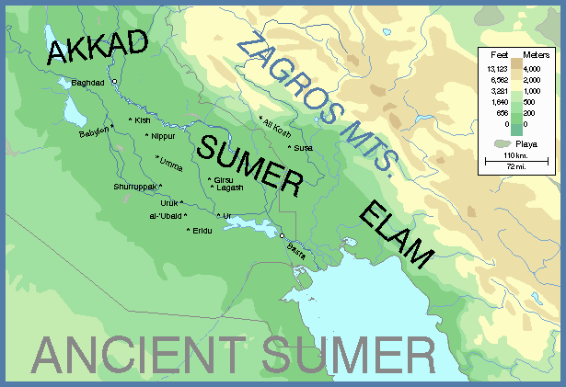
Modern Baghdad
Babylon
Uruk
Ur
Eridu
Modern Basra

Slide 43
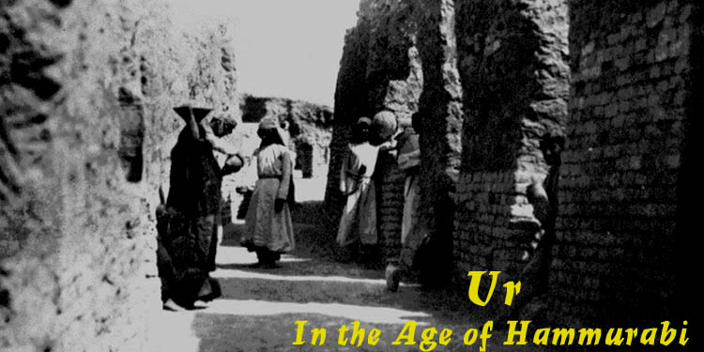
Ur and Uruk:
  In 4,000 BCE, towns with c. 10,000 inhabitants
  By 3,000 BCE, cities with 50,000 inhabitants
By 3,000 BCE, there were a number of independent city-states, all about the size of Ur and Uruk
Towns grew into cities

Slide 44
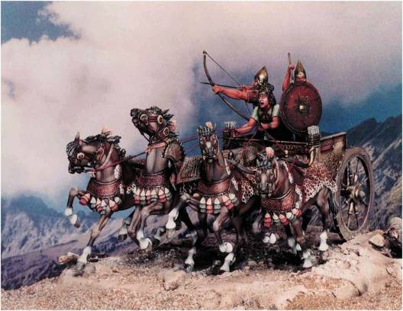
Cities required more complicated types of government
Some major features of early city-states
Monumental architecture and temples
New forms of taxation
New forms of administration: writing
Armies: Coercion
Assyrian Chariot Warfare!

Slide 45
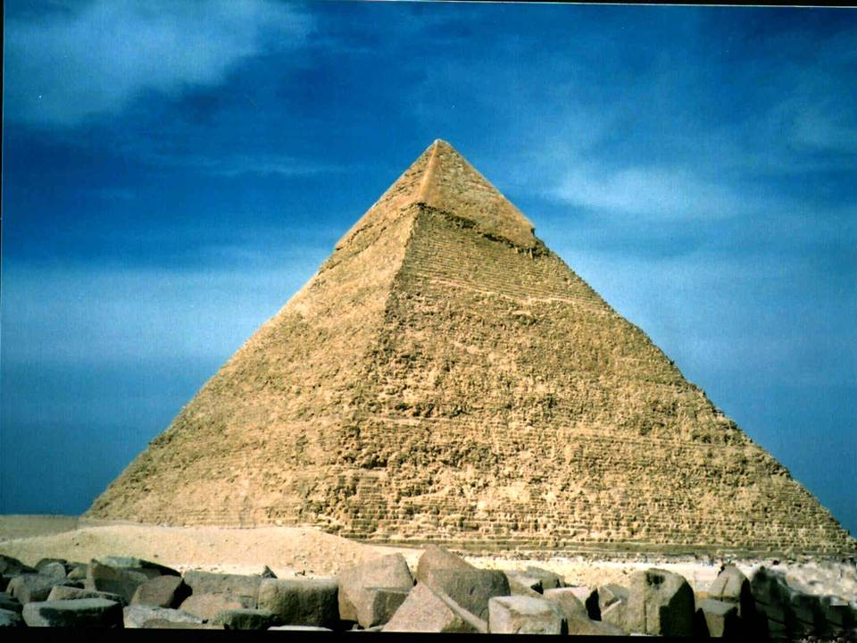
Pyramid of Khafre, Giza, Egypt
www.black-triangle-ufo-roma.com/ EgyptImagesMA...

Slide 46
Managing Resources:
Collecting Goods and maintaining Treasuries
To fulfill these functions, leaders had to have access to large stores of goods
  Many resources were donated willingly, e.g. as gifts to temples
  Increasingly, though, resources were exacted through the threat of force: taxation?
Temples and leaders accumulated large stores of goods

Slide 47
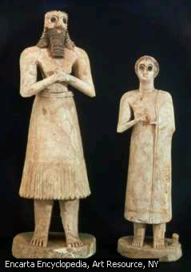
Sumerian sculptured figures, c. 2,700 BCE
Do these represent wealthy donors, seeking the blessings of the gods?
Or were they forced to make donations?

Slide 48
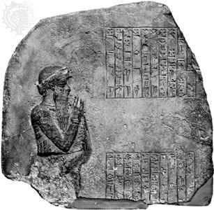
Administration:
Keeping track of tributes and other resources: Writing
As resources accumulated it was vital to keep records of them
The first writing systems were really lists of objects: writing began as accounting
In Sumer, these were recorded by marks in clay, using triangular shaped wedges of papyrus: this was ‘cuneiform’ writing

Slide 49
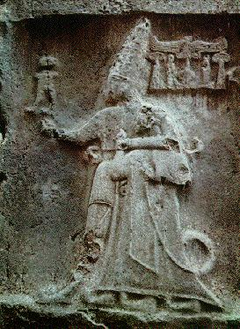
Who led the first city-states?
Powerful rulers who could impose their will over hundreds of thousands, or millions of people
  The first Sumerian rulers may have been priests as well as secular kings
  They ruled over single cities
  Later Mesopotamian rulers controlled several cities in the first ‘empires’
ancientneareast.tripod.com/ Anatolia.html
Hittite King, Mesopotamia

Slide 50
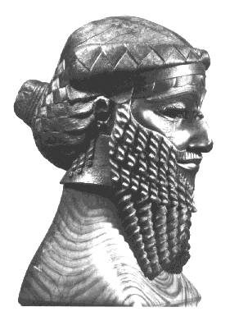
Is this Sargon, the first Emperor?
Head of a king of Akkad, found in Nineveh
Could it be Sargon
(r. 2370-2316 BCE)?
Sargon was the first monarch to rule over a large number of city states

Slide 51
Same basic pattern of city & state formation applies everywhere
Growth: Increasing size and complexity of settlements
New problems: New need for leaders to coordinate group projects, warfare and worship
New resources: Leaders control more labor and resources and become more powerful
Coercion: Eventually, they can use these resources to pay for armies which they can use to coerce their own subjects
POWER BASED ON COERCION is added to
POWER BASED ON CONSENT

Slide 52
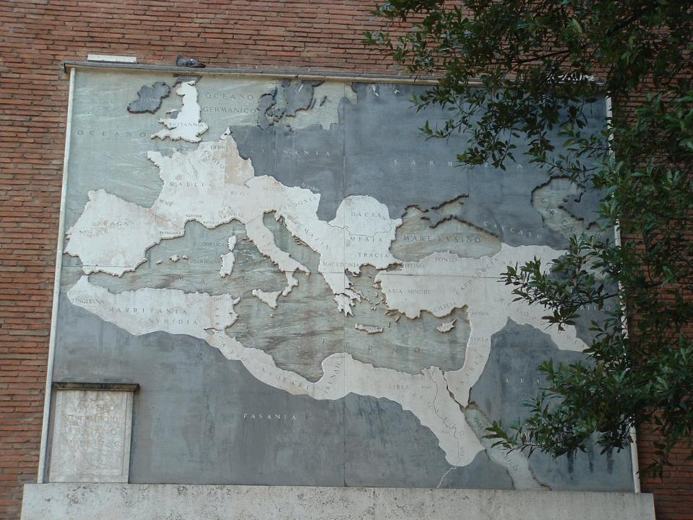
Eventually some of these early city-states were able to expand to become vast civilizations in Era 3 – like Rome!
Later this afternoon we will talk about
Era 3. But first, here is a book you might
find useful for thinking BIG!

