Slide 1
The South And West Transformed
Chapter 3 Section 3

Slide 2
Chapter 3 Section 3 Bell Ringer
Which of the following statements do you most agree:
Westward expansion was an inevitable and positive process.
Westward expansion was immoral and unfair because of the way it affected Native Americans.
Westward expansion was a process of its time and cannot be judged by modern standards.

Slide 3
Learning Targets
B.3. e. Analyze the immediate and long-term influences of Reconstruction on the lives of African Americans and U.S. society as a whole
C.1.f. Compare and contrast the experiences of African Americans in various U.S. regions in the late 19th century
C.1.g. Identify and evaluate the influences on the development of the American West
C.1.h. Analyze significant events for Native American Indian tribes, and their responses to those events, in the late 19th century

Slide 4
Sec 1: The New South
The New South
Industries and Cities Grow
Main Idea: In the 1880s, new industries spread throughout the south. As cigar and lumber production increased, along with the growth of coal-, iron-, and steel-processing centers, new cities emerged in the Carolinas, Georgia, Virginia, Tennessee, and Alabama.
Southern Farmers Face Hard Times
Main Idea: Before the Civil War, most southern planters had concentrated on such crops as cotton and tobacco, which were grown not to be sold for cash. The lure of the cash crop continued after the war, despite efforts to diversify. The South’s heavy reliance on these cash crops made them vulnerable when pests threatened their crops.
Black Southerners Gain and Lose
Main Idea: The Thirteenth, Fourteenth, and Fifteenth amendments had changed African Americans’ legal status. Over time, however, these legal gains were pushed back by a series of Supreme Court decisions.
Continued…

Slide 5
The New South
Industries and Cities Grow
Northern money produced textile mills, cigar and lumber production
Cities sprung up around steel, coal, and iron processing plants
Smaller farms took place of large plantations
Railroads – needed to continue industrialization
Connected rural to urban hubs – only two went North to South
Southern economic recovery limited
Had to recover from war
South had little capital
Unskilled labor – poor education – low wages
Weak banking system – who had money to invest?

Slide 6
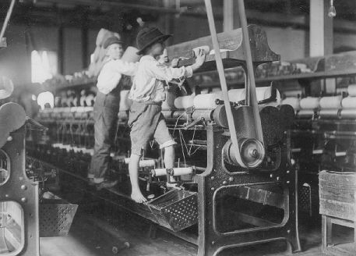
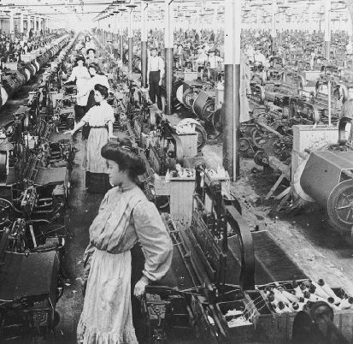
The New South

Slide 7
The New South
What factors limited southern economic recovery?
Lack of workers and investment capital
Poor conditions after the Civil War
Railroads only connecting in two southern areas

Slide 8
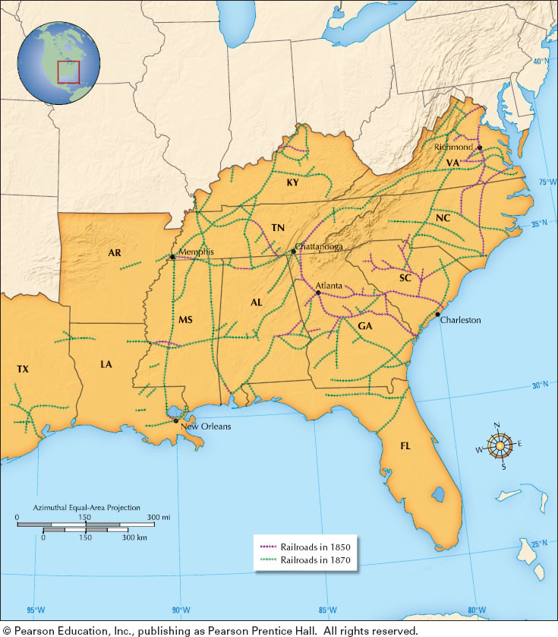
Transparency: Railroads Connect the South
TRANSPARENCY
Railroads Connect the South

Slide 9
The New South
Southern Farmers Face Hard Times
Cash Crop – cotton & tobacco = $$$
Too much cotton causes the price to _____________
Farmers band together – Farmers alliance
Tried – force railroads to lower rates
Government regulates pricing - price = distance
African American Gains
13th, 14th, 15th, military, businesses, education, new colleges, Civil Right Act 1875 – guaranteed use of public facilities
African American Losses
Segregation, violence, Court decisions reversed CRA-1875 – owners could choose who they served
DROP

Slide 10
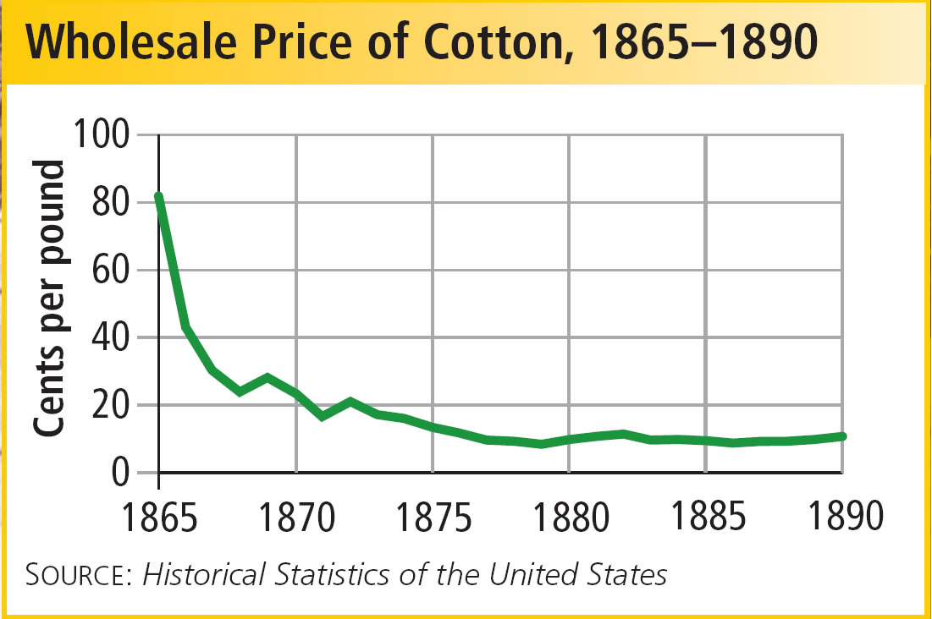
Chart: Wholesale Price of Cotton 1865-1890
CHART
Wholesale Price of Cotton, 1865-1890

Slide 11
The New South
Why did southern farmers face hard times?
How did southern blacks lose their rights?
When cotton prices because of a lack of buyers and the boll weevil infestation, southern farmers, whose main crop was cotton suffered
Some whites wanted to reverse the gains African Americans had made during reconstruction by segregating churches and passing laws that supported the elimination of black officials. Also, the Supreme Court made decisions that allowed segregation on the local level

Slide 12
Sec 2: Westward Expansion and the American Indians
Westward Expansion and the American Indians
Cultures Under Pressure
Main Idea: By the end of the Civil War, about 250,000 Indians lived in the region west of the Mississippi River referred to as “The Great American Desert.” Although they were lumped together in the minds of most Americans as “Indians,” Native Americans embraced many different belief systems, languages, and ways of life.
New Settlers and Native Americans Clash
Main Idea: The rapid industrial development and expansion following the Civil War set Native Americans and white settlers on a collision course.
The End of the Indian Wars
Main Idea: The conditions facing Native Americans had all the ingredients for tragedy. Indians were confined to isolated and impoverished areas, which were regularly subject to disease. Frustration, particularly among young warriors, turned to violence.
The Government Promotes Assimilation
Main Idea: The reservation policy was a failure. Making Indians live in confined areas as wards of the government was costly in human and economic terms.
Continued…

Slide 13
Westward Expansion and the American Indians
Cultures under pressure
Though most Native American tribes had different ways of life they all believed they were one with nature and nature was sacred – white men did not feel the same way.
Early 1800s Indians can have the west – desert uninhabitable
1830s trade regulation = limited white access to territory
1850s Gold & silver found in Indian territory
1851 railway wanted restrict Indians to smaller territory
1860s Indians forced onto reservations
New diseases spread from white settlers

Slide 14
Westward Expansion and the American Indians
1. What three circumstances hurt Native Americans?
The forcing of Native Americans onto reservations;
the introduction of diseases which Native Americans were not immune;
the destruction of buffalo herds

Slide 15
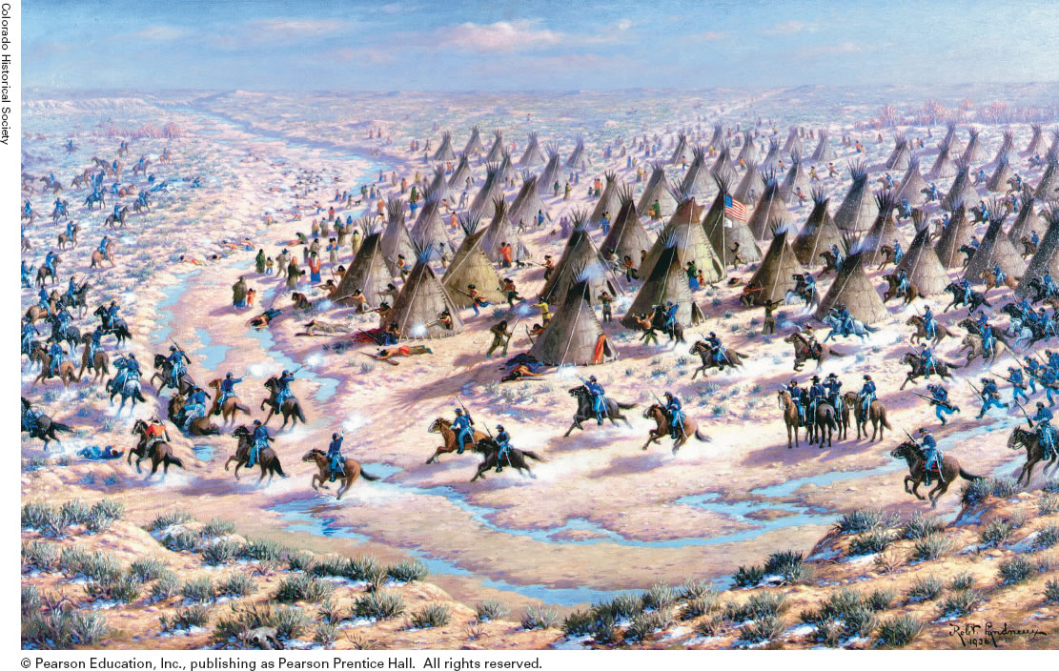
Transparency: Sand Creek Massacre
TRANSPARENCY
Sand Creek Massacre

Slide 16
Westward Expansion and the American Indians
New Settlers & Native Americans Clash
Sioux Indians resisted expulsion – attacked settlements in Minnesota
Sand Creek Massacre – US troops massacre federally protected Cheyenne and Arapaho tribes residing at Sand Creek (unarmed)
Plan for Peace Fails
Indians must settle on farms & become civilized
Fort Laramie Treaty – Sioux gained more land
Land was not adequate, some Natives could not abide by the rules

Slide 17
Westward Expansion and the American Indians
1. Why did tension exist between settlers and Indians?
Settlers wanted the land and its resources, but Native Americans did not want to move. Treaties were made, but the government did not enforce them.

Slide 18
Westward Expansion and the American Indians
Apache & Navajo War (1861-66)
Fetterman Massacre (1866)
Red River War (1874-75)
Battle of Little Big Horn (1876) – Sitting Bull
Nez Perce` War (1877) – Chief Joseph
Battle of Wounded Knee (1890)
Please understand all of these battles (wars) between settlers and Indians

Slide 19
Westward Expansion and the American Indians
Government promotes assimilation
Indians would become farmers and adapt white mans culture
Assimilate – take on traits of others immediately
Why is forced assimilation destined to fail?
Dawes General Allotment Act
Replaced reservation system and gave Indians 160 acre lots to KEEP for 25 years. Worked fine in the east, but was not enough to supply a family in the west.
More assimilation – schools - learn our culture
This entails major psychological changes and often severing of emotional ties with one’s background and family. Most cases this causes a person to no longer belong to their old culture or their new one, leaving them with no future. Can cause severely violent reactions

Slide 20
Infographic: Assimilation by Force
INFOGRAPHIC
Assimilation by Force

Slide 21
Westward Expansion and the American Indians
1. How did the Dawes Act change the way Indians were treated?
Native American families were granted land, and it was protected for 25 years in hopes that younger generations would take up farming to go along with their knowledge of their new culture.

Slide 22
Sec 3: Transforming the West
Transforming the West
Miners Hope to Strike It Rich
Main Idea: Mining was the first great boom in the West. Gold and silver were the magnets that attracted a vast number of people. Prospectors from the East were just a part of a flood that included people from all around the world.
Railroaders Open the West
Main Idea: As industry in the West grew, the need for a railroad to transport goods increased as well. The effects of the new railroads were far reaching. They tied the nation together, moved products and people across the continent, and spurred industrial development.
Ranchers Build the Cattle Kingdom
Main Idea: Cattle ranching fueled another western boom. This was sparked by the vast acres of grass suitable for feeding herds of cattle. Once the railroad provided the means to move meat to eastern markets, the race was on for land and water.
Farmers Settle on Homesteads
Main Idea: The Great Plains were the last part of the country to be heavily settled by whites. It was originally set aside for Indians because it was viewed as too dry for agriculture. Yet, with the coming of the transcontinental railroad, millions of farmers moved into the West.
Continued…

Slide 23
Note Taking: Reading Skill: Identify Main Ideas
NOTE TAKING
Reading Skill: Identify Main Ideas

Slide 24
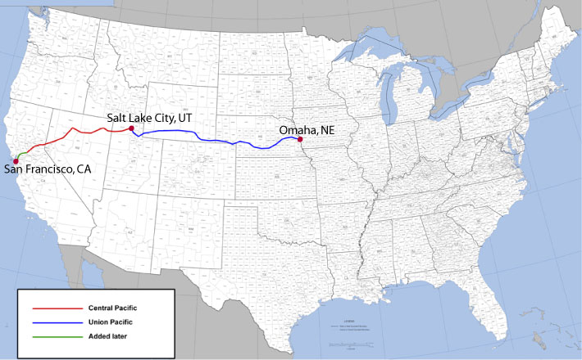
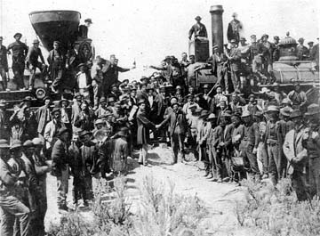
Transforming the West
Miners hope to strike it rich
Mining towns spring up over night
Rules set up to settle disputes – vigilantes – administered justice
Boomtowns to ghost towns when the gold ran out
Mining goes from small time to big time
Companies drill deep mines – extract gold using tracks – hire Mexicans and Chinese to work underground
Railroads Open the West
Transcontinental Railroad – not government owned
Used land grants to fund
Central Pacific headed east while the Union Pacific headed west, meet at Promontory Point, Utah
Promontory Point

Slide 25
Transforming the West
Railroad Opens the West
Workers – Irish, Chinese, Mexican, short supply, harsh conditions, DEATH
Railroad changed the west – New towns and cities – you wanted your city close to the railroad; people bought up land that might get access to the railroad (Why?)
Union begins to swell
To become a part of the United States of America from 1864-1896 you had to meet the following requirement
You must have 60,000 inhabitants
10 new territories met this requirement

Slide 26
Transforming the West
Ranchers build the cattle kingdom Railroad was used to move meat (food)
Open-range system
No fences, cattle grazed freely
Stereotypical Cowboy emerges along with cattle drives (dangerous)
Cow Town – Dodge City, Kansas
Rise of legends: Wild Bill, Wyatt Earp, Doc Holiday, Jesse James
Demise of the Open-Range
Barbed wire invented
Supply of beef exceed demand
Extreme weather

Slide 27
Transforming the West
What were the two major phases of mining?
2. How did the government encourage the development of the Transcontinental Railroad?
3. How did the railroad affect the cattle industry?
Individual miners worked surface soil or streambeds; big companies took over to mine deep underground
It provided money for construction and gave land grants to the railroad companies
Railroads provided a way to ship beef. Ranchers had to use cattle drives to get cattle to railroad stations.

Slide 28
Transforming the West
The Great Plains
Homestead Act provides anyone willing to live on, build a road, and dig a well, 160 acres of land
African Americans (Exodusters) – took this chance in Kansas & Oklahoma
Everyone had a job to do to provide for the family in the west
Needs met? Barb wire, plow, windmill – all helped farmers succeed somewhat
Morrill Act 1892 – establishment of Agricultural Colleges
Competition, Conflict & Change
How to use the west – led to violence
Prejudice & Discrimination – not just black & white – ranchers vs. farmers. Only 20% of the population with 80% of the minorities
By 1890 all of the US was inhabited closing the frontier

Slide 29
Transforming the West
Why did farmers move to the Great Plains?
2. What were some of the causes of prejudice and discrimination in the West?
To own land and for more space, freedom, and profit given to them through the Homestead Act
The West only had 20% of the US population at the time, however 80% of the population in the West was a minority. Differences in language, food, culture, and religious practices reinforced each groups fear & distrust of one another. There were also cases of ranchers vying for the use of land that would be much different than the ideas of a farmer.

Slide 30
