Slide 1
Chapter 8: The Jefferson Era (1800-1816)
“The Presidents”

Slide 2
Federalists | Democratic-Republicans
The name Federalist was first used to describe supporters of the Constitution. By the 1790’s the word was applied to a the group of people who supported the polices of Alexander Hamilton. Generally, Federalists stood for a vigorous federal government. | The efforts to turn public opinion against the Federalists began in 1791 when Philip Freneu began publishing the National Gazette. Thomas Jefferson helped the newspaper get started. The Republicans wanted to leave as much power as possible to the state governments. They feared that a strong federal government would endanger people’s liberties.

Slide 3




Thomas Jefferson
Becomes The 3rd President
Of The United States
March 4, 1801
Thomas Jefferson became the third President of the United States on March 4, 1801.
The president was from the state of Virginia. He was a Republican. He was the vice president to John Adams. He worked on the committee that wrote the Declaration of Independence. Jefferson was in the first cabinet to George Washington and held the office of Secretary State.
Jefferson was 57 years old when elected. His occupation(job) was a planter/farmer and lawyer.
Jefferson believed in a wise and frugal government and supported strong state governments.
Jefferson also believed in a policy called “laissez-faire”. This meant that the government plays only a small part in the economic concerns of a country.

Slide 4


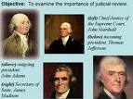


Marbury v. Madison
The First Supreme Court Case
1803
In Marbury v. Madison, the Supreme Court for the first time exercised its right to review and rule on acts of the other branches of government.
Chief Justice John Marshall was the individual in charge of the Supreme Court for this decision.
This exercised right is known as judicial review. This power has become a basic part of the system of checks and balances of our government .

Slide 5


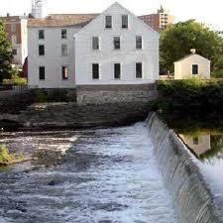
People left their homes and farms to work in the mills. This meant a new way of working as well as a new way of producing goods. The changes this system brought about were so great that this time in history is known as the Industrial Revolution.
The Industrial Revolution began to take root in the United States around the 1800’s, appearing first in New England. The New England states-Massachusetts, Rhode Island, Connecticut, Vermont, and New Hampshire-offered ideal conditions for the development of factories. New England’s poor soil made it difficult to farm. As a result, people were willing to leave their farms to find work elsewhere. New England had many rushing rivers and streams, which provided the necessary waterpower to run the machines.

Slide 6
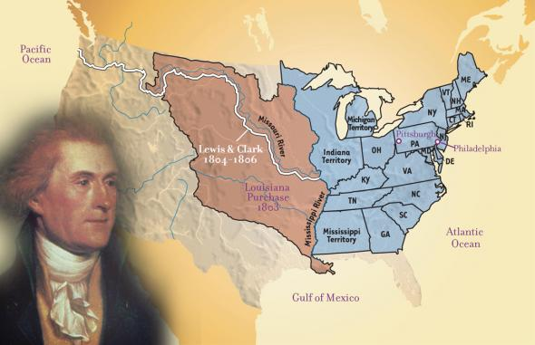
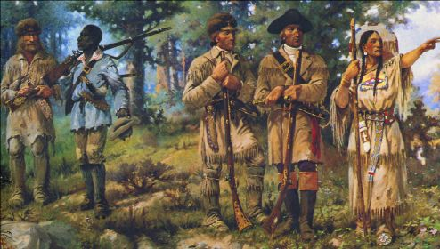
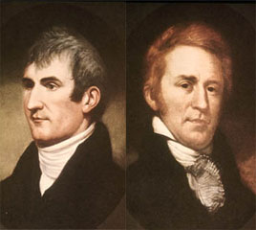
The Louisiana Purchase
&
The Adventures of Lewis & Clark
1804
In 1800 the territory of the United States extended only as far west as the Mississippi River. The area to the west of the river----was known as the Louisiana Territory---belonged to Spain. It was an enormous area of land, anchored to the south by the city of New Orleans and extending west to the Rocky Mountains.
The Spanish allowed American pioneers to travel up and down the river. Many pioneers settled down and established farms along the rivers fed into the upper Mississippi River. They needed the river to ship their crops to markets.
The Spanish also allowed farmers to sail on the lower Mississippi and trade in New Orleans. For the western farmers, this right was vital.

Slide 7
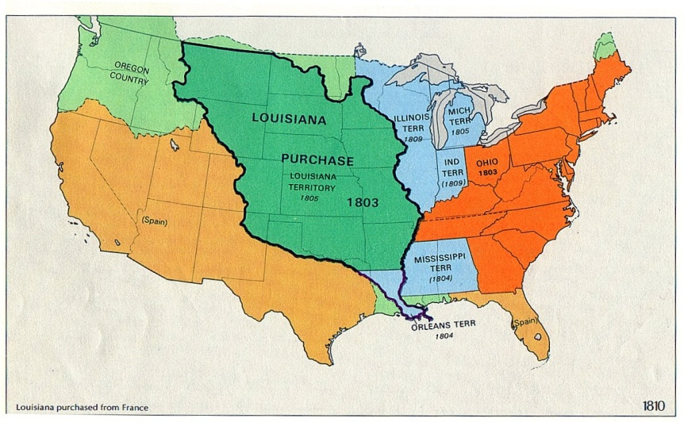

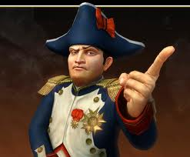
The Louisiana Purchase
&
The Adventures of Lewis & Clark
Suddenly in 1802 the Spanish changed their policy and refused to allow American goods to move into or past New Orleans.
That same year President Jefferson learned that Spain and France had made a secret agreement to transfer the Louisiana Territory to France.
This agreement posed a series threat to the United States. France’s leader Napoleon Bonaparte, had plans for an empire in Europe and in the Americas.
As a result President Jefferson authorized U.S. Ambassador to France(Robert Livingston) to offer $10 million dollars for the port of New Orleans and West Florida.

Slide 8
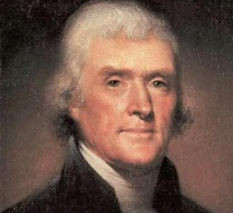

The Louisiana Purchase
&
The Adventures of Lewis & Clark
Napoleon was forced to abandon his plans for an American Empire due to the revolt on the island of Santo Domingo(Haiti and the Dominican Republic). As a result of this situation, the French were stunned by their losses and feared that the British may ask the Americans to join forces against them. Also, France needed money to finance Napoleon’s plans for war with Britain. The French believed they had something for sale and that the United States might want to buy it.
The French foreign minister Charles de Talleyrand informed the Americans that the whole Louisiana Territory was for sale. James Monroe and Livingston were completely surprised. This was a deal to good to pass up. President Jefferson approved of the $15 Million Dollar Purchase through the use of the federal government’s treaty-making powers.

Slide 9
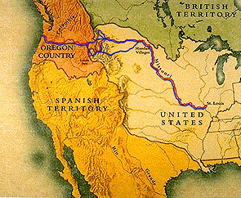
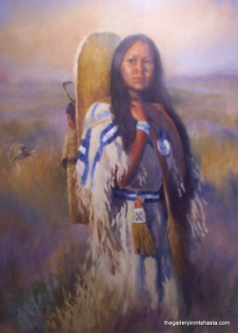
The Louisiana Purchase
&
The Adventures of Lewis & Clark
President Jefferson wanted to know more about the mysterious lands west of the Mississippi River. To head the expedition, Jefferson choose 28 year old Merriweather Lewis. Lewis was Jefferson’s personal secretary and well qualified to lead this journey of exploration. The expedition’s co-leader was William Clark, 32, a friend of Lewis’s from his military experience.
The expedition left St. Louis in the spring of 1804, slowly working its way up the Missouri River. Lewis and Clark kept a journal of their voyage, making notes on what they saw and did. They camped in present day Bismarck, North Dakota and hired a French trader that was married to a Shoshone women named Sacagawea. When the group finally reached the Rocky mountains, Sacagawea was instrumental in navigating this difficult area, which were her native lands.
The expedition finally reached the Pacific Ocean at the mouth of the Columbia River in November 1805, after 18 months and nearly 4,000 miles of travel. They established Fort Clatsop at this point and returned to St. Louis in 1806.

Slide 10

James Madison
Becomes The 4th
President of The United States
March 4, 1809
James Madison became the fourth President of the United States on March 4, 1809. He served as President until March 11, 1817.
He is hailed as the “Father of the Constitution” for being instrumental in the drafting of the United States Constitution and as the key champion and author of the United States Bill of Rights. After the Constitution had been drafted, Madison became one of the leaders to ratify it. His collaboration with Alexander Hamilton and John Jay produced the Federalist Papers in (1788). These papers became one of the most important pieces to rally support for the Constitution’s ratification amongst the Thirteen Original Colonies.
James Madison did not take office as president under the most favorable conditions. Following in the imposing footsteps of President Jefferson was not an easy task. In addition, the United States was stuck in the middle of embargo crisis and Britain continued to claim the right to halt American ships, and cries for war with Britain grew louder and louder from the “War Hawks”.

Slide 11
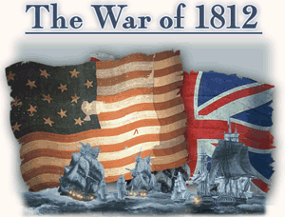
“Mr. Madison’s War”
The War of 1812
After his election to the presidency, he presided over renewed prosperity for several years. As president (1809–17), after the failure of diplomatic protests and a trade embargo against Great Britain, he led the nation into the War of 1812.
He was responding to British encroachments on American honor and rights; in addition, he wanted to end the influence of the British among their Indian allies, whose resistance blocked United States settlement in the Midwest around the Great Lakes.
Madison found the war to be an administrative nightmare, as the United States had neither a strong army nor financial system; as a result, he afterward supported a stronger national government and a strong military, as well as the national bank, which he had long opposed.

Slide 12
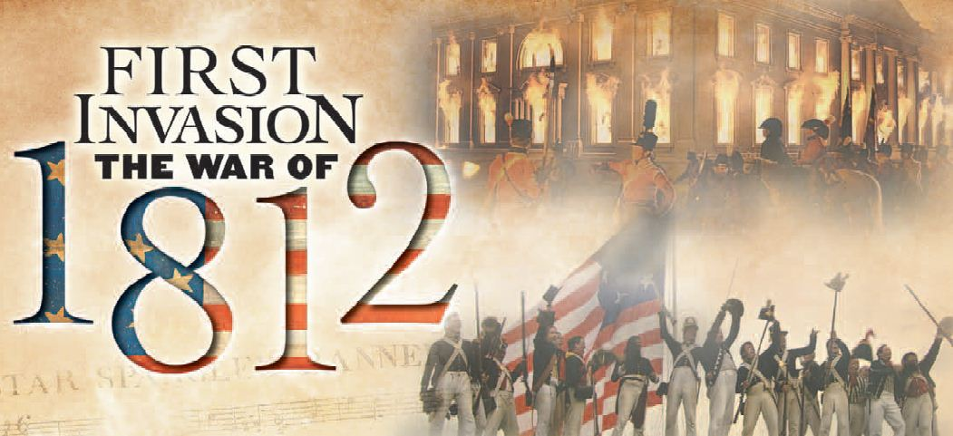
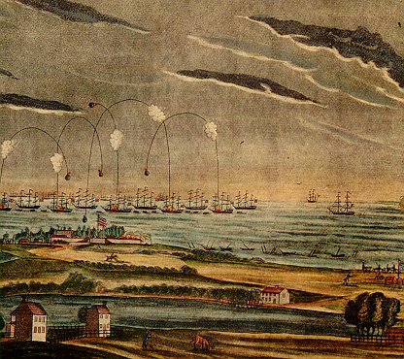
The War of 1812
Attack on Washington, D.C.
The Capital and the president’s mansion were burned by the British
“Mr. Madison’s War”
“The Star-Spangled Banner “
Is written by an attorney named Francis Scott Key as the bombs burst over Fort McHenry which guarded Washington, D.C.!
The War Ends:
American and British representatives signed the Treaty of Ghent in 1814 ending the war. In the end, the War achieved nothing for either side. The treaty did not change any existing borders. In Europe there was a big result, Napolean had been defeated finally, by the British. There was one more battle to be fought in the America’s between the British and the United States.

Slide 13
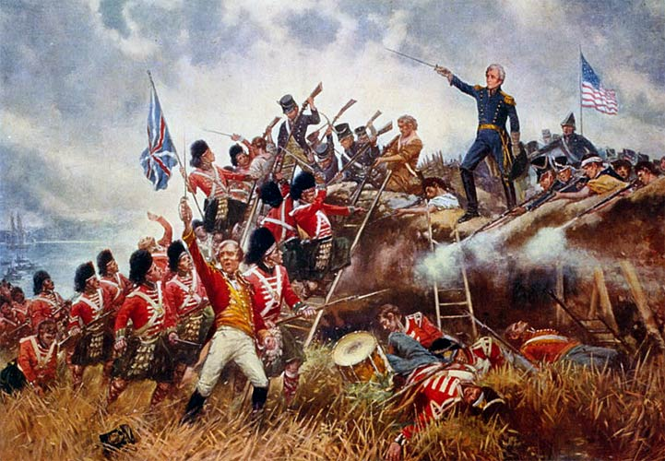
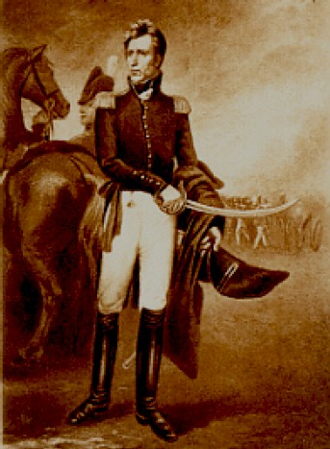
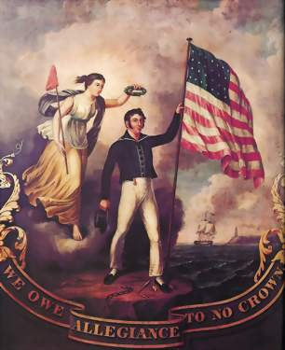
The War of 1812
However, the news of the treaty did not arrive in time to North America prior to a final ferocious battle which occurred in New Orleans.
Led by General Andrew Jackson the Americans achieved a decisive and bloody victory at New Orleans and ended the War of 1812 over the British very positively!
With this victory there were candlelight parades, fireworks, and public prayers. The War brought a new spirit of nationalism throughout the country!
Americans felt pride in their new country and more equal in their relationship with their former homeland!

