Slide 1
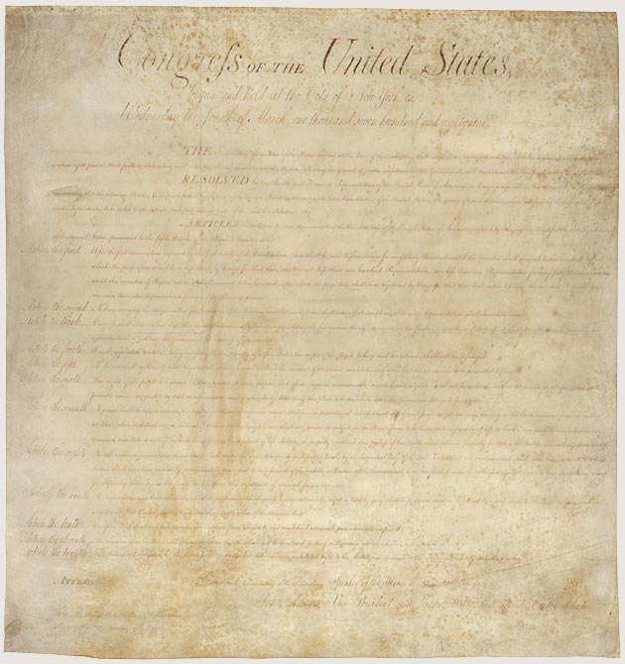
The Bill of Rights

Slide 2
Amendment 1
Congress shall make no law respecting an establishment of religion, or prohibiting the free exercise thereof; or abridging the freedom of speech, or of the press; or the right of the people peaceably to assemble, and to petition the Government for a redress of grievances.

Slide 3
Amendment 1
No state religion
Government can’t ban a religion
Free speech
Government can’t interfere with the press
We have the right to meet in (peaceful)groups
We can complain to the government

Slide 4
Amendment 2
A well regulated Militia, being necessary to the security of a free State, the right of the people to keep and bear Arms, shall not be infringed.

Slide 5
Amendment 2
Citizens have the right to own weapons/firearms
Implies that national defense will rely on state militias, not the US military
Much argument over what weapons are allowable according to the 2nd amendment

Slide 6
Amendment 3
No Soldier shall, in time of peace be quartered in any house, without the consent of the Owner, nor in time of war, but in a manner to be prescribed by law.

Slide 7
Amendment 3
You cannot be forced to let soldiers stay in your house
Only applies to times of peace

Slide 8
Amendment 4
The right of the people to be secure in their persons, houses, papers, and effects, against unreasonable searches and seizures, shall not be violated, and no Warrants shall issue, but upon probable cause, supported by Oath or affirmation, and particularly describing the place to be searched, and the persons or things to be seized.

Slide 9
Amendment 4
The government cannot search through or take your things without “probable cause”
In other words, they have to have a valid reason
Police officers need a search warrant in order to look through someone’s property
Police can still conduct “emergency searches”

Slide 10
Amendment 5
No person shall be held to answer for a capital, or otherwise infamous crime, unless on a presentment or indictment of a Grand Jury, except in cases arising in the land or naval forces, or in the Militia, when in actual service in time of War or public danger; nor shall any person be subject for the same offence to be twice put in jeopardy of life or limb; nor shall be compelled in any criminal case to be a witness against himself, nor be deprived of life, liberty, or property, without due process of law; nor shall private property be taken for public use, without just compensation.

Slide 11
Amendment 5
You can’t be charged and tried for a serious crime without enough evidence for an indictment, formal accusation.
You cannot be a witness against yourself in a trial
This is known as “pleading the 5th”
You cannot be tried for the same crime twice, double jeopardy
You cannot have your property taken without good reason
One exception, the government’s power of eminent domain, the power to take personal property for the benefit of the public.
If you do have property taken away, you need to be compensated for your loss.
This is all part of due process of the law. Laws must be fairly applied

Slide 12
Amendment 6
In all criminal prosecutions, the accused shall enjoy the right to a speedy and public trial, by an impartial jury of the State and district wherein the crime shall have been committed, which district shall have been previously ascertained by law, and to be informed of the nature and cause of the accusation; to be confronted with the witnesses against him; to have compulsory process for obtaining witnesses in his favor, and to have the Assistance of Counsel for his defence.

Slide 13
Amendment 6
Protects the rights of citizens on trial
Trials must be speedy and held publicly, with an unbiased jury
Allows for more transparency
The accused has the right to know what they are on trial for
They have the right to question witnesses called against them
They have the right to an attorney. If they can’t afford one the government must provide one.

Slide 14
Amendment 7
In Suits at common law, where the value in controversy shall exceed twenty dollars, the right of trial by jury shall be preserved, and no fact tried by a jury, shall be otherwise re-examined in any Court of the United States, than according to the rules of the common law.

Slide 15
Amendment 7
Citizens have the right to take civil cases (non-criminal) to a judge and jury for trial.
Civil cases usually involve disputes over money or property.

Slide 16
Amendment 8
Excessive bail shall not be required, nor excessive fines imposed, nor cruel and unusual punishments inflicted.

Slide 17
Amendment 8
We have a right to a reasonable bail if we are on trial.
By posting a bail a defendant is able to stay out of jail while waiting for and/or during their trial.
If they don’t show up to their trial they have to pay the bail amount, like a fine.
Bails cannot be excessive, however they can be denied in very serious cases
Punishments for crimes cannot be excessive or overly cruel
Many argue over the exact definition of “cruel and unusual”

Slide 18
Amendment 9
The enumeration in the Constitution, of certain rights, shall not be construed to deny or disparage others retained by the people.

Slide 19
Amendment 9
The people have more rights than what the constitution and the bill of rights specifically grant them.
For instance: we are not specifically given the right to an education but we still view it as one.

Slide 20
Amendment 10
The powers not delegated to the United States by the Constitution, nor prohibited by it to the States, are reserved to the States respectively, or to the people.

Slide 21
Amendment 10
Any rights not given specifically to the national government goes to the state governments or the people.
This helps to balance out power between the state and federal government

Slide 22
The rejected amendments

Slide 23
Amendment 1
After the first enumeration required by the first article of the Constitution, there shall be one Representative for every thirty thousand, until the number shall amount to one hundred, after which the proportion shall be so regulated by Congress, that there shall be not less than one hundred Representatives, nor less than one Representative for every forty thousand persons, until the number of Representatives shall amount to two hundred; after which the proportion shall be so regulated by Congress, that there shall not be less than two hundred Representatives, nor more than one Representative for every fifty thousand persons.

Slide 24
Amendment 2
No law, varying the compensation for the services of the Senators and Representatives, shall take effect, until an election of Representatives shall have intervened.

