Slide 1
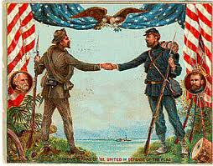
Reconstruction Era (1863-1877)

Slide 2
Define Reconstruction-
The art, process, or manner of re-establishing, re-building, or re-making something.
Question- What needed to be Reconstructed after the Civil War?
a) Political Institutions d) Cities
b) Transportation System e) Economy
c) Financial Structure f) Countryside
g) The relationship between the North & the South

Slide 3
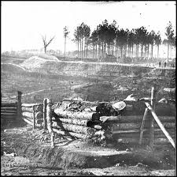
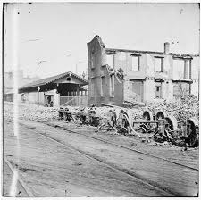
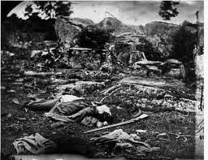
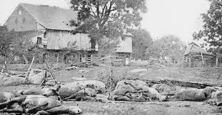
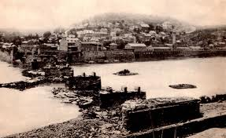
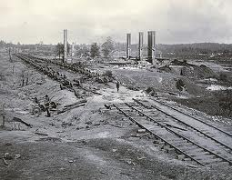
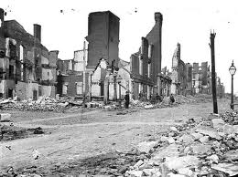
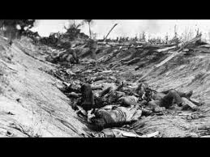
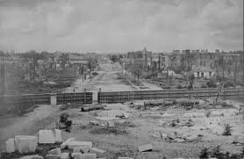

Slide 4
Repair the damage
The casualties of the Civil War were over 650,000. (From 10,455 engagements, naval clashes, accidents, suicides, sicknesses, murders, and executions)
The U.S. government spent an estimated $6.2 billion by 1879. (War & Reconstruction)
The Confederacy spent perhaps $2.1 billion.
Physical Devastation: burned or plundered homes, pillaged countryside, untold losses in crops & animals, ruined buildings/bridges, destroyed railroads, and neglected roads (South in Ruins)

Slide 5
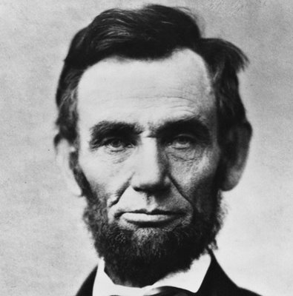
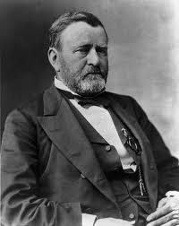
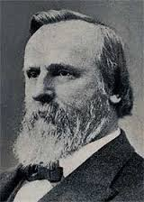
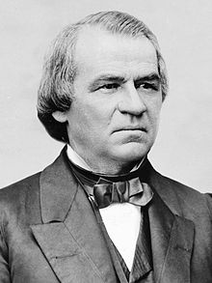
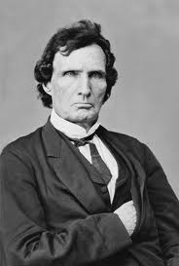
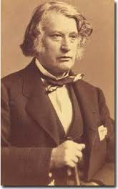
Faces of Reconstruction

Slide 6
Reconstruction Plans
Lincoln’s Plan- (10% Plan)
Amnesty for Oath of Loyalty
Emancipate the Slaves
New Gov’t after 10% take oath
No Confed. officers or officials
Mod/Rad.- Wade Davis Bill (51%)
Majority of voters must take oath
New States must abolish slavery
Must reject Confed. War debts
Deny officers/officials vote & office
Johnson’s Plan
Amnesty for all except wealthy
Revoke ordinance of succession
Ratify the 13th Amendment
Reject Confederate War debts
Congressional Plan
No officer/official in new Gov’t
Abolish Slavery & give AA’s Vote
Civil Rights Act / 14th Amendment
Pass Military Reconstruction Act

Slide 7
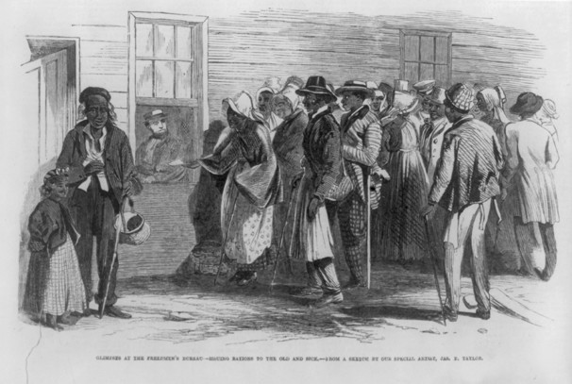
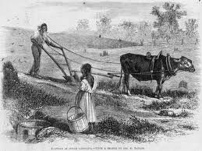
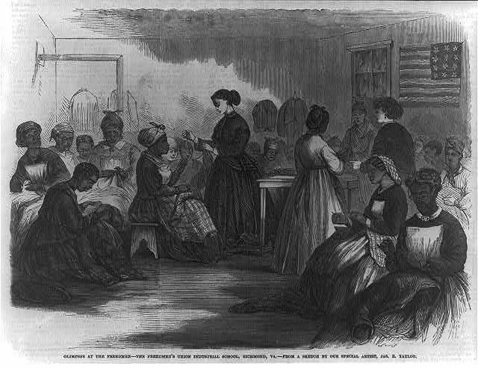
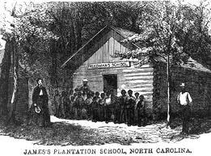
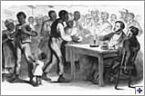
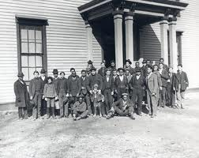
The Freedmen’s Bureau
Aid Organization
Provide Food
Provide Clothes
Provide Money
Legal Services
Labor Contracts
Create Schools
Medical Care
For Whites/Blacks
Food Lines
Labor & Land Contracts
Public Schools
Make Clothes
Provide Money / Legal Adv.
Howard University

Slide 8
Controlling Reconstruction
Lincoln- pocket vetoes the Wade Davis Bill
A. Johnson- blames wealthy Southerners for the war. Re-admits States but they elect CSA leaders and States pass black codes.
Radical/Moderate Republicans- (Stevens/Sumner) join forces & override Johnson’s veto’s(Freedmens Bureau/Civil Rights Act/Military Reconstruction)
Impeached- Congress charges Johnson with violating the Office of Tenure Act (fired Stanton). He is not removed b/c he didn’t commit a crime.
US Grant- Republican’s nominate Grant for the Election of 1868 (War Hero)

Slide 9
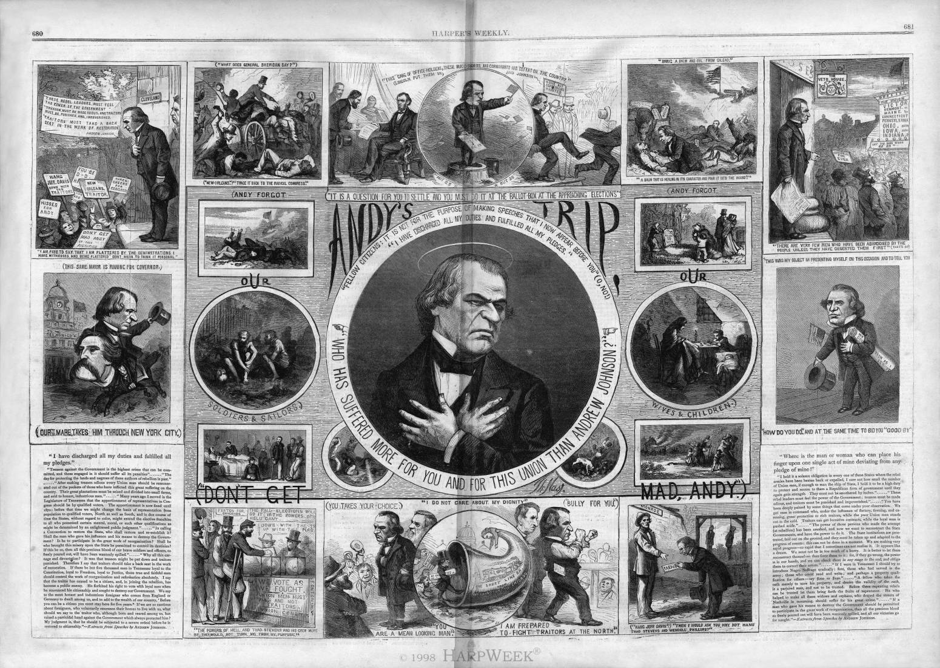

Slide 10
Johnson Loses Control
Johnson attacks the Radical Republicans & their policies (Fires Stanton & other officers/Tenure Act)
Radicals push Military Reconstruction Act through Congress (override veto/ 5 districts/ start over)
House of Representatives impeaches Johnson but the Senate is 1 vote short of removal (no crime)
In the Election of 1868 the Republicans nominated US Grant over Johnson because he was the hero of the war and he would get votes from AA voters in the South (esp. with the military protecting them)

Slide 11
Reconstruction Amendments
All persons born or naturalized in the US are citizens
Neither slavery nor involuntary servitude shall exist within the US or any place subject to its jurisdiction
The right of citizens of the US to vote shall not be denied or abridged by the US or State on account of race, color, or previous condition of servitude
No State shall deprive any person of life, liberty, or property, without due process of law
Congress has power to pass appropriate legislation to enforce the law
All persons must have equal protection of the laws

Slide 12
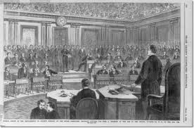
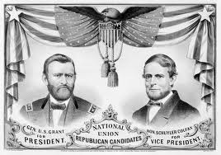
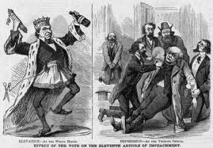
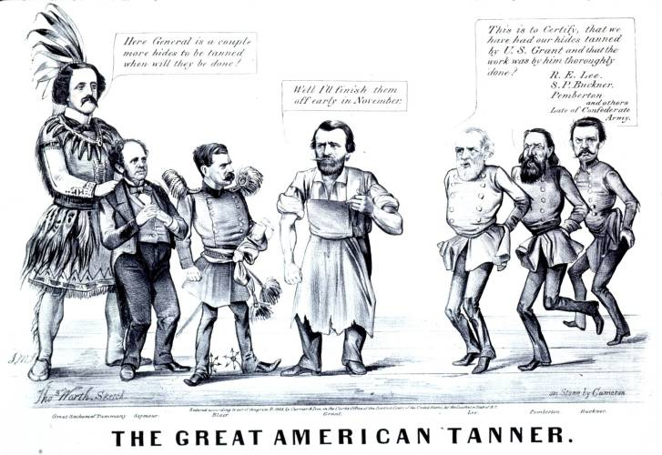
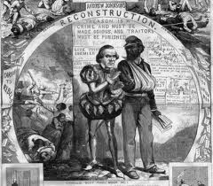
Johnson to Grant 1865-1868

Slide 13
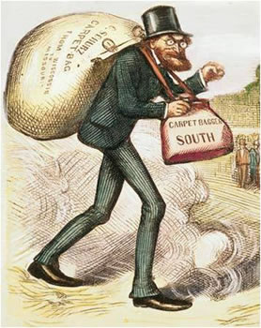
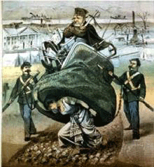
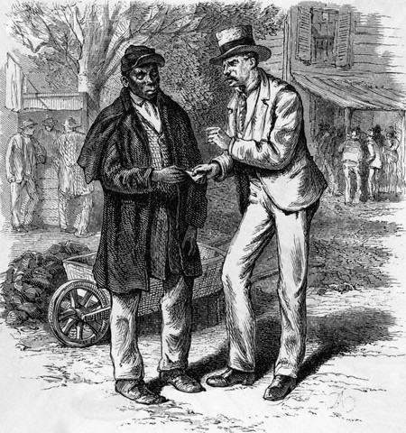
Carpetbaggers & Scalawags
1. A Northerner who went to the South after the Civil War for political or financial advantage.
2. An outsider, especially a politician, who seeks a position or success in a new locality.
a scamp; rascal.
2. a white Southerner who supported Republican policy during Reconstruction, often for personal gain.

Slide 14
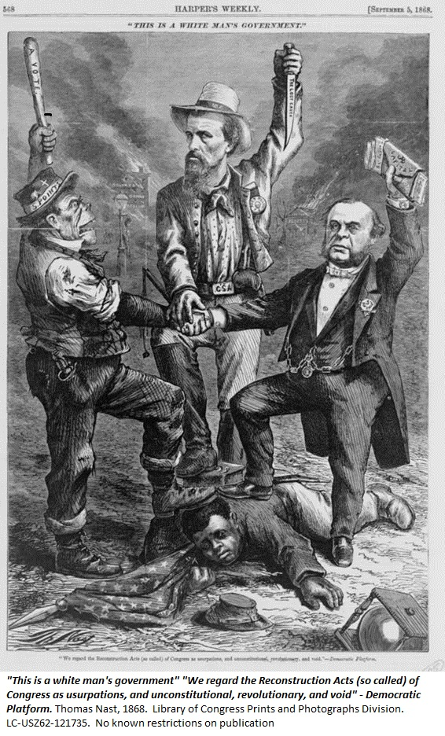
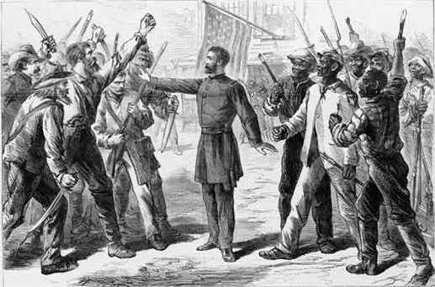
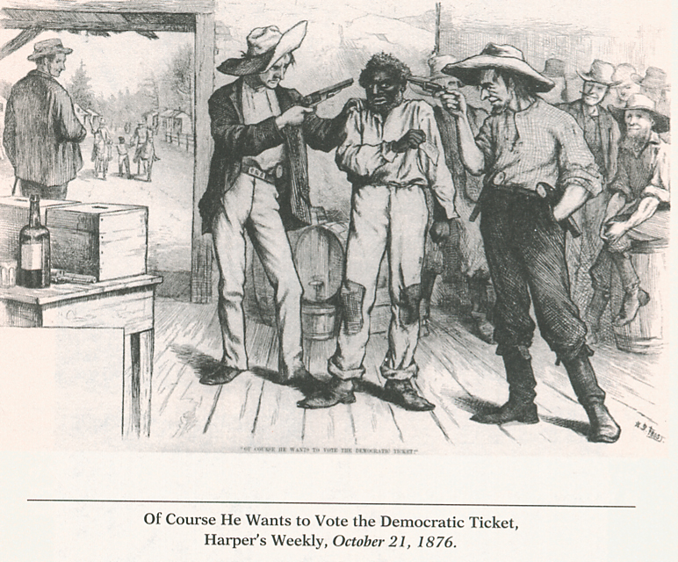
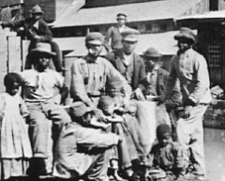
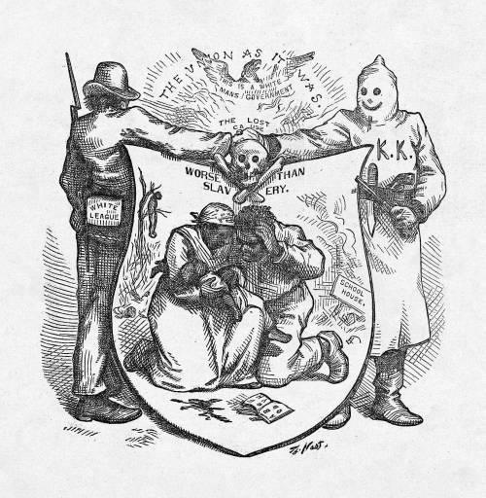
Broken Promises

Slide 15
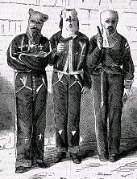
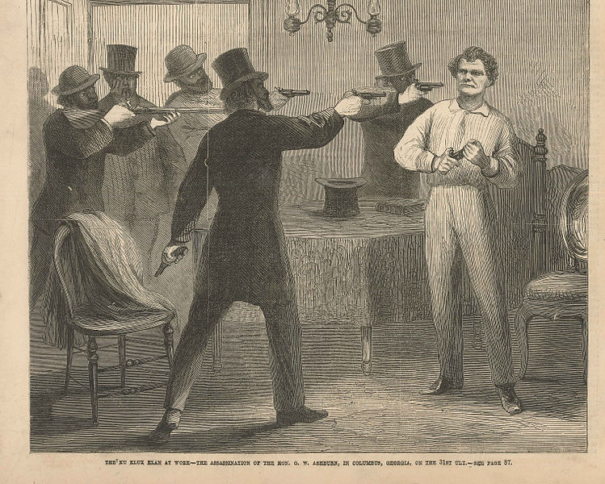
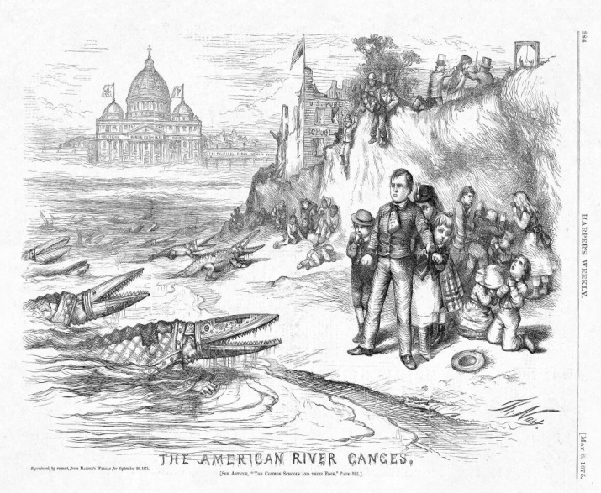
The Ku Klux Klan
The first Klan began in the South during the late 1860s.
Adopted white costumes: robes, masks, and conical hats, to be terrifying, and to hide their identities.
Desired to rid the South of all Northern influence.
Advocated white supremacy, white nationalism, and anti-immigration/catholic.
Contributed to Democrats regaining political power in all the Southern states by 1877
Congress passed the Enforce- ment Acts in 1870 to combat the violence.

Slide 16
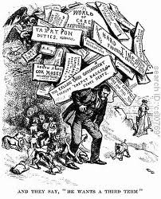
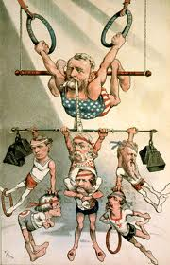
Grant’s Challenges

Slide 17
Grants Reconstruction Woes
Southerners fought against the “Carpetbaggers”, “Scalawags”, & “Freedmen”
The Military & Congress combat attacks on white & black supporters of “Republicanism” with the Enforcement Acts (KKK Act)
Graft undoes the positives of hospitals, building projects, orphanages, industries, & schools (bribes)
Democrats are against “Sin Taxes” (favor wealthy)
Presided over: Transcontinental RR completed and the 1st National Park is created(Yellowstone)
Scandals (Whiskey Ring) make Grant look corrupt and incompetent. (Bribes/False Tax Reports)

Slide 18
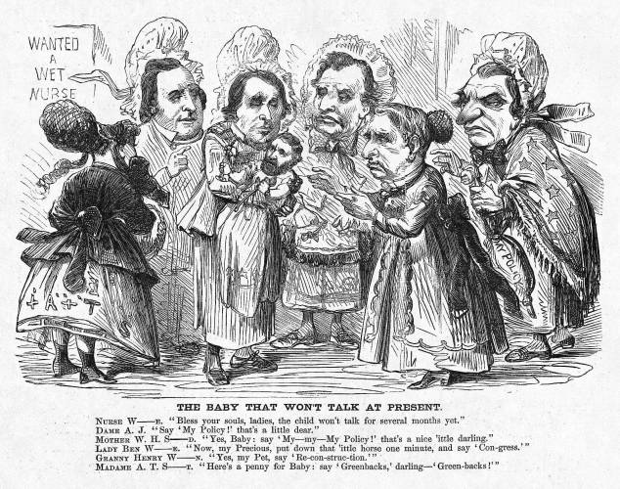
Grants Shortcomings

Slide 19
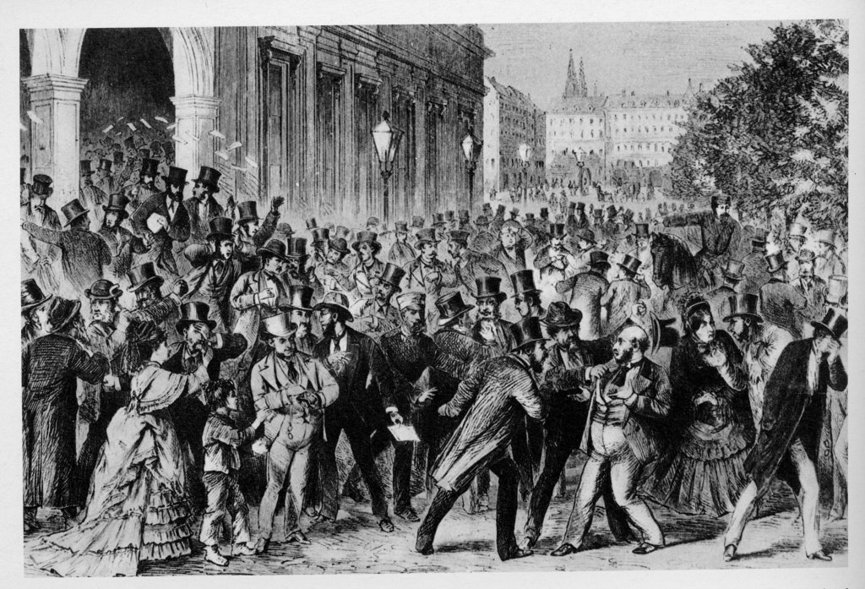
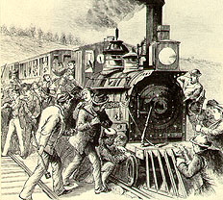
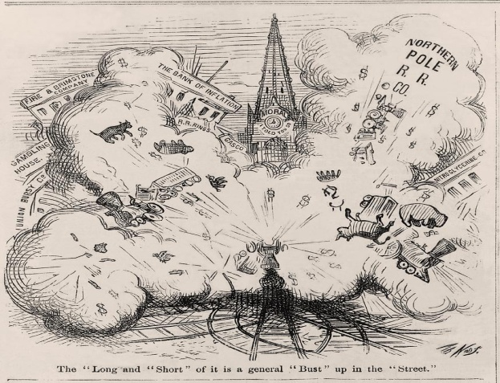
Panic of 1873
Sparked by Jay Cooke & Company bankruptcy (investment banking). They financed the No. Pacific RR, managed government wartime loans, sold bonds to people to raise capital)
The NY Stock Exchange was closed for 10 days, credit dried up, foreclosures rose, banks & RR’s failed, & factories closed. Charities were unable to give aid to the rising number of unemployed.
The people blamed Grant for mishandling the economy. The postwar period was one of unregulated growth with the government playing no role in curbing abuses (GRAFT).
In addition to the panic, working Americans developed a bitter distrust of banking and manufacturing leaders.

Slide 20
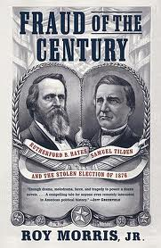
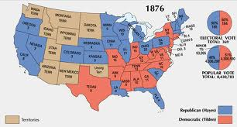
Election of 1876
Candidates
Rutherford B. Hayes (Rep)
Samuel J. Tilden (Democrat)
Platforms
Hayes-no scandals/end Reconstruction
Tilden-end corruption/ end Reconstruction
Results
Tilden- 1 short of majority
Compromise of 1877- gives Hayes the Win (North will remove troops from South)

Slide 21
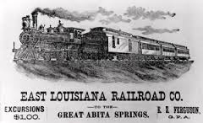
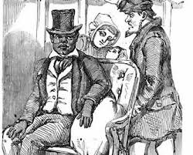
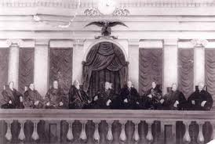
Plessy vs. Fergusson
Case that came before the Supreme court in 1896.
Ruled that “Separate but Equal is Legal”
Not undone until 1954 Case- Brown vs. Board

