Slide 1
Raising Minimum Wage
Olivia Susalla
Mary Marogi
Merna Yousif
Julius Eillya
5th hour
December 9, 2014

Slide 2
Why should minimum wage be raised?
About 47 million Americans live in poverty. When minimum wage is increased, many of these families will be able to live more comfortably.
Raising minimum can also increase worker productivity- when a worker feels he or she is getting paid fairly, he will work
The current minimum wage is not enough to keep many Americans above the poverty line.

Slide 3
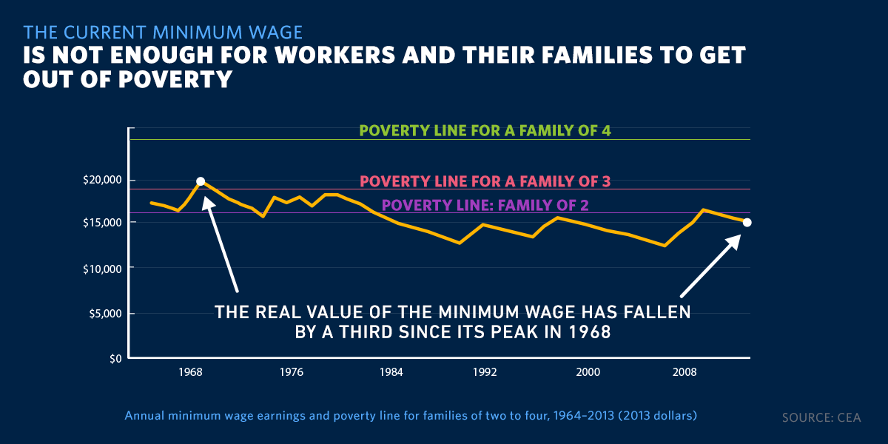
Graph shows poverty line and average yearly wage with minimum wage

Slide 4
opposition
Many people who oppose believe that raising minimum wage will create job loss. This is not true- Nobel Prize-winning economist Paul Krugman stated that "the evidence... points to little if any negative effect of minimum wage increases on employment.“
People also believe that minimum wage workers are mostly teenagers. But people over the age of 20 constitute more than 88 percent of the 30 million American workers who receive minimum wage. These are not teenagers.

Slide 5
Works cited
http://www.huffingtonpost.com/lawrence-wittner/the-minimum-wage-should-b_b_4251211.html
http://www.whitehouse.gov/raise-the-wage

