Slide 1
Think Tanks, Lobbyists, Interest Groups
Opposing an Increase in Minimum wage
By: Samiha Azmal,Tyler Tinsley, Kyle Skorupski, and Mario

Slide 2
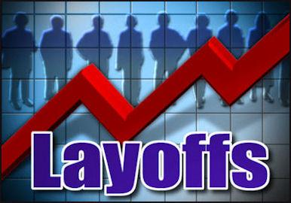
Higher Wages cause Higher Unemployment
This will cause employers to lay off some of their workers to compensate for higher wages and unemployment will increase due to the inability of employers paying higher wages to workers.

Slide 3
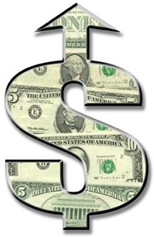
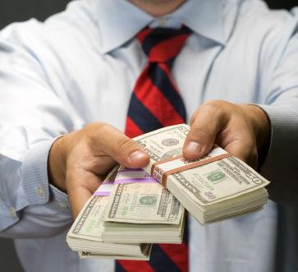
Minimum wage is a starting wage
Normally in most jobs under minimum wage, workers have the ability to get a raise to support themselves and their families.

Slide 4
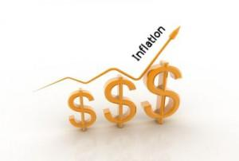
Inflation Occurs
*Inflation is a general increase in prices and fall in the purchasing value of money.
To compensate for the increase in minimum wage, businesses would increase prices and services.

Slide 5
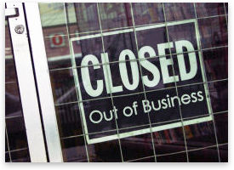
Small businesses will be threatened
Higher minimum wages put small businesses in danger. These businesses would have to lay off employees or be forced out of business.

Slide 6
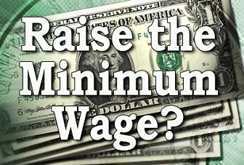
Credits
http://mrkay.weebly.com/uploads/2/9/3/5/2935169/_chapter_12_fact_sheet.pdf

