Slide 1
Minimum Wage Should Not Be Raised
Presented by
Chamber Of Commerce
Sara Clarke
Dinko I.
Darek E.
Jabir Ahmed

Slide 2
Raise Minimum Wage, Kill Jobs
During his State of the Union address, President Obama announced that he intended to raise minimum wages to $10.10/hour for certain workers. Based on data from EU countries, it is clear that minimum wage laws kill jobs.
Chief Financial Officers from around the world were interviewed and the majority of them concurred: a minimum wage increase from $7.25/hour to $10.10/hour would kill a significant number of jobs.
In other words, a increase in minimum wage would lead to employers having to pay their employees more. These employers are not all necessarily rich or big businesses that can afford a increase in wage pay. Many of America’s businesses wont be able to afford higher pays and therefore will have to cut employees in order to keep the business running and afford it.

Slide 3
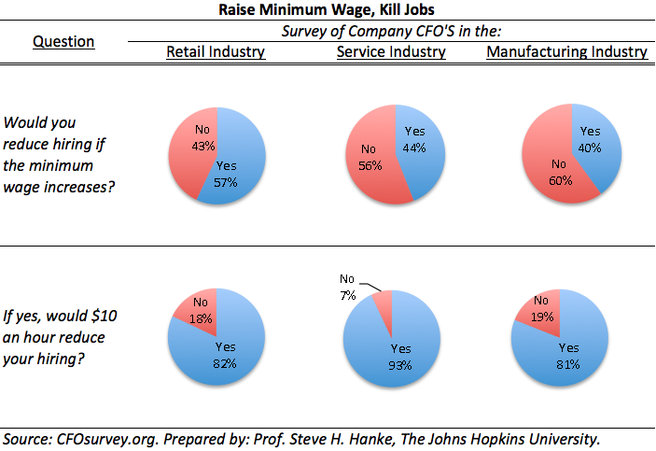
Raise Minimum Wage, Kill Jobs

Slide 4
Raising Minimum Wage Hurts Young People
According to the U.S. Department of Labor, half of minimum wage workers are younger than 25, and 24 percent are teens. This group’s unemployment rates are already higher than the 7.3 percent average rate. Not only this, the teen unemployment rate is 22 percent.
At its current level, the minimum wage disproportionately affects teens and low-skill workers. The minimum wage of $7.25 an hour, plus the mandatory employer’s share of social security, unemployment insurance, and workers’ compensation taxes, brings the hourly employer cost to $8, even without benefits. Raising the hourly minimum wage to $9 will bring the cost to employers to about $10.
In other words, a raise in minimum wage will cause employers more. And because of this, employers are more likely to keep or hire skilled workers at minimum wage than those unskilled, historically teens and young adults. An employer would hire a skilled worker at minimum wage knowing that with that skill comes more productivity from the worker and in turn also profit. Therefore, the young people who make up nearly half of the workers at minimum wage would be hurt due to a raise in it.

Slide 5
Raise Minimum Wage, Kill Jobs

Slide 6
Raising Minimum Wage Will Result in Higher Prices for Consumers
The costs of minimum wage increases must be paid by someone.
According to the 2012 Wilson review: A 2004 “study of more than 20 minimum wage studies looking at price effects found that a 10 percent increase in the U.S. minimum wage raises food prices by up to 4 percent.”
Also a 2007 study from the Federal Reserve Bank of Chicago found that restaurant prices increase in response to minimum wage increases.
Not only this, but raising minimum wage will cause costs for all people to go up whether, they are at minimum wage or not. For an employer to cover for the loss in pay, he or she may have to cut employees or in some situations raise prices on products. This means there will be higher costs on all products overall and thus a con for all people in general.
This affects especially those who are at minimum wage because it is already hard for them to get by in their life and now with an increase in costs, it’ll be even harder.

Slide 7
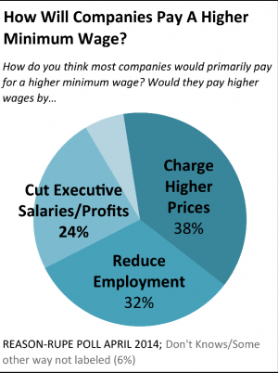
Raising Minimum Wage Will Result in Higher Prices for Consumers
In other words, employers might raise prices of their product in order to generate enough income to cover for this increase in wage, which could ultimately create a ripple effect for other shops and industries, resulting in a slightly higher cost of living, resulting in another push to raise minimum wage again.

Slide 8
Raising Minimum Wage Would Have Little Effect On Reducing Poverty
Studies from both sides of the debate make it relatively clear that increasing minimum wage will not make a significant impact on the poverty level.
According to the Congressional Budget Office report on The Effects of a Minimum-Wage Increase on Employment and Family Income, increasing the minimum wage from $7.25 to $10.10 per hour will only reduce the number of people in poverty by 900,000, a relatively few portion of the 16.5 million people that would supposedly benefit from the raise.
In other words, this is because of the number of minimum wage workers, relatively few are actually in poverty, and of families who live in poverty, only about 7 percent have a full-time worker in the family meaning poverty is not because people are not being paid enough, it is because they are not working or not working enough.
Not only this, but the 2012 Wilson review noted: “Since 1995, eight studies have examined the income and poverty effects of minimum wage increases, and all but one have found that past minimum wage hikes had no effect on poverty.”

Slide 9
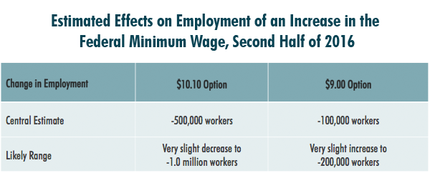
Raising Minimum Wage Would Have Little Effect On Reducing Poverty
Minimum wage has little effect on reducing poverty since poverty, the majority of it, is because of the number of jobs available and those that work. According to the supporters of this bill, an increase will help alleviate this poverty. But from our evidence we found, poverty has not been affected majorly by an increase in pay. Rather, we feel that poverty should be dealt with by other means such as creating more jobs. In doing so, poverty stricken people will have an opportunity to leave poverty and make money.

Slide 10
Competition Will Intensify
Finally, raising minimum wage will cause greater competition for work in the labor system.
If minimum wage increases, overly qualified individuals will be vying for minimum wage positions, pushing younger, inexperienced workers out of the running and robbing them of their opportunity to gain experience and knowledge to build a resume for themselves and enter the workforce.
In other words, employers will more likely hire skilled or experienced workers rather than unskilled or inexperienced ones. From earlier in our presentation, you may recall that nearly 50% of the people at minimum wage are under the age of 25, aka young people. And the majority of these young people are just leaving high school or have just started college where they have little experience in the actual job market. Therefore, this increase in minimum wage would be unfair and hurtful towards those who may not qualify as much as others for a job and also make it harder for some to be hired as well.

Slide 11
It Is Not Fair For Everyone
Not only is it not fair in terms of employment in the job market, a raise in minimum wage is not fair for everyone.
Raising the minimum wage to $10.10 an hour would be unfair to those who are already employed at that pay. So for those people, they would ask for a raise since they didn’t sign up to be paid at minimum wage. And so what this does is it creates a ripple affect that when minimum wage is increased, all other wages are affected in some way as well. And if an employer or business does not have to raise another’s wage just because of an increase in minimum wage, then this would be unfair to that person. For example, if I am working at 10.10 an hour and the minimum wage is raised to 10.10 an hour, it’d be logical for me or any other person in similar situations to ask for a raise since I did sign up to be paid at minimum wage.
And so, raising minimum wage would be very unbeneficial to any working employee, especially if that employee is now being paid, technically, minimum wage

