Slide 1

Life in the Colonies

Slide 2
Learning Target
Learning Objective: Students will be able to compare and contrast life each colonial region.

Slide 3
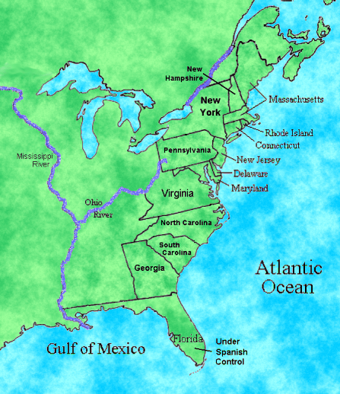
The 3 Colonial Reagions

Slide 4

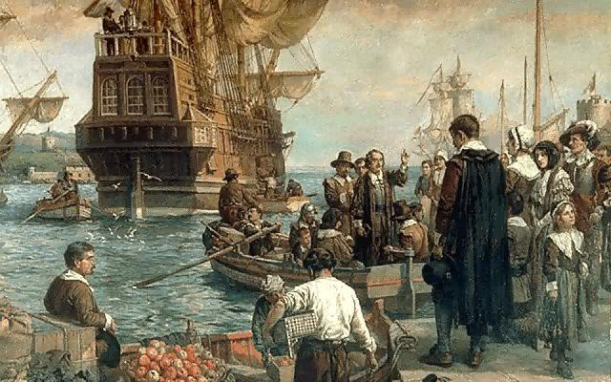
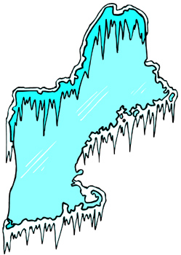

New England Colonies
Massachusetts, New Hampshire,
Rhode Island, and Connecticut
Geography and Climate:
  Appalachian Mountains
  Boston harbor
  Hilly terrain and rocky soil
  Jagged coast line
  Cold winters and moderate summers

Slide 5



New England Economy and Resources:
  Fishing,
  Shipbuilding
  Naval supplies
  Timber
  Fish
  Deep harbors
  Trade and port cities
  Skilled craftsmen
  Shopkeepers
  Shipbuilders

Slide 6
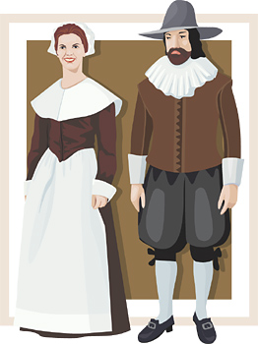

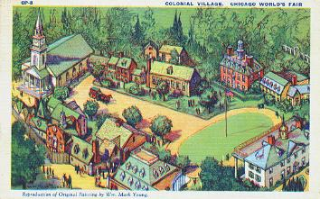
New England Colonies
Massachusetts, New Hampshire,
Rhode Island, and Connecticut
Political and Social Life:
  Village and church
  as center of life
  Religious reformers and separatists
  Town meetings

Slide 7
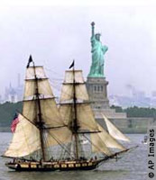


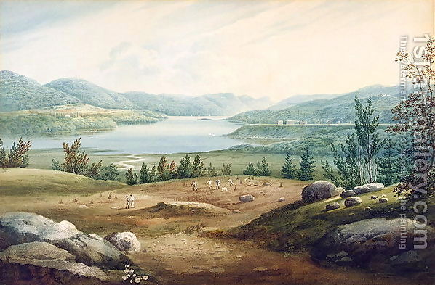
Middle Colonies
“The Breadbasket”
New York, Pennsylvania,
New Jersey, and Delaware
Geography and Climate:
  Appalachian Mountains
  Coastal lowlands
  Harbors and bays
  Mild winters and moderate climate
  Wide and deep rivers

Slide 8
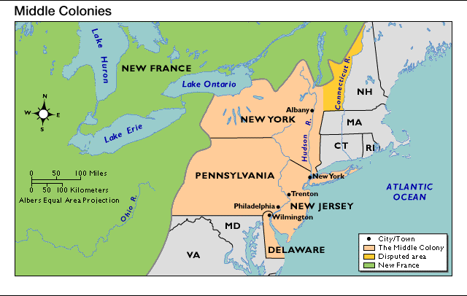
Middle Colonies

Slide 9
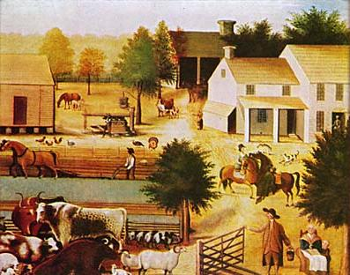
Mid-Atlantic farmers relied on family members to work the farm.

Slide 10
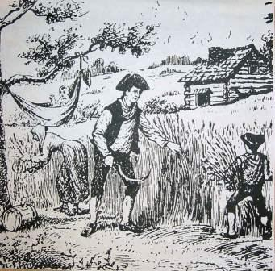

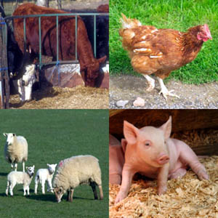

Middle Colonies: “The Breadbasket”
New York, Pennsylvania, New Jersey, and Delaware
Economy and Resources:
  Livestock, grain, and fish (rich farmlands and rivers)
  Unskilled/Skilled workers and fishermen

Slide 11
Social and Political Life
Villages and cities / Market towns
Varied and diverse lifestyles
Diversity – People arrived from
many countries
  Religions – Many different religions
  Languages – The language of their country
  Food – The food that is known in their country

Slide 12
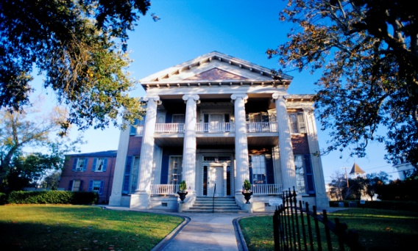
Southern Colonies
Maryland, Virginia, North Carolina,
South Carolina, and Georgia
Geography and Climate:
  Appalachian Mountains
  Piedmont
  Atlantic Coastal Plain
  Good harbors and rivers
  Humid climate with mild winters and hot summers
Economy and Resources:
  Fertile land (tobacco, cotton, indigo, and wood products)
  Farmers and slaves
Social and Political Life:
  Plantations (slavery) mansions, indentured servants, few cities with few schools
  Church of England
  Counties

Slide 13
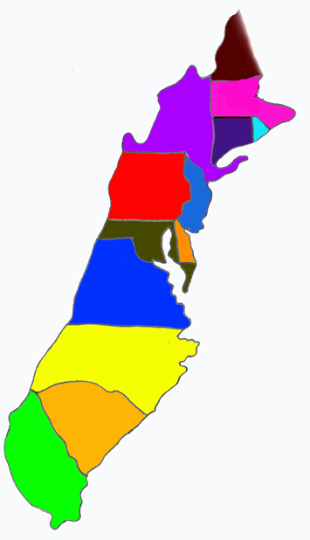
Examples of Interdependence
The Mid-Atlantic colonies traded with both the Southern and New England colonies to get products they didn’t produce.
The Southern colonies depended on the New England colonies for manufactured goods, including tools and equipment.
New England colonies had limited farming resources and depended on the Southern colonies for raw materials such as cotton and the Middle colonies for grain and livestock.

