Slide 1
Thomas Jefferson as President

Slide 2
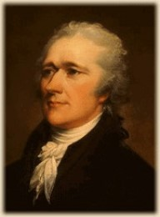
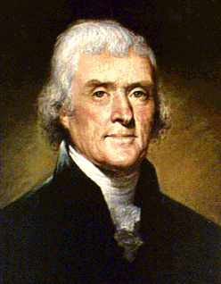
Election of 1800
Federalists
Republicans
VS

Slide 3
Political Parties-Review
Federalists
Strong National Government
Democracy is dangerous
Manufacturing and trade = Basis of national wealth
Artisans, merchants, manufacturers, bankers
Republicans
Support for Agrarianism (Farmers are backbone of our nation)
As long as people own their own land, they will defend it.
Too much emphasis on commerce
Rural supporters in S & W

Slide 4
Jefferson
Decisions of the Majority
Central government: frugal and simple
Limited federal gov’t with strict interpretation
Ended internal taxes
Agrarian Republic
Needed industry

Slide 5
Louisiana Purchase
Adds 828,000,000 miles to the U.S.-doubling size
Mississippi River to Rocky Mountains
Territory: France -> Spain -> France -> US
Worries: Napoleon… “We will have to realign ourselves with the British”-Jefferson
Sends Richard Livingston and Monroe to France
1803 purchased for $15 million (only 3 cents per acre!)

Slide 6
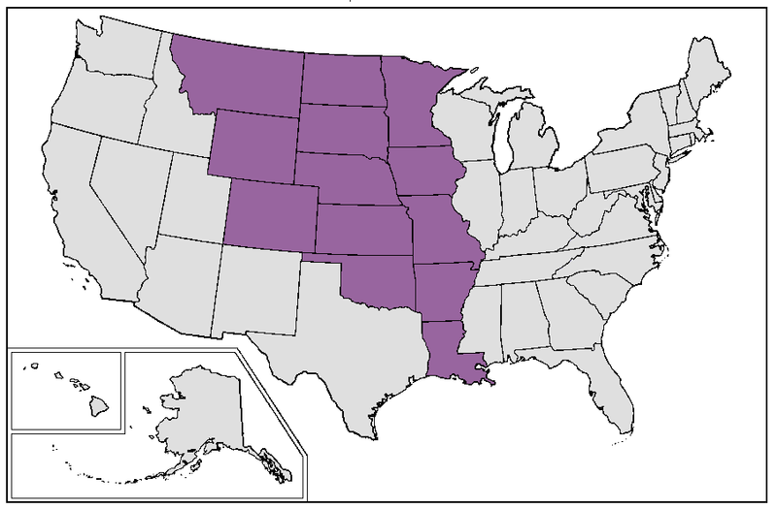

Slide 7
Foreign policy
Thomas Jefferson

Slide 8
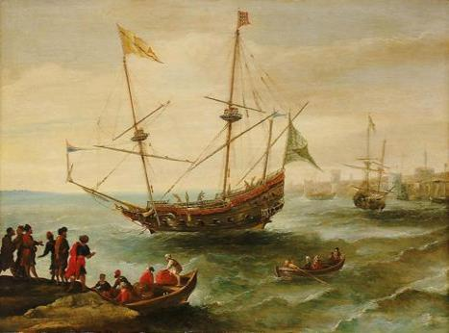
Barbary War
Barbary States of North Africa
Seizing American ships for money
Washington and Adams paid protection money; Jefferson does the same
Increased price: Jefferson blocks Tripoli port until peace in 1805

Slide 9
Foreign Policy
France and Great Britain are still fighting
US proclaims neutrality again
British ships v. French ships v. American ships
Re-export: America picks up cargo in colonies, sells it out of American ports to France
Trade soars, tripled merchant marine
British extremely upset
Sustained Napoleon’s Army, US=biggest competitor

Slide 10
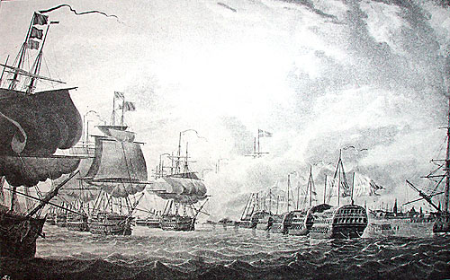

Slide 11
British Impressment
Britain starts impressment—kidnapping US soldiers and forcing them into he British Navy
Starts with forcing British deserters back into the Navy; desperate for soldiers
Spreads to American born merchants

Slide 12
Tensions Rise
1807 British warship Leopard asks to board American warship Chesapeake to look for British Deserters.
Chesapeake Captain refuses.
British open fire, kills 3 Americans then seizes 4 sailors

Slide 13
Economic Diplomacy
Jefferson doesn’t want to go to war-Economic Diplomacy
Jefferson gets congress to pas the Embargo Act of 1807-prove neutrality
Embargo—a government ban on trade with other countries, in this case, France and Britain
This hurts the US more than France or Britain
Exports drop from $108 million to $22 million

Slide 14
Embargo Reactions
Embargo is wildly unpopular
Congress repeals the Embargo to help decrease the bad opinions of the Democratic-Republicans; “Non-Intercourse Act”
Lifted embargo on ships except those headed to GB/F
Jefferson is ready to retire after 2 terms as President, goes back to Monticello
Secretary of State James Madison takes office

Slide 15
Thomas Jefferson’s Presidency
Expansion of Central Power
Constriction of Central Power
Louisiana Purchase expanded federal power (elastic clause)
Jefferson bought the Louisiana Purchase with loans from the National Bank
Presidency=more casual
Reduced number of government employees
Cut down size of Army and Navy
Reduced national debt
Strict interpretation of Constitution (when convenient)

