Slide 1
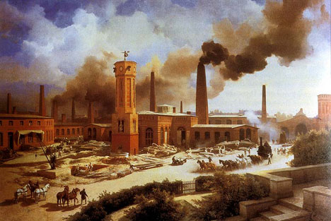
Famous Inventions of the Industrial Revolution
And why they are important

Slide 2

Introduction Question
In your own words what does the word revolution mean?
What is the difference between invention & innovation?

Slide 3
Revolution
What does revolution mean?
Revolution means dramatic, rapid change.

Slide 4
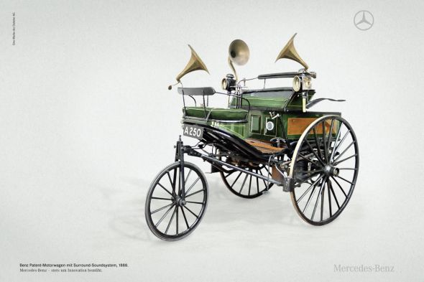
Revolution
THIS

Slide 5
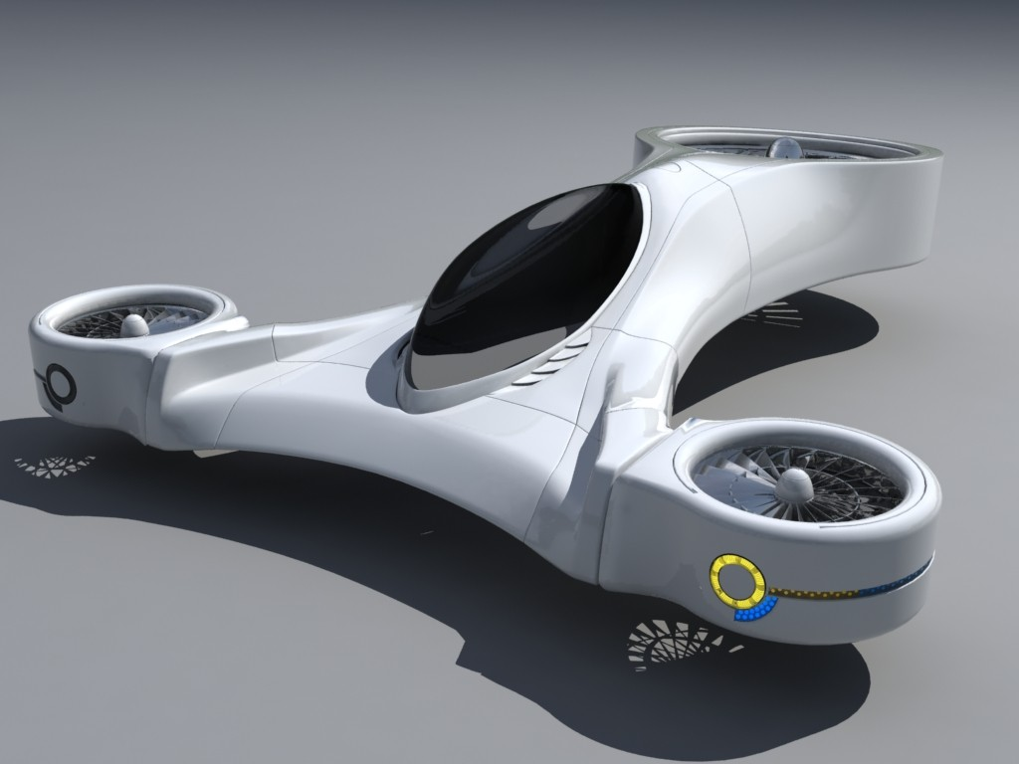
Revolution
TO THIS

Slide 6

Revolution
OR THIS

Slide 7

Revolution
TO THIS

Slide 8
American Industrial Revolution
Time of unprecedented invention and innovation in Europe and America.
Lasted from about 1840’s – 1910’s in America.
Created enormous economic growth as well as terrible pollution and social problems.

Slide 9
Why is invention/innovation important?

Slide 10
Why is invention/innovation important?
Brings about new tools and machines
Manufactures products quicker
Helps economic growth
Provides employment

Slide 11
Difference between invention/innovation
Invention: Creating brand new machines or devices that improve the human condition.
Innovation: Taking existing ideas/machines and improving them.

Slide 12
Difference between invention/innovation
Invention

Slide 13
Difference between invention/innovation
Innovation:

Slide 14
Patents/Copyrights
Patent: a certificate from the government that proves you own the rights to your invention.
Copyright: as above, but for a creative work, such as a song, book or painting.

Slide 15
Robert Stephenson
Invented Steam Locomotive
Year 1826-29
Forerunner of modern locomotives.
Used steam power.
Went about 30 miles per hour, which was groundbreaking for its time.

Slide 16
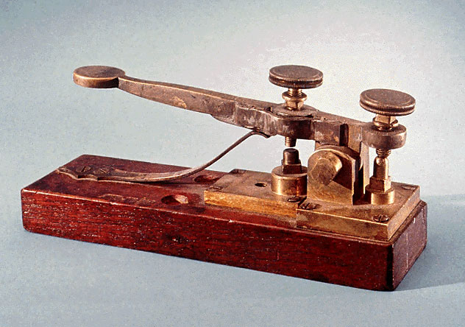
Samuel F. B. Morse
Invented Telegraph
YEAR: 1836
Made instantaneous, long range communication possible.
System of wires stretched hundreds of miles.
“More Code” was a special language used

Slide 17
Why is this important?
These inventors and inventions powered the enormous American economic expansion that made America the world’s largest economy.
During the 19th century, this power drove America to great heights of prestige and world influence.
In addition, these inventions improved the quality of life for hundreds of millions of people across the globe. Areas such as communication, transport and manufacturing were transformed.

Slide 18
Exit Ticket/Reflection
Choose one inventor and his/her invention, that you believe had the greatest impact on American society, and write a paragraph explain why you think so

