Slide 1
The Columbian Exchange (Turn to page 84 of your Atlas before we begin)

Slide 2
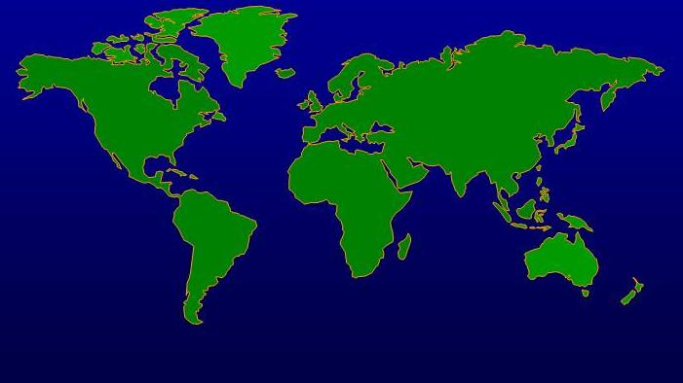
Western Hemisphere
(New World)
Eastern Hemisphere
(Old World)

Slide 3
The Columbian Exchange
Columbus’ voyages May have had greater consequences biologically than culturally
The Columbian Exchange was coined to describe the worldwide redistribution of plants, animals, and diseases that resulted from the initial contacts between Europeans and Natives.

Slide 4
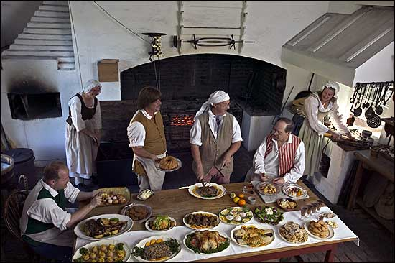
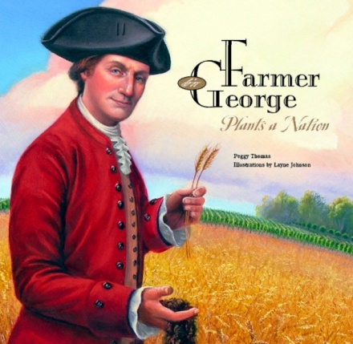
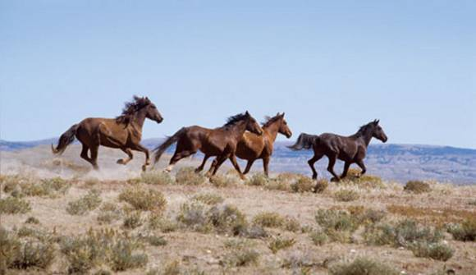
Impact of Columbian Exchange
Exchanged food, plants, and animals during colonization.

Slide 5
Columbian Exchange
Old World (Europe) to New World (Americas)
Plants:
rice melons
wheat olives
barley dandelions
oats daisies
coffee ragweed
sugarcane (Kentucky) bluegrass
bananas

Slide 6
Columbian Exchange
New World (Americas) to Old World (Europe)
Plants:
avocados pumpkins guavas
peanuts pineapple squash
corn (maize) tobacco
potatoes (white / sweet)
beans (snap / kidney, lima)
cacao (source of chocolate)
chicle (source of gum)

Slide 7
Columbian Exchange
Old World (Europe) to New World (Americas)
Animals:
horses
cattle
pigs
sheep
goats
chickens

Slide 8
Columbian Exchange
New World (Americas) to Old World (Europe)
Animals:
llamas
alpacas
guinea pigs

Slide 9
Columbian Exchange
Old World (Europe) to New World (Americas)
Disease:
measles
chicken pox
smallpox
yellow fever
Malaria
influenza (flu)
common cold

Slide 10
Columbian Exchange
New World (Americas) to Old World (Europe)
Disease
Hepatitis
Polio
Tuberculosis

Slide 12
What was the Effect of the Columbian Exchange?
2. What was the effect of the Columbian Exchange?
a. Both hemispheres were introduced to new foods and animals that changed entire societies.
b. Potatoes and corn became major food sources for Europeans allowing populations to increase greatly.
c. The introduction of pigs, cows, and horses gave new food sources and new animals for the Native Americans to use.

Slide 13
What was the Effect of the Columbian Exchange?
d. The diseases the Europeans brought with them killed up to 90% of the Native Americans in the New World. European conquest of the Native Americans was made easy by the effect disease had on the Natives.
e. The Native Americans had never been exposed to these diseases so their bodies could not fight them. Europeans had lived with these diseases for thousands of years and were not as likely to die from them.

Slide 14
Economic Revolution
Spurred growth of towns
Many merchants became very wealthy
Most people still lived in rural areas
Mainly only traders and merchants gained social mobility
Mercantilism started to create national identity
Effects of Globalization?

