Slide 1
Chapter 9 American Foreign Policy
The Big Idea and Concept
The United States peacefully settled disputes with foreign powers.
Main Ideas and Objectives
The United States and Great Britain settled their disputes over boundaries and control of waterways.
The United States gained Florida in an agreement with Spain.
With the Monroe Doctrine, the United States strengthened its relationship with Latin America.

Slide 2
Main Idea 1: The United States and Great Britain settled their disputes over boundaries and control of waterways.
United States and British Canada both wanted naval and fishing rights on the Great Lakes
Rush-Bagot Agreement (1817) limited naval power on Great Lakes for both
Disputes over fishing rights off Canada, fur trade in Oregon Country, and the U.S.–Canadian border
Convention of 1818 allowed U.S. fishing off Canada and set the border between the United States and Canada at the 49th parallel as far west as the Rocky Mountains.
United States and Britain agreed to share Pacific Northwest

Slide 3
Main Idea 2: The United States gained Florida in an agreement with Spain.
Conflict with Spain over American settlers near the U.S.–Florida border
Secretary of State John Quincy Adams talked with Spain’s Luis de Onís.
President James Monroe sent troops to secure the border.
There was conflict with the Seminoles over settlements and runaway slaves.

Slide 4
The First Seminole War and the Adams-Onís Treaty
Andrew Jackson’s troops captured Seminole raiders, beginning First Seminole War in 1818.
U.S. troops captured Spanish military posts and overthrew Spanish governor of Florida.
Spain and United States signed Adams-Onís Treaty in 1819; settled all border disputes.
United States received East Florida, gave up claim to Texas, and agreed to pay U.S. citizens’ claims against Spain.

Slide 5
Main Idea 3: With the Monroe Doctrine, the United States strengthened its relationship with Latin America.
Latin American countries declared independence from Spain.
Simon Bolívar led many of these revolutions.
The United States feared European countries would take control of newly free countries.
United States issued Monroe Doctrine.
Warned European powers not to interfere in Americas.
Put Latin America in U.S. sphere of influence.

Slide 6
The Monroe Doctrine: Four Basic Points
The United States would not interfere in the affairs of European nations.
The United States would recognize, and not interfere with, countries that already existed in the Americas.
The Western Hemisphere was off-limits to colonization by any foreign power.
The United States would consider any attempt by a European power to colonize or interfere in the Western Hemisphere a hostile act.

Slide 7
Nationalism and Sectionalism
The Big Idea and Concept
A rising sense of national unity allowed some regional differences to be set aside and national interests to be served.
Main Ideas and Objectives
Growing nationalism led to improvements in the nation’s transportation systems.
The Missouri Compromise settled an important regional conflict.
The outcome of the election of 1824 led to controversy.

Slide 8
Main Idea 1: Growing nationalism led to improvements in the nation’s transportation systems.
Nationalism: feelings of pride and loyalty to a nation
Henry Clay proposed the American System: a series of measures to make America economically self-sufficient.
National bank to provide a single currency, and improved roads and canals funded by a protective tariff
Some in Congress felt such improvements were not permitted by the Constitution.
Clay argued that possible gains for the country justified federal action.
Congress agreed with Clay.

Slide 9
Henry Clay
Served as a U.S. representative from Kentucky, a senator, the Speaker of the House, and secretary of state.
Supported nationalism.
Developed the American System.
Dedicated to preserving the Union.
Initiated the Missouri Compromise.

Slide 10
Roads and Canals
Roads
Cumberland Road was first federally built road
Begun in Maryland in 1815, stretched to Illinois by 1850
Canals
Americans tried to make water transportation easier by building canals.
Erie Canal ran from Albany to Buffalo in New York, allowing goods and people to move between East Coast and towns on Lake Erie
Success of Erie Canal provided incentive for future canal building

Slide 11
The Era of Good Feelings
Era of Good Feelings: time of peace, prosperity, and progress from 1815–1825.
National unity strengthened by two Supreme Court decisions that reinforced federal power.
McCulloch v. Maryland (1819) asserted implied powers of Congress, allowing for creation of national bank.
Gibbons v. Ogden (1824) said states could not interfere with power of Congress to regulate interstate trade.

Slide 12
Main Idea 2: The Missouri Compromise settled an important regional conflict.
Sectionalism, or disagreements between different regions, threatened the Union.
Missouri applied to enter Union as slave state, which would change balance between free and slave states
Initial compromise rejected
Henry Clay proposed Missouri Compromise in 1820
Missouri entered as slave state
Maine would join Union as a free state, preserving balance between free and slave states
Slavery would be prohibited in any new states or territories north of 36°30’.
Disagreements between the North and South over slavery continued.

Slide 13
Main Idea 3: The outcome of the election of 1824 led to controversy.
Andrew Jackson won the popular vote but did not have enough electoral votes.
The House of Representatives was required by the Constitution to choose the winner; they chose John Quincy Adams.
Jackson’s supporters claimed Adams had made a “corrupt bargain” with Henry Clay.
Accusations grew after Adams made Clay secretary of state.
Controversy weakened Adams’s support.

Slide 14
American Culture
The Big Idea and Concept
As the United States grew, developments in many cultural areas contributed to the creation of a new American identity.
Main Ideas and Objectives
American writers created a new style of literature.
A new style of art showcased the beauty of America and its people.
American ideals influenced other aspects of culture, including religion and music.
Architecture and education were affected by cultural ideals.

Slide 15
Main Idea 1: American writers created a new style of literature.
Washington Irving
Wrote about American history
Used satire to warn that Americans should learn from the past and be cautious about the future
Combined European influences with American settings and characters
James Fenimore Cooper
Focused on American characters and society
Wrote stories about the western frontier and Native Americans
Popularized historical fiction

Slide 16
Main Idea 2: A new style of art showcased the beauty of America and its people.
Early American artists had painted mainly portraits, but the new style of art involved painting landscapes that showed the history of America and the beauty of the land.
Hudson River School
Emerged in 1830s
Founded by landscape painter Thomas Cole
Created paintings that reflected national pride and beauty of American landscape

Slide 17
Art in the 1840s
The style of art began to change in the 1840s.
Artists tried to combine images of the American landscape and scenes of people’s daily lives.
Fur Traders Descending the Missouri, by George Caleb Bingham, is an important example of this style.

Slide 18
Main Idea 3: American ideals influenced other aspects of culture, including religion and music.
Religious revivalism swept the United States in the early and mid-1800s.
Spirituals—songs based on text from the Bible—became popular in both African American and white folk-music traditions.
Popular folk music reflected the unique views of the growing nation and rising nationalism.

Slide 19
Main Idea 4: Architecture and education were affected by cultural ideals.
American architects modeled buildings after the style of ancient Greece and Rome.
Admired classical civilizations for their democratic and republican ideals.
Early American political leaders believed an educated populace was needed for democracy.
The idea of state-funded public schools gained support.
Massachusetts created state board of education in 1837, and other states followed.

Slide 20
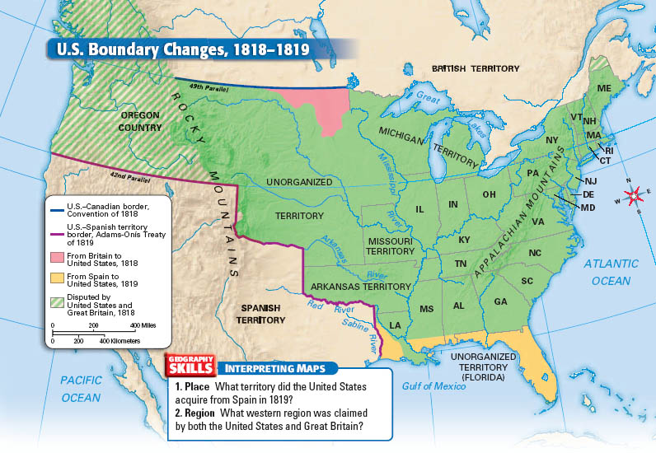

Slide 22
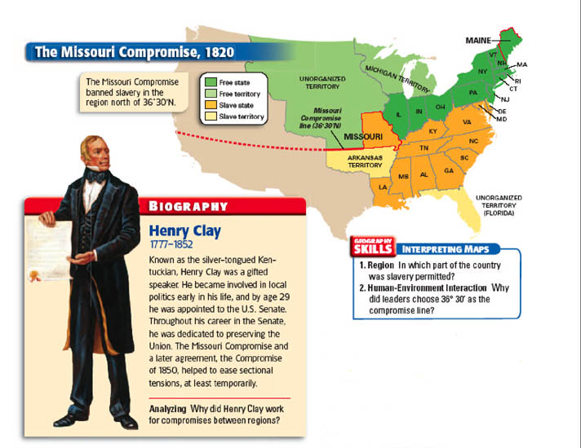

Slide 23
