Slide 1
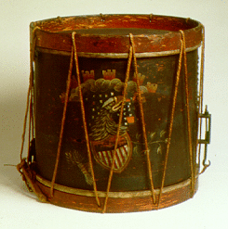
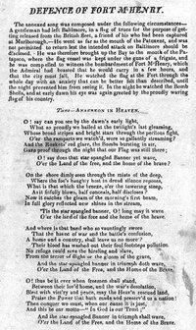
Chapter 8 Section 3 The Causes of The War of 1812

Slide 2
Causes
British blockade of Europe- U.S. ships seized
Impressment-forcing Americans into British Navy
Chesapeake Incident-British. Attack after refusal to allow search killing 3 wounding 18
U.S. Embargo backfires, hurting U.S. economy
British supply Native Americans with guns
War Hawks-senators from the “west” want protection from Native attack

Slide 3
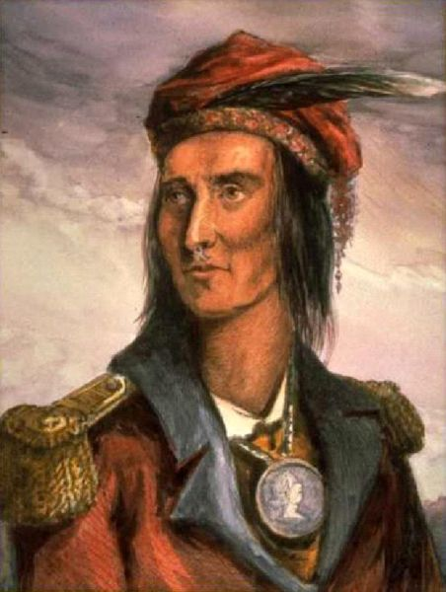
Tecumseh and Tenskwatawa
Tecumseh the Shawnee chief and his brother the “prophet” led resistance against those Americans setting out West.
Growth:
Population in Ohio: 1810: 230,000
1817: 300,000

Slide 4
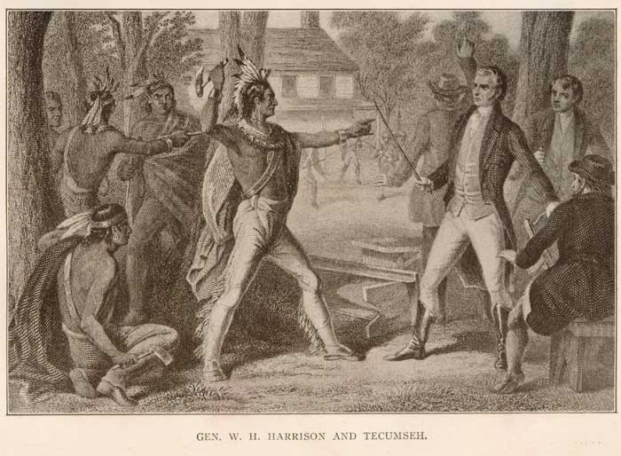
Tecumseh’s confederacy
Solidified alliances with northern tribes and British agents and fur traders.
Goal: Potential war against United States.
Angered by the Governor of Indiana William Henry Harrison treaties with the Shawnee.

Slide 5
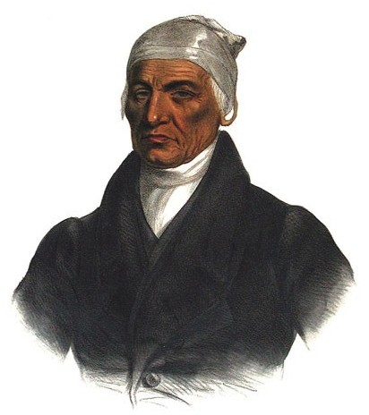
Shawnee split
“No tribe has the right to sell, even to each other, much less to strangers…sell to a country! Why not sell the air, the sky, the earth?” Tecumseh said

Slide 6
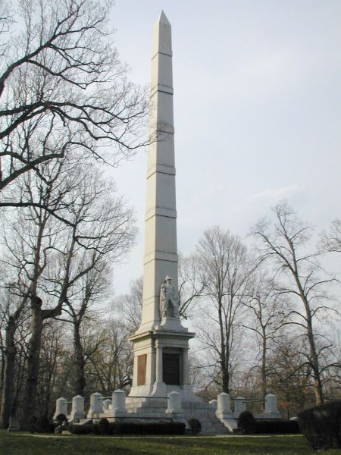
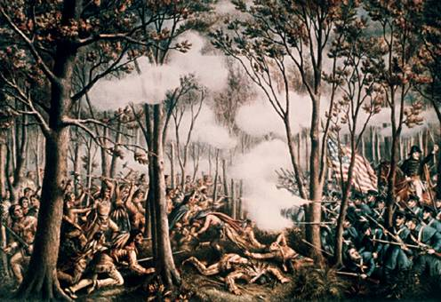
Battle of Tippecanoe
On November 7, 1811, then-Governor William Henry Harrison defeated the Shawnee warriors at the Battle of Tippecanoe in what is now the state of Indiana.
We learn the British are supplying Natives with guns
Memorial at battlefield

Slide 7
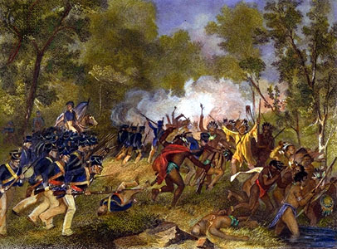
Battle of Tippecanoe
The battle made a hero out of Harrison among many American settlers seeking land out west.
Strengthened Tecumseh’s resolve to hold back Americans.

Slide 8
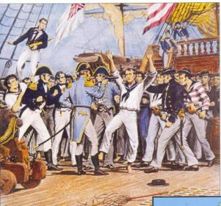
The War of 1812
Native American conflicts of 1811 merged with larger conflict with England became known as the War of 1812.
1809-1812: Madison teetered between England and France as the enemy as both were attacking American merchant ships.

Slide 9
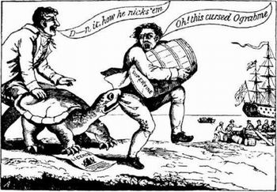
The Economic War
Jefferson’s Embargo Act of 1807-No major outside commerce. Madison’s Non-Intercourse Act (1810) forbade commerce with only England and France and their colonies—limiting our commerce.

Slide 10
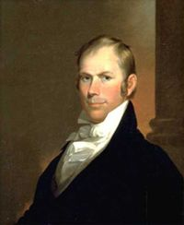
Elections of 1810: The War Hawks
Nearly everyone was disappointed with Madison’s miscalculation and the disruption in trade.
The nation responded with elections in 1810 that brought into power the War Hawks. Young Republicans eager to go to war with Great Britain.
Henry Clay and John C. Calhoun

Slide 11
Favoring War
War Hawks
South and West
Expansionists
War Hawks
Quadruple the defense budget they wanted
“On to Canada”
This motto became the rallying cry of the War Hawks.

Slide 12
Opposing the War
Vote in June 1812:
Favor of war: South and West
Against: Parts of New England and Middle Atlantic.
* The British had announced just days earlier an end to search and seizure of American ships.
Congress had acted, the momentum was going in the directions of declaring war on Great Britian.

