Slide 1
Chapter 8
Sections 1, 2, 3, and 4

Slide 2
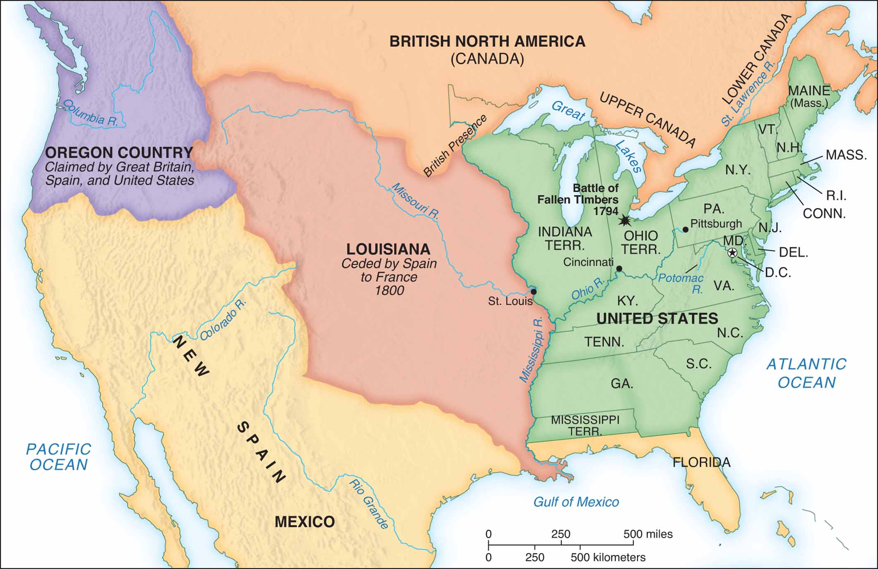
North America in 1800

Slide 3
Westward the Course of Empire
Intense migration to West after 1790
New states – Kentucky, Tennessee, Ohio
Western regional culture
Depended on water transportation
Notes:
2

Slide 4
Commercial Life in the Cities
U.S. economy based on agriculture and trade (84% of population in agriculture)
American shipping prospered, 1793–1807
Cities’ main function was depots for international trade, otherwise marginal role in national life: only 7% of population was urban
Notes:
4

Slide 5
Section 1 Jefferson as President
Jefferson’s personal style
Despised ceremonies and formality
Dedicated to intellectual pursuits
Jefferson’s goals as president
Reduce size and cost of government
Repeal Federalist legislation like the Sedition Act
Keep U.S. out of war
Notes:
5

Slide 6
Jeffersonian Reforms
Cutting federal debt a priority
Tax system re-structured, direct taxes eliminated, federal revenue from customs
Military cut substantially
Cut government expenses in order to cut debt
Republican ideology favored militia over standing army
Military professionalism kept by creating Army West Point
Notes:
6

Slide 7
Federalists
Federalists Lost Political Power
Moderate Federalists did win seats in congress.
Many leaders like John Jay retired from public life
Westward expansion favored Republicans
Notes:
6

Slide 8
Attack on the Judges: Judiciary Act
Judiciary Act of 1801 created new circuit courts filled with loyal Federalists
“Midnight judges”
1802—Jeffersonians repealed Judiciary Act of 1801 to abolish courts and save money
Federalists charged violation of judges’ constitutional right of tenure
Notes:
12

Slide 9
Attack on the Judges: Marbury v. Madison
Marbury v. Madison (1803) ruled Judiciary Act of 1789 unconstitutional
Federalist Marbury denied his judgeship
Republicans claimed victory
Chief Justice John Marshall ensured Federalist influence through judicial review
Supreme Court has the right to judge the constitutionality of congressional acts
Notes:
13

Slide 10
Section 2 The Louisiana Purchase
Spain gave Louisiana to France, New Orleans was closed to American ships
Jefferson saw New Orleans as vital to U.S.
Sent to Livingston and Monroe negotiate its purchase
Napoleon offered to sell all of Louisiana for $15 million
Importance: The purchase of the land would help make America a power nation
Notes:
7

Slide 11
The Louisiana Purchase
Constitution is vague on power to acquire land inhabited by foreigners
Louisiana’s French and Spanish inhabitants unfamiliar with Republican principles
Jefferson denied Louisiana self-rule
Another Jeffersonian departure from Republicanism
Notes:
9

Slide 12
The Lewis and Clark Expedition
Lewis and Clark Expedition commissioned prior to purchase of Louisiana
Goal to find if Missouri River goes to Pacific and to explore plants and animals
Report on Louisiana’s economic promise confirmed Jefferson’s desire to purchase
Notes:
8

Slide 13
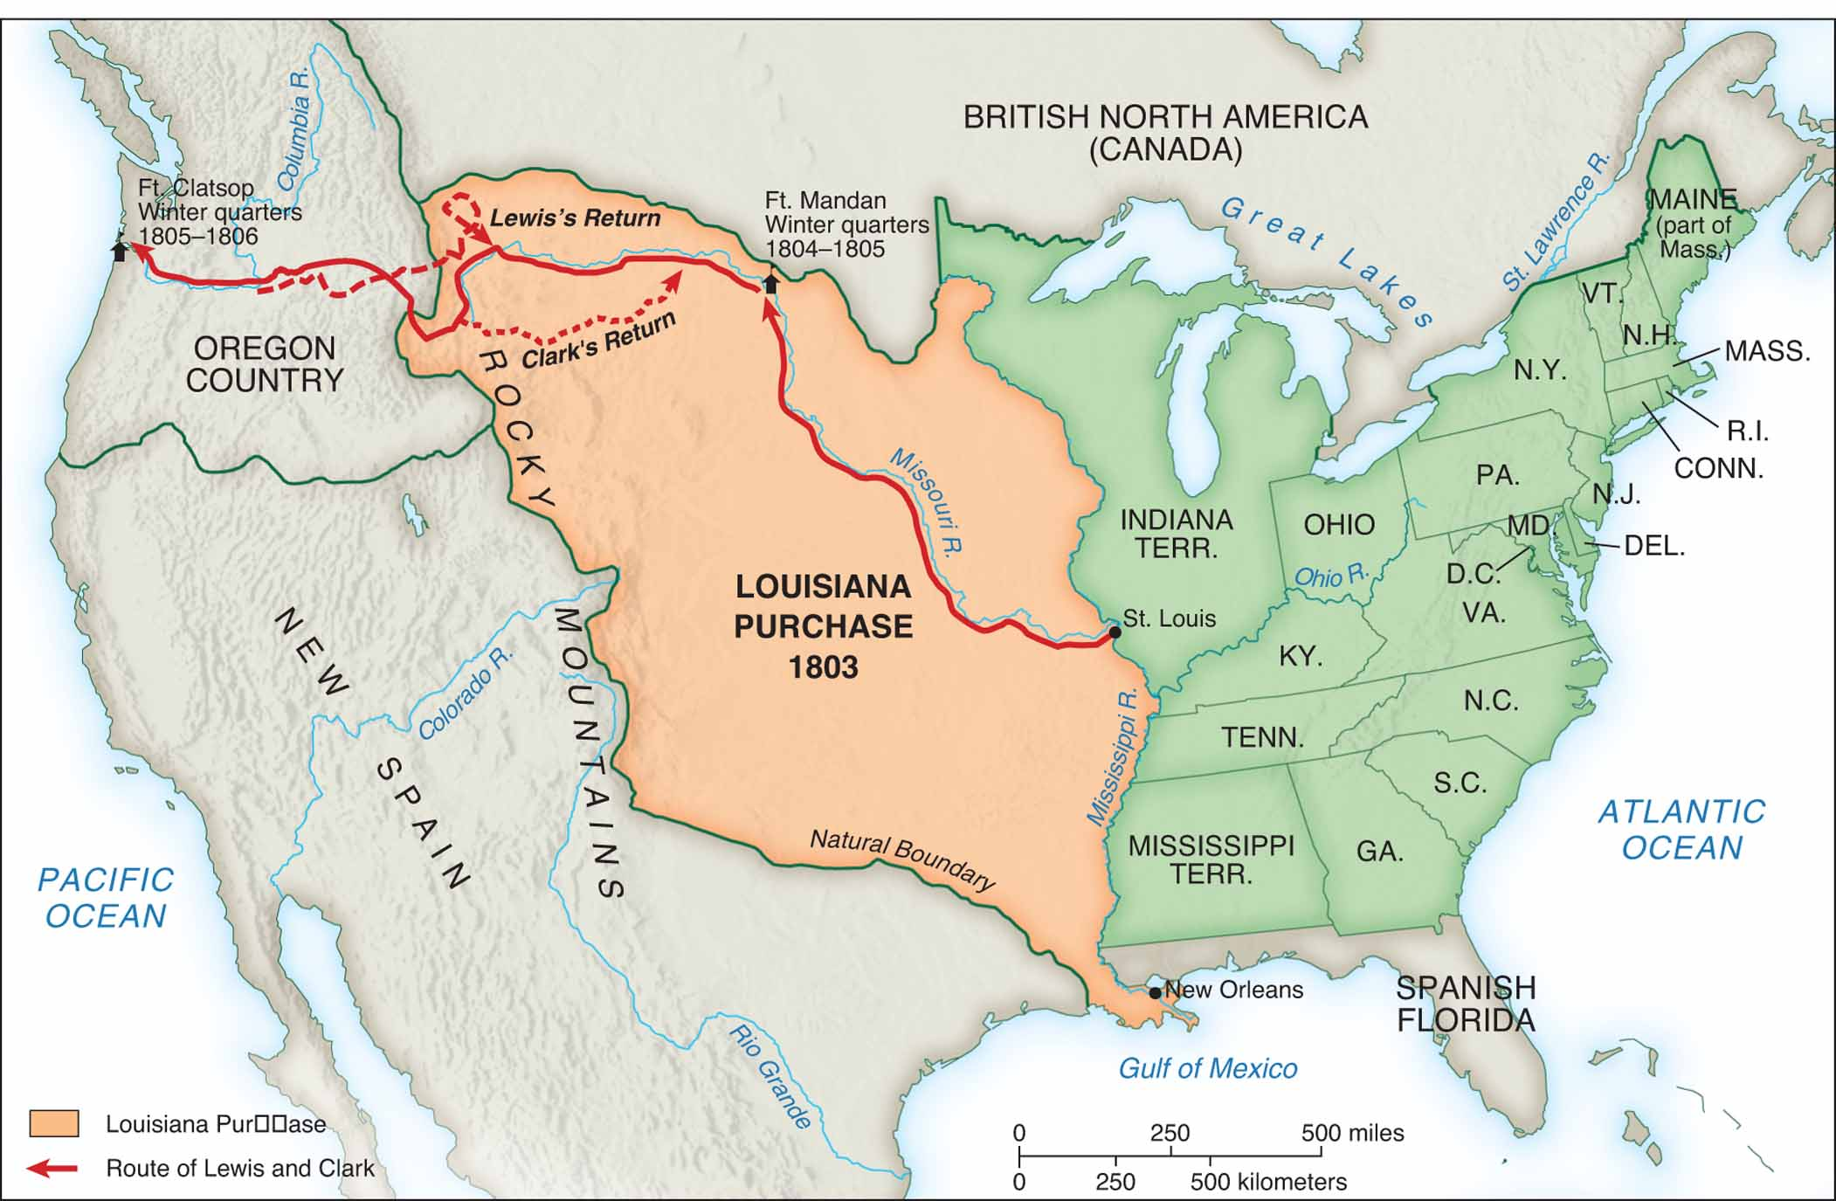
The Louisiana Purchase and the Route of Lewis and Clark

Slide 14
Section 3 Embargo Divides the Nation
1807—Congress prohibited U.S. ships from leaving certain American port cities “peaceable coercion”
Purpose: To win English, French respect for American rights
Embargo unpopular at home – causes political mayhem
Detailed government oversight of commerce
Army suppressed smuggling
New England economy damaged and they did not like this political policy
Notes:
20

Slide 15
A New Administration Goes to War
1808—James Madison elected president
1809—U.S. would resume trade with England and France on promise to cease seizure of U.S. vessels
British official promised to comply and then changed mind
French promised to comply but changed their mind
Notes:
21

Slide 16
Fumbling Toward Conflict
Congressional War Hawks demanded war with England to preserve American honor
Madison asked for declaration of war
War aims somewhat vague
Difference between War Hawks and Madison administration over purpose of invading Canada
Election of 1812 showed division over war
Notes:
23

Slide 17
The Strange War of 1812: Early Course
Americans unprepared for war
Congress refused to raise wartime taxes
New England refused to support war effort – Hartford Convention
United States Army small
State militias inadequate
Most early attacks against Canada failed
Notes:
24

Slide 18
Section 4 War of 1812: English Attack, 1814
British invasion of New York from Canada stopped at Lake Champlain
Campaign in the Chesapeake
Washington, D.C. burned in retaliation for American burning of York (Toronto) earlier
Baltimore saved by defense of Fort McHenry
Notes:
25

Slide 19
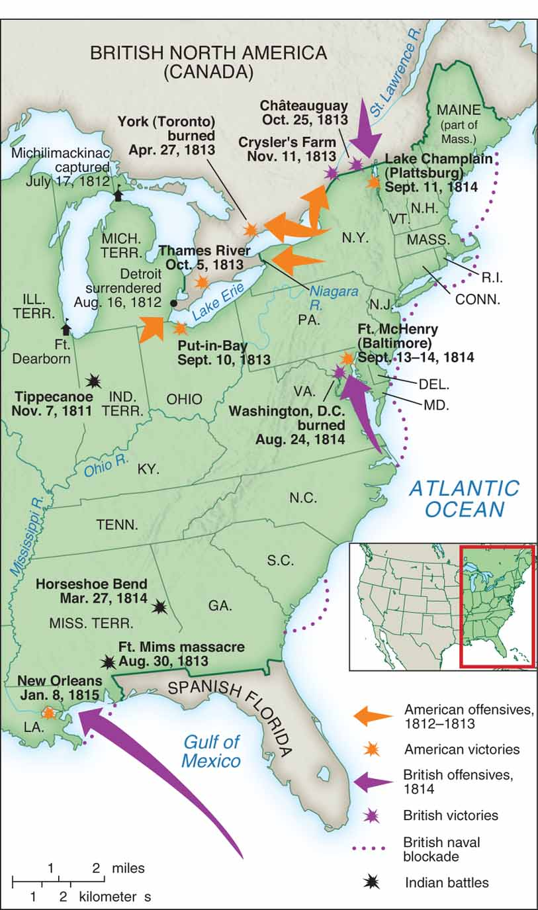
The War of 1812

Slide 20
The Strange War of 1812: Three-Pronged English Attack, 1814
Attempt to capture New Orleans thwarted by Andrew Jackson, January, 1815
War already over, communication lag
Gave Americans source of pride
Made Jackson a national hero
Notes:
25

Slide 21
Hartford Convention: The Demise of the Federalists
Federalists convened in December, 1814
Proposed constitutional changes to lessen power of South and West
Treaty of Ghent, victory of New Orleans made Convention appear disloyal
Federalist party never recovered
Notes:
26

Slide 22
Treaty of Ghent Ends the War
Most problems left unaddressed
Senate unanimously ratified Treaty of Ghent
Americans portrayed it as victory and it stimulated American nationalism
Notes:
27

Slide 23
Republican Legacy
Founders began to pass away in 1820s
Thomas Jefferson and John Adams both died July 4, 1826
James Madison died in 1836
Notes:
28

