Slide 1
Chapter 7
Launching a New Republic

Slide 2
Federal Judiciary Act of 1789
To create a court system, Congress passed the Federal Judiciary Act of 1789. This act gave the Supreme Court six members: a chief justice, or judge, and five associate justices. Over time, that number has grown to nine. The act also provided for other lower, less powerful federal courts. Washington appointed John Jay, the prominent New York lawyer and diplomat, as chief justice.

Slide 3
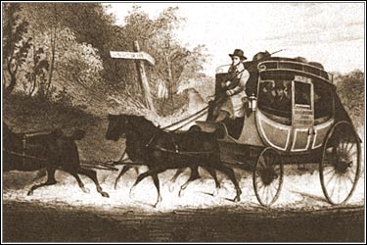
What did the Judiciary Act of 1789 establish?
Set-up a federal court system
Determined the number of Supreme Court Judges. 1 Chief Justice and 5 Associate Judges. John Jay was the 1st Chief Justice

Slide 4
The Congress created three departments. In his first major task as president, Washington chose talented people to run them. For secretary of war, he picked Henry Knox, a trusted general during the Revolution. It was Knox’s job to oversee the nation’s defenses. For secretary of state, Washington chose Thomas Jefferson. He had been serving as U.S. minister to France. The State Department oversaw relations between the United States and other countries.
Washington turned to the brilliant Alexander Hamilton to be the secretary of the treasury. Hamilton had to manage the government’s money. The secretary’s ties to the president began during the war when he had served as one of
Washington’s aides. To advise the government on legal matters, Washington picked Edmund Randolph as attorney general.

Slide 5
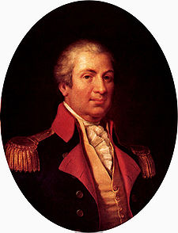
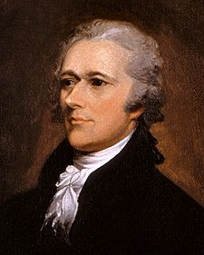
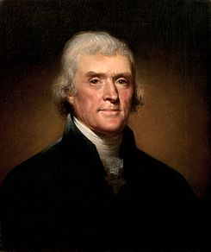
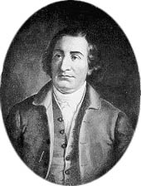
What departments did Washington create, and whom did he appoint to head them?
Cabinets
Secretary of war/ Henry Knox
Secretary of state/ Thomas Jefferson
Secretary of treasury/ Alexander Hamilton
Attorney General/ Edmund Randolph

Slide 6
The debate over Hamilton’s plan for a national bank exposed differences about how to interpret the Constitution. Madison and Jefferson argued that the Constitution did not give the government the power to set up a bank. They believed in the strict construction—narrow or strict interpretation—of the Constitution. They stated that the government has only those powers that the Constitution clearly says it has. Therefore, since the Constitution does not mention a national bank, the government cannot create one.

Slide 7
Hamilton disagreed. He favored a loose construction—broad or flexible interpretation—of the Constitution. Pointing to the elastic clause in the document, he argued that the bank was “necessary and proper” to carry out the government’s duties. (See The Living Constitution, page 238.) According to this view, when the Constitution grants a power to Congress, it also grants Congress the “necessary and proper” means to carry out that power. Jefferson and Hamilton argued their positions to Washington. Hamilton won, and the Bank of the United States was set up in 1791. The president, meanwhile, was dealing with other challenges at home and abroad, which you will read about in Section 2.

Slide 8
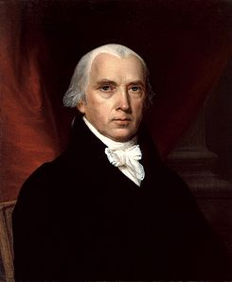
Why did Jefferson and Madison oppose the National Bank? Why did Hamilton Support the national bank?
He deemed it Unconstitutional
H believed it would give government a safe place to keep money, make loans to businesses/governments, and Issue money.

Slide 9
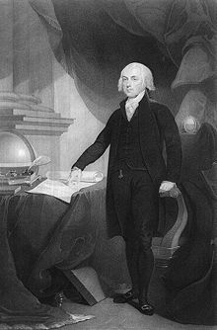
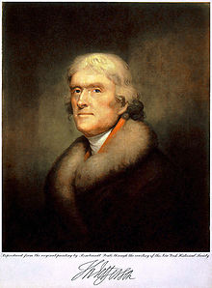
What are loose and strict constructions of the Constitution, and who favored each?
Loose Construction-broad or flexible interpretation-Hamilton
Strict Construction-narrow or strict interpretation-Madison and Jefferson

Slide 10
The war between France and Britain put the United States in an awkward position. France had been America’s ally in the Revolution against the British. A 1778 treaty still bound the two nations together. In addition, many saw France’s revolution as proof that the American cause had been just. Jefferson felt that a move to crush the French Revolution was an attack on liberty everywhere. Hamilton, though, pointed out that Britain was the United States’ most important trading partner, and British trade was too important to risk war. In April 1793, Washington declared that the United States would remain neutral, not siding with one country or the other. He stated that the nation would be “friendly and impartial” to both sides. Congress then passed a law forbidding the United States to help either side.

Slide 11
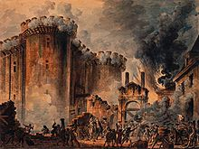
1789 The French Revolution
United States stayed Neutral
U.S. Was caught in-between because France had helped them in the Revolutionary War and the British were in charge of them for so long.

Slide 12
The Native Americans retreated to Fort Miami. The British, not wanting war with the United States, refused to help them. The Battle of Fallen Timbers crushed Native American hopes of keeping their land in the Northwest Territory. Twelve tribes signed the Treaty of Greenville in 1795. They agreed to cede, or surrender, much of present-day Ohio and Indiana to the U.S. government.

Slide 13
What Did the Judiciary Act of 1789 established.
1.) Why did Hamilton want to place tariffs on foreign goods?
A.) to ensure a steady flow of income
B.) to encourage Americans to buy American goods
C.) To encourage the growth of American industry.
D. All of the Above
2.) Which document set up the federal court system?
A.) the Constitution of the United States.
B.) The Articles of Confederation
C.) The Federal Judiciary Act of 1789
D.) The Alien and Sedition Acts

Slide 14
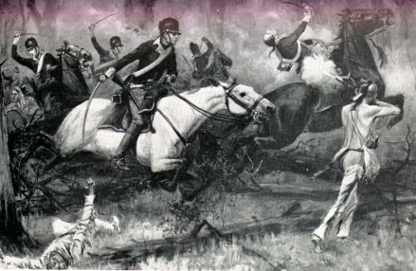
1794 Battle of Fallen Timbers
Native Americans resistance in Ohio
Gained Ohio and Indiana through Treaty of Greenville

Slide 15
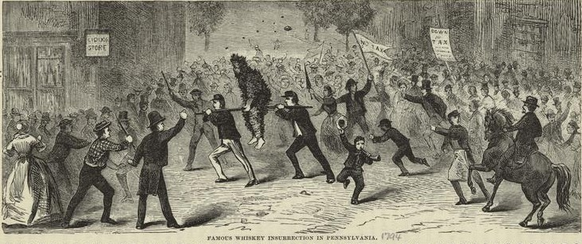
Whiskey Rebellion
13,000 soldiers went to the west to put down the uprising

Slide 16
Washington, urged on by Hamilton, was prepared to enforce the tax and crush the Whiskey Rebellion. They feared that not to act might undermine the new government and weaken its authority. Hamilton condemned the rebels for resisting the law. In October 1794, General Henry Lee, with Hamilton at his side, led an army of 13,000 soldiers into western Pennsylvania to put down the uprising. As news of the army’s approach spread, the rebels fled. After much effort, federal troops rounded up 20 barefoot, ragged prisoners. Washington had proved his point. He had shown that the government had the power and the will to enforce its laws. Meanwhile, events in Europe gave Washington a different kind of challenge.

Slide 17
Washington sent Chief Justice John Jay to England for talks about the seizure of U.S. ships. Jay also hoped to persuade the British to give up their forts on the Northwest frontier. During the talks in 1794, news came of the U.S. victory at the Battle of Fallen Timbers. Fearing another entanglement, the British agreed to leave the Ohio Valley by 1796. In Jay’s Treaty, the British also agreed to pay damages for U.S. vessels they had seized. Jay failed, however, to open up the profitable British West Indies trade to Americans. Because of this, Jay’s Treaty was unpopular.

Slide 18
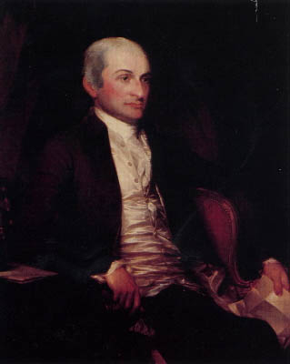
Jay’s Treaty
The British would evacuate posts in the Ohio Valley
British Pay Damages

Slide 19
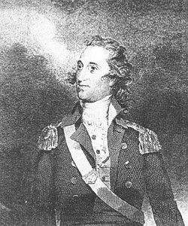
1795 Pinckney’s Treaty
Spain Recognized 31st parallel as the northern boundary of Florida
Agreed to open the Mississippi River and Port of New Orleans to American traffic.

Slide 20
Like Jay, Thomas Pinckney helped the United States reduce tensions along the frontier. In 1795, Pinckney’s Treaty with Spain gave Americans the right to travel freely on the Mississippi River. It also gave them the right to store goods at the port of New Orleans without paying customs duties. In addition, Spain accepted the 31st parallel as the northern boundary of Florida and the southern boundary of the United States.

Slide 21
Americans listened more closely to Washington’s parting advice on foreign policy—relations with the governments of other countries. He urged the nation’s leaders to remain neutral and “steer clear of permanent alliances with any portion of the foreign world.” He warned that agreements with foreign nations might work against U.S. interests. His advice served to guide U.S. foreign policy into the twentieth century.
Despite Washington’s warning against political parties, Americans were deeply divided over how the nation should be run.

Slide 22
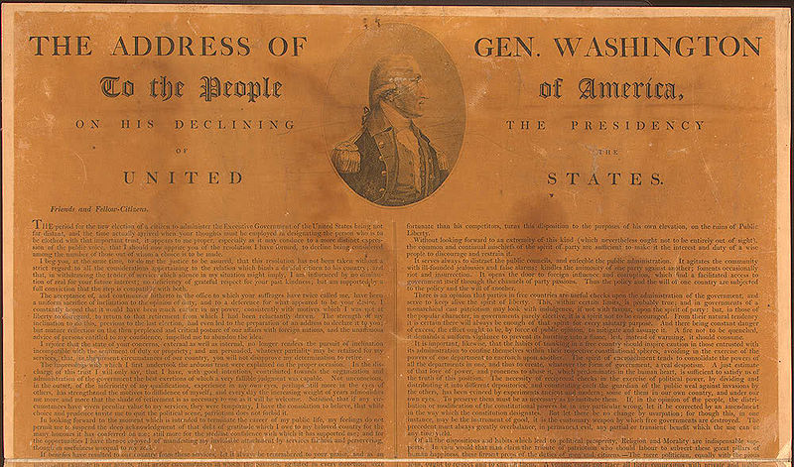
1796 Washington’s farewell address
Against “Spirit of Party” by which he meant political divisions.

Slide 23
John Adams Takes Office
In 1796, the United States held its first elections in which political parties competed. The Federalists picked Washington’s vice-president, John Adams, as their candidate for president. An experienced public servant, Adams had been a leader during the Revolution and at the Continental Congress. He had also been a diplomat in France, the Netherlands, and Britain before serving with Washington. The Democratic-Republicans chose Jefferson.

Slide 24
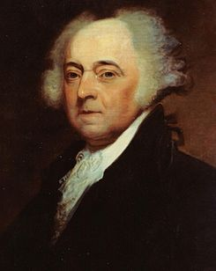
Adams elected president
1st election in which political parties competed.
It resulted in a president and vice president from separate parties.

Slide 25
Problems with France
Then three French agents—later referred to as X, Y, and Z—took the Americans aside to tell them the minister would hold talks. However, the talks would occur only if the Americans agreed to loan France $10 million and to pay the minister a bribe of $250,000. The Americans refused. “No, no, not a sixpence,” Pinckney shot back. Adams received a full report of what became known as the XYZ Affair. After Congress and an outraged public learned of it, the press turned Pinckney’s words into a popular slogan: “Millions for defense, not one cent for tribute!” In 1798, Congress canceled its treaties with France and allowed U.S. ships to seize French vessels. Congress also set aside money to expand the navy and the army.

Slide 26
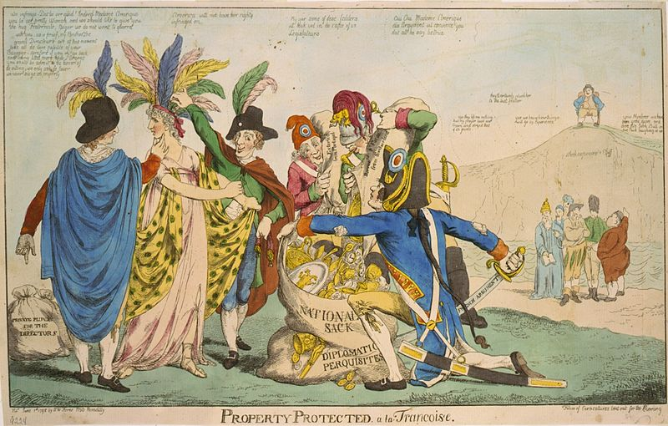
XYZ Affair
I Can explain the struggles of John Adams Presidency
Led to anti-French feelings in U.S.
Treaties with France cancelled-seized French vessels.

Slide 27
The Alien and Sedition Acts
Angered by criticism in a time of crisis, Adams blamed the Democratic-Republican newspapers and new immigrants. Many of the immigrants were Democratic-Republicans. To silence their critics, the Federalist Congress passed the Alien and Sedition Acts in 1798. These acts targeted aliens—immigrants who were not yet citizens. One act increased the waiting period for becoming a U.S. citizen from 5 to 14 years. Other acts gave the president the power to arrest disloyal aliens or order them out of the country during wartime. A fourth act outlawed sedition, saying or writing anything false or harmful about the government.

Slide 28
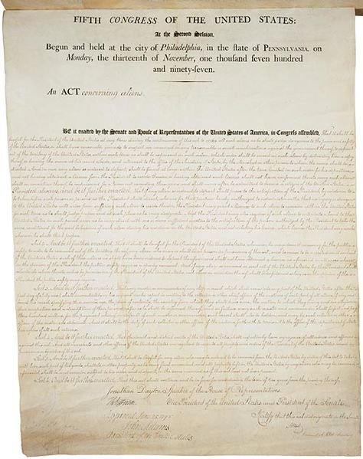
1798 Alien and Sedition Acts
Raised waiting periods for American citizenship 5 to 14 years.
Allowed President to deport or jail aliens.
Outlawed negative opinions toward governors and president.

Slide 29
The Democratic-Republicans, led by Jefferson and Madison, searched for a way to fight the Alien and Sedition Acts. They found it in a theory called states’ rights. According to this theory, states had rights that the federal government could not violate. Jefferson and Madison wrote resolutions (or statements) passed by the Kentucky and Virginia legislatures in 1798 and 1799. In the Kentucky Resolutions, Jefferson proposed nullification, the idea that a state could nullify the federal law within the state. In the Virginia Resolutions, Madison said a state could interpose, or place, itself between the federal government and its citizens. These resolutions declared that the Alien and Sedition Acts violated the Constitution. No other states supported Kentucky and Virginia. However, within two years the Democratic-Republicans won control of Congress, and they either repealed the Alien and Sedition Acts or let them expire between 1800 and 1802.

Slide 30
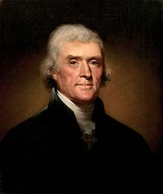
Virginia and Kentucky Resolutions
Alien and Sedition Acts Unconstitutional

Slide 31
Know Strict and Loose Construction of the Constitution.
Strict Construction-Narrow or strict interpretation of the Constitution; Madison and Jefferson had this type of interpretation.
Loose Construction-broad or flexible interpretation of the Constitution; Alexander Hamilton had this type of interpretation.

Slide 32
Please answer the questions below
18.) _____ Alexander Hamilton favored a strong federal government because he believed it would
benefit the economy. As a result of this belief, he also supported —
A.) the abolishment of all tariffs
B.) the establishment of a national bank
C.) increasing agricultural activity
D.) imposing high taxes on factories
*Strict interpretation of the U.S. Constitution
*Agricultural economy
*Weak central government
*Loose interpretation of the
U.S. Constitution
*Industrial economy
*Strong central government
Use the information above and your knowledge of social studies to answer the following question.
19.) ______ The different political views in the diagram above represent the —
F.) Loyalists and Patriots
G.) Democratic-Republicans and Federalists
H.) Know-Nothings and Abolitionists
J.) Whigs and Loyalists

Slide 33
Pages to Read from your textbook
1.) Setting Up the Courts pg. 278
2.) Washington’s Cabinet pg. 278
3.) Interpreting the Constitution pg 281
4.) Hamilton’s Financial Plan pg 279-281
5.) Interpreting the Constitution pg 281
1.) The French Revolution pg 285-286
2.) Battle of Fallen Timbers pg 283-284
3.) The Whiskey Rebellion pg 284-285
4.) Remaining Neutral pg 286
5.) Remaining Neutral pg 286
Must Read these sections could be a possible quiz.

Slide 34
Explain the struggles of John Adams Presidency
1.) A person who favors a loose construction of the Constitution would take the same view as which early U.S. political figure?
A.) John Adams
B.) Alexander Hamilton
C.) George Washington
D.) None of the Above
2.) How did Congress finally agree to address George Washington, the first President?
A.) Your Most High
B.) Your Majesty
C.) Mr. President
D.) King

Slide 35
I can answer chapter 9 questions in a review.
1.) What group was the target of the Alien and Sedition Acts of 1789
A.) immigrants
B.) the French
C.) the British
D.) the Spanish
2.) In which document did Jefferson and Madison use the political theory of states’ rights to fight the Alien and Sedition Acts?
A.) the Bill of Rights
B.) the Kentucky and Virginia Resolution
C.) the Federal Judiciary Act of 1789
D.) the Constitution of the United States
3.) What happened as a result of the Battle of Fallen Timbers?
A.) Native Americans gave up land
B.) British helped Native Americans
C.) Little Turtle’s leadership was rejected by Native American Tribes.
D.) Washington sent troops to New Orleans.
4.) What was George Washington’s view of political parties?
A.) they were needed for national unity
B.) Political parties would split the nation
C.) Political parties made issues clearer for the voters
D.) The Federalist party was the most correct party

Slide 36
1.) Who was the first vice-president and the second President of the U.S.?
John Adams

Slide 37
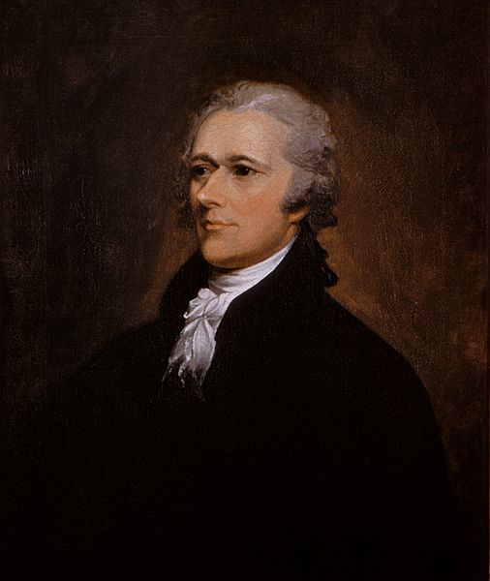
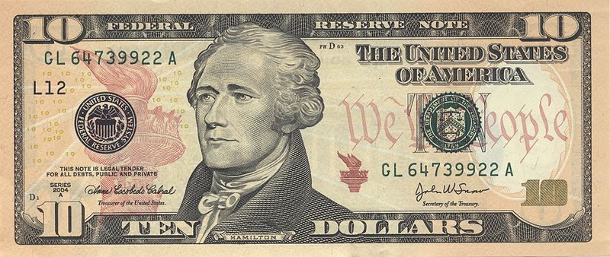
2.) A person who favors a loose construction of the Constitution would take the same view as which early U.S. political figure?
Alexander Hamilton

Slide 38
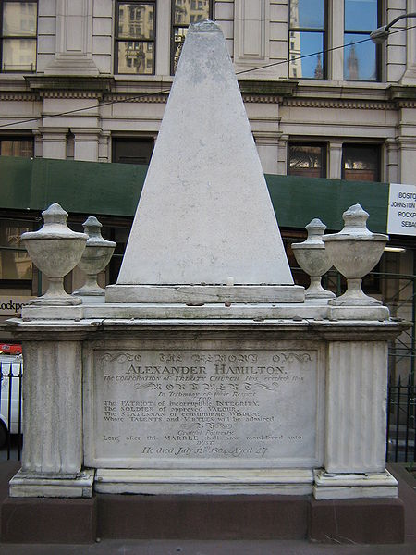
3.) Why did Hamilton want to place tariffs on foreign goods?
Ensure income for the government; encourage Americans to buy American goods; grow American industry.

Slide 39
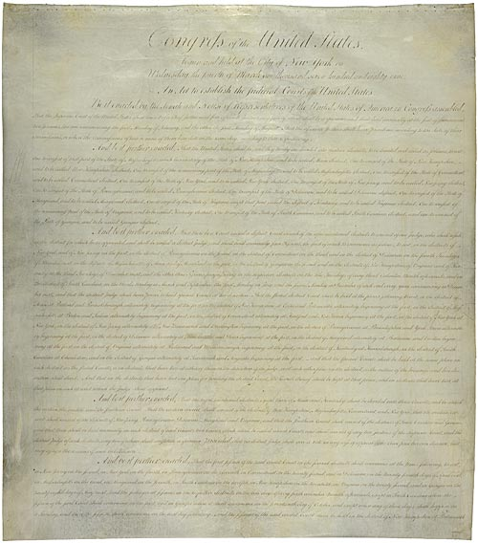
4.) Which document set up the federal court system?
Federal Judiciary Act of 1789

Slide 40
5.) From whom did the Native Americans expect to get aid from the Battle of Fallen Timbers?
British

Slide 41
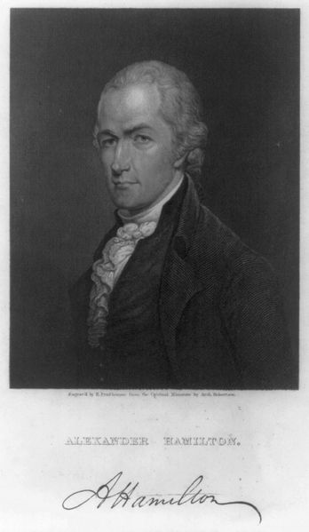
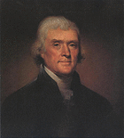
6.) Who did Washington turn to for help in solving the challenges facing the new nation?
Cabinet
Henry Knox Alexander Hamilton Thomas Jefferson

Slide 42
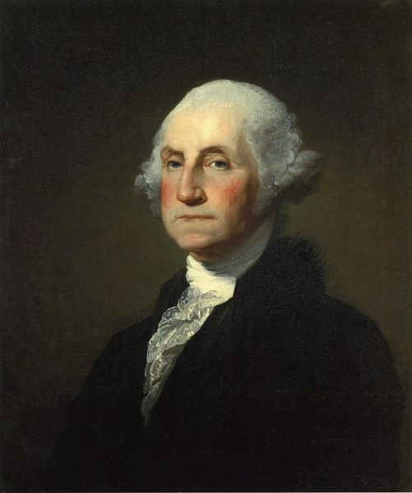
7.) How did Congress finally agree to address George Washington, the first President?
Mr. President

Slide 43
8.) What group was the target of the Alien an Sedition Acts?
Immigrants

Slide 44
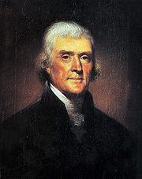
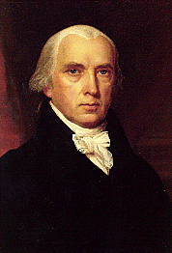
9.) In which document and Jefferson and Madison use the political theory of states rights to fight the Alien and Sedition Acts?
Virginia and Kentucky Resolution

Slide 45
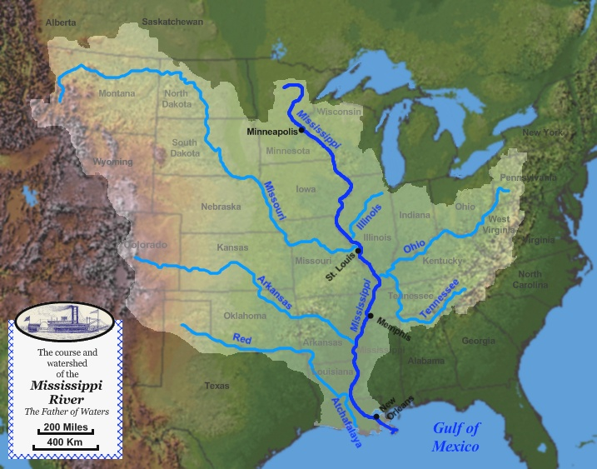
10.) What marked the Western boundary of the Trans-Appalachian West?
Mississippi River

Slide 46
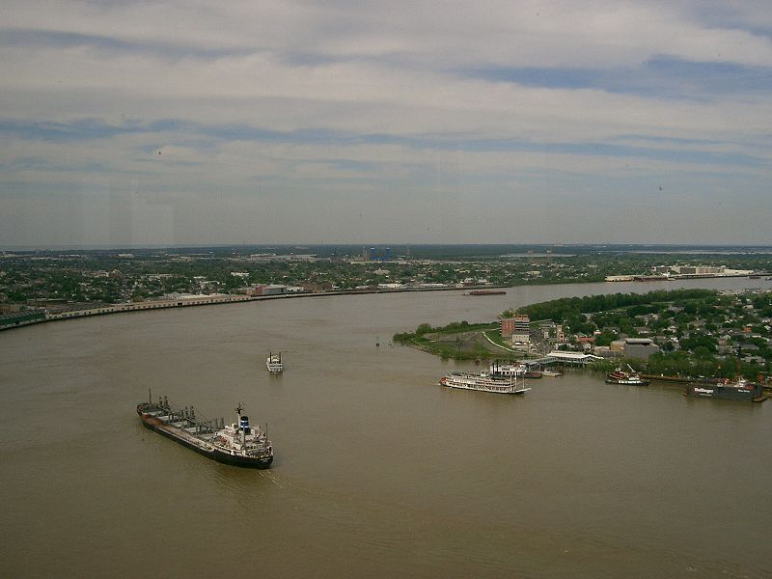
11.) How did Pinckney’s Treaty make it easier for settlers in the Trans-Appalachian West to get their goods to the market?
Use of the Mississippi River and Port of New Orleans

Slide 47
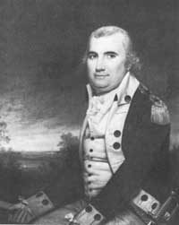
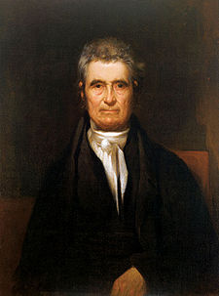
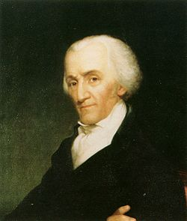
12.) What happened in the XYZ Affair?
U.S. Diplomats were asked for bribes to meet with France officials.

Slide 48
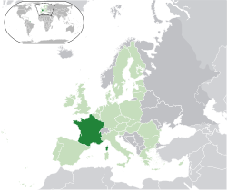
13.) Why did war between Britain and France put the U.S. in an awkward position?
France was our ally, but Britain was a major trading partner

Slide 49
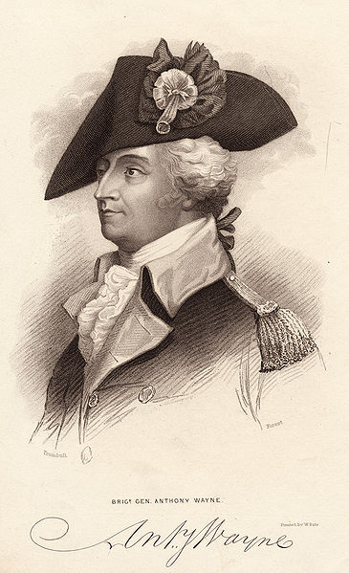
14.) What happened as a result of the Battle of Fallen Timbers?
Native Americans gave up land

Slide 50
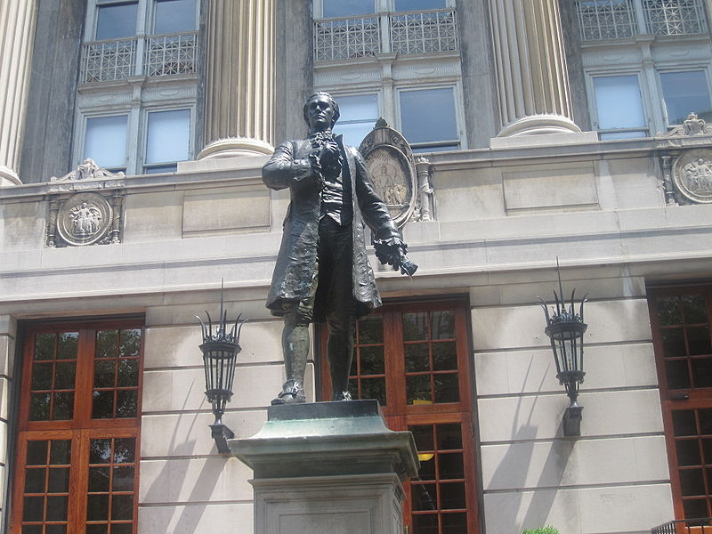
15.) How did Alexander Hamilton deal with the nation’s financial problems?
Asked Congress to put tax on foreign goods

Slide 51
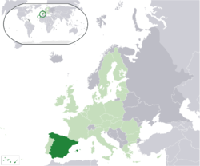
16.) What were some foreign policy issues faced by President Washington?
Spanish caused problems between Native Americans and settlers

Slide 52
17.) What contributed to the rise of political parties?
Disagreements over the war between France and Britain; Hamilton and Jefferson had opposing views on the Constitution;

Slide 53
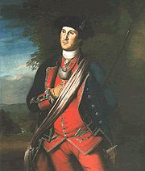
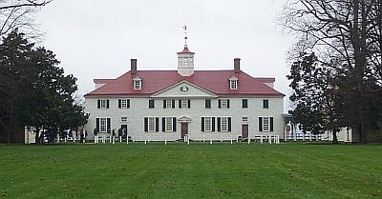
18.) What was George Washington’s view on political parties?
They would split the Nation

Slide 54
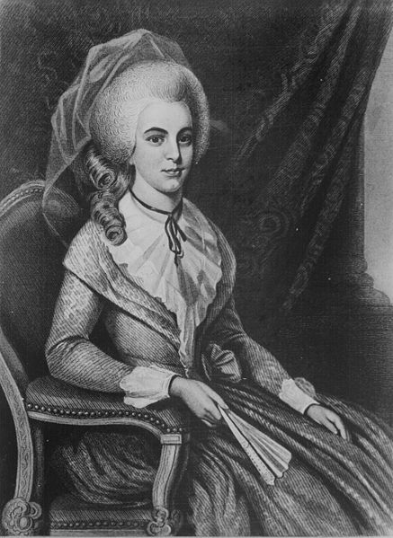
19.) Why did Alexander Hamilton believe the nation needed to pay its debts?
Other countries would not do business with the U.S. until debts were paid

Slide 55
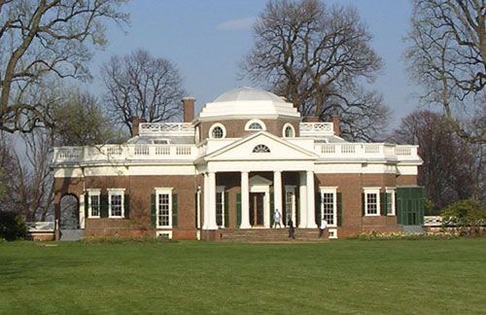
20.) How did the rise of political parties affect the election of 1796?
Federalist President and Republican Vice President

Slide 56
21.) Why did Washington advise the nation to remain neutral in world affairs?
Alliances might pull us into foreign war

Slide 57
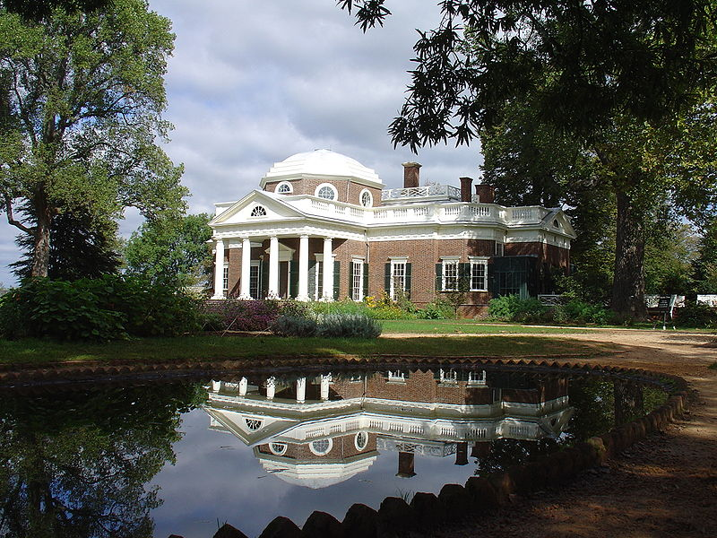
22.) How did Thomas Jefferson become Vice President in the 1796 election?
The Constitution stated that the runner up would become Vice President

Slide 58
23.) How are Pinckney’s Treaty and the Whiskey Rebellion related?
Both grew out of attempts of Western farmers to sell products

Slide 59
24.) What was the basis for the Virginia and Kentucky resolutions?
The states rights theory after the Alien and Sedition Acts

Slide 60
