Slide 1
Chapter 7
Launching the New Republic
1789-1800

Slide 2
A new government
Presidency | Congress | Judicial | Bill of Rights
People feared “king-like” powers | Established courts below Supreme Ct. | Supreme court had final jurisdiction | Drafted by James Madison Ratified Dec. 1781
GW’s reputation calmed fears | Judiciary Act of 1789 |  | 1-8 guaranteed personal liberty
Had to get senate’s “advice and consent” to nominate | Appointed Cabinet positions |  | Not supposed to impede on federal authority
VP John Adams helped defeat proposal to limit Pres. Power |  |  | Chisholm v. Georgia 1793
Cabinet:
Secretary of State: Thomas Jefferson
Secretary of Treasury: Alexander Hamilton
Secretary of War: Henry Knox
Attorney General: Edmond Randolph

Slide 3
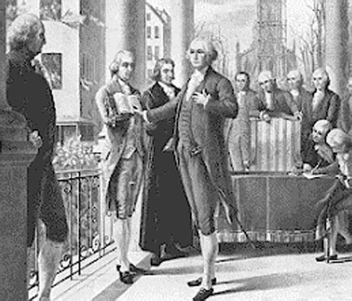

Slide 4
George Washington's Presidency
Domestic Policy
Proposed few laws to congress
Limited public statements
Cast only two vetoes
Tried to balance interests between northern merchants and southern planters
Whiskey Rebellion
Public Land Act 1790
Encourages settlement
VT, KY, and TENN added
Foreign Policy
Native Americans
Between the Appalachian Mts. and Mississippi River
GW’s “patient” diplomacy
Treaty of New York 1790
Ohio River Valley different story
Spain
Expanding empire
1769 est. New California
French
Revolution issues
Proclamation of Neutrality April 1793
Citizen Genet

Slide 5
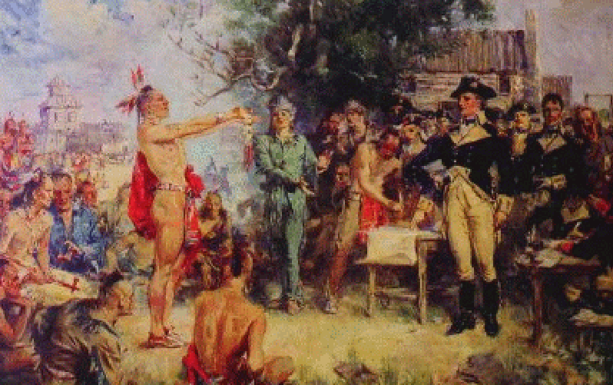

Slide 6
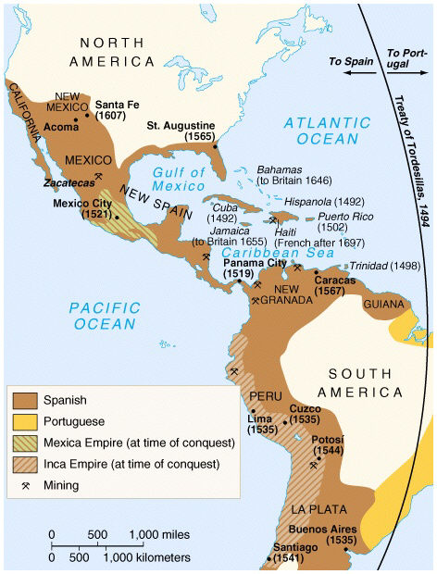

Slide 7
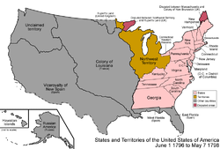
Avoiding War 1793-1796
Britain
Wants no U.S. support of French
Orders confiscating of US ships and impressment
Solution: Jay’s Treaty
Britain promises to withdrawal troops
Restricted trade with France
In the West
Treaty of Greenville
“Mad Anthony” Wayne
Shawnees and Ft. Defiance
Opened up Modern-day OH
Spain
Treaty of San Lorenzo (Pinckney's Treaty) 1796
Won restricted duty-free access to Mississippi River
31st parallel the boundary
Spain promised to stop encouraging attacks

Slide 8
Alexander Hamilton
Feared
War with Britain or Spain
Disintegration of the Union
Report on Public Credit 1790
Goals:
Strengthen nation’s credit
Defer paying debt
Entice wealthy investors
Recommendations:
Raise $54 million by selling securities and western land
Pay of state debt
Pay of foreign debt
Customs/duties tax
Critics:
Madison
Thought wealthy would gain
Compromise
Nation’s capital
National Bank
Goals
Raise $10 million – stock
Cost taxpayers nothing
Regulate business practices of state banks
Provide much needed credit to expand economy
Critics
Too much power in hands of wealthy
unconstitutional
Approval
“loose” interpretation
“necessary and proper” clause
Legacy
Report on credit worked
Divide between Feds and Reps

Slide 9
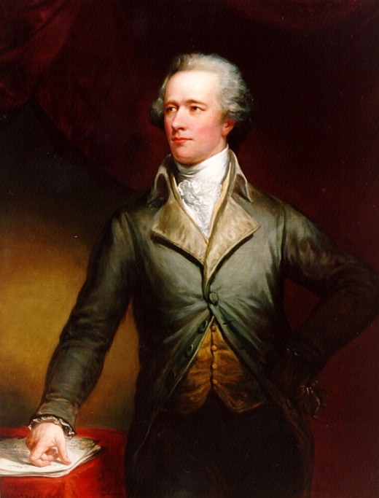

Slide 10
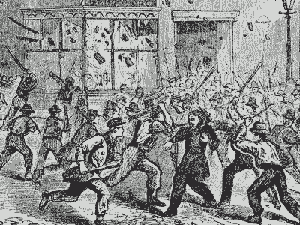
Whiskey Rebellion 1794
Congress passed a federal excise tax on whiskey to fund the assumption of state debts by the nation
Western Pennsylvania farmers rebel
Attack tax collectors
Washington sends in militia
Set severe limits on public opposition to federal policies

Slide 11
Party Politics
Federalists
Madison, Hamilton, Washington, Jay
Hamilton promoted industrialization, capital investment, and new technology
Scared of “mobocracy”
Strong, central government needed
Vote should be based on personal merits of elite candidates
Centered in Urban NE, VA
Anti-Federalists
Thomas Jefferson, Patrick Henry, later Madison
Jefferson believed small, independent farmers the backbone of the republic, and wished to keep the U.S. agricultural
Saw elite as corrupt
Liberty needed to be diffused
Emphasis on liberty and equality
Supported by slave owners
Rural NE, Mid-Atlantic, Rural South

Slide 12
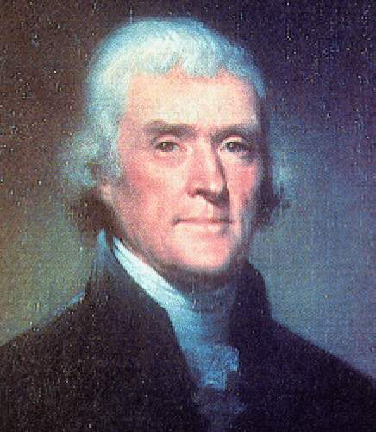
Rise of the Democrat-Republicans
Beginnings 1793-1796
first societies began organizing
Called “Republicans”, thought “Democrat” was too rebellious
Mainly seaboard cities, south and west rural areas
Success at national level
Election of 1794
Won slight majority in House of Representatives

Slide 13
Election of 1796
Washington’s Farewell Address
Warned of partisan politics
Warned against “entanglement” in European affairs
Sets precedent for “two term limits”
Candidates
Federalist: John Adams
Republican: Thomas Jefferson
Election
States
NE, NJ, SC = Federalist
Mid-At, South = Republican
Swing states: PA and NY
Immigrants important
Electoral College
Jefferson loses by three votes
Problem
Framers didn’t foresee party politics so runner-up = vice president

Slide 14
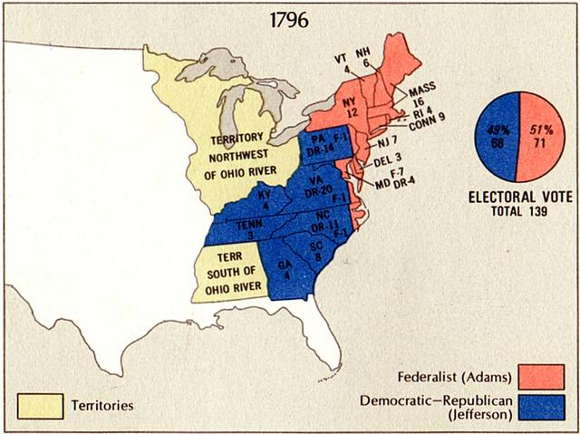

Slide 15
Adam’s Presidency 1796-1800
French Crisis 1798-1799
Problem
French mad about Jay’s Treaty, seen as alliance with Britain
French seize US ships and hang US sailors of British ships
Adam’s response
Sends peace commission
XYZ affair
Foreign Minister won’t meet but sends agents
Bribe: $250,000 + $12 million loan
Americans outraged!
Congress responses by tripling army and arming ships
Alien and Sedition Acts
Federalist’s insist on legislation to protect nation’s security
1798 4 measure pass
Alien Enemies Act
Alien Friends Act
Naturalization Act
Sedition Act
Reaction
Republicans cry foul
KY and VA militias arm and sign petitions
VA and KY Resolutions
Secretly penned by Madison and Jefferson
States had rights to protect liberty of citizens
Issue of “nullification”

Slide 16
Election of 1800
Problems for Adams
Negotiates peace with France
But:
Taxes high for two years
Added $10 million to national debt
Seen as defender of the wealthy
Republican Candidates
Thomas Jefferson
Aaron Burr for Vice President
Big Problem
Aaron Burr and Thomas Jefferson TIE
Outcome
Goes to Congress
Led by Federalists
Hamilton casts the deciding vote
“by far not so dangerous a man”
Jefferson Era begins

Slide 17
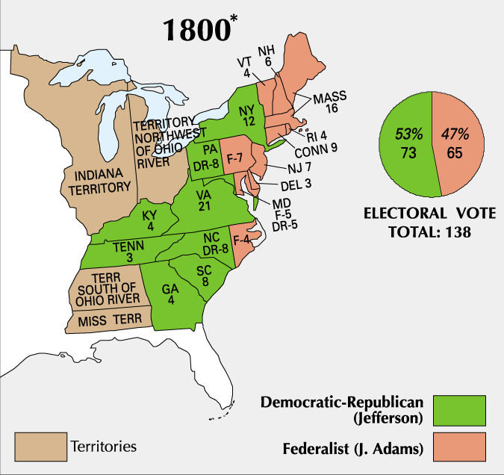

Slide 18
Election results, 1800
Image Source: Wikimedia Commons (public domain) Which of the following is true of the presidential election of 1800?
(A) John Adams won the popular vote, but Thomas Jefferson won the electoral vote (B) it marked the first transition from one political party to another for the presidency (C) President Washington endorsed Jefferson (D) it was the first time a slave-owner was elected president
(E) it was a victory for New England vs. the southern and western states

Slide 19
Economic and Social Change
Households and Market Production
post- revolution changes
Prosperous farms direct surplus to market
Less prosperous farms
Men moved west
Women unmarried
Urban merchants catered to South (clothe slaves)
New industries emerged
Shoes/ leather making
Investors
First private banks
1st cotton-spinning mill
White Women
Legal position unaffected
More social “rights”
Republican Motherhood
Education emphasized
Native Americans
In the East
Suffered severe population loss
Loss of land
Treaties often ignored
Demoralization
Violence
alcohol
Crisis within Tribes
Seneca Tribe
1799 Handsome Lake
Led spiritual revival
Highlights conflict between traditional ways and embracing “new” ways
Color Line
Hesitant attempts to ensure free black’s legality
Slavery entrenched by end of 1790s
Disenfranchisement
Free African Society of Philadelphia
1793 Fugitive Slave Law

Slide 20
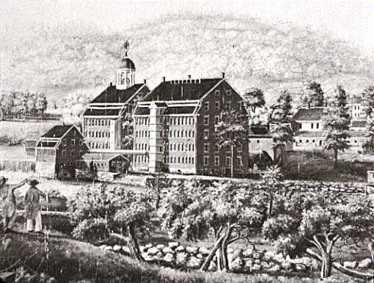
Report on Manufactures Boston Manufacturing Company, 1813, an early American textile factory (Source: Wikimedia Commons--public domain)
Which of the following statements about the Report on Manufactures is inaccurate?
A) it was proposed by Alexander Hamilton B) one of its goals was to raise revenue for the national government C) it proposed "bounties" or subsidies to American industries D) it was supported enthusiastically by representatives from both New England and Southern states, including Thomas Jefferson and James Madison E) it recommended moderate tariffs to spur economic growth in the U.S.

Slide 21
Answer:
D) it was supported enthusiastically by representatives from both New England and Southern states, including Thomas Jefferson and James Madison
Explanation: Alexander Hamilton's Report on Manufactures proposed a plan of subsidies and tariffs to provide support for American industries. Jefferson and Madison, along with others in the South, opposed elements of the plan, particularly the subsidies to industry.

