Slide 1
Chapter 6: Citizenship and the Constitution Section 1

Slide 2
Objectives
Understand the basic outline of the Constitution.
Understand the six basic principles of the Constitution: popular sovereignty, limited government, separation of powers, checks and balances, judicial review, and federalism.

Slide 3
Key Terms
limited government: the idea that government may only do those things that the people have given it the power to do
constitutionalism: the idea that government must be conducted according to constitutional principles

Slide 4
Key Terms, cont.
separation of powers: the principle that each of the basic powers of government—executive, legislative, and judicial—should be wielded by an independent branch of government

Slide 5
Key Terms, cont.
checks and balances: the system under which each branch of government can check, or limit, the actions of the other branches
veto: to reject an act of Congress
judicial review: the power of a court to determine whether a government action is constitutional or not

Slide 6
Key Terms, cont.
unconstitutional: in violation of a provision of the Constitution, and therefore illegal and of no effect
federalism: the principle that political power should be divided between a central government and a number of regional governments

Slide 7
Introduction
What are the four main principles on which the Constitution is based?
Separation of Powers
Checks and Balances
Judicial Review
Federalism
The Constitution embodies these key principles along with describing the basic structure of our government.

Slide 8
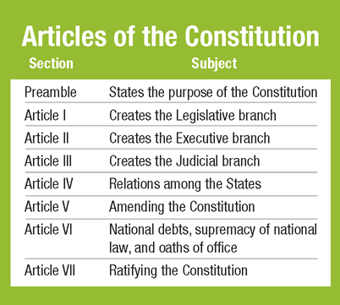
Outline of the Constitution
The Constitution is organized in a simple fashion and is fairly brief.
In many areas it focuses more on principles than specific details. This helps it guide the nation through changing times.
The seven articles are followed by the 27 amendments.

Slide 9
Separation of Powers
Checkpoint: How does the separation of powers keep government from becoming too powerful?
The Constitution divides power among the legislative, executive and judicial branches.
Congress makes the laws, the President executes and administers the laws, and the Supreme Court interprets the laws.
Separation of powers keeps a strong central government from being too powerful.
Too much power concentrated in any one branch could lead to abuses of that power.
Notes:
Checkpoint Answer: By dividing power among three branches, it makes it very difficult for any one branch to assume too much authority. The only way the government could abuse its powers is if every branch agreed to work together, which is unlikely given all the different individuals and goals involved.

Slide 10
Checks and Balances
Each branch of the federal government can check the power of the other two.
The President can veto bills passed by Congress, but Congress can override a veto.
The Senate can reject presidential appointees or refuse to ratify a treaty.
Congress can vote to impeach a federal official.
The federal courts can rule that executive and legislative acts are unconstitutional.

Slide 11
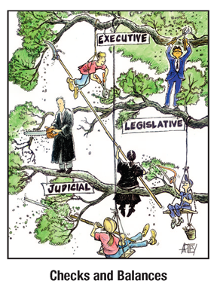
Checks and Balances, cont.
The use of checks is fairly rare.
Compromise is more common
Conflicts more likely when Congress and the presidency are controlled by different parties.

Slide 12
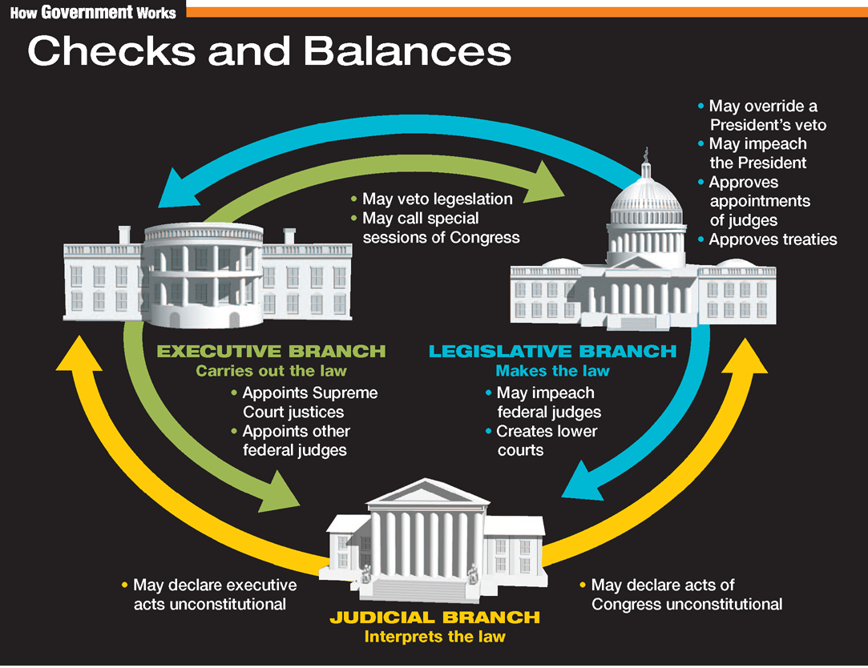

Slide 13
Judicial Review
The Courts can decide if a government action is constitutional.
The power of judicial review is held by all federal courts and most state courts.
Judicial review was established as a necessary power of the courts by Supreme Court Chief Justice John Marshal in the case Marbury v. Madison in 1803.
Most acts are found to be constitutional, but the Supreme Court has struck down many presidential, congressional, and state measures over the years.

Slide 14
Federalism
Federalism is a compromise between an all-powerful central government and an independent state government.
It corrected the weaknesses of the Articles of Confederation without replacing them with a British-style monarchy.
The Framers felt that too much governmental power threatened liberty.
Federalism helps prevent that power from being abused, by dividing governmental power.

Slide 15
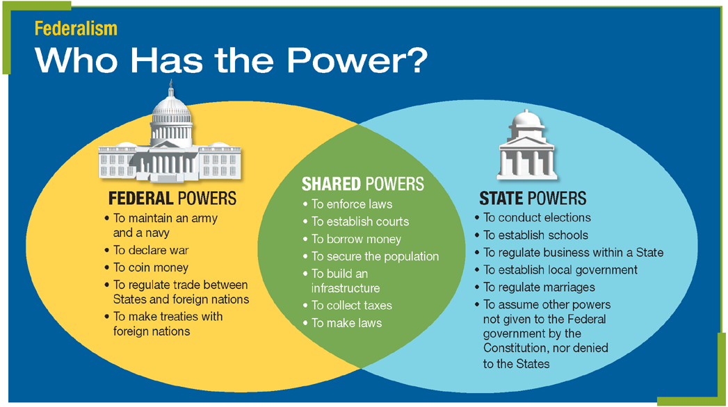
Federalism, cont.
The Constitution divides power among the State and Federal Governments.
Why might the Constitution give the power to regulate trade among the States to the Federal Government?
Notes:
Diagram question answer: Under the Articles of Confederation, states regulated trade among themselves with disastrous results for the national economy. Having interstate trade disputes settled by the central government is an efficient and fair way of ensuring that such disputes do not cause national problems.

Slide 16
Review
Now that you have learned about the six main principles on which the Constitution is based, go back and answer the Chapter Essential Question.
How has the Constitution lasted through changing times?

