Slide 1
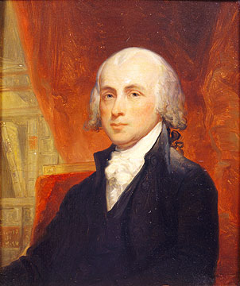
Chapter 5
Main Ideas
Shaping a New Nation
Americans adopt the Articles of Confederation. A new constitution is ratified after Federalists agree to include a Bill of Rights.
James Madison, 4th president of the United States.

Slide 2
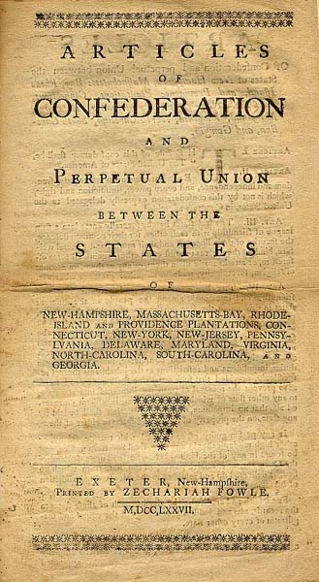
Experimenting with
Confederation
Americans adopt the Articles of Confederation but find the new government too weak to solve the nation’s problems.

Slide 3
Americans Debate Republicanism
Colonies Become States
• People considered self-governing colonies the basic political unit
- colonists gave their allegiance to colony
- idea persisted when colonies become states

Slide 4
Americans Debate Republicanism
State Constitutions
• Many states limited powers of government leaders
• Guaranteed specific rights to citizens; stressed liberty, not equality
• Only white males could vote; there were property requirements for voting in some states
Political Precedents
• Previous republican governments could not be adapted to U.S. needs:
- none balanced concerns of state and national governments
• Ancient Greece, Rome, Italian city-states did not last

Slide 5
The Continental Congress Debates
Representation by Population or by State?
• Size, population varied; represent people or states in Congress?
• Congress believed it represented states; every state got one vote
Supreme Power: Can It Be Divided?
• Confederation or alliance: national government, states share powers
• Articles of Confederation-laws assigning national, state powers
• National government handled war, treaties, weights, measures, mail
• No executive or court system established to enforce, interpret laws

Slide 6
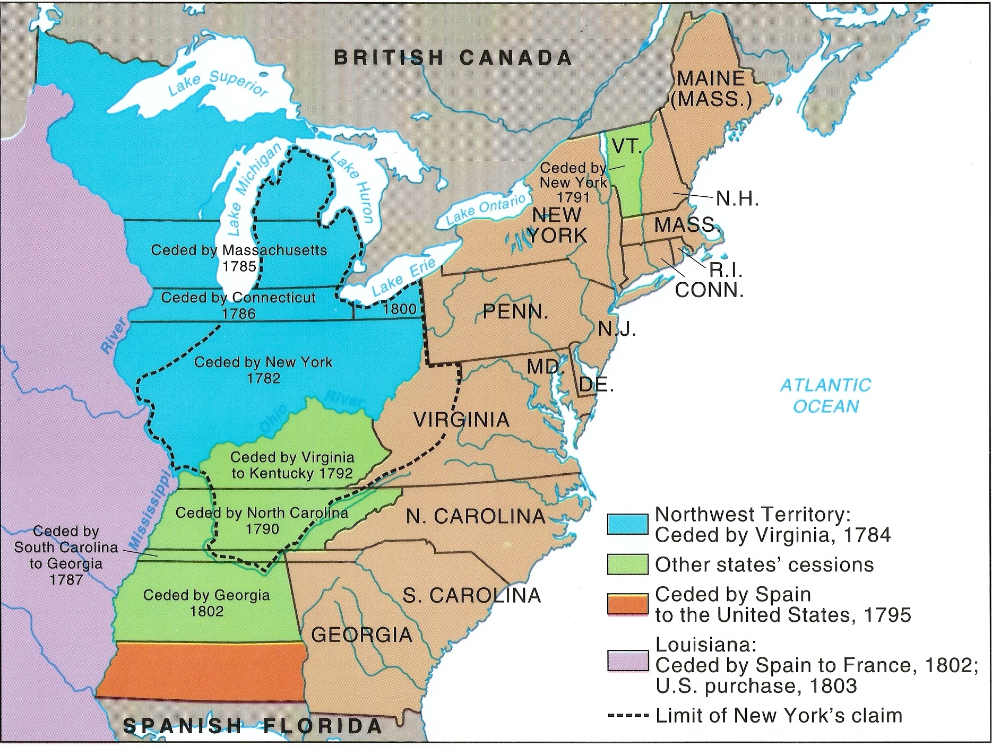
The Continental Congress Debates
Western Lands: Who Gets Them?
• By 1779, 12 states approved the Articles of Confederation
• Maryland approved when western land claims were given to U.S.
• Articles of Confederation
went into effect March 1781

Slide 7
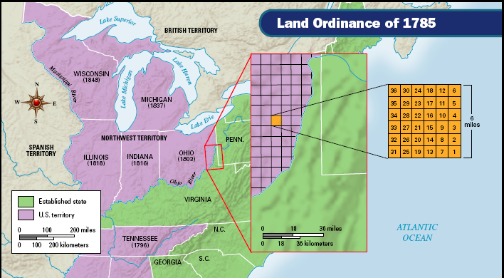
Governing the Western Lands
• Land Ordinance of 1785 created plan for surveying western lands

Slide 8
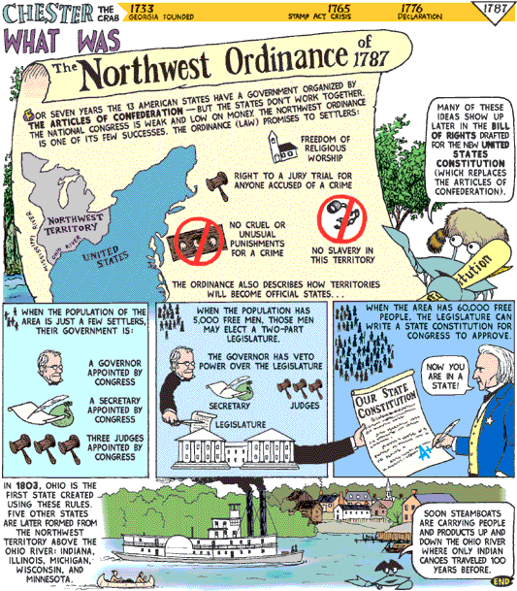
Governing the Western Lands
• Northwest Ordinance of 1787—plan for organizing territories, application for statehood

Slide 10
The Confederation Encounters Problems
Political and Economic Problems
• Confederation lacked unity; states pursued their own interests
• Congress amassed huge debt during Revolutionary War
• Rhode Island rejected tariff on imports; foreign debt could not be paid

Slide 11

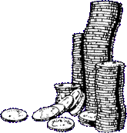

The Confederation Encounters Problems
Borrowers Versus Lenders
• Creditors favored high taxes so they could be paid back
• Taxes put farmers in debt; many lost land and livestock
• Debtors wanted large supply of paper money; creditors wanted small supply of paper money (scarcity made the currency more valuable)

Slide 12


The Confederation Encounters Problems
Foreign-Relations Problems
• U.S. did not pay debts to British merchants or compensated Loyalists
• In retaliation, Britain refused to evacuate forts on the Great Lakes
• In 1784, Spain closed Mississippi River to American navigation
• Westerners were unable to ship crops east through New Orleans
• Overall, Congress was unable to resolve problems with foreign nations

Slide 13
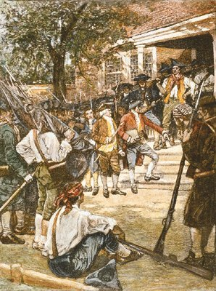
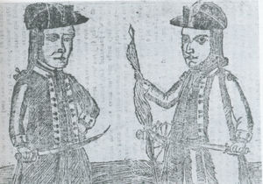
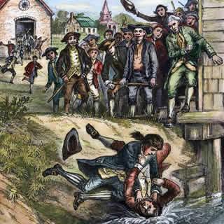
Nationalists Strengthen the Government
Shays’s Rebellion
• 1786–87 armed farmers demanded closing of courts to avoid losing farms
• Shays’s Rebellion-state militia defeated farmers led by Daniel Shays
• Many leaders feared rebellion would spread through country
• George Washington called for stronger national government

