Slide 1
Chapter 5 Section 4

Slide 2
Objectives
Identify the opposing sides in the fight for ratification and describe the major arguments for and against the proposed Constitution.
Describe the inauguration of the new government of the United States of America.

Slide 3
Key Terms
Federalist: a person favoring ratification of the proposed U.S. Constitution
Anti-Federalist: a person opposing ratification of the proposed U.S. Constitution

Slide 4
Introduction
What issues aroused the vigorous debate over the ratification of the Constitution?
The key issues debated included:
How strong should the new central government be to avoid the problems faced under the Articles of Confederation?
Why didn’t the Constitution have a Bill of Rights, and was one really necessary?
Did Congress and the presidency have too much power?

Slide 5
A New Government
The Articles of Confederation could only be amended by a unanimous vote of all 13 states.
But the delegates at the Constitutional Convention decided to require only 9 of 13 states to ratify the Constitution.
They felt that a unanimous vote would be too difficult to achieve, and that the Articles were being replaced rather than amended.
Copies of the new Constitution were sent to the states on September 18, 1787.

Slide 6
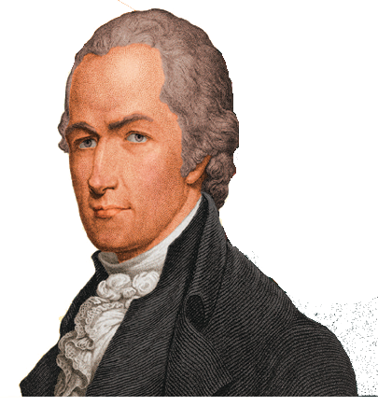
Federalists
Supporters of ratification were called Federalists.
They argued that the Articles of Confederation were weak and needed to be replaced.
Alexander Hamilton was a leader among the Federalists
Alexander Hamilton

Slide 7
Anti-Federalists
Opponents of ratification were called Anti-Federalists.
They opposed the new ratification process.
They thought the new central government would be too strong.
Most of all, they argued that the Constitution needed a Bill of Rights to protect the people.

Slide 8
Bill of Rights
Checkpoint: Why did the Framers not include a bill of rights in the original Constitution?
At first, Federalists said a Bill of Rights was not needed because:
The state constitutions already protected individual rights and freedoms.
The separation of powers among the three branches would keep the new national government from abusing its authority.
But Anti-Federalists opposition was so strong that Federalists eventually promised to add a Bill of Rights once the Constitution was ratified.
Notes:
Checkpoint Answer: Because they felt the federal government would not be strong enough to abuse the rights of the people due to its separation of powers, and because the state constitutions already protected individual rights.

Slide 9
Federalist Writings
The Federalist Papers influenced many Americans to support the Constitution
These were written by Alexander Hamilton, James Madison, and John Jay, all using the pen name, Publius.
They consisted of 85 political essays, written between 1787 and 1788, and were soon published across the nation.
These essays are still read widely today for their insights into the Constitution, the federal government, and the nature of representative democracy.

Slide 10
Anti-Federalist Writings
Anti-Federalists also wrote many essays, pamphlets, and letters
The essays by “Brutus” were most likely written by Robert Yates. They were first published in New York.
Richard Henry Lee of Virginia wrote a number of pamphlets and letters using the name “The Federal Farmer.”
Around the country, debate over ratification was fed by these various written works expressing strong views on both sides.

Slide 11
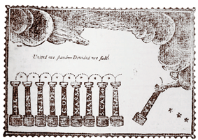
Ratification Debate
Ratification was swift in some states and bitterly contested in others.
Approval of the Constitution required ratification by nine states.
On June 21, 1788, New Hampshire became the ninth ratifying state.
Notes:
NOTE TO TEACHERS: Columns representing the States that had ratified ed the Constitution are placed in a row by the hand of God.

Slide 12
Trouble with Ratification
Even though 9 states had ratified the Constitution, without the support of the key states of New York and Virginia, the Constitution would fail.
In Virginia, James Madison, George Washington, and Thomas Jefferson supported the Federalists against Anti-Federalists led by Patrick Henry, James Monroe, and George Mason.
New York was deadlocked until Alexander Hamilton helped turn the tide for the Federalists.

Slide 13
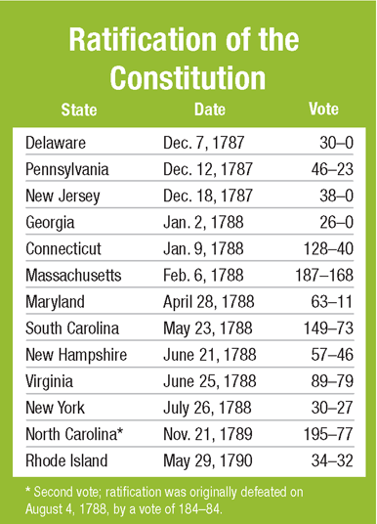
Success
When Virginia and New York ratified the Constitution by narrow votes, success was finally ensured.
Eventually all 13 states ratified the Constitution.

Slide 14
Review
Now that you have learned about the issues that arose the vigorous debate over the ratification of the Constitution, go back and answer the Chapter Essential Question.
How does the Constitution reflect the times in which it was written?

