Slide 1
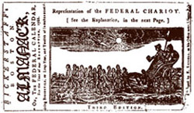
Chapter 5 Section 4 Ratifying the Constitution
This drawing appeared in the 1788 edition of Bickerstaff's Boston Almanack. It shows elder statesmen George Washington and Benjamin Franklin driving the "Federal Chariot," pulled by the 13 states, and heading toward ratification of the Constitution.
Notes:
Less than three months after the Constitution was signed, Delaware became the first state to ratify it, on December 7, 1787. New Hampshire was the ninth state, putting the Constitution into effect on June 21, 1788. But the Founding Fathers could not be sure that the Constitution would be generally accepted until the important states of New York and Virginia had ratified it. Powerful organized opposition to the Constitution had developed in these two states and in others. Such men as Elbridge Gerry, Patrick Henry, Richard Henry Lee, and George Mason spoke out against ratification.

Slide 2
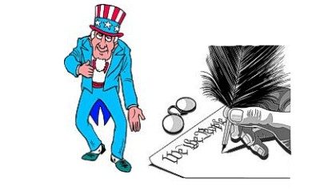
Constitution: Signing the Constitution
Once the debate ended, Governor Morris of New Jersey put the Constitution in its final form. He competed the task of hand-writing 4,300 words in two days
The Constitution was signed by 39 of the 55 delegates on September 17, 1787.

Slide 3
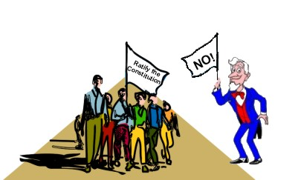
Constitution: Ratifying the Constitution
The Continental Congress received the proposed Constitution on September 20. It then voted to send the document to the state legislatures for ratification.
Notes:
Framers of the const. bypassed the state legislatures b/c they feared the legislatures would never approve a document that reduced their powers

Slide 4
Federalists vs. Anti-Federalists
Those who favored the Constitution
Strong National Government
Supporters included: Washington, James Madison, & Alexander Hamilton
Opposed the Constitution
New Constitution was a threat to state governments & individual rights
Supporters included: Patrick Henry, Sam Adams, & George Mason

Slide 5
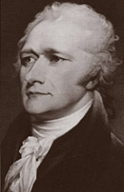
Federalists
Federalists believed in a strong national government. They believed that the Constitution was a "loose" document that did not define all of the powers that the federal government should have. The government had the right to adopt additional powers to fulfill its duties under the Constitution.

Slide 6
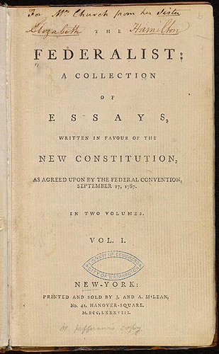
Federalists Papers
The Federalist Papers were written and published during the years 1787 and 1788 in several New York State newspapers to persuade New York voters to ratify the proposed constitution.

Slide 7
Federalist Papers
In total, the Federalist Papers consist of 85 essays outlining how this new government would operate and why this type of government was the best choice for the United States of America. All of the essays were signed "PUBLIUS" and the actual authors of some are under dispute, but the general consensus is that Alexander Hamilton wrote 52, James Madison wrote 28, and John Jay contributed the remaining five.

Slide 8
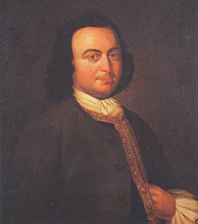
Anti-Federalists
The Anti-Federalists saw in the constitution threats to rights and liberties so recently won from England
A desire to establish a weak central government
Notes:
George Mason (1725-1792) was called on in May 1776 to draft the Virginia Declaration of Rights, which Thomas Jefferson paraphrased a few weeks later in the opening lines of the Declaration of Independence. Mason's document also was the pattern for the federal Bill of Rights, added as amendments to the Constitution in 1791.

Slide 9
Anti-Federalists
A corresponding desire for strong state governments
The support of many small farmers and small landowners
“The Constitution should be read, ‘We the states, not we the people…I strongly oppose the ratification of the new constitution” Samuel Adams
Notes:
Though those who opposed the Constitution actually wanted a more purely federal system (as the Articles provided), they were more or less forced into taking the name "Anti-Federalists." These men had many reasons to oppose the Constitution. They did not feel that a republican form of government could work on a national scale. They also did not feel that the rights of the individual were properly or sufficiently protected by the new Constitution. They saw themselves as the true heirs of the spirit of the Revolution. Some very notable persons in United States history counted themselves Anti-Federalists, like Patrick Henry, Thomas Paine, George Mason, George Clinton, and Luther Martin.

Slide 10
Anti-Federalists
The Anti-Federalists did not want to ratify the Constitution. Basically, they argue that:
It gave too much power to the national government at the expense of the state governments.
There was no bill of rights.
The national government could maintain an army in peacetime.
Congress, because of the `necessary and proper clause,' wielded too much power.
The executive branch held too much power.

Slide 11
Anti-Federalists Papers
Many letters were written to newspapers under various pseudonyms, like "The Federal Farmer," "Cato," "Brutus," and "Cincinnatus." These letters and several speeches are now known as "The Anti-Federalist Papers."

Slide 12
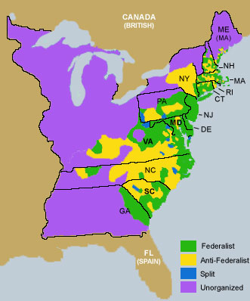
Ratification

Slide 13
Did the Federalists Win?
Anti-Federalists had no other document to offer in place of the new Constitution.
Anti-Federalists ran a negative campaign, which was not well received by all
Federalists were more organized.
However, the Anti-Federalists did secure a guarantee that a Bill of Rights would be included in the Constiution.

Slide 14
Fight for Ratification
First state conventions took place in Dec. 1787 and Jan 1788.
Delaware, Pennsylvania, New Jersey, and Georgia, & Connecticut quickly ratified the constitution.

Slide 15
Fight for Ratification
In order to get the Constitution ratified in Massachusetts, Federalists promised to add a bill of rights and an amendment that would grant powers to the states that were not granted to the federal government .

Slide 16
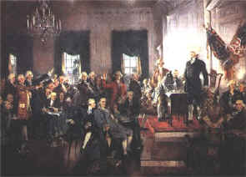
Fight for Ratification

Slide 17
Fight for Ratification
Virginia
Ratified the Constitution when the Federalists agreed to add a bill of rights
New York
Ratified the Constitution only after it learned surrounding states of Connecticut and New Hampshire did because they did not want to operate independently.

Slide 18
Fight for Ratification
By June 1788, all states except Rhode Island and North Carolina had ratified the Constitution.
By 1790 both states had ratified the Const.
Bill of Rights-States ratified Bill of Rights Dec. 15, 1791

