Slide 1
Creating the Constitution
Section 3: Creating the Constitution

Slide 2
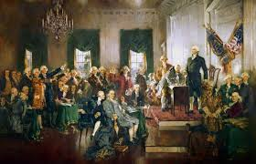
The Constitutional Convention

Slide 3

Disagreements and questions
Should representatives be equal or based on population?
How much power should the federal government be allowed?
Slavery?
?

Slide 4

Setting the Ground Rules
May 25, 1787 – September 17, 1787
Presiding Officer – George Washington
Secret Discussions
  Doors shut, windows closed
  No involvement from outside world
  Each state = 1 vote
  Very professional and organized

Slide 5
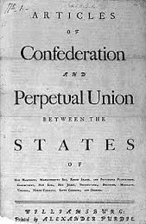
First Acts during the Convention
SCRAP the Articles
– start over

Slide 6




A New Idea!
Articles of Confederation:
New Idea:
1 Branch
Legislative—makes laws
3 Branches

Slide 7

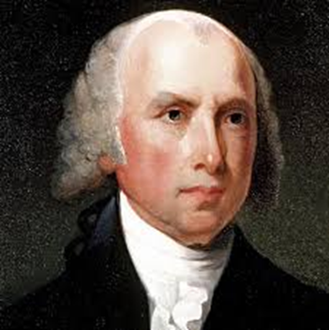
James Madison, Virginia
His plan –
  Three branches of Government
  Bicameral Legislature
  Based on Population
  Elect members of house who choose senators
  *Large States favored, Small states opposed

Slide 8

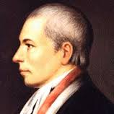
William Patterson, New Jersey
His plan –
  Three Branches of Government
  Unicameral Legislature
  Equal Representatives
**Still a conflict among states

Slide 9
Battle of the Plans
The Virginia Plan
The New Jersey Plan
Legislative branch has ___ “chambers”
Number of votes for each state depends on the state’s ___________
________ states would have more power
2
Legislative branch has ___ “chamber”
Each state gets ___ vote
________ states would have more power
1
1
Smaller
population
Larger
(Virginia was a large state, and New Jersey was a small state. Surprise!)

Slide 10
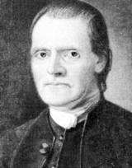


The Great Compromise
Roger Sherman, Connecticut
His plan –
  Bicameral Legislature
  House – based on population
  Senate – two for each state
Senate
House of
Representatives

Slide 11

The Constitution Solution
Legislative:
Makes laws
Divide Congress Into Two Houses
Senate | House of Representatives
Each state gets 2 votes. | The more people the state has, the more votes it gets!
Executive:
Carries out laws
Judicial:
Interprets laws

Slide 12
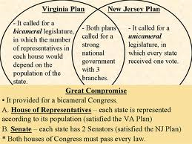

Slide 13
Now What?
We’ve decided on Bicameral Legislature
  One based on population –
    House of Representatives
  One with equal representation –
    Senate
Who is determined in state’s population?
What to do with the institution of slavery?

Slide 14
Three-Fifths Compromise
Answered the question of slavery counted in population
Northern States
  Opposed having slaves count
  Why?
Southern States
  For having slaves count
  Why?

Slide 15
Three-Fifths Compromise
A compromise that counted each individual slaves as three-fifths of a person when a state’s population was calculated.
  For every 5 slaves, 3 counted towards the population

Slide 16
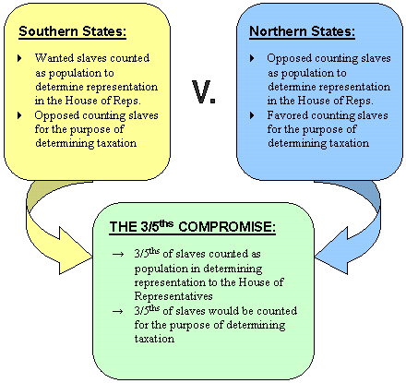

Slide 17
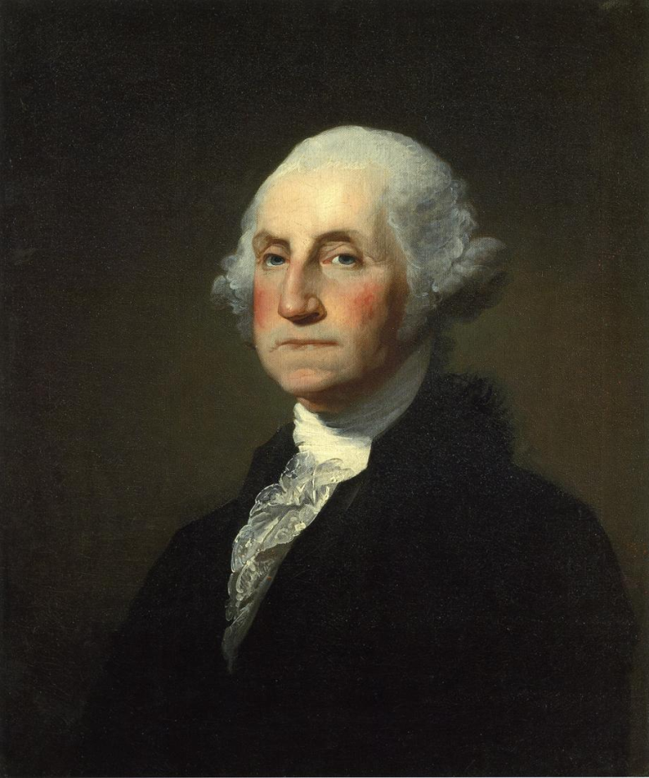
Executive Branch
Needed for separation of powers
One President
  Not Committee of Leaders
Power: Enforce Laws
George Washington
  Unanimous decision

Slide 18
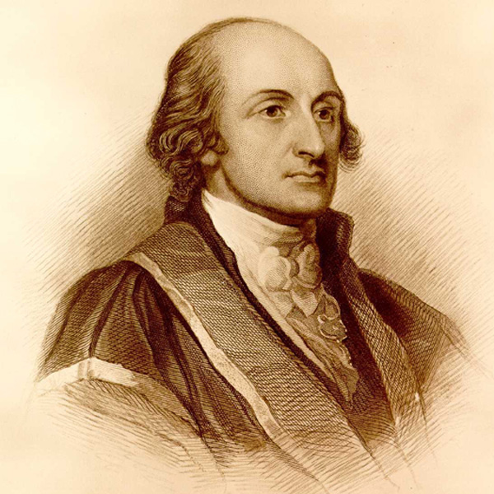
Judicial Branch
Needed for separation of powers
Supreme Court
Power: Interpret Laws
John Jay

Slide 19
Elections in 1787
House of Representatives – Voted by Citizens
Senate – Selected by State Legislatures
President – Group of electors, Electoral College
“Average citizens will never be sufficiently informed” – Roger Sherman

Slide 20
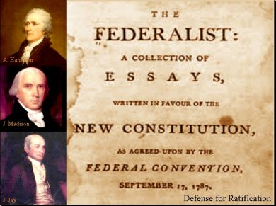
Federalists
Supporters of the Constitution
Favored strong, national government

Slide 21
Anti-Federalists
Those opposed to the Constitution
Opposed a strong, federal government
What exactly did they oppose?
  “Necessary and Proper” Clause (Article 1, Section 8)
  Wanted Bill of Rights

