Slide 1
Chapter 5 Section 1
The Articles of Confederation

Slide 2
The Articles of Confederation
English Laws and the Enlightenment
We gather much of what we put into our laws and our government from the English
Magna Carta
Signed in 1215
Also Called the “The Great Charter”
Protected nobles privileges and authority and gave rights to land owners
Equal treatment under the law trial by ones peers
No one was above the law which limited the power of the Monarch

Slide 3
The Articles of Confederation
English Bill of Rights
1689
Further restricted Monarch’s Power
Couldn’t pass new taxes, or make new laws with out the consent of Parliament
Free Elections
Right to Fair Trial
Elimination of Cruel and Unusual Punishments

Slide 4
The Articles of Confederation
Philosophical Influences
John Locke
Wrote “The Second Treatise of Government”
All People were born free, equal and independent
Natural Rights- Life, Liberty, and Property that no government could take away
Social Contract- people agree to give up part of freedom for protection
Jean-Jacques Rousseau
Wrote “Social Contract”
“Man is born free, yet everywhere he is found in chains”
People alone had right to determine how they should be governed

Slide 5
The Articles of Confederation
Baron De Montesquieu
Separation of Powers
Sources of American Law
Greek Law- Citizens expected to take part in government
Roman Law- Standardized throughout the empire
Common Law- Precedent
Equity Law- Fairness
Constitutional Law- Americas Laws
Statutory Law- written law made by legislature

Slide 6
The Articles of Confederation
American Models of Government
Jamestown
1st Permanent Settlement- Virginia Company( Joint Stock Company)
Ruled by council appointed by the Company
Mayflower Compact
Helped set direct democracy by having town meetings
Fundamental Orders of Connecticut (1639)
1st written constitution (set of laws that is the blue print of the government, states the laws and duties)
Representatives, popular elections

Slide 7
The Articles of Confederation
States Constitutions
Many states created very limited governments, which kept individuals from gaining too much power
Each state had different laws,
Massachusetts constitution that was written in 1780 is the oldest that is still in effect today
Virginia
Virginia Stature for Religious Freedom
No person could be forced to attend a certain church or pay for a church with tax money (separation of church and state
House of Burgesses (legislative body)

Slide 8
The Articles of Confederation
Right to Vote
In Britain only free white land owning men could vote
In the U.S. many states granted suffrage (right to vote) to any white man that paid taxes.
Only land owners could hold office though

Slide 9
The Articles of Confederation
The Articles of Confederation
Nov. 15, 1777 @ the Second Continental Congress
1779- Every state except Maryland had approved it. Maryland wouldn’t until state gave up their western claims.
Finally Ratified by March of 1781
1 house legislature
Each State had 1 vote
Very limited powers- army control, foreign countries dealings
Couldn’t enforce laws or tax

Slide 10
The Articles of Confederation
Land Ordinance of 1785
Created a system of surveying land
Arranged land into townships 36 square miles
Each township was 36 sections of 1 square mile (640 acres)
One lot was reserved for public schools and 4 were for veterans, rest was sold
Still used today

Slide 11
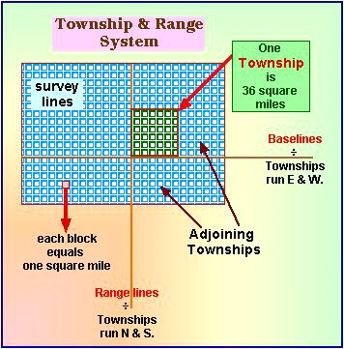
The Articles of Confederation

Slide 12
The Articles of Confederation
Northwest Ordinance of 1787
Laid basis of setting up new territorial governments
Set method on how territories were admitted as States
Once a territory reached 60,000 the settlers could draft a constitution and ask to become a state
Also outlawed slavery
Formed the Northwest Territory
Areas of Illinois, Indiana, Michigan, Ohio, Minnesota and Wisconsin

