Slide 1
Chapter 5 Overview
Articles of Confederation: Adopted November 1777 – loosely unified the states under a Continental Congress (to which each state would send delegates)
How does our fledgling country pay for
its war debts?
Sell western land to settlers
Northwest Ordinance: basis for
governing the western lands –
guaranteed rights to people living
there, including disallowing slavery
Trade

Slide 2
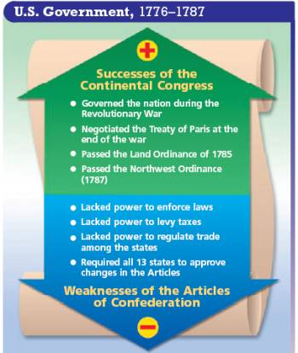
Confederation Congress
Problems:
Diplomacy
Britain refused to hold up to some of their end of the bargain at the close of the War and the Congress had no power and or money to force them to leave
Spain – challenged the border between Georgia and Spanish territory
Economy
Much debt
Personal and State (Country)
Big argument over the use of paper money and raising taxes

Slide 3
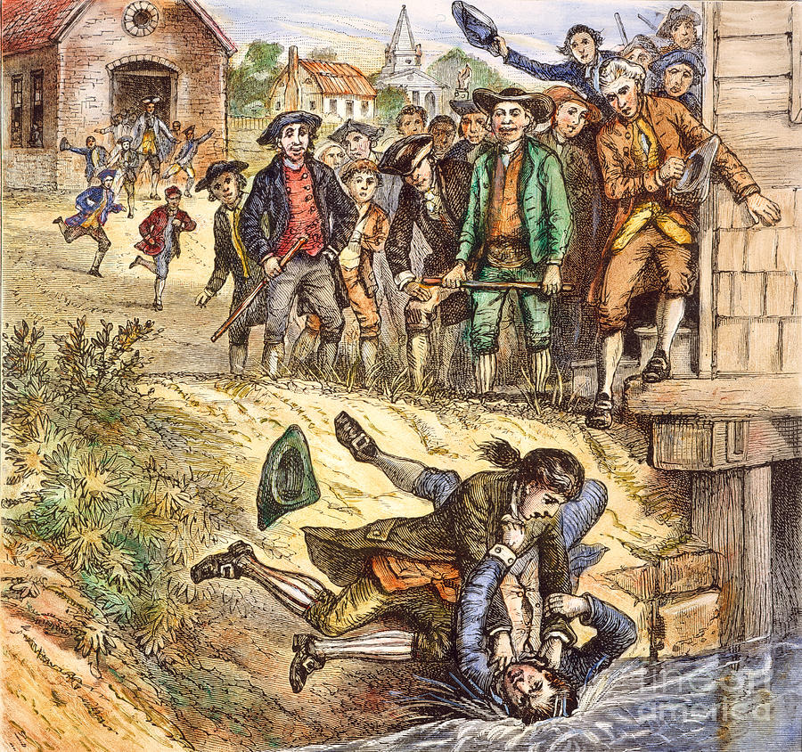
Shays' Rebellion – Massachusetts 1786
Massachusetts government raises taxes instead of issuing paper money to pay of its debts
Poor farmers were highest taxed
Daniel Shays – (Former Captain in the Army during Revolution)Was now a bankrupt farmer who led the rebellion into Boston
There him and his men were met by state militia and rebels were dispersed
So what happened?
The rebellion caused people to think the country was unstable
They called for a stronger central government

Slide 4
What were some of the problems faced by the Confederation Congress? Did they handle them well? How can you tell?
Was the Confederation Congress successful at all?
What do you think Shays' Rebellion led to?
Who do you think Shays' Rebellion affected the most?

Slide 5
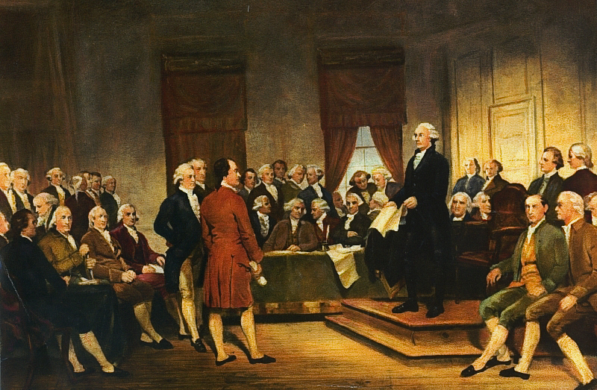
The Constitutional Convention
Nationalists – supported a stronger central government
55 delegates met – chose George Washington as presiding officer

Slide 6
Virginia Plan | New Jersey Plan
National government – three branches: legislative, judicial, executive | Congress would have a single house with each state equally represented
Legislature: two houses – one elected by voters, one nominated by state gov’t | Congress would have the power to raise taxes and regulate trade
Both houses the number of representatives would reflect state population
Abandon Articles of Confederation | Modified Articles of Confederation
Why would smaller states oppose the Virginia Plan?
Do you find it odd that the Convention decided to proceed with the Virginia plan?

Slide 7
The Great Compromise
One house of Congress represented according to population
One house of Congress – the Senate – equal representation
Voters choose representatives
State legislatures appoint Senators
Representation based on population – sounds fair, right?
But… are slaves considered population?
Three-Fifths Compromise
Every five slaves counted as three free citizens for purposes of taxes and representation

Slide 8
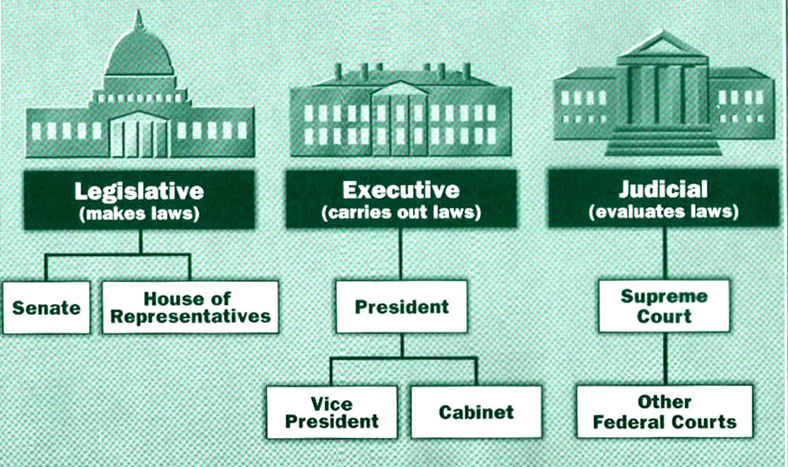
Government Framework:
Popular sovereignty: rule by the people (not a true democracy)
Federalism: divided gov’t power between national and state
Separation of powers: three branches of federal government
Legislative branch: two houses of Congress – make the laws
Executive branch: led by President – enforce the laws
Judicial branch: federal court system – interpret the laws

Slide 9
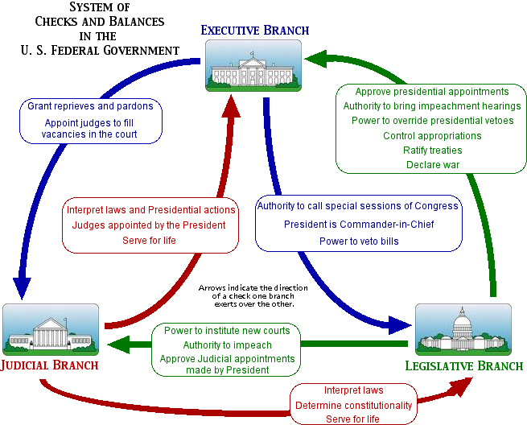
checks and balances
Prevent any one of the branches from having too much power

Slide 10
What if something in the Constitution needs to be changed? What is that process called?
A two-step process called amending –
#1 – propose amendment;
#2 – ratify amendment (must have ¾ of all states agree)

Slide 11
Federalists | Anti-Federalists
Support Constitution | Accepted need for national government
Better organized than anti-federalists | Didn’t agree that Federal gov’t should be supreme
Offered a solution to the new nation’s problems with the Constitution as written | Complained the Constitution failed to protect basic rights – but offered no alternative

Slide 12
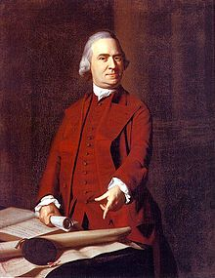
In Massachusetts – Anti-federalist, Samuel Adams objected to ratification –
Concessions are made by Federalists to secure his vote (and ultimately satisfying Anti-feds in other states):
Promise to attach a bill of rights to Constitution once ratified
Support an amendment which would give states all powers not specifically granted to the federal gov’t.
Two states waited until the new government was in place before ratification (RI and NC)
March 4, 1789 – first meeting of new Congress
George Washington was chosen to become the first president under the new constitution

