Slide 1
Chapter 5 – Creating a New Government
Section Notes
Video
The Articles of Confederation
Drafting the Constitution
Ratifying the Constitution
Creating a New Government
Maps
Quick Facts
The Land Ordinances of 1785 and 1787
Ratification of the Constitution
Weaknesses of the Articles of Confederation
The Great Compromises
Checks and Balances
Visual Summary: Creating a New Government
Federal Office Terms and Requirements
Federal Judicial System
Federalism
Visual Summary: The Constitution of the United States
Images
Republican Motherhood
The Constitutional Convention
Political Cartoon: United We Stand
The Bill of Rights

Slide 2
The Articles of Confederation
Main Idea
In order to carry on the war and build a new nation, Americans had to create a framework of government, but their first attempt had many weaknesses.
Reading Focus
What were some key aspects of the new American republic?
What was the structure of the new national government?
What problems did the Confederation face?
What did the government accomplish in the Northwest Territory?

Slide 3
The American Republic
State governments had similarities
Legislative branch made the laws.
Judicial branch interpreted the laws.
Executive branch (the governor) carried out the laws.
Remembering the powerful royal governors, the states chose to limit the governor’s power.
The elected legislatures held more power.
Republicanism
Americans wanted a republic, a political system without a monarch. It would rule “with the consent of the governed.”
Ideal of republicanism was that property-owning citizens would be active in government
In reality, women, African Americans, Native Americans, and poor white laborers seldom owned property or took part in government.

Slide 4
The American Republic
Republican motherhood
The Revolutionary War brought a shift in women’s roles.
Managed farms and businesses
Fought in battle or defended their homes
Organized boycotts
Supported war effort
Republican motherhood encouraged mothers to raise their sons to be patriotic future leaders and their daughters to be intelligent, patriotic, and competent so they could run households and educate their own children.
Judith Sargent Murray, a contemporary author, maintained that young women should be educated in reasoning, not just household skills.

Slide 5
A New National Government
The Articles of Confederation
Established a confederation—an association of independent sovereign states with certain common goals
Formally adopted the Articles of Confederation in November 1777
Powers of the new government
The states retained most of their powers.
Weak national government
Legislative branch, Continental Congress
Each state had only one vote, regardless of population.

Slide 6
A New National Government
The Articles of Confederation allowed Congress to
Establish national policies and conduct foreign relations, including relations with Native American nations
Coin money and set up post offices
Establish an army
Declare war
Nine of the 13 states had to agree on any major law.
All 13 states had to agree to amend the Articles.
The new government’s major problems involved money.
Large war debts
No power to impose or collect taxes
Could not afford an army or navy
Could not repay money it borrowed from foreign governments and from individual Americans during the war

Slide 7
A New National Government
Problems with the states
Congress had very little power over the individual states.
It could not settle disputes between states because there was no national court system.
Problems with foreign nations
Because it was so weak, Congress had trouble taking advantage of the territory that the United States had won in the Treaty of Paris.
The British did not leave their forts in the Great Lakes region.
The British and their Native American allies kept American settlers out of the Northwest Territory.
Negotiating with Spain about uses of the Mississippi and port of New Orleans was difficult.

Slide 8
A New National Government
Economic problems
Private citizens and businesses in every state had money problems after the war.
New England’s trade with Britain and the British West Indies was lost. Traders had to pay high customs duties.
The southern economy was hurt without Great Britain’s bonuses to support key colonial industries such as indigo and naval stores.
Paper money that was not backed by gold or silver was issued—led to inflation.
States could levy taxes.
Some states required taxes be paid in gold or silver.
People who could not pay were jailed.

Slide 9
A New National Government
The Northwest Territory
Was a need to organize the settlement of the vast Northwest Territory—present-day Wisconsin, Illinois, Indiana, Ohio, and Michigan
Western land claims
Articles of Confederation did not address the question of new states.
States had to give up their western land claims to the central government.
Most states gave up their lands by the early 1790s.

Slide 10
A New National Government
Dividing western lands
The territory was divided into 10 districts.
Land Ordinance of 1785
Land would be surveyed and divided into a neat grid of townships, each 6 miles square.
Each township had 36 sections, each 1 mile square.
Government owned four of the sections.
One section would be sold to support public schools.
This same regular grid was used in other territories. It ended many boundary disputes.

Slide 11
A New National Government
Northwest Ordinance was passed in 1787.
Encouraged orderly settlement and the formation of new states, all controlled by law
Promised settlers religious freedom and other civil rights
Did not allow slavery in the Northwest Territory
A single governor was put in charge.
A district could become territory with a population of 5,000 adult males. Then could send a nonvoting representative to Congress
A territory could write a constitution and apply for statehood with a population of 60,000.

Slide 12
Drafting the Constitution
Main Idea
The Constitutional Convention tried to write a document that would address the weaknesses of the Articles of Confederation and make compromises between large and small states and between the North and South.
Reading Focus
What different points of view emerged at the Constitutional Convention?
What compromises did the delegates make at the Constitutional Convention?
How does a system of checks and balances prevent any one branch of the federal government from becoming too powerful?

Slide 13
The Constitutional Convention
Many were frustrated with the Articles of Confederation: farmers, veterans, merchants doing business between states, and creditors of the Continental Congress who had not been paid.
Congress called all the states to meet in Philadelphia in May 1787 to revise the Articles of Confederation.

Slide 14
Checks and Balances
Constitutional Convention
12 states attended some or all of the meetings.
Politicians in Rhode Island were opposed to a stronger government; they chose not to take part in the convention.
James Madison kept a detailed account of the convention in his diary.
Controversial plans
Congress had to find a balance between the large and small states and northern and southern interests.
The Virginia Plan:
Gave more power to states
Bicameral legislature
The number of representatives for each state would be based on population.
Small states objected; came up with new plan.
New Jersey Plan:
Gave more power to national government
Unicameral legislature
Each state would have an equal number of representatives.

Slide 15
Compromises at the Convention
There were major disagreements about the Virginia Plan and New Jersey Plan. The Connecticut delegates came up with a compromise.
The Great Compromise (or Connecticut Compromise)
Bicameral legislature
In the lower house, the number of representatives for each state is determined by population.
In the upper house, each state has an equal number of representatives.

Slide 16
Compromises at the Convention
Compromises on slavery
Southern states wanted to count all slaves for representation purposes but none for taxation.
Northern states objected.
Three-Fifths Compromise: all whites plus three-fifths of the slave population would be counted for both representation and taxation.
Native Americans were not counted.
In order to maintain unity between North and South, delegates agreed to a clause allowing the slave trade to continue for 20 years.
Another clause, the fugitive slave clause, stated that a slave who fled to another state had to be returned to his or her original state.

Slide 17
Checks and Balances
LEGISLATIVE BRANCH
Checks on Judicial Branch
May propose constitutional amendments to overrule judicial decisions
May impeach Supreme Court justices
Checks on Executive Branch
May reject appointments made by executive
May reject treaties
Controls funding for presidential initiatives
May impeach president
May override a veto
JUDICIAL BRANCH
Checks on Legislative Branch
May declare laws passed by Congress to be unconstitutional
Checks on Executive Branch
May declare executive actions to be unconstitutional
EXECUTIVE BRANCH
Checks on Legislative Branch
May veto bills
May adjourn Congress in certain situations
Checks on Judicial Branch
Appoints judges

Slide 18
Checks and Balances
Planning the court system
Delegates wanted to keep judges and courts independent, maintaining a separation of powers.
President nominates federal judges.
Senate approves them.
Judges cannot be fired arbitrarily.

Slide 19
Checks and Balances
We, the People of the United States . . .
Three delegates would not sign the Constitution because it lacked a bill of rights.
39 delegates from 12 states signed it, and the Constitutional Convention adjourned on September 17, 1787.

Slide 20
Ratifying the Constitution
Main Idea
Federalists and Antifederalists struggled over the principles of the new Constitution. But the promise of adding a Bill of Rights brought about ratification.
Reading Focus
What arguments for and against the Constitution were put forth by Federalists and Antifederalists?
What ideas were published in The Federalist?
Why was adding a Bill of Rights significant in the ratification process?

Slide 21
Federalists and Antifederalists
The new Constitution created a strong national government with certain powers left to the states.
When it was published, the drastic changes surprised and angered some people. They feared the idea of a too-powerful national government.
Federalists: supporters of the Constitution
Antifederalists: opponents of the Constitution

Slide 22
Federalists and Antifederalists
Federalist viewpoint
Led by James Madison, John Dickinson, and Alexander Hamilton
Benjamin Franklin and George Washington also backed the Federalists.
Federalist cause was generally popular in the cities, but they were outnumbered in the general population.
Well organized and knew how to gather political support

Slide 23
Federalists and Antifederalists
Antifederalist viewpoint
They were less organized and less unified than the Federalists.
Their core consisted of farmers and planters.
Agreed on one central issue: they distrusted any central authority
Believed strong national government would lead to a kind of tyranny like the kind they fought against in the Revolution.
Worried that the government would abuse both states’ rights and individual liberties
Thought the new government favored the educated and wealthy over ordinary people
Led by Samuel Adams, Patrick Henry, and Richard Henry Lee
Robert Yates, New York delegate, wrote anti-Constitution essays under the name Brutus.

Slide 24
Federalists and Antifederalists
Ratification process
Antifederalists demanded the addition of a Bill of Rights.
Wanted to spell out some basic rights in the Constitution to make sure those rights would be protected
Adding the rights became the main focus of the struggle over ratification.
Congress called for special ratifying conventions in each state.

Slide 25
The Federalist Papers
A series of essays discussing and defending the Constitution were published in New York newspapers.
Written under the pen name Publius
Circulated widely in other states
Collected in a book, The Federalist, also known as the Federalist Papers
Main goal of essays was to persuade New York delegates to ratify the document by explaining the advantages it would bring
Publius was three Federalists: James Madison, Alexander Hamilton, and John Jay

Slide 26
The Federalist Papers
Ideas in the Federalist
Hamilton wrote that the decision they were about to make was important for the whole world.
Madison warned against the dangers of factions—groups with specific, often opposing, interests.
Had torn apart some European governments
They were a natural part of American society and should not be suppressed.
A republican government would help balance the influence of factions.
He explained how the separation of powers described in the Constitution would limit government powers.

Slide 27
The Federalist Papers
Adding a Bill of Rights
Fight for ratification
The Federalists were better prepared than their opponents. They quickly organized and gained control of several state conventions, especially in small states.
After 11 states had ratified the Constitution, the Congress of the Confederation set dates for elections to choose members of Congress and presidential electors.

Slide 28
Adding a Bill of Rights
Constitutional amendments
Several crucial states had ratified the Constitution only because they were promised a bill of rights.
Once the new Congress was elected, it needed to add the bill in the form of amendments to the Constitution.
James Madison took charge of putting the Bill of Rights through Congress.
He pointed out that in England the constitution limited only the king’s power, not Parliament’s. The amendments would protect against all abuses of power.
The states approved 10 of the 12 amendments that Congress had approved. They became the Bill of Rights.

Slide 29
Adding a Bill of Rights
The Bill of Rights
First eight amendments dealt with individual civil liberties.
Ninth Amendment stated that listing certain rights given to the people did not mean that other rights did not exist as well.
The final amendment addressed the actions that states could do.
Tenth Amendment defined two kinds of government powers.
Delegated powers: powers that the Constitution gives to each branch of the national government
Reserved powers: powers that the Constitution does not specifically give to the federal government or deny to the states
Reserved powers belong to the states or to the people.

Slide 30
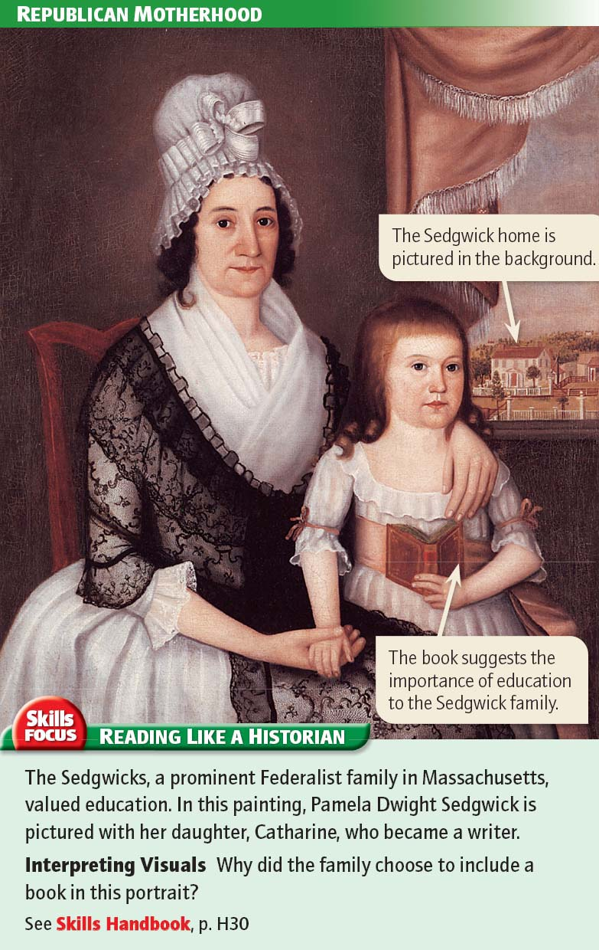

Slide 31
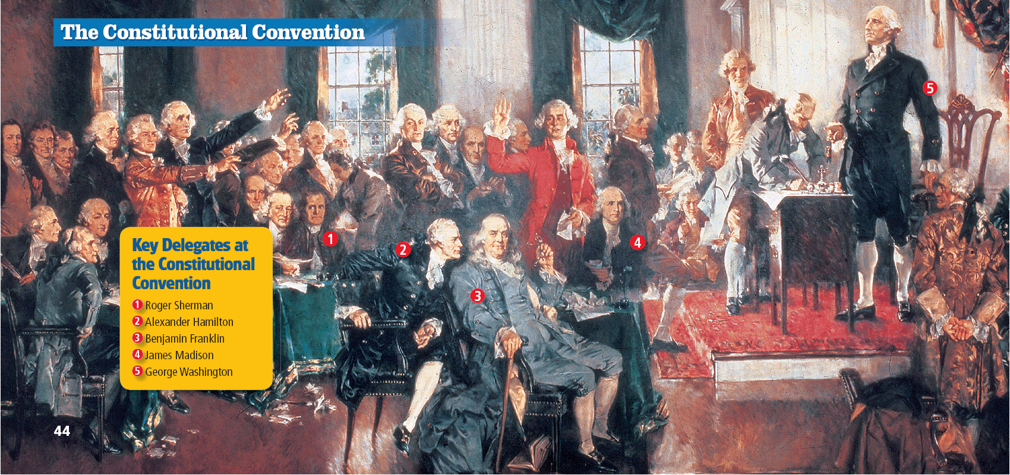

Slide 33
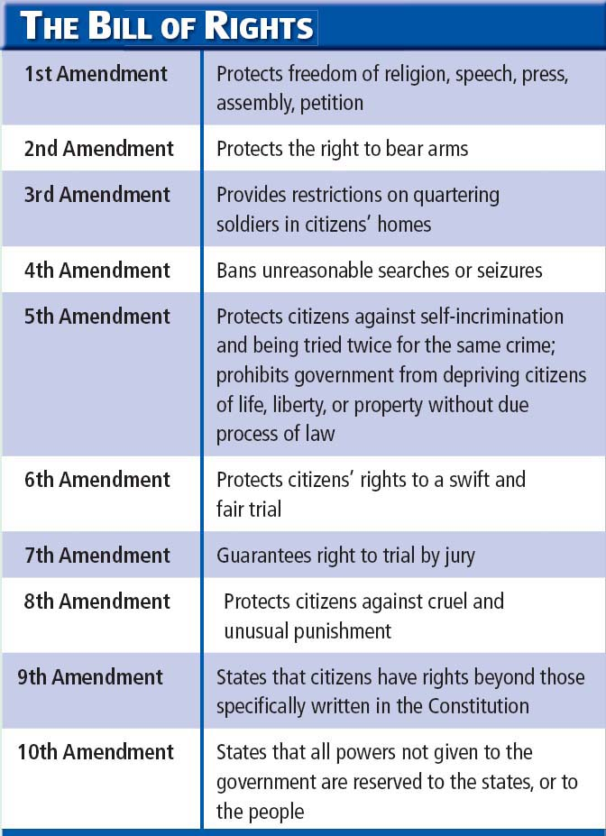

Slide 34
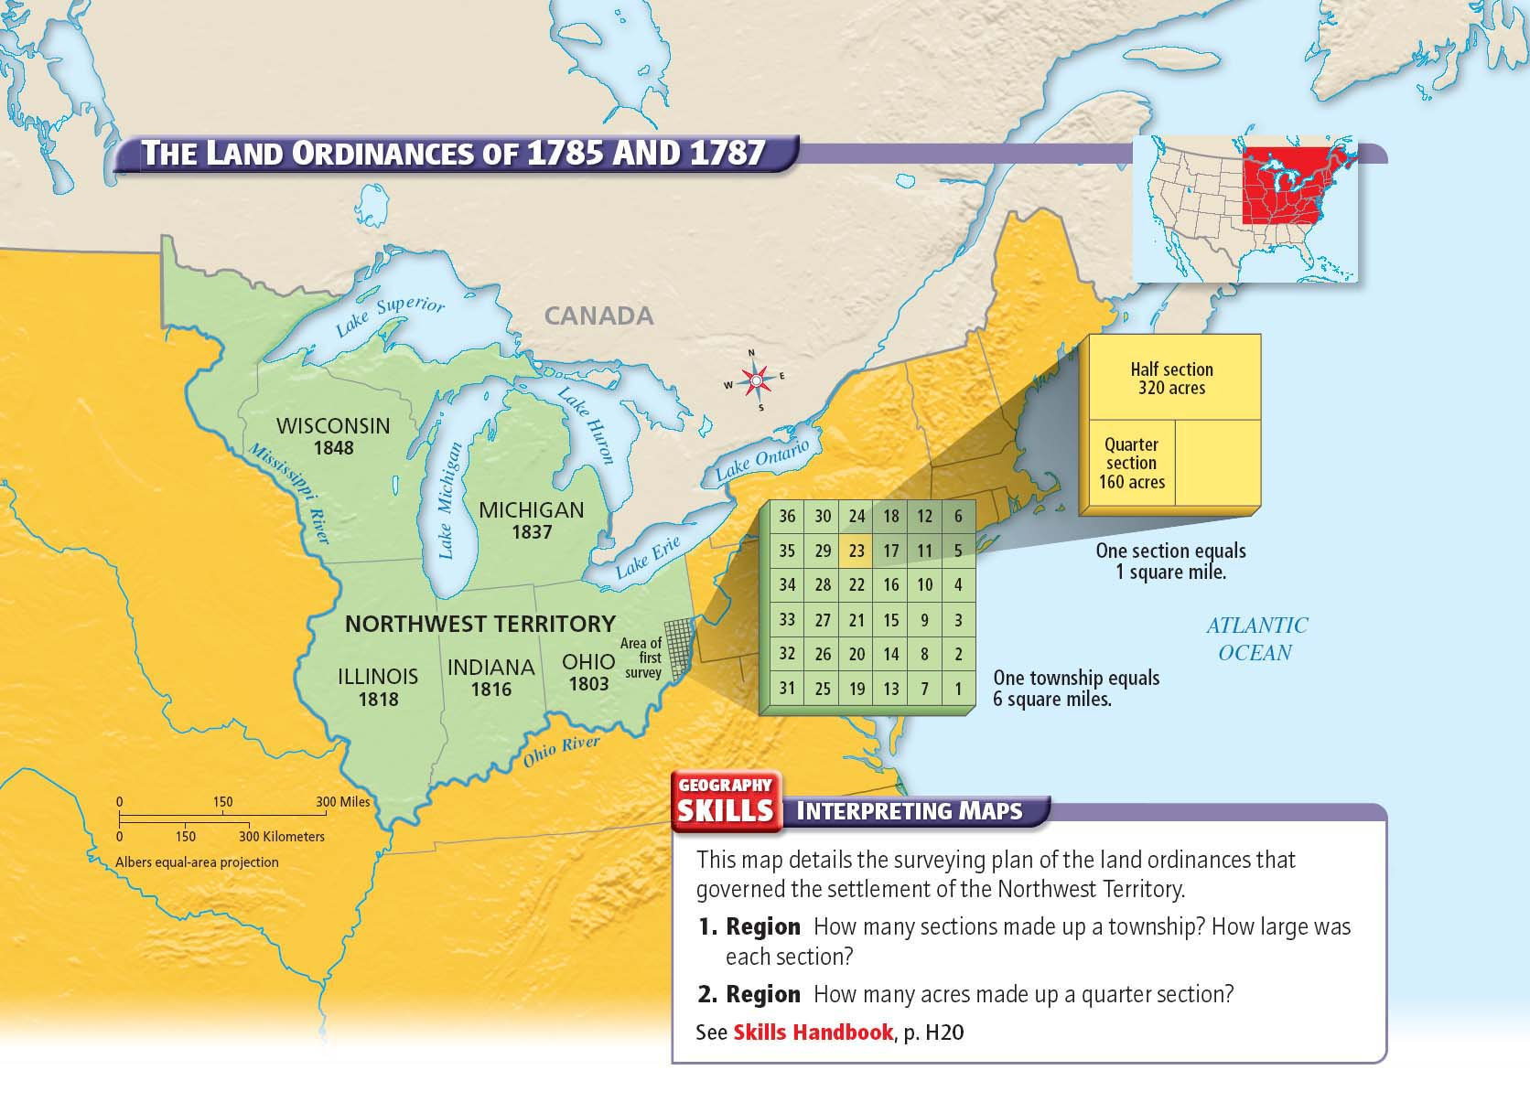

Slide 35
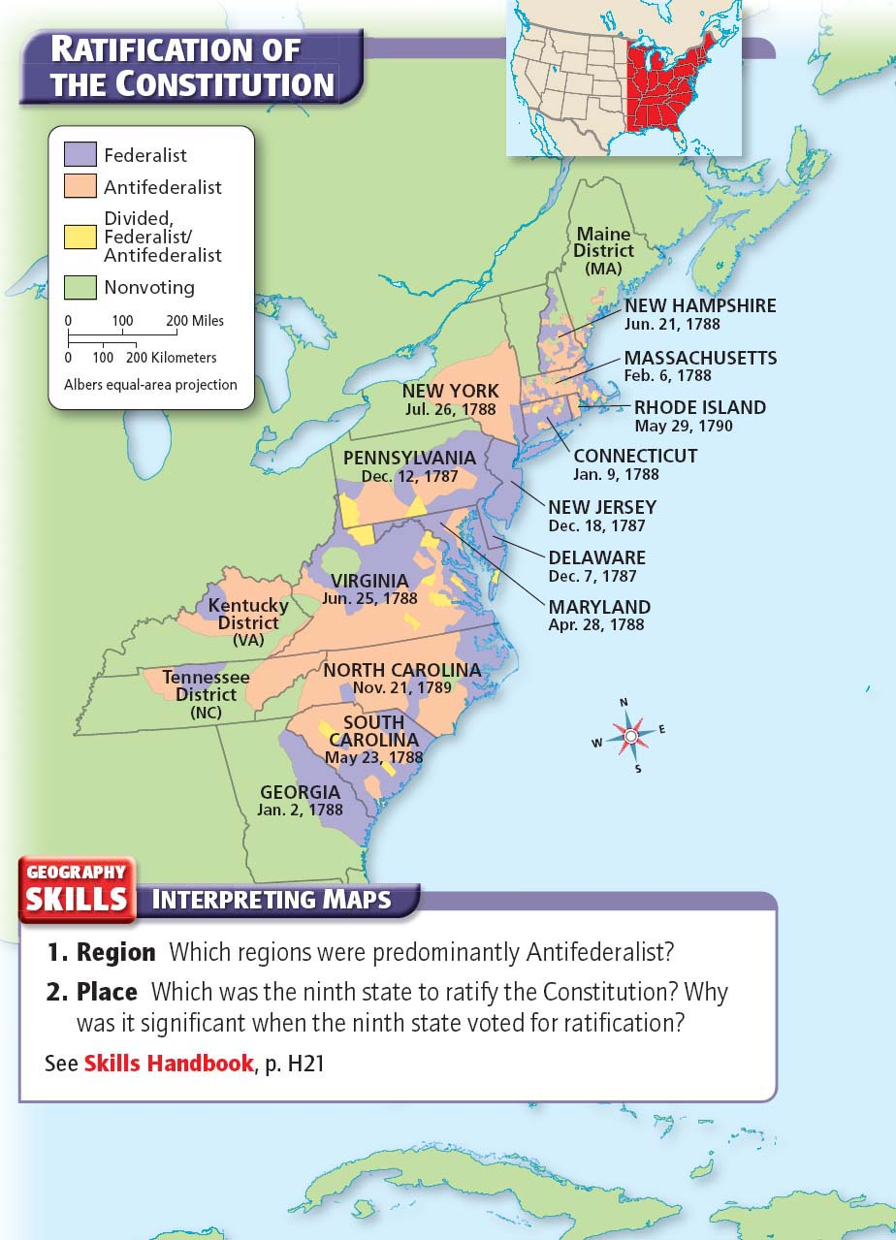

Slide 36
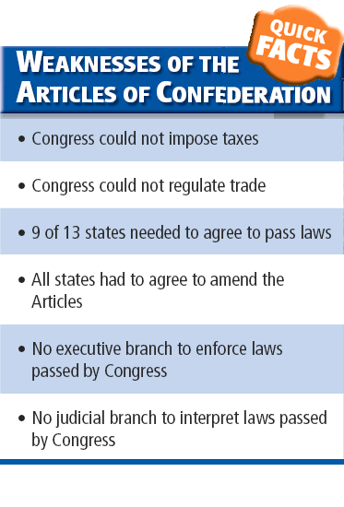

Slide 37
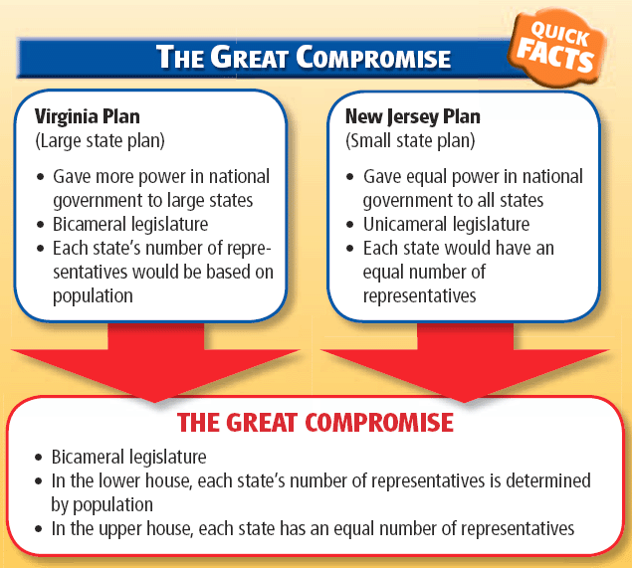

Slide 38
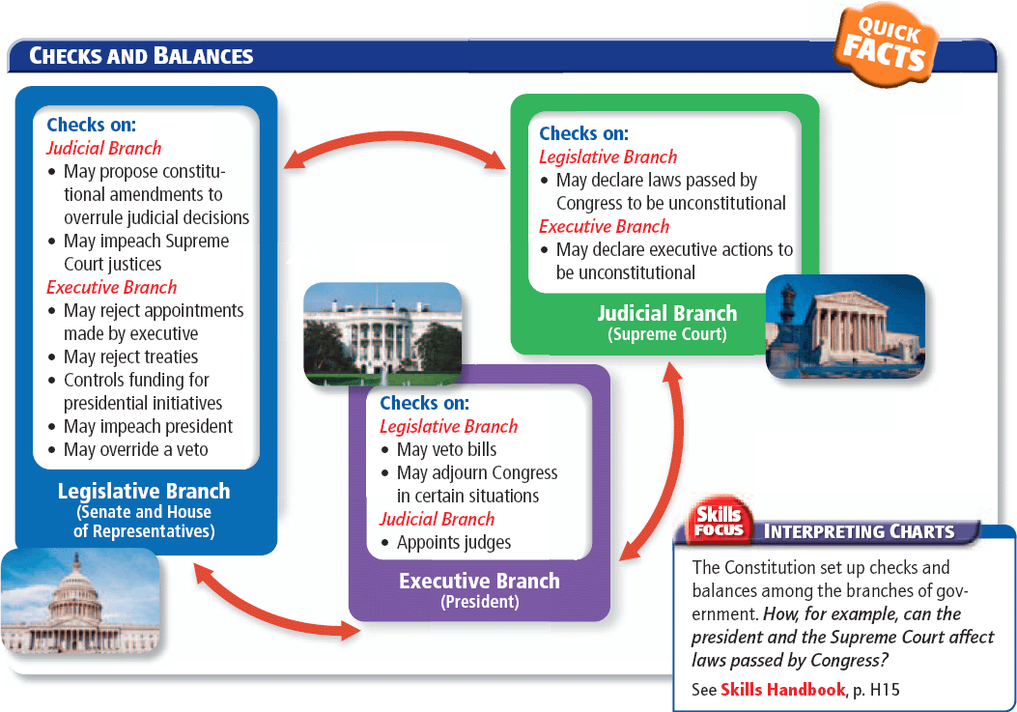

Slide 40
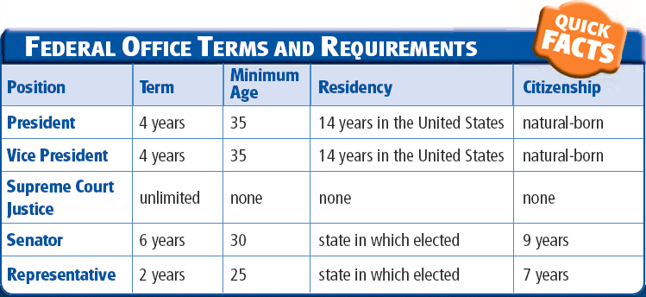

Slide 41
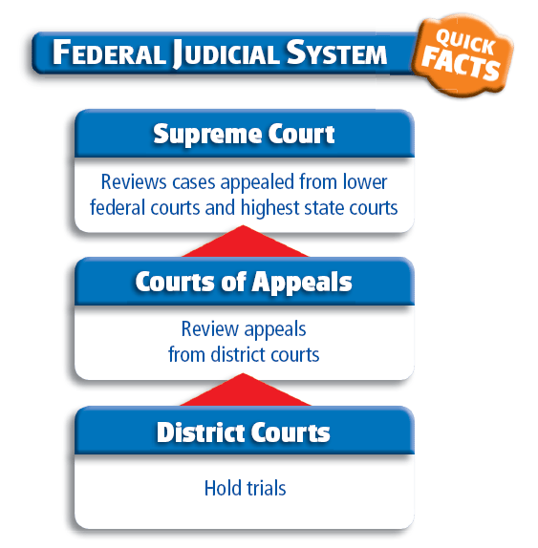

Slide 42
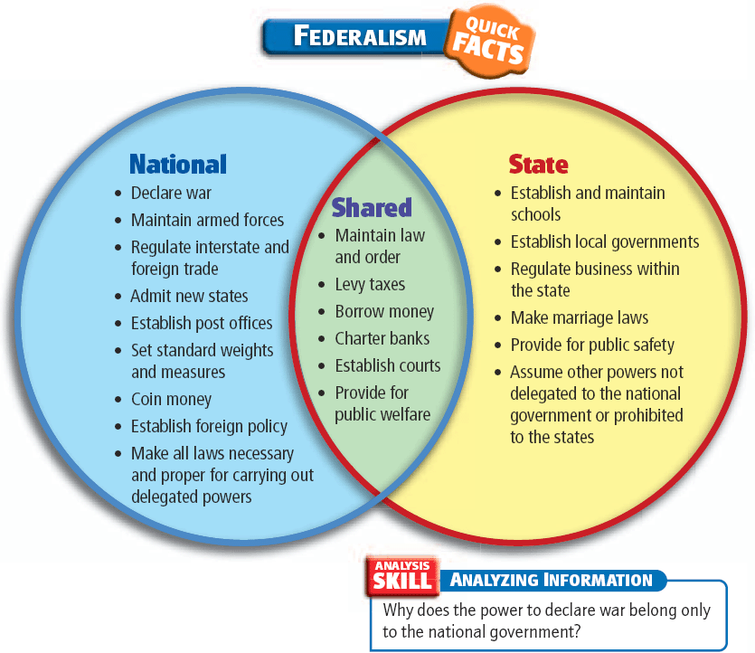

Slide 43
