Slide 1
Chapter 4 Section 3
The Struggle for Liberty

Slide 2
The Struggle for Liberty
Supporting the War Effort
Main goal for Washington was to raise an Army
Over 230,000 people served in the Army
Over 145,000 people served in local militias
Most Soldiers were young, had little money and land
African Americans
Continental Army didn’t let them serve at first
When British gave them the chance to serve the Continental Army changed its mind

Slide 3
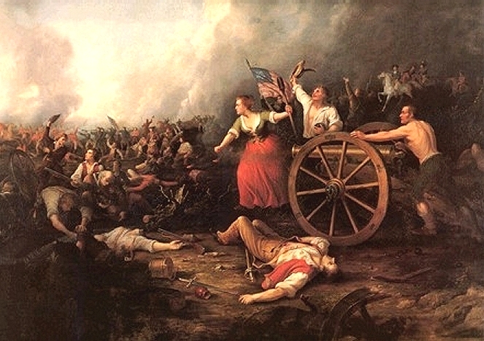
The Struggle for Liberty
Women
Women were in charge of running the household with their husbands away fighting
Mary Ludwig Hays (Molly Pitcher)
Brought water to the troops
Ended up loading cannons
Deborah Sampson
Dressed as a man so she could fight for Independence

Slide 4
The Struggle for Liberty
Defeats and Victories
Canada
People wanted to make Canada the 14th Colony
Montgomery led the Patriots and took Montreal
Benedict Arnold and Montgomery tried to take Quebec, but were defeated

Slide 5
The Struggle for Liberty
Defeats and Victories
New York (June 1776)
Washington moved troops to New York
British led by William Howe met him
Most of the 23,000 men for Washington were militia not a permanent army and they were defeated and pushed into New Jersey

Slide 6
The Struggle for Liberty
Defeats and Victories
New Jersey (Nov. 1776)
Washington’s Army was being worn down
Only 6,000 men remained and most were almost done with their service
Howe started using Hessians who were mercenaries to fight
Washington retreated to Pennsylvania and gathered 2,000 new troops
Dec. 25, 1776- Washington and his men rowed across the Delaware River and attacked the Hessians at the Battle of Trenton
Hessians were groggy from festivities and Washington won a victory

Slide 7
The Struggle for Liberty
Defeats and Victories
Saratoga
British General John Burgoyne and General Howe
Took back Ft. Ticonderoga
Howe left and Captured Philadelphia
Burgoyne was attacked on Oct. 17, 1777 by Patriots near Saratoga NY and was defeated
Turning point of the War.

Slide 8
The Struggle for Liberty
Help from Europe
Victories such as Saratoga helped get the European powers involved.
Marquis de Lafayette- Frenchman who showed up with his own soldiers to fight against the British
Became a general and helped support the war both in a military fashion and financially
Baron Friedrich von Steuben- Prussian who came and helped train the Patriot forces

Slide 9
The Struggle for Liberty
Help from Europe (Continued)
France and Spain also helped.
Had a lot to do that they didn’t really care about the colonies, but wanted to see the British defeated

Slide 10
The Struggle for Liberty
Valley Forge
Running very low on supplies, Washington settled his army in Dec. 1777 in Valley Forge
Men didn’t have the basic supplies such as clothing
Valley Forge became a place of suffering
Over 2,000 people died in the winter
Drill and practice over the winter made the troops better soldiers

Slide 11
The Struggle for Liberty
War at Sea
The French brought their navy to fight the British
American fleet was small and not true war ships
The Americans went after the supplies not the fleet directly
John Paul Jones- American Naval Hero
Captured supplies and ships

Slide 12
The Struggle for Liberty
War in the West
The War wasn’t just east of the Appalachian Mts.
George Rogers Clark was the leader of the troops in the west
His raids including battles of 1779’s Fort Sackville helped Americans win the west

