Slide 1
Chapter 3 Colonial America 1587-1770
Section 1
Early English Settlements

Slide 2
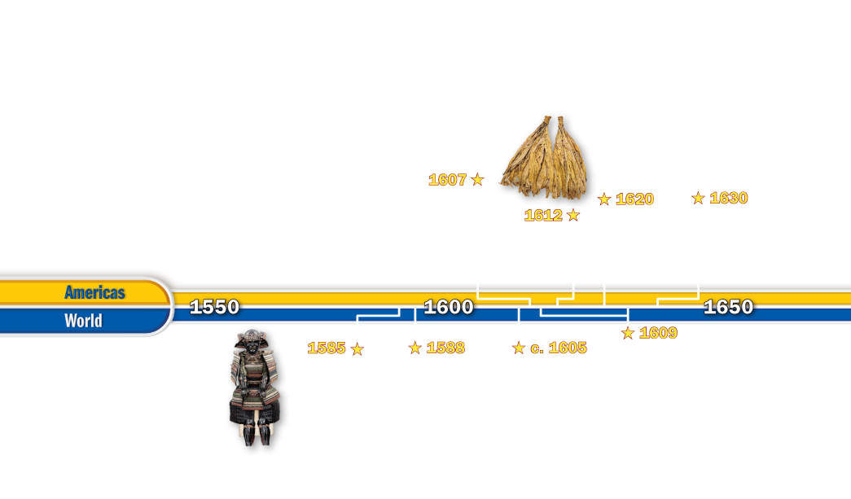
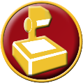
Chapter Time Line

Slide 3
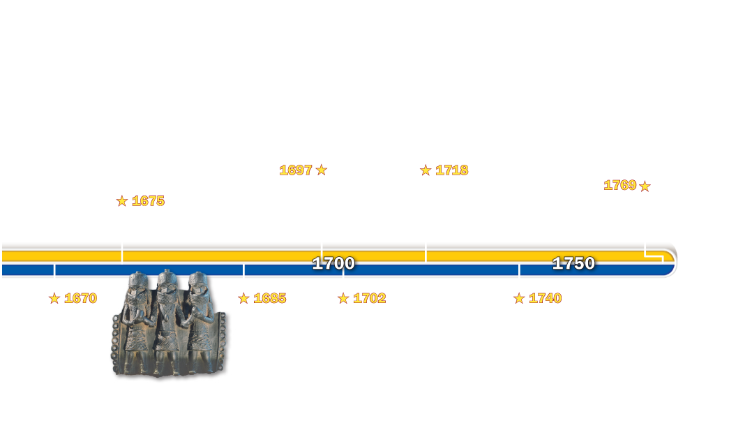
Chapter Time Line

Slide 4
Section 1-Polling Question
Which would be more important to you—helping to settle a new colony or remaining in your home country?
A. Settle a new colony
B. Remaining home
A
B

Slide 5
Essential Question
Why did the English settle in North America?
Why did the English settle in North America?

Slide 6
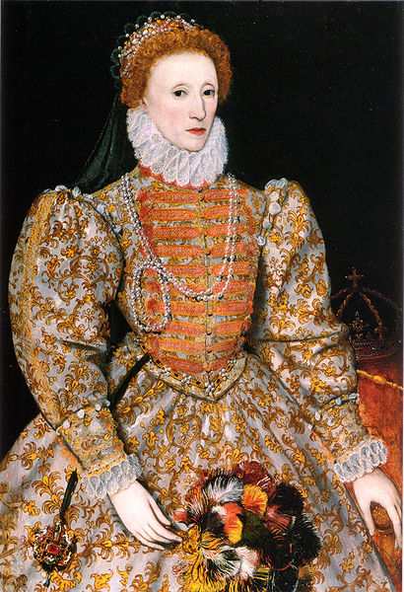
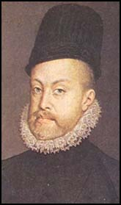
England and Spain
Trading rivalry and religious differences had been pushing England and Spain toward war
King Philip II, the powerful ruler of Spain, wanted a Catholic ruler on the throne of England
He didn’t consider Queen Elizabeth, a Protestant, the rightful ruler of England

Slide 7
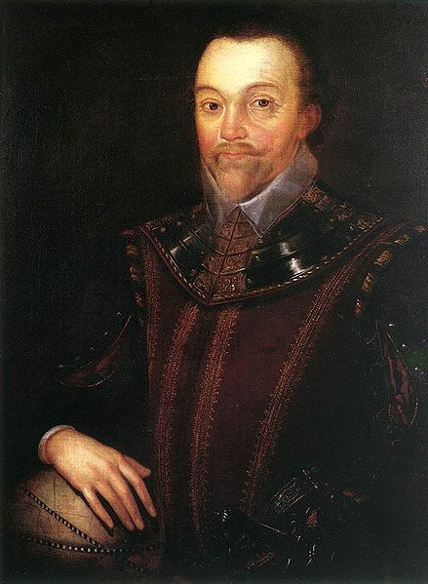
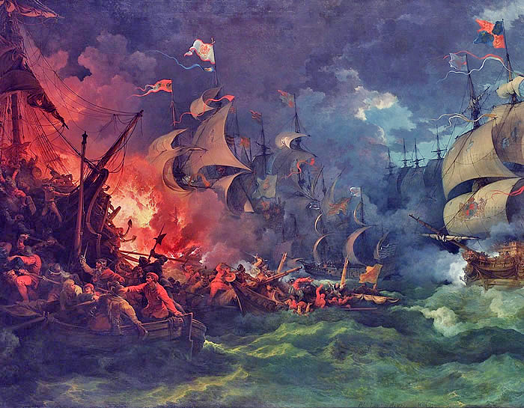
The Spanish Armada
English adventurers, such as Sir Francis Drake, had attacked Spanish ships and ports
King Philip wanted Elizabeth to punish Drake for his raids
Instead, Elizabeth honored Drake with Knighthood
Philip sent the Spanish Armada to conquer England
It failed completely
War continued until 1604
The defeat of the Armada marked the end of Spanish control of the seas
The way was clear for England to start colonies in North America

Slide 8
Section 1
Who was the ruler of England when the Spanish and English were at war in the 1500s?
A. King James
B. Queen Elizabeth
C. Queen Mary
D. King Philip II
A
B
C
D

Slide 9
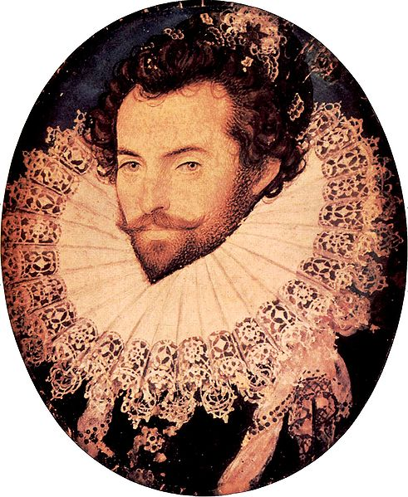
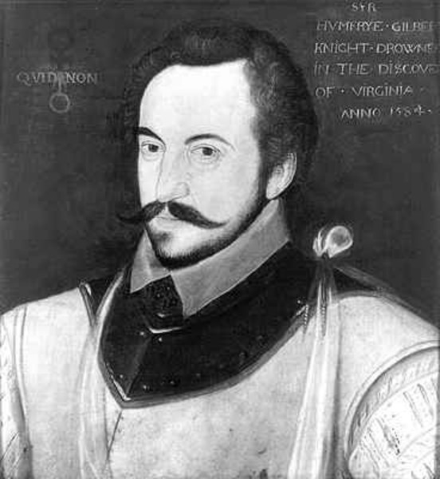
England tries to make colonies
England had tried several times to establish a base in North America
Sir Humpfrey Gilbert claimed Newfoundland in 1583
But before he could find a place for a colony he died at sea
The next year, Queen Elizabeth gave Sir Walter Raleigh the right to claim land in North America
Raleigh sent an expedition to find a place to settle
His scouts said Roanoke Island (North Carolina today) was the place to settle

Slide 10
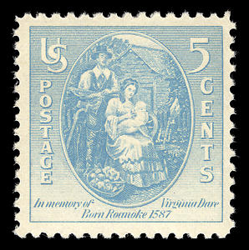
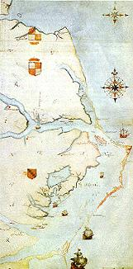
Roanoke Island
100 men settled there first
Difficult winter
Returned to England
1587- Raleigh sent 91 men, 17 women, and 9 children
John White, artist and mapmaker, led the group
Shortly after arriving, White’s daughter gave birth
Virginia Dare was the first English child born in North America
White explored the area and drew pictures of what he saw
In a book illustrated by white, another colonist described the Native American towns the settlers encountered:
“Their towns are small… a village may contain but ten or twelve houses- some… as many as twenty.”

Slide 11
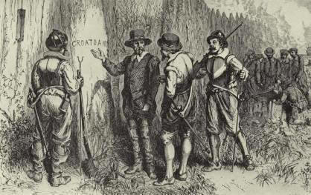
More of Roanoke Island
Nine days after White’s granddaughter was born he returned to England
Needed supplies
He hoped to return within a few months
The war with Spain delayed his return for nearly 3 years
When he returned, he found Roanoke deserted
Found the word Croatoan carved on a gatepost
White believed they had gone to Croatoan Island, about 50 miles to the south
Bad weather kept White from investigating
The Roanoke colonists were never seen again

Slide 12
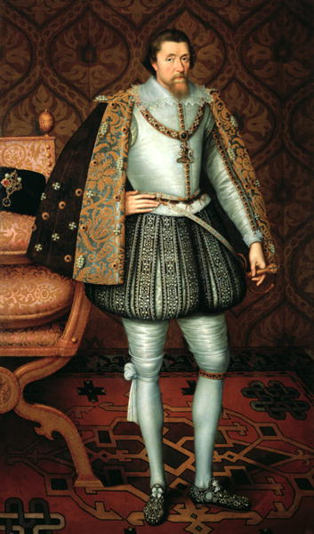
The Roanoke Colony
Discouraged others from planning English colonies in North America
The idea emerged again in 1606
Groups of merchants sought charters
Charters- documents granting the right to organize settlements in an area
From King James I

Slide 13
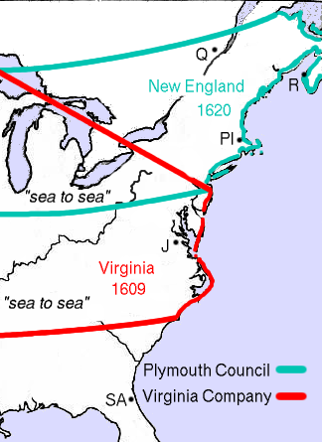
The Virginia Company of London
Received a charter
Virginia Company was a joint-stock company
Investors bought stock, or part ownership, in the company in return for a share of its future profits
Settlers in America were to search for gold
And establish trade in fish and furs

Slide 14
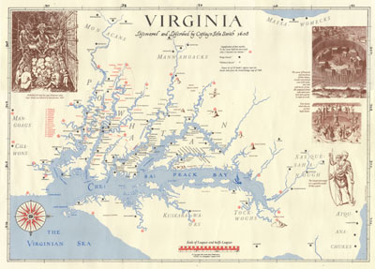
Virginia Company Sends Settlers
December 1606
The company sent 144 settlers in three ships to build a new colony
April 1607, the ships entered Chesapeake Bay and then up a river
Flowing into the bay
Colonists named the river the James
And their new settlement Jamestown in honor of King James I

Slide 15
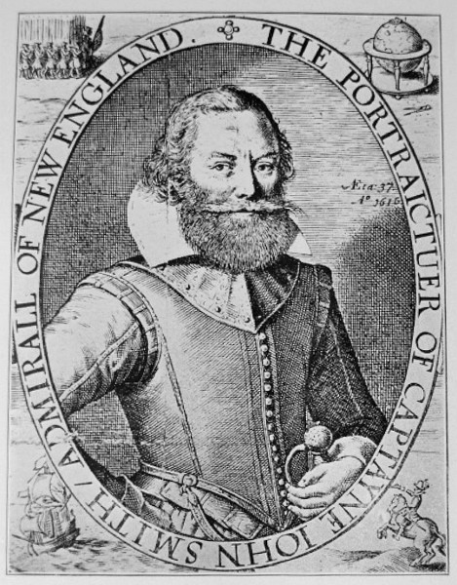
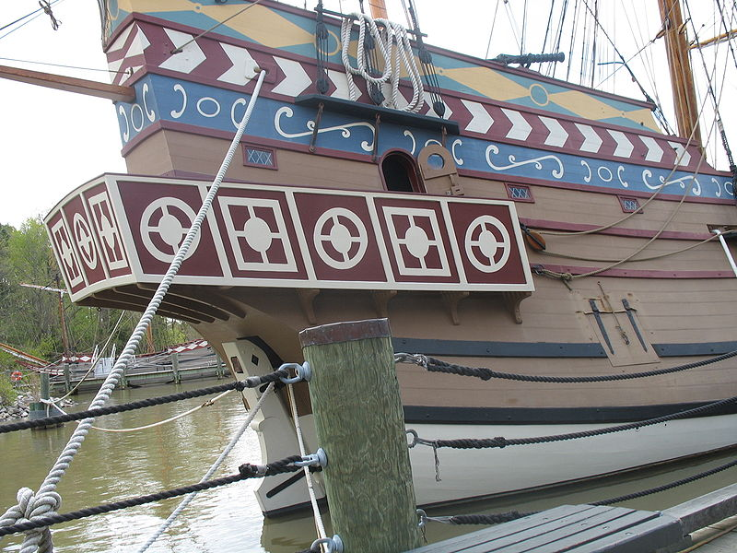
Jamestown Hardships
Jamestown settlers faced hardships of disease and hunger
The colony survived its first two years because of Captain John Smith, an experienced explorer
Smith forced the settlers to work
Explored the area
Sought corn from the local Native Americans led by Chief Powhatan
John Smith returned to England and Jamestown lacked strong leadership
Winter of 1609-1610 became known as “the starving time”
Fighting also broke out with the Native Americans

Slide 16
Jamestown Colonists Make Money
Colonists found a way to make money for the investors
Growing tobacco using seeds from the West Indies
Soon planters all along the James River were raising tobacco

Slide 17
Section 1
The colony of Virginia began to prosper due to which crop?
A. Tobacco
B. Maize
C. Wheat
D. Squash
A
B
C
D

Slide 18
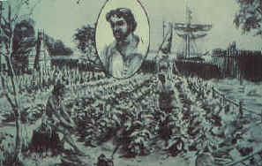
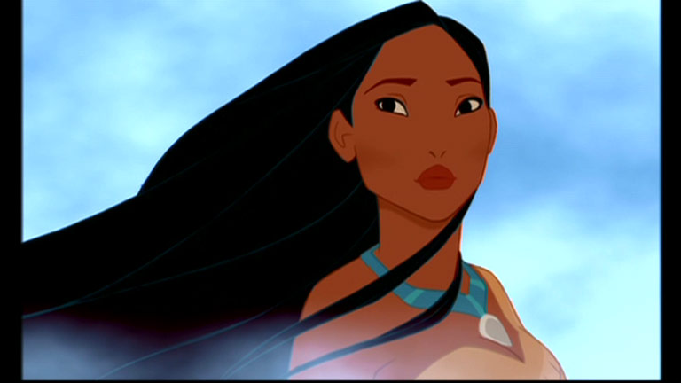
Colony of Virginia Prospers
Relations with the Native Americans improved
After colonist, John Rolfe, married Pocahontas
Daughter of Chief Powhatan
Land ownership was expanded when the Virginia Company gave a headright
Headright- a land grant
50 acres to settlers who paid their own way to the colony
Colonists also participated in government
The House of Burgesses first met in 1619
Burgesses were representatives of the colony’s towns
They would make local laws for the colony

Slide 19
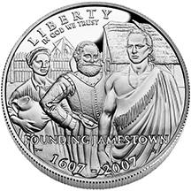
More about Jamestown
Virginia company sent women to Jamestown
Marriage and children became part of life in Virginia
Another part was slavery, first recognized in Virginia law in the 1660s
By the 1620s, the Virginia Company faced financial troubles
Jamestown was returning little profit
In 1624 King James cancelled the company’s charter and made Jamestown England’s first royal colony in America

Slide 20
Essential Question
Why did the English settle in North America?
Why did the English settle in North America?
- The English hoped to profit from resources found in America.

Slide 21
Chapter 3 Section 1 Quiz

Slide 22
What cleared the way for England to start colonies in North America?
Drake's raids on Spain
Drake's knighthood
defeat of the Spanish Armada
England declared war on Spain.

Slide 23
Which of the following is an example of a joint-stock company?
the Roanoke Company
the England Company
the Drake Company
the Virginia Company

Slide 24
The Jamestown colonists called the winter of 1609–1610
the lavish time.
the starving time.
the good time.
the friendly time.

Slide 25
Which crop saved Jamestown by making money for investors?
tobacco
corn
rice
indigo

Slide 26
The first English child born in the American colonies was
James Yeardley.
Francis Drake.
Virginia Dare.
John White.

