Slide 1
8th Grade Social Studies Chapter 2 Section 2
Europeans Reach the Americas

Slide 2
Europeans Reach the Americas
Columbus Sails across the Atlantic
Christopher Columbus
Italian from Genoa
Convinced he could reach Asia by sailing west
Asked King Ferdinand and Queen Isabella of Spain to finance expedition
Had to bring back items and claim land for Spain
Aug. 3, 1492- 3 Ships (Nina, Pina, and Santa Maria) set sail
Carried about a years worth of supplies
Hit the Canary Island (off the coast of Africa) then west
October 12, 1492- Hit land in what would be the Bahamas
Thought he had reached Asia, but instead North America

Slide 3
Europeans Reach the Americas
Named the Island San Salvador (Holy Savior)
Called the Native Peoples (Taino) Indians since he thought he had reached the Indies of Asia
Taino’s were very generous to Columbus
Could never find gold and returned to Spain after 3 month
Made 3 more trips

Slide 4
Europeans Reach the Americas
Impact
Changed the way Europeans saw themselves in the world.
Saw themselves as great conquerors
Led to competition between European countries
1493- Conflict between Spain and Portugal led to Line of Demarcation drawn where Spain could claim land west
The Treaty of Todesillas later signed- move the line further west

Slide 5
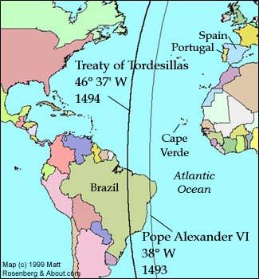
Europeans Reach the Americas

Slide 6
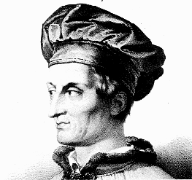
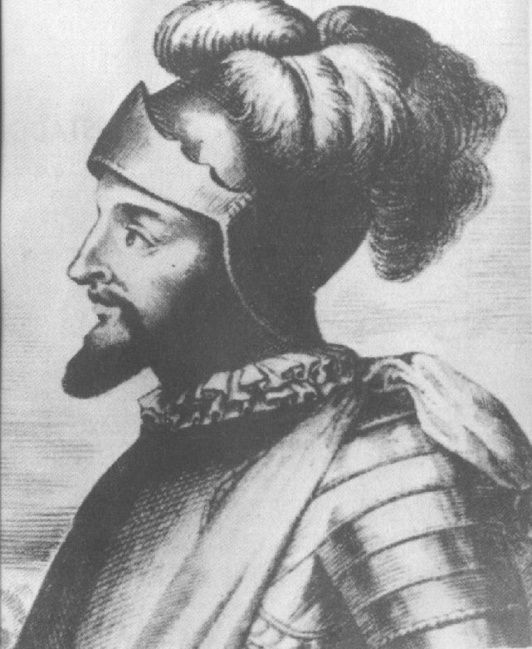
Europeans Reach the Americas
Other Explorers
Amerigo Vespucci
1501- Present day South America
Convinced the land wasn’t Asia,
A mapmaker named it America in honor of Amerigo
Vasco Nunez de Balboa
Explored present day Panama
Heard stories about another ocean and set out to find it
1513- from a mountain top saw the Pacific Ocean

Slide 7
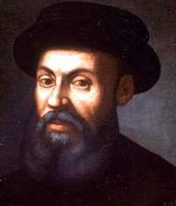
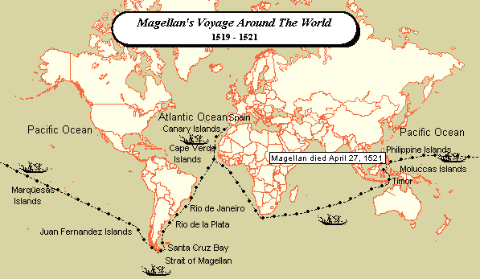
Europeans Reach the Americas
Other Explorers (continued)
Ferdinand Magellan
1519- Portuguese using Spanish ships sailed to the Philippines, where Magellan was killed
1522- 1 ship and 18 crew members returned to Spain, first to circumnavigate the world
The trade of goods and plants became known as the Columbian Exchange
Also new diseases were introduced to new parts of the world

