Slide 1
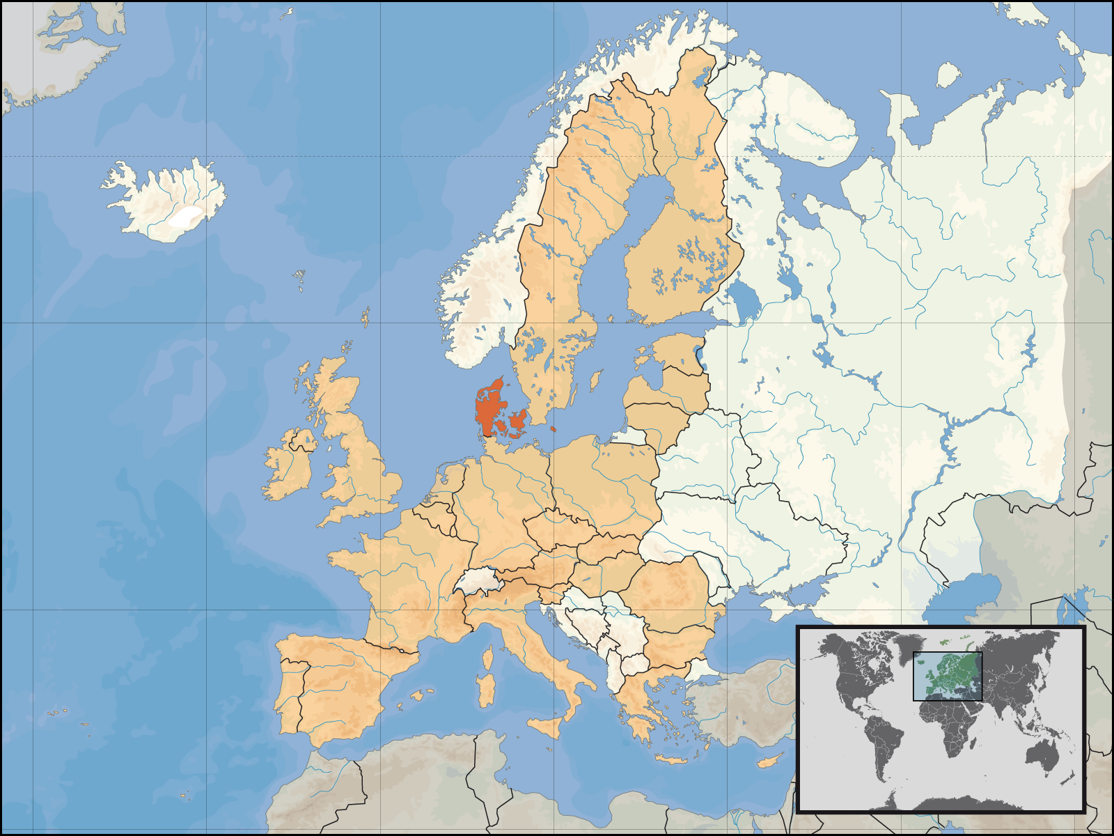
Viking

Slide 2
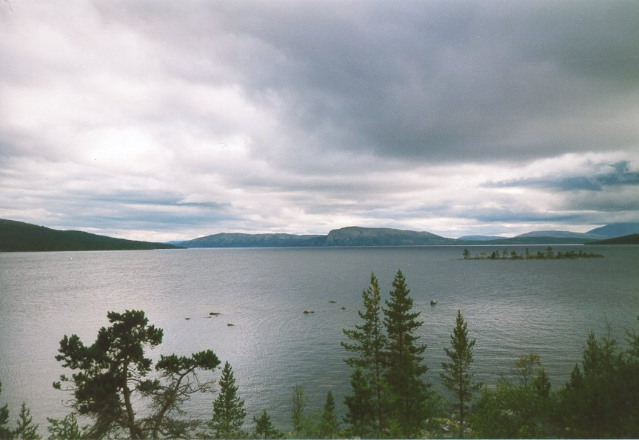
Who Were the Vikings?
The Vikings, or Norse, were a phenomenal race of Scandinavian warriors who raided Northern Europe, Eastern Asia, and Eastern North America. The exploits of the Norwegian vikings lead them west to settle into Iceland in 860 and later to colonize Greenland about a hundred years later. The Swedish Vikings set out across the Baltic Sea into Poland, Latvia, Lithuania, and Russia. By the end of the first millennium the Vikings reached North America five hundred years before Columbus.
Vikings were not just pirates and warriors but also traders and colonists.
The word Viking means one who lurks in a “Vik” or bay, in effect, a pirate.
The word “Viking” also describes a whole new age in Europe between about the mid 700 to 1150 AD. This was a period of raiding as well as creating far trade networks of settlements by Scandinavians.
Vikings were comprised of Norwegian, Danish, and Swedish decent.

Slide 3
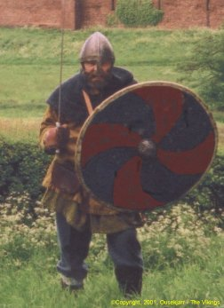
What were their goals?
Raids and loot were not the whole story of the Vikings. Land to farm was also a commodity. There were limited sources of food.
They received influences from Europe that they saw as technologically and politically superior to their culture. Unlike many other invaders in history, the vikings weren’t trying to spread their religion that was paganism, rather gain new resources and new connections. They wanted political and economical advantage.
They had to find food, live off the land, and set up shop. They drove people out and took their money and other valuables they had. Vikings targeted the church and monasteries, which were the major sources of wealth at the time.
An accurate depiction of what a Viking looked like.

Slide 4
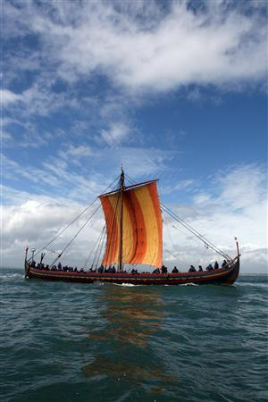
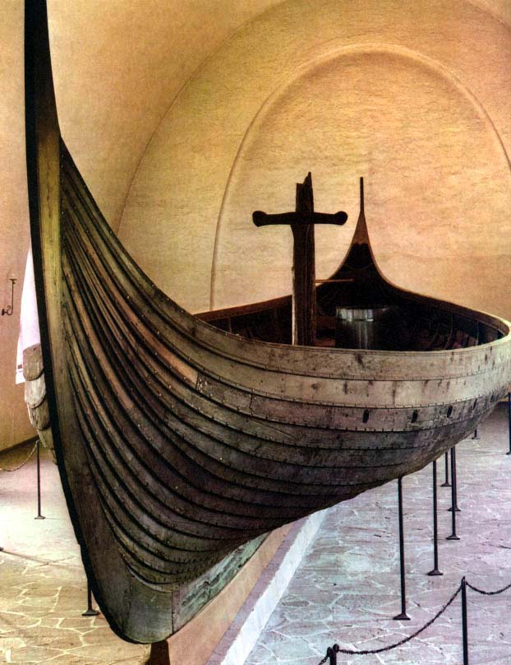

Slide 5
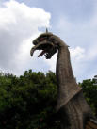
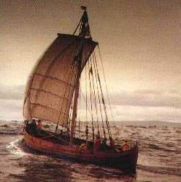
Ships and Navigation
We know what their ships looked like because many vikings were buried with their goods that sometimes included their boats.
They had swift wooden long ships, equipped with sails and oars.
Shallow drought of these ships meant they were able to reach far inland by river or stream to strike and move before local forces could assemble.
Ships had overlapping planks, and measured between 17.5m and 36m in length. They were steered by a single oar mounted on the starboard side.
Reached an average speed of 10 to 11 knots
Crews of 25 to 60 men would be common, but larger ships could carry over a hundred people.
Sea battles were rare. They fought close to shore. Ships were roped together in lines to face an enemy fleet.
Figureheads would be raised at stem and stern as a sign of war.

Slide 6
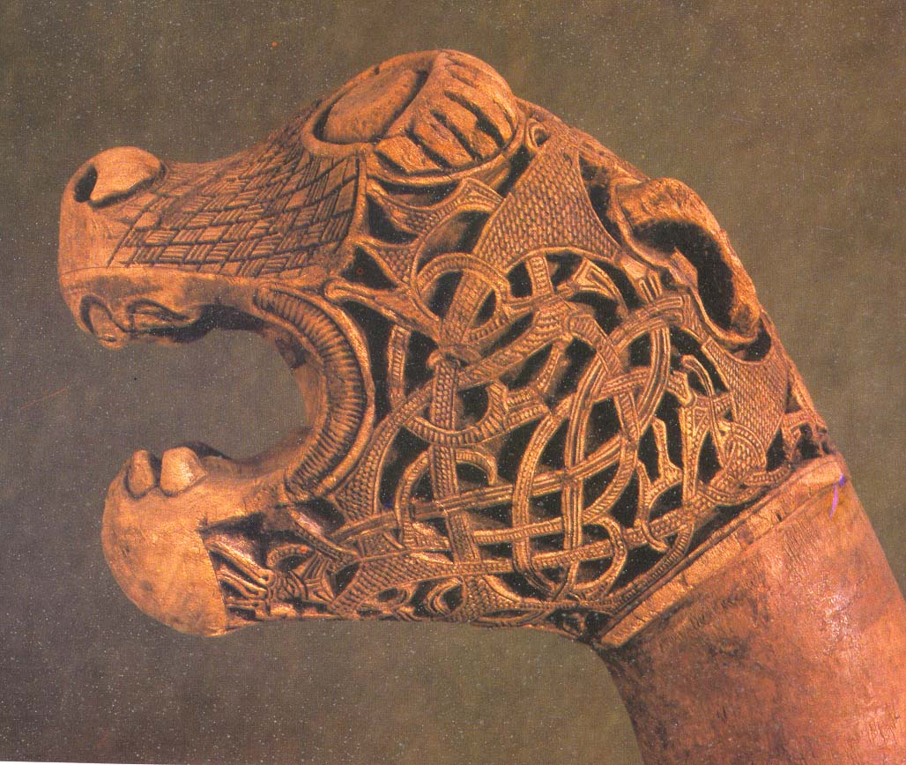
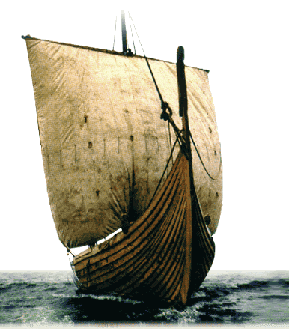
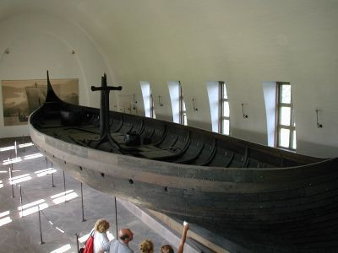

Slide 7
Viking Jutland (shown in orange) was used mostly for farming

Slide 8
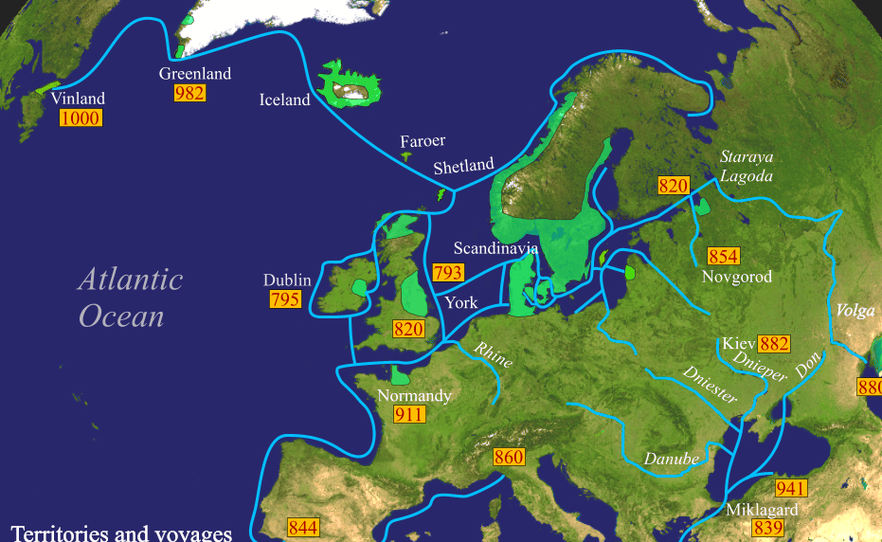
Viking Voyages and Territories

Slide 9
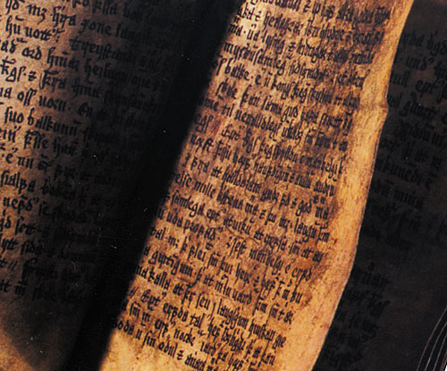
The Sagas
“Saga” is a Norse word meaning tales. These writings provide almost all of the knowledge we have of the Vikings.
There are about forty sagas that include descriptions of historical events in Iceland and voyages across the North Atlantic from Norway, Greenland and Vinland (Newfoundland). The sagas also have records of family history such as Erik the Red who founded Greenland, and his son Leif Erickson who discovered North America.
The Sagas were compiled in the 13th and 14th century, and later based on stories that originated as early as 400 and 500 years before that.
Archaeology is providing that a lot of these stories have a good basis of fact; in fact the Icelandic sagas were used to help find what might be the site of Vinland.

Slide 10
1. How do you think life in the United States might be different today if the Vikings had established colonies where they landed in North America before the year 1000?
2. What effect did Vikings have on the development of Europe during the Middle Ages?

