Slide 1
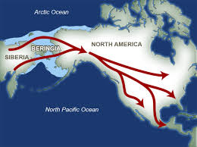
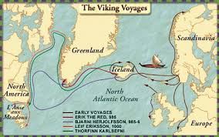
FirFirst Visitors from Europe
Native Americans (Asia)
Vikings (Scandinavia)

Slide 2
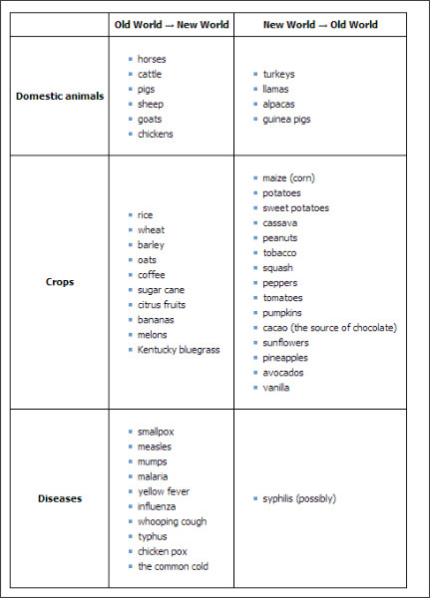
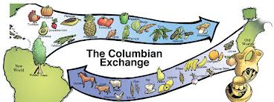
The Columbian Exchange
The “Exchange” of people, products, and ideas
between the Eastern and Western Hemispheres

Slide 3
Spain’s Empire in the Americas
Chapter 2 Section 3

Slide 4
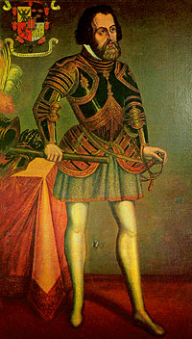
Hernan Cortes
Conquered Cuba for Spain
Heard tales about cities of gold across the Gulf of Mexico
Cortes went against Spain’s wishes and set out with 11 ships, 600 Spanish soldiers, and 200 Cubans.

Slide 5
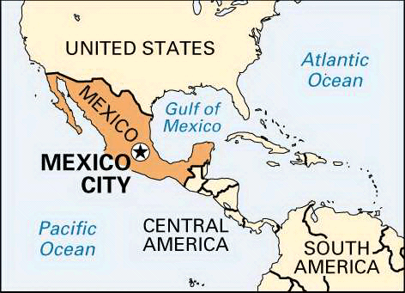
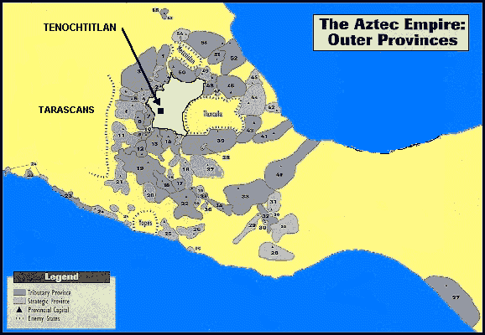
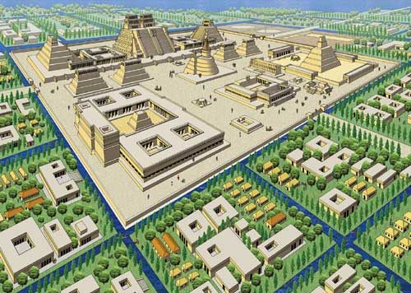
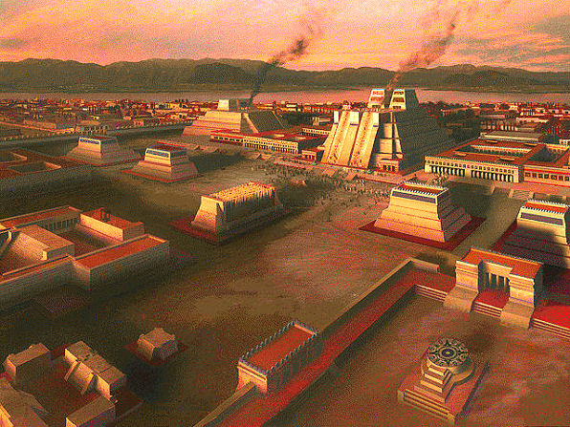
Tenochtitlan

Slide 6
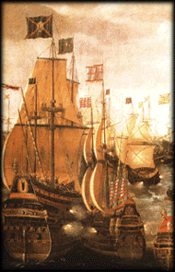
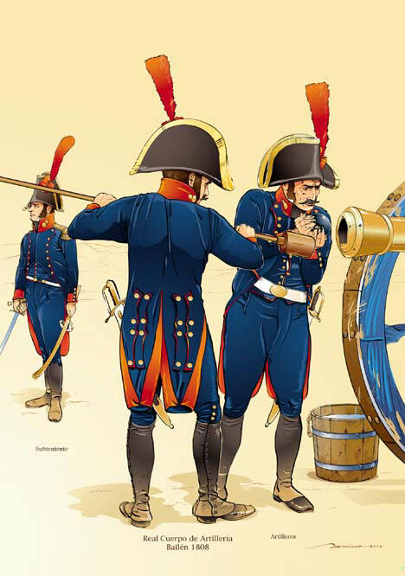
Spain Builds a Vast Empire
New wealth
Expansion of Navy & Army
Explorations
Settlements
in the new
Americas

Slide 7
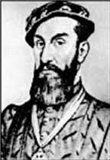
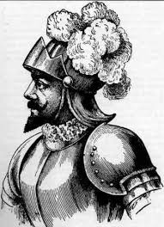
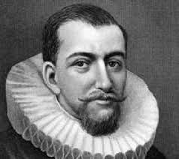
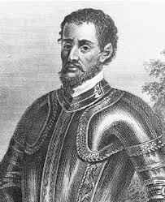
Other Spanish Explorers
Juan Ponce de Leon
Alva Nunez Cabeza de Vaca
Francisco Coronado
Hernando de Soto

Slide 8
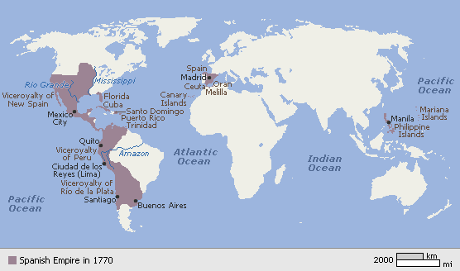
Spain’s American Empire
New Spain
Northern Empire
Peru
Southern Empire

Slide 9
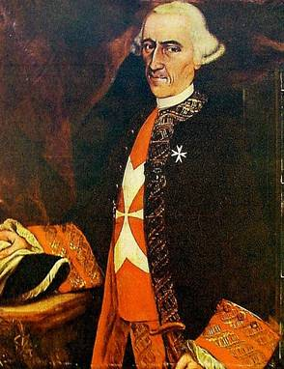
Viceroy
The governing officials put in charge of “New Spain” and “Peru”
Responsible for producing wealth for Spain
Rich deposits of silver, cotton, sugarcane, and other crops grown on plantations

Slide 10
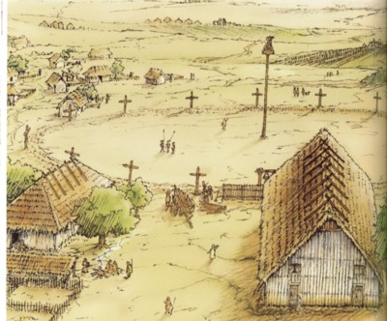
Missions
Religious communities that usually included a small town surrounding farmland and a church
Started by Catholic religious workers called
Natives are taught religion, crafts, and skills

Slide 11
Social Classes in New Spain
Peninsulares
Creoles
Mestizos

Slide 12
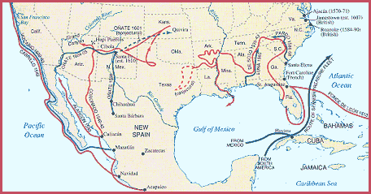
Spanish Explorers

