Slide 1
The Civil War
Chapter 16

Slide 2
Election of 1860

Slide 3
Secession
Order of Secession During the American Civil War
State | Date of Secession
South Carolina | December 20, 1860
Mississippi | January 9, 1861
Florida | January 10, 1861
Alabama | January 11, 1861
Georgia | January 19, 1861
Louisiana | January 26, 1861
Texas | February 1, 1861
Virginia | April 17, 1861
Arkansas | May 6, 1861
North Carolina | May 20, 1861
Tennessee | June 8, 1861

Slide 4
Lincoln’s First Inauguration
March 4, 1861: Abraham Lincoln gave his Inaugural Address, and in it , he was firm yet conciliatory and made the following points:
There would be no conflict unless the South provoked it.
Secession would not work because there was no geographic separation between North and South.

Slide 5
Lincoln’s First Inauguration
Uncontested secession would create new controversies:
How to divide the national debt.
How to divide federal territories.
How would the Fugitive Slave Act be resolved because Underground Railroad would continue and runaways would just have to cross Ohio River, not go all the way to Canada.

Slide 6
Lincoln’s First Inauguration
Foreign nations would benefit:
Foreign colonies (especially the British) would benefit from weaker United States
European powers would defy the Monroe Doctrine and try to colonize more in the Americas.

Slide 7
Fort Sumter April 12, 1861
Confederate States seized the U.S. forts, arsenals, mints, and other public property within their borders, including Fort Sumter in Charleston, South Carolina harbor.
Fort Sumter only had enough supplies to last until the middle of April.

Slide 8
Fort Sumter April 12, 1861
Lincoln’s dilemma:
Fort Sumter was not strong enough to hold its own against Confederate attack.
If he sent reinforcements, Confederates would immediately attack.

Slide 9
Fort Sumter April 12, 1861
Lincoln’s decision:
He notified S.C. that he was sending provisions but not reinforcements.
Union naval force headed to Fort Sumter.
Confederates viewed this as an act of aggression and began a bombardment of the fort.
After 36 hours, the Union troops surrendered with no lives lost.

Slide 10
Impact of Fort Sumter
Lincoln proclaimed that since the Confederates had fired first, a response was necessary.
He issued a call for 75,000 militiamen and got so many that they had to be turned away.
On April 19th and 27th, Lincoln ordered a blockade of Southern ports.

Slide 11
Impact of Fort Sumter
Lincoln’s call for troops infuriated the Confederates and in their view, he was now waging an aggressive war on the Confederacy – The War of Northern Aggression.
Virginia, Arkansas, Tennessee, and North Carolina reluctantly seceded and joined the Confederacy.
Richmond, VA became the new Confederate capital.

Slide 12
Border States
Kentucky, Missouri, Maryland, Delaware and later West Virginia – the mountain area that broke away from Virginia and applied for statehood were all slave states that did not secede from the United States of America.
Lincoln had to repeatedly insist that he was fighting the war to preserve the Union – not to end slavery – in order to keep these borders states from joining the Confederacy.

Slide 13
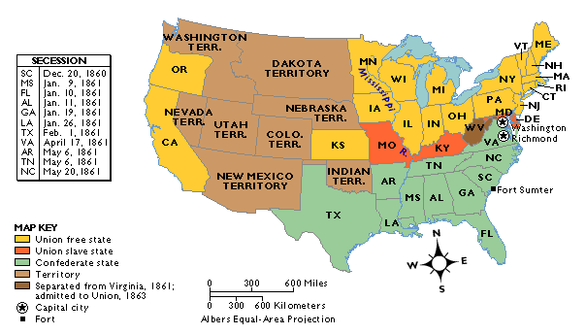
The Union & Confederacy in 1861

Slide 14
North
Advantages
Disadvantages
Manufacturing ability
Transportation (railroads, canals, roads, etc.)
Economy
Wealth
Superior navy
Larger population for manpower
More immigrants for manpower
Had to invade and conquer the South to force it back into Union.
Northerners much less prepared to fight
Fewer qualified military leaders

Slide 15
South
Advantages
Disadvantages
Could fight a defensive war – did not have to invade North.
Did not have to win the war, just had to keep from losing.
Morale (in the beginning)
Most talented military officers
Soldiers bred to fight
Rebel yell
Lack of factories to produce weapons of war
Lack of adequate transportation system (fewer railroads)
Economy dependent on cotton

Slide 16
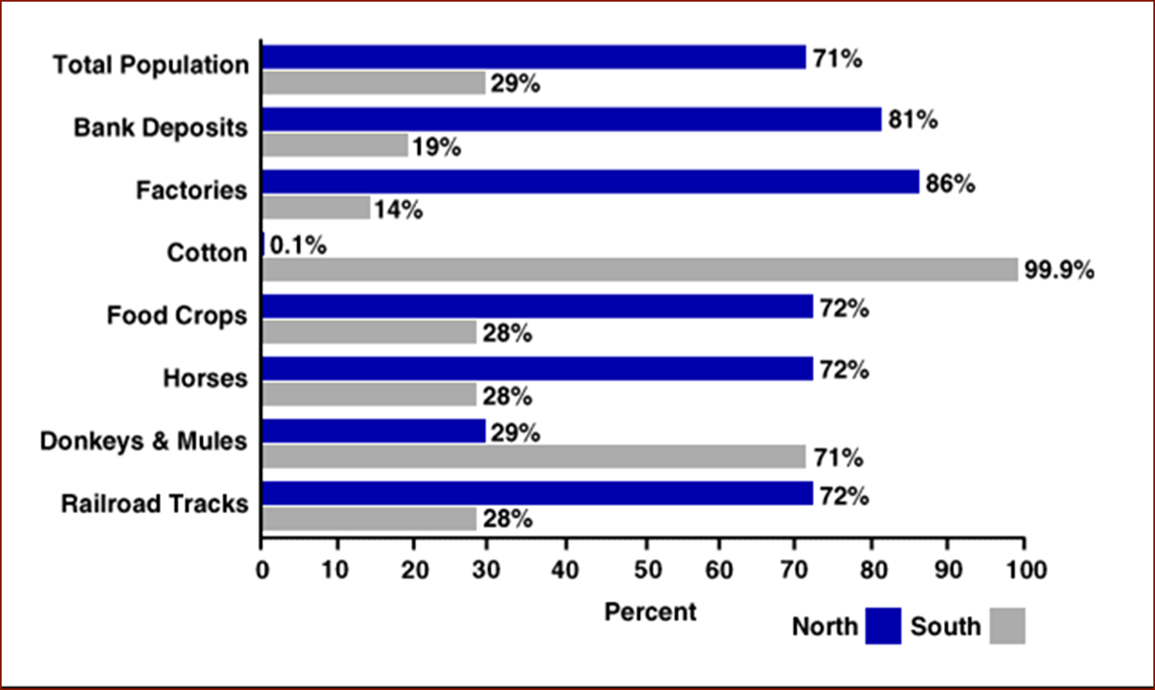

Slide 17
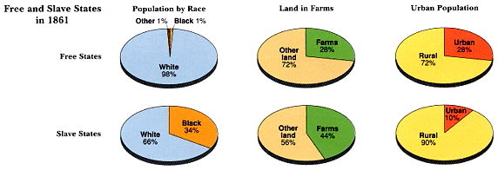
Slave/Free States Population, 1861

Slide 18
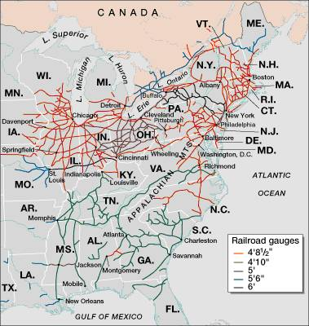
Railroad Lines, 1860

Slide 19
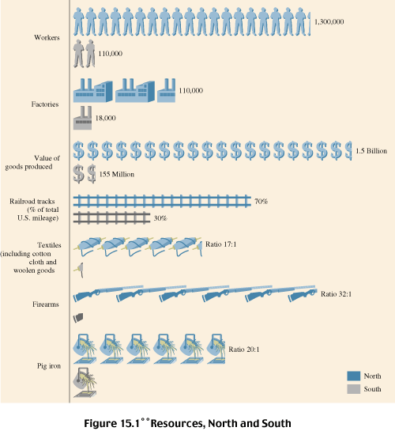
Resources: North & the South

Slide 20
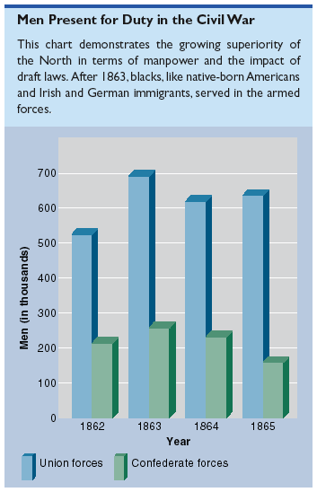
Men Present for Duty in the Civil War

Slide 21
Political Leadership

Slide 22
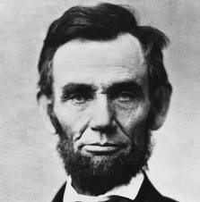
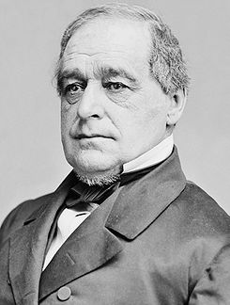
Leaders of the Union
President Abraham Lincoln
Vice-President
Hannibal Hamlin 1861-1865

Slide 23
Lincoln Leadership
Lincoln enjoyed the benefit of a long-established government that was financially stable and fully recognized both at home and abroad,
He was skilled at interpreting and leading public opinion.
He demonstrated charitableness toward the South and tolerance for infighting colleagues.

Slide 24
Lincoln Takes Power
He proclaimed the naval blockade and increased the size of the army – something that only Congress could do and later approved.
He suspended the writ of habeas corpus so that anti-Unionists could be arrested.
He ordered supervised voting in the border states.
He ordered the suspension of certain newspapers and the arrests of their editors.

Slide 25
Extensive Legislation Passed Without the South in Congress
1861 – Morrill Tariff Act
1862 – Homestead Act
1862 – Legal Tender Act
1862 – Morrill Land Grant Act
1862 – Emancipation Proclamation (1/1/1863)
1863 – Pacific Railway Act
1863 – National Bank Act

Slide 26
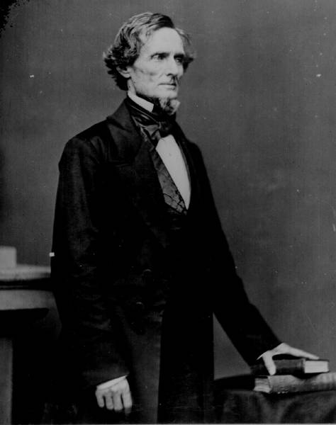
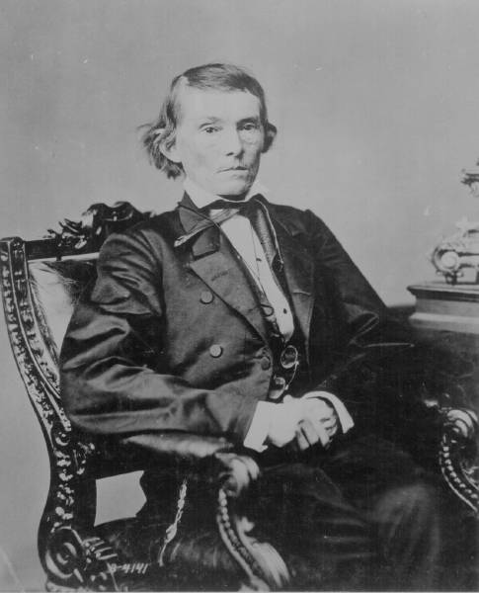
The Leaders of the Confederacy
President Jefferson Davis
Vice President Alexander Stevens

Slide 27
Davis as President of the Confederacy
Davis wanted a strong central government but Confederate States still valued states’ rights.
He had trouble persuading certain state troops to serve the military outside of their state’s borders.
At times he was very popular, at others, there was talk of impeaching him.

Slide 28
He tended to defy public opinion rather than lead it.
He overworked himself on details of civil government and military operations.
He led a government that had no long-term recognition or acceptance at home or abroad.
His government was financially unstable.

Slide 29
Military Leadership

Slide 30
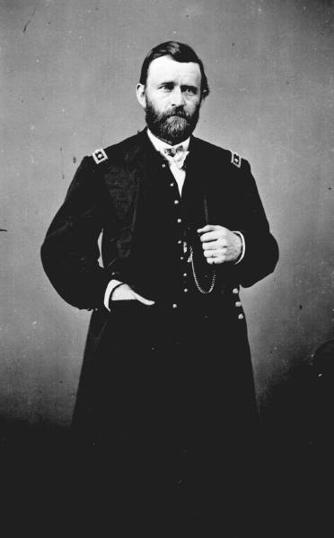
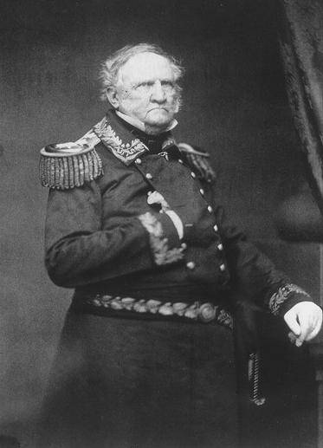
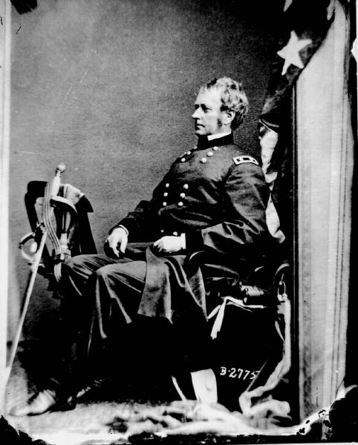
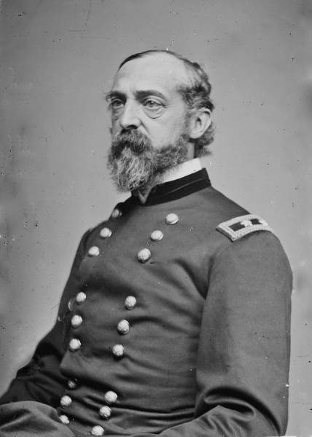
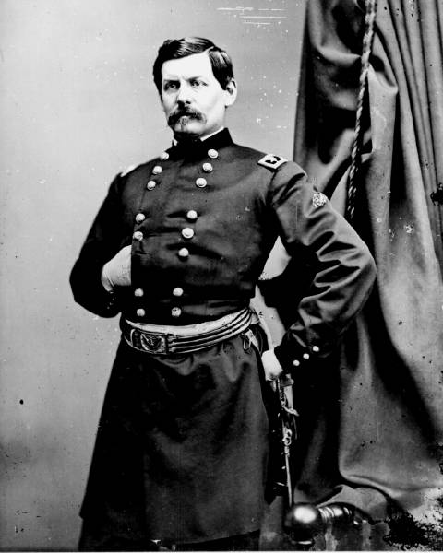
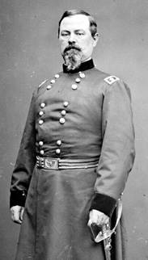
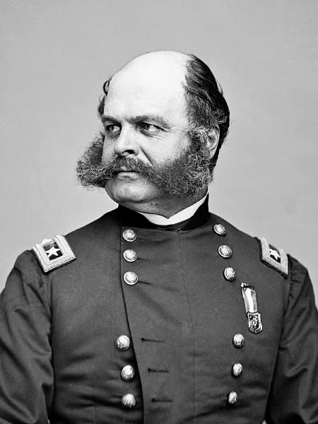
Lincoln’s Generals
Ulysses S. Grant
Joseph Hooker
Winfield Scott
George Meade
Irwin McDowell
George McClellan
Ambrose Burnside
George McClellan

Slide 31
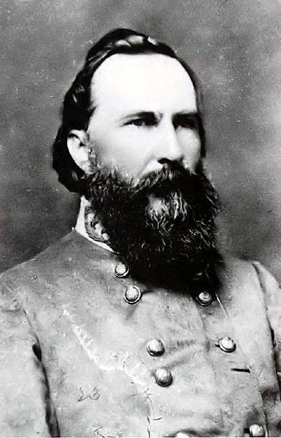
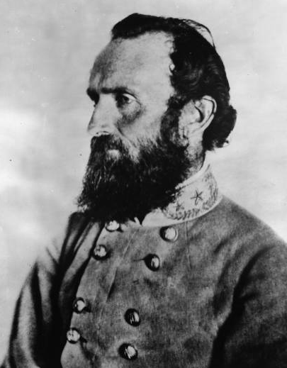
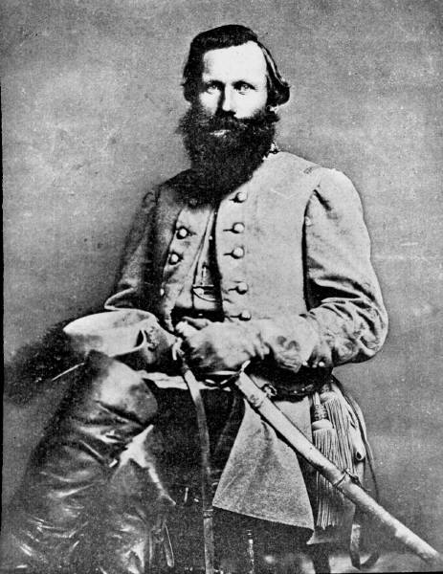
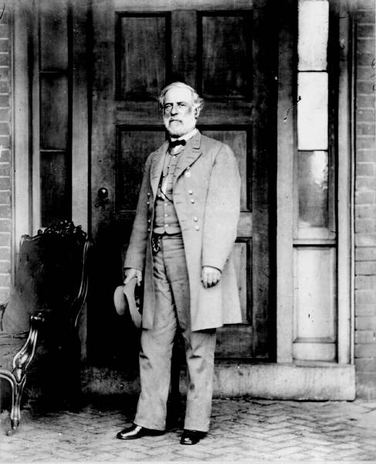
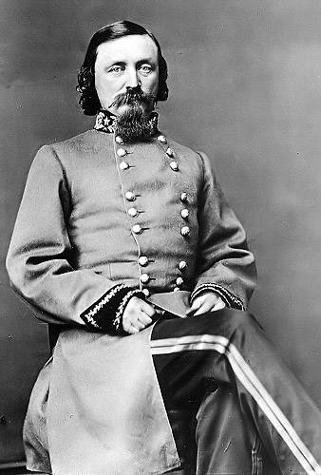
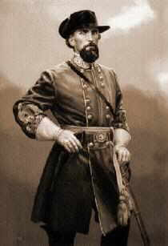
The Confederate Generals
“Stonewall” Jackson
James Longstreet
Jeb Stuart
Nathan Bedford Forrest
George Pickett
Robert E. Lee

Slide 32
Economics
Union
Confederacy
Taxes and tariffs increased to support war effort.
Paper money issued an mostly held its value.
National Banking System created.
War bonds sold to support war effort.
Tariffs didn’t raise income because blockade cut off most trade.
States’ rights southerners wouldn’t pay direct taxes to a central government.
Paper money issued but inflation made it practically worthless.

Slide 33
Economics
Union
Confederacy
New factories built
Millionaire class developed for the first time from business class.
Some manufacturers ripped off the military with shoddy products.
Grain exports replaced profits from cotton.
Cotton had to make it passed the blockade to be sold.
Goods had to be snuck passed blockade to get into Confederacy.
Blockade runners had some success but not enough.
King Cotton failed the South.

Slide 34
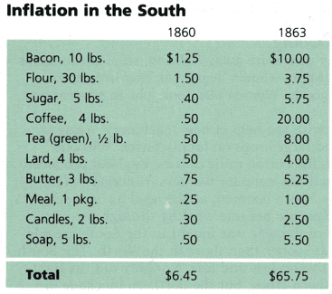
Inflation in the South

Slide 35
Foreign Perspectives
Many of Europe’s ruling classes favored the South.
However, working people in those nations favored the North and its attempts to end slavery (Uncle Tom’s Cabin).
Governments like Britain were not able to intervene on behalf of the Confederacy and help to break the blockade.

Slide 36
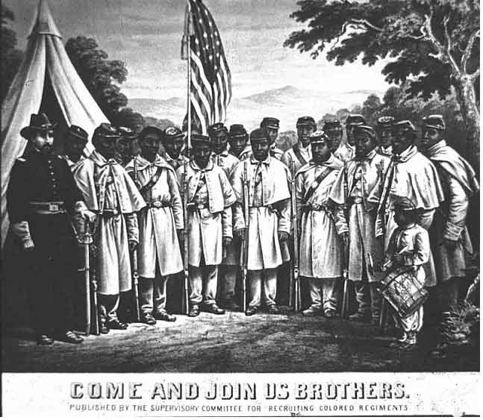
African-American Recruiting Poster

Slide 37
In the beginning, freed African Americans were not allowed to serve in Union army.
After Emancipation Proclamation and as manpower ran low, African Americans enlistees were sought despite protest from some whites.
By war’s end, 180,000 served in the Union armies.

Slide 38
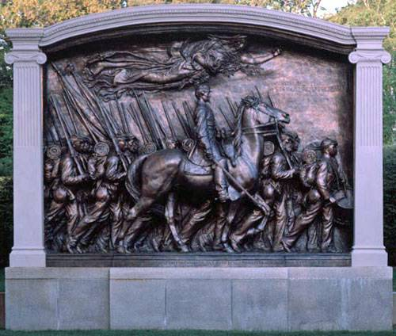
August Saint-Gaudens Memorial to Col. Robert Gould Shaw

Slide 39
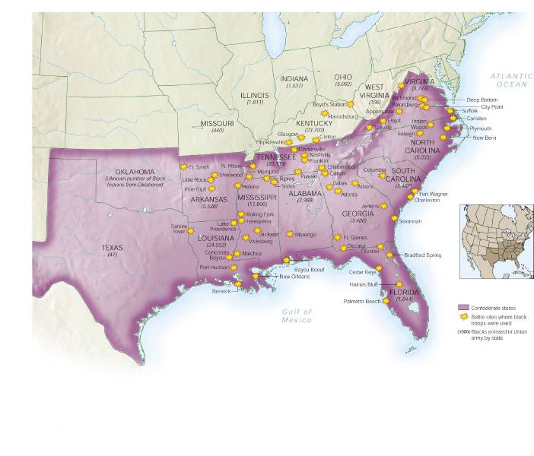
African-Americans in Civil War Battles

Slide 40
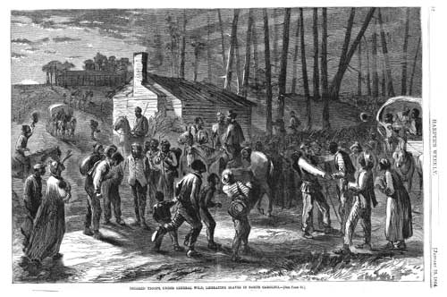
African Americans Troops Freeing Slaves

Slide 41
First Battle of Bull Run (Manassas) July 21, 1861
Because the press and the public were demanding action, Lincoln decided that the Union army drilling near Washington, D.C. should attack Confederate forces at Bull Run (30 miles southwest).
Confederate troops under Stonewall Jackson were able to repel the attack and sent the Union forces retreating back to D.C.

Slide 42
First Battle of Bull Run (Manassas) July 21, 1861
The victory for the Confederacy actually turned out to be more of defeat as it built overconfidence and caused a drop in Confederate enlistments and preparation for a long war.
The defeat for the Union proved to be more of a victory as it ended all hope of a short war and caused Northerners to get more serious about preparations.

Slide 43
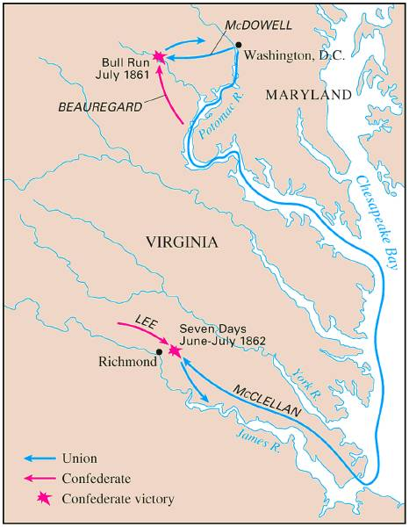
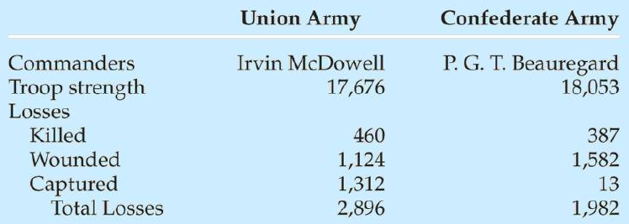
Battle of Bull Run (1st Manassas) July, 1861

Slide 44
Fort Henry and Fort Donelson February 1862
General Ulysses S. Grant led Union forces in western Tennessee to victories at these two forts on the Tennessee and Cumberland Rivers after heaving fighting.
These victories locked Kentucky more securely to the Union and opened a gateway to Tennessee and on to Georgia.

Slide 45
Peninsular Campaign Spring 1862
General George McClellan was given command of the Union army, known as the Army of the Potomac.
Experienced
Great organizer and drillmaster and improved morale.
Overly cautious and arrogant.
Lincoln finally ordered him to advance on Richmond.

Slide 46
McClellan’s reinforcement were diverted to protect D.C. from Stonewall Jackson’s army and he stalled before reaching Virginia.
Jeb Stuart’s Confederate cavalry rode around McClellan’s army.

Slide 47
Seven Days Battles June-July 1862
General Robert E. Lee and his Confederate army counterattacked McClellan and drove his forces back to the sea.
The Union forces abandoned the Peninsular Campaign and Lincoln fired McClellan.

Slide 48
Northern Strategy Anaconda Plan
Suffocate the South by blockading its coasts.
Liberate the slaves and undermine the economic foundations of the South.
Cut the Confederacy in half by seizing control of the Mississippi River.
Chop the Confederacy up by sending troops through Georgia and South Carolina.
Decapitate it by capturing its capital in Richmond.
Engage the enemy’s main strength at every opportunity and grind it into submission.

Slide 49
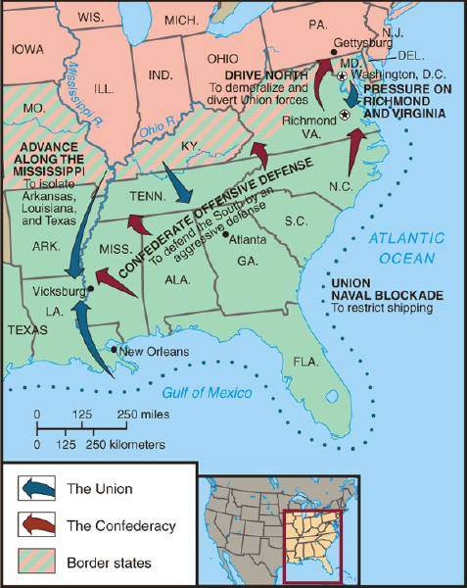
Overview of the North’s Civil War Strategy:
“Anaconda” Plan

Slide 50
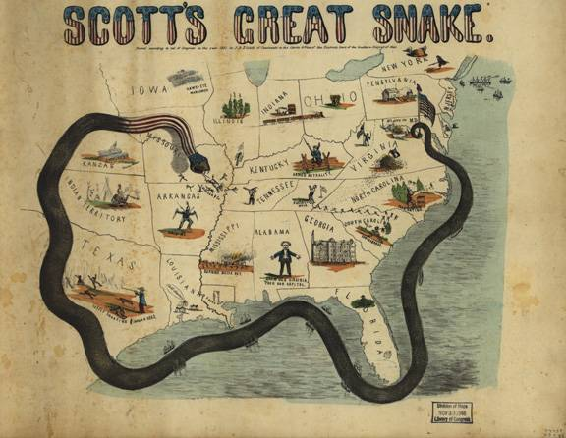
The “Anaconda” Plan

Slide 51
Second Battle of Bull Run (Manassas) August 29-30, 1862
Confederate forces under General Lee, Stuart, and Longstreet defeat the Union army under General Pope on the same ground where the first battle was fought.

Slide 52
War at Sea
Union navy could not completely blockade the South so they concentrated on the main ports.
Most foreign nations honored the blockade.
Southern blockade runners had some success slipping in and out.

Slide 53
Confederates covered an old ship – the Merrimac but renamed the Virginia - with iron plates and used it to crush through the wooden Union ships.
The only Union “ironclad” – the Monitor – fought the Merrimac to a stalemate in 1862 but the two ships made little difference to the outcome of the war and future warships would all be ironclads.

Slide 54
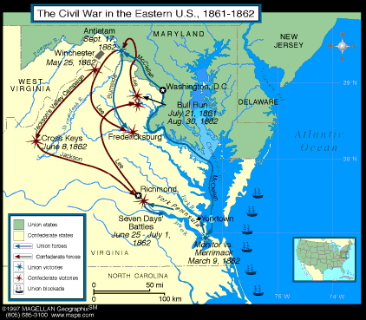
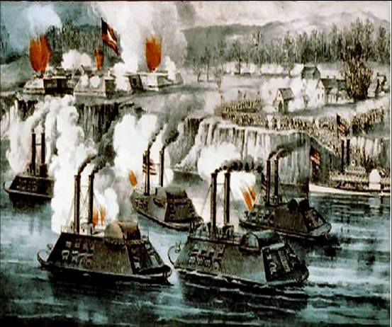
The Battle of the Ironclads, March, 1862
The Monitor vs. the Merrimac

Slide 55
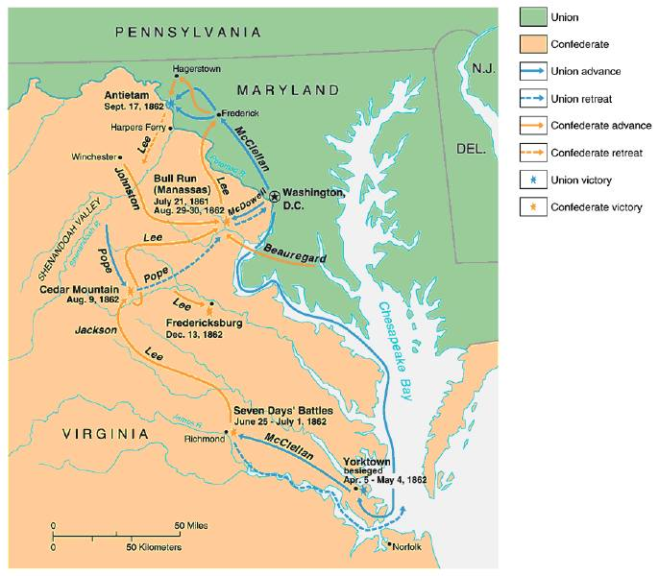
War in the East: 1861-1862

Slide 56
Shiloh, Tennessee April 6-7, 1862
Union General Grant attempted to capture the junction of the Confederate north-south and east-west railroads in the Mississippi Valley.
Confederate forces stopped him at a gory battle at Shiloh just over the Tennessee border.

Slide 57
The Union forces were able to capture New Orleans.
This meant Union forces were taking control of the Mississippi River from both the North and the South and this would mean disaster for the Confederacy.
Only the Confederate fortress of Vicksburg on the Mississippi protected the western sources of supplies.

Slide 58
Confederacy Institutes a Draft April 1962
“Draft Age Range” – ages 17-50.
Rich could hire a substitute to fight for them or purchase an exemption.
Led to bad feelings among the poor “a rich man’s war but a poor man’s fight.”

Slide 59
Battle of Antietam (Sharpsburg) September 17, 1862
After his victory at the Second Bull Run, General Lee moved northward into Maryland hoping to
Encourage foreign intervention on behalf of the Confederacy.
Persuade the border state (and the others) to secede and join the Confederacy.

Slide 60
McClellan, who had been restored by Lincoln, had gotten hold of Lee’s battle plan.
He succeeded in halting Lee’s advance in the single bloodiest day of the war.
Lee retreated across the Potomac River.
McClellan was again fired by Lincoln for not pursuing Lee.
Britain and France did not begin support of the Confederacy.

Slide 61
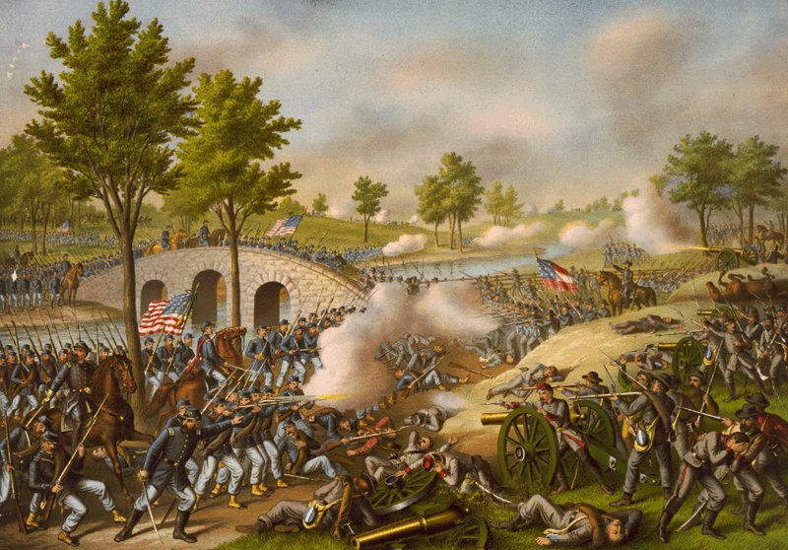
Battle of Antietam “Bloodiest Single Day of the War”
September 17, 1862
23,000 casualties

Slide 62
Emancipation Proclamation
Confiscation Act of 1862 punished the Confederate traitors by declaring that their slaves were captives of war who would “forever be free.”
Lincoln hesitated to go further in freeing the slaves in the border states because of the fear of the border states leaving the Union and he was unsure of Union success against Confederate forces.

Slide 63
After Antietam, when Lee’s invasion was halted, he was ready.
September 23, 1862 he issued his preliminary Emancipation Proclamation that would free all slaves in the Confederate States (not the border states) effective January 1, 1863.
Lincoln had officially now made the Civil War about the moral cause of ending slavery.

Slide 64
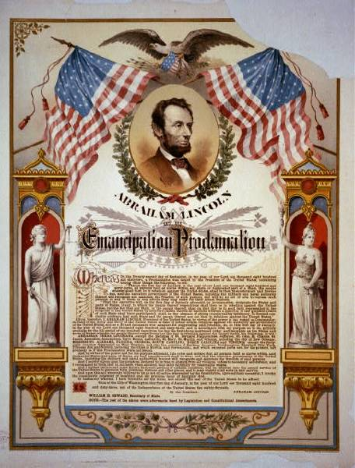
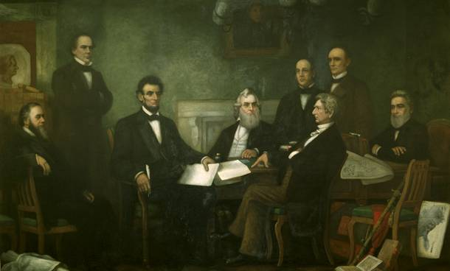
The Emancipation Proclamation

Slide 65
Effects
Not a single slave was actually freed because of the Proclamation.
However, thousands of slaves, upon hearing of it, ran away to the invading Union armies.
The Emancipation Proclamation did lead to the 13th Amendment which abolished slavery in the United States in 1865, eight months after the end of the war.
It also ended any chance of a negotiated settlement to end the war because the South could never agree to it.

Slide 66
Public Reaction
Some abolitionists said he had not gone far enough.
Other Northerners, especially those in the border states, said he had gone too far and opposition increased to an “abolition” war.
Desertions increased sharply among Union soldiers from the border states.

Slide 67
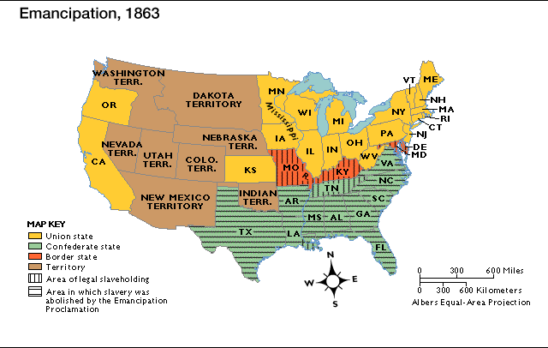
Emancipation in 1863

Slide 68
Fredericksburg December 1862
Confederates repel new Commander of the Army of the Potomac, General Burnside’s rash frontal attack on Lee’s strong position.
Burnside yielded his command to General “Fighting Joe”.

Slide 69
Chancellorsville May 1863
Lee’s most brilliant victory – he sent Stonewall Jackson and his men to attack General Hooker’s flank whose forces were badly beaten but not totally crushed.
Jackson was accidently shot by his own men and died days later.

Slide 70
Gettysburg July 1-3, 1863
General Robert E. Lee prepared to follow up his victory at Chancellorsville by invading the North again, this time in Pennsylvania.
He hoped for a decisive blow that would increase the demands of the Northern public for peace and encourage foreign intervention.

Slide 71
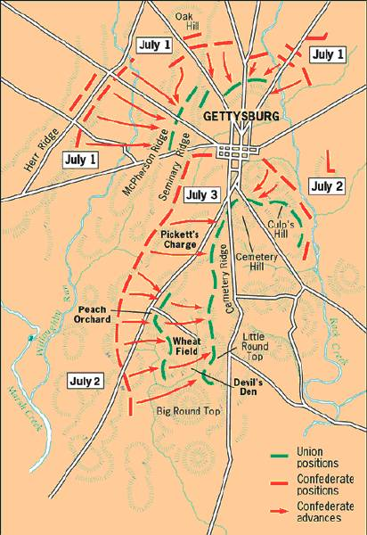
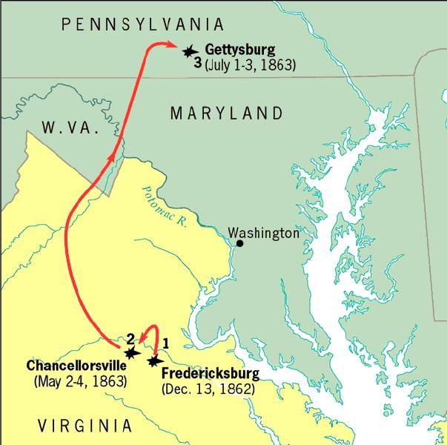
The Road to Gettysburg: 1863

Slide 72
General George Meade was the new commander of the Army of the Potomac.
He and 92,000 Union soldiers faced Lee and his 76,000 near the small town of Gettysburg, PA.
The battle would rage on for 3 days and the outcome would be in doubt until the very end.

Slide 73
Confederate General George Pickett led a magnificent but futile charge that resulted in the defeat of Lee’s forces and the victory belonged to Lincoln and the Union.
The Confederate peace negotiators who had hoped to arrive in D.C. just as Lee surrounded the city, were refused passage into the city the Confederacy was doomed.

Slide 74
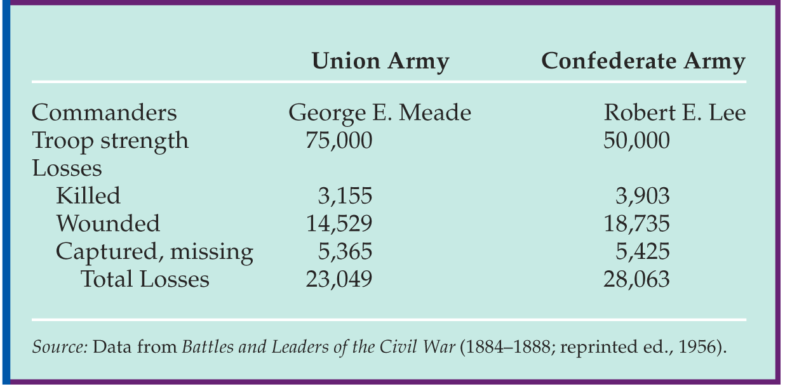
Gettysburg Casualties

Slide 75
Gettysburg Address Abraham Lincoln
Four score and seven years ago our fathers brought forth on this continent, a new nation, conceived in Liberty, and dedicated to the proposition that all men are created equal.
Now we are engaged in a great civil war, testing whether that nation, or any nation so conceived and so dedicated, can long endure. We are met on a great battlefield of that war. We have come to dedicate a portion of that field, as a final resting place for those who here gave their lives that that nation might live. It is altogether fitting and proper that we should do this.
But, in a larger sense, we cannot dedicate—we cannot consecrate—we cannot hallow—this ground. The brave men, living and dead, who struggled here, have consecrated it, far above our poor power to add or detract. The world will little note, nor long remember what we say here, but it can never forget what they did here. It is for us the living, rather, to be dedicated here to the unfinished work which they who fought here have thus far so nobly advanced. It is rather for us to be here dedicated to the great task remaining before us—that from these honored dead we take increased devotion to that cause for which they gave the last full measure of devotion—that we here highly resolve that these dead shall not have died in vain—that this nation, under God, shall have a new birth of freedom— and that government of the people, by the people, for the people, shall not perish from the earth.

Slide 76
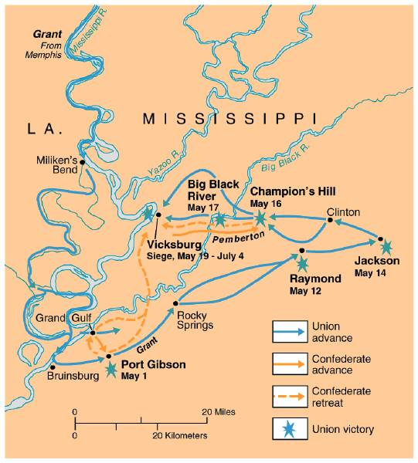
The War in the West, 1863:
Vicksburg

Slide 77
Vicksburg, MS - July 4, 1863
General Grant was given command of the Union forces attacking Vicksburg – the last remaining Confederate stronghold on the Mississippi River.
The six-week siege of Vicksburg was the best-fought Union campaign of the war and the city was forced to surrender on July 4, 1863 resulting in total Union control of the Mississippi River – severing the Confederacy.

Slide 78
This Union victory came the day after the Confederate defeat at Gettysburg and the political significance of the back to back victories was monumental.
Control of the Mississippi helped to lessen Northern cries for peace.
It also convinced both Britain and France to stop selling war materials to the Confederacy.

Slide 79
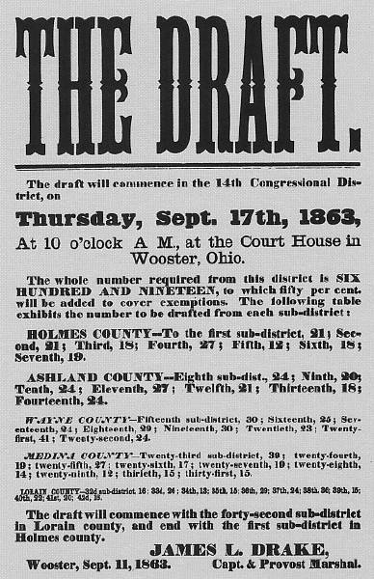
The North Initiates the Draft, 1863

Slide 80
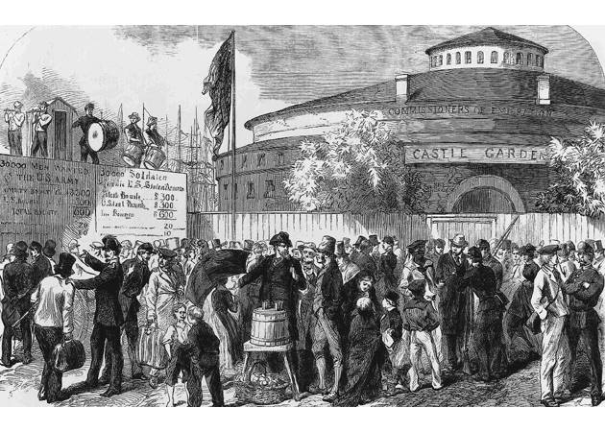
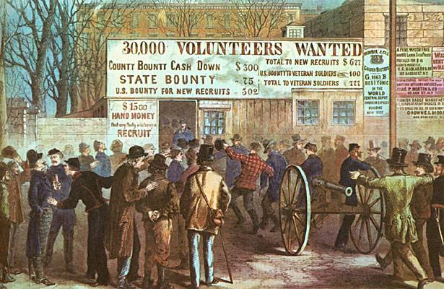
Recruiting Irish Immigrants in NYC

Slide 81
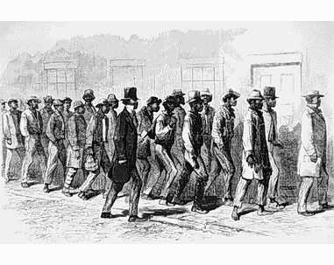
Recruiting African Americans in NYC

Slide 82
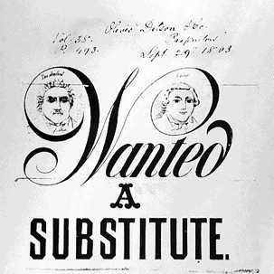
Buy Your Way Out of Military Service

Slide 83
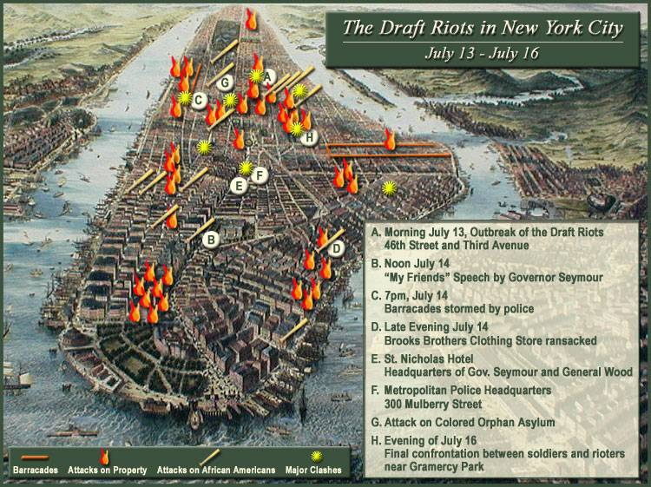
NYC Draft Riots, (July 13-16, 1863)

Slide 84
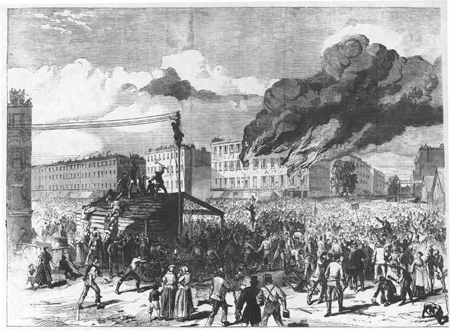
NYC Draft Riots, (July 13-16, 1863)

Slide 85
Chattanooga November 23–25, 1863
Grant was transferred to eastern Tennessee and defeated and cleared the state of the Confederate forces and opened the way for an invasion of Georgia.

Slide 86
Wilderness Campaign May 4 - June 12, 1864
Grant was given command of the Army of the Potomac because he had the fortitude to keep attacking despite the number of casualties he lost.
His basic strategy was to attack the enemy’s armies at the same time so that they could not assist each other.
With more than 100,000 men, he marched toward Richmond.
In a series of battles in the Virginia Wilderness (Bloody Angle and Hell’s Half Acre, Grant suffered about 50,000 casualties.

Slide 87
Cold Harbor June 3, 1864
Grant ordered a frontal assault on Lee’s impregnable position of Cold Harbor and Union soldiers advanced to certain death.
Grant was finally forced to withdraw from the battle giving Lee his last victory of the war.
Public opinion was highly against Grant’s tactic of fighting on despite the losses but his strategy of trading two men for one was brutally necessary to eventually ending the war.

Slide 88
Atlanta September – November, 1864
General William Tecumseh Sherman was given command of Union invasion of Georgia.
He captured the city in September and then burned it in November.

Slide 89
U.S. Election of 1864
In the midst of the war, Lincoln had to run for reelection.
The Congressional Committee on the Conduct of the War, formed in 1861, resented his expansion of Presidential power during the war and pressed him for complete emancipation.

Slide 90
The “peace Democrats” opposed Lincoln and the war.
An extreme group of them, known as the Copperheads, openly obstructed the war effort with attacks against the draft, against Lincoln, and after 1863, against emancipation.

Slide 91
Fearing defeat, the Republican Party joined with the War Democrats and proclaimed itself the Union party (Republican Party passed out of existence temporarily).
Lincoln received their nomination despite some opposition and Andrew Johnson, a War Democrat, was chosen as his vice-Presidential running mate.

Slide 92
The peace Democrats and Copperheads nominated General George McClellan and Lincoln’s reelection was in doubt because the war was going badly for the Union.
But victories in Alabama and Virginia, along with the burning of Atlanta, along with a huge military vote from the soldiers in the Union armies, gave him the election.

Slide 93
1864 Election
Pres. Lincoln (R)
George McClellan (D)

Slide 94
The Peace Movement: Copperheads
Clement Vallandigham

Slide 95
Political Cartoon
Democratic Copperheads in 1864

Slide 96
Presidential
Election Results: 1864

Slide 97
Sherman’s March to the Sea November 1864 - February 1865
Sherman and his force of 60,000 cut a sixty-mile wide swath of destruction through Georgia destroying everything in their path.
His methods were brutal – total war- designed to destroy supply lines and the morale of the Confederate men fighting on the front by destroying their homes.

Slide 98
Sherman seized Savannah, Georgia as a “Christmas present” for Lincoln then headed north into South Carolina were his destruction was even worse.
He destroyed the capital of Columbia and then continued northward into North Carolina.

Slide 99
Sherman’s “March to the Sea” through Georgia, 1864

Slide 100
The Final Virginia Campaign: 1864-1865

Slide 101
The Progress of War: 1861-1865

Slide 102
Appomatox Courthouse April 9, 1865
Rapidly advancing Union troops under General Grant captured Richmond and cornered Lee at Appomattox Courthouse in VA.
Grant met with Lee and granted generous terms of surrender.
Lincoln traveled to Richmond and walked the streets where he was greeted by freed slaves.

Slide 103
Surrender at Appomattox April 9, 1865

Slide 104
Casualties on Both Sides

Slide 105
Civil War Casualties in Comparison to Other Wars

Slide 106
Assassination of Lincoln April 14, 1865
Abraham Lincoln was assassinated by Southern sympathizer John Wilkes Booth while attending at play five days after the Confederate surrender.
His death would change the direction of the Reconstruction of the United States following the Civil War.

Slide 107
Ford’s Theater (April 14, 1865)

Slide 108
The Assassin
John Wilkes Booth

Slide 109
The Assassination

Slide 110
WANTED

